Slide 1
✈
AIRLINE PASSENGER
Satisfaction Analysis
Recep Efkan Aykıner
MIS24102E – Programming and Algorithms II | Prof. Dr. Fatih Erdoğan Sevilgen

Slide 2
Process
1
2
3
Dataset Overview
Methodology
Key Findings
What data we used and why it matters
Data cleaning, Pandas & NumPy operations
5 visualizations with business insights
4
Recommendations
Actionable steps for management

Slide 3
1 | Dataset Overview
Source & Structure
103,594
24
Source: Kaggle – Airline Passenger Satisfaction dataset
Cleaned passengers
Columns after cleaning
Cleaned dataset: 103,594 passenger records
Each row represents one passenger’s flight experience
5
10+
Main goal: understand what affects passenger satisfaction
Main categorical variables
Main numerical variables
Key Variables:
| Categorical: Gender, Customer Type, Type of Travel, Class, Satisfaction
| Numerical: Age, Flight Distance, Departure/Arrival Delay, Online Boarding, Seat Comfort, Inflight Entertainment, Cleanliness…
Target Variable:
| satisfied / neutral or dissatisfied

Slide 4
2 | Methodology
Step 1
Step 2
Step 3
Data Cleaning
Feature Engineering
Analysis & Visualization
Removed unnecessary index column
Dropped rows with missing values in Arrival Delay
Checked for duplicate rows
Verified correct data types
Satisfied Flag with np.where()
Delay Category (no/small/medium/long)
Distance Category (short/medium/long)
Average Service Score (mean of rating cols)
groupby() by class, delay, distance, age
pd.crosstab() for category comparisons
corr() for correlation heatmap
Matplotlib for all charts
df.drop("Unnamed: 0", axis=1, inplace=True)
df.dropna()
df.duplicated().sum()
df["Satisfied Flag"] = np.where(
df["satisfaction"] == "satisfied", 1, 0
)
df["Delay Category"] = np.select(
conditions, choices, default="Unknown"
)
class_satisfaction = df.groupby("Class")["Satisfied Flag"].mean() * 100
pd.crosstab(df["Distance Category"], df["Class"])
correlation_matrix = df[selected_numeric_cols].corr()

Slide 5
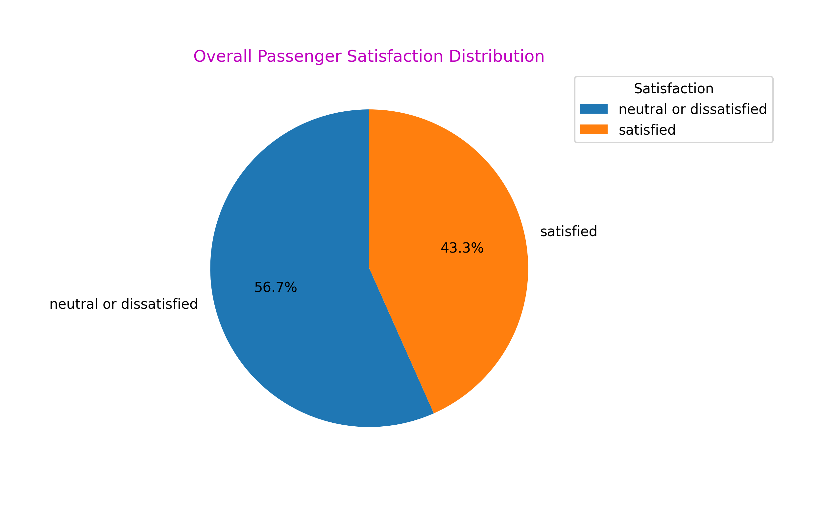
3 | Finding 1: Overall Satisfaction Rate
43.3%
of passengers are satisfied
56.7%
neutral or dissatisfied
Business Insight
The airline has a customer satisfaction problem. Improving passenger experience should be a top priority because more than half of passengers are not satisfied.

Slide 6
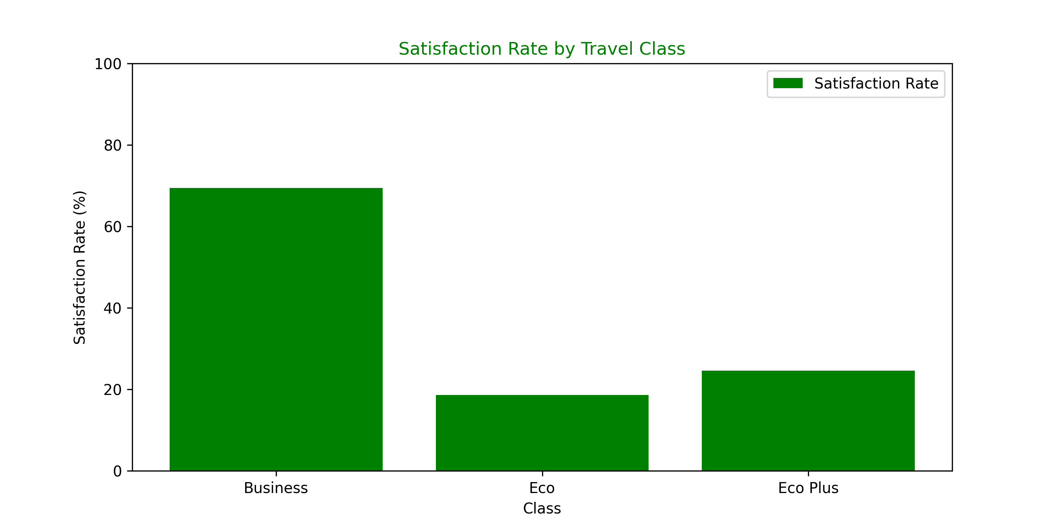
3 | Finding 2: Satisfaction by Travel Class
69.4%
Business Class
Premium service drives loyalty
18.6%
Economy Class
The biggest opportunity to improve
Key Takeaway
Business Class is strong, but Economy needs improvement. Raising Economy satisfaction can increase the airline’s overall satisfaction rate.

Slide 7
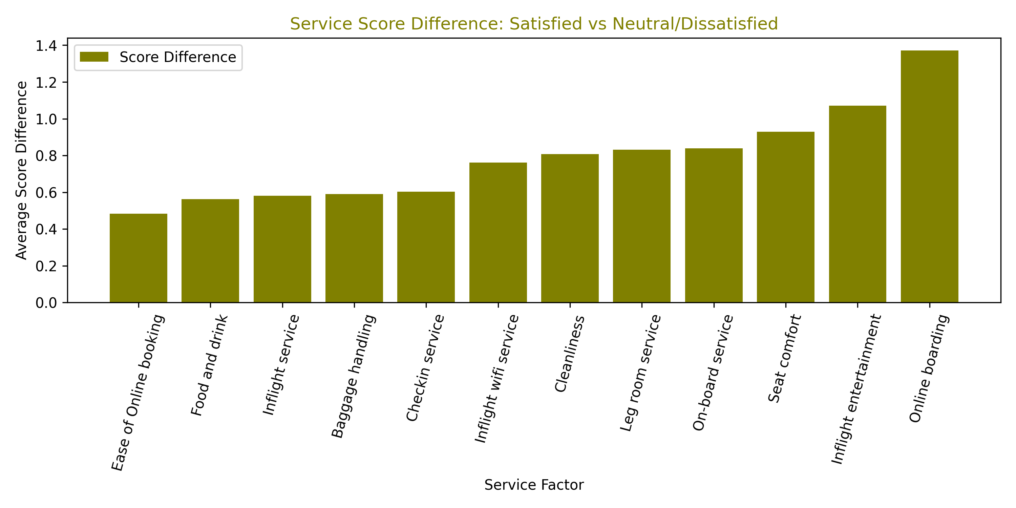
3 | Finding 3: Which Services Drive Satisfaction?
TOP PRIORITY
#1
Online Boarding
+1.37 pts gap
#2
Inflight Entertainment
+1.07 pts gap
#3
Seat Comfort
+0.93 pts gap
These 3 areas separate satisfied from unsatisfied passengers the most.

Slide 8
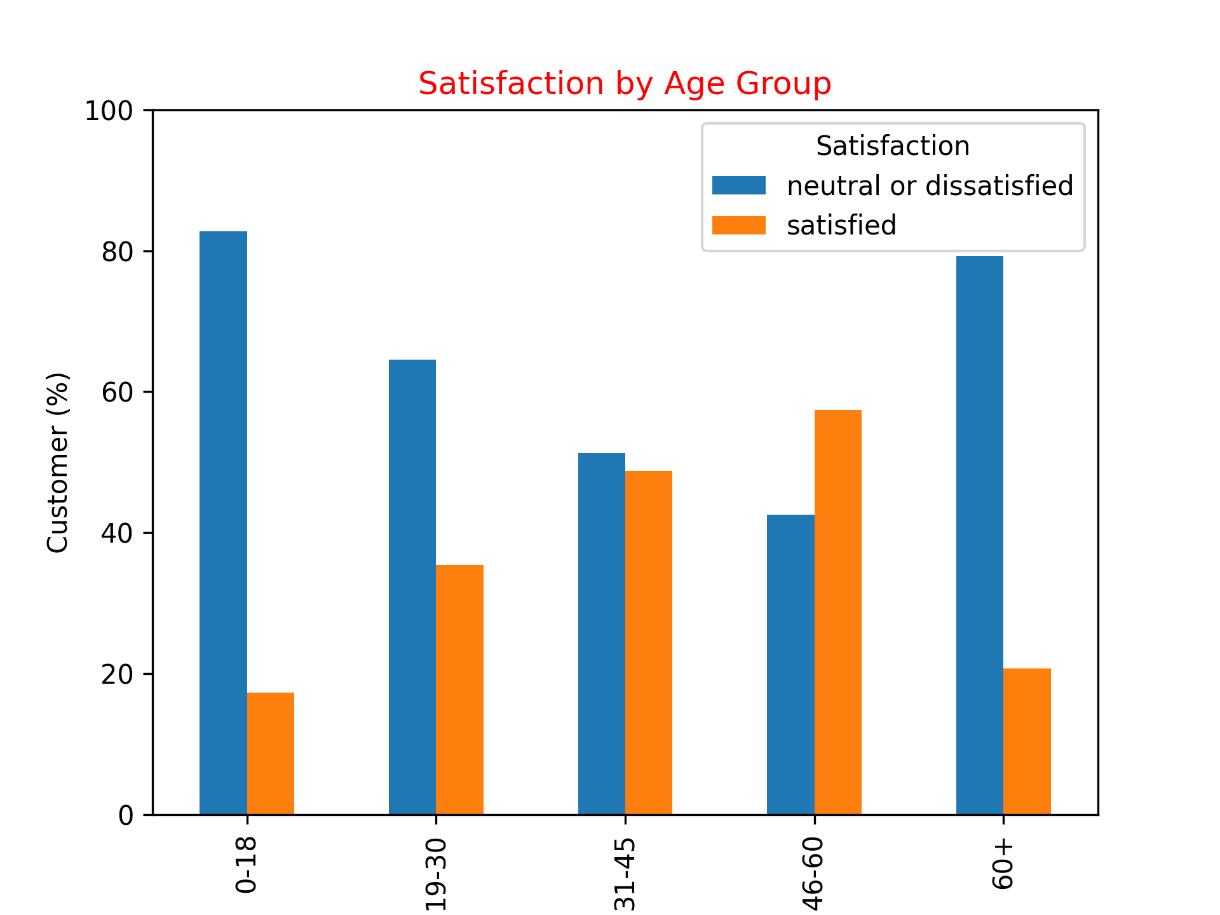
3 | Finding 4: Satisfaction by Age Group
46–60 age group has the HIGHEST satisfaction rate (57%)
0–18 and 60+ have the LOWEST satisfaction (≈20%)
Young passengers expect digital services (Wi-Fi, boarding app)
Older passengers value comfort, assistance & reliability

Slide 9
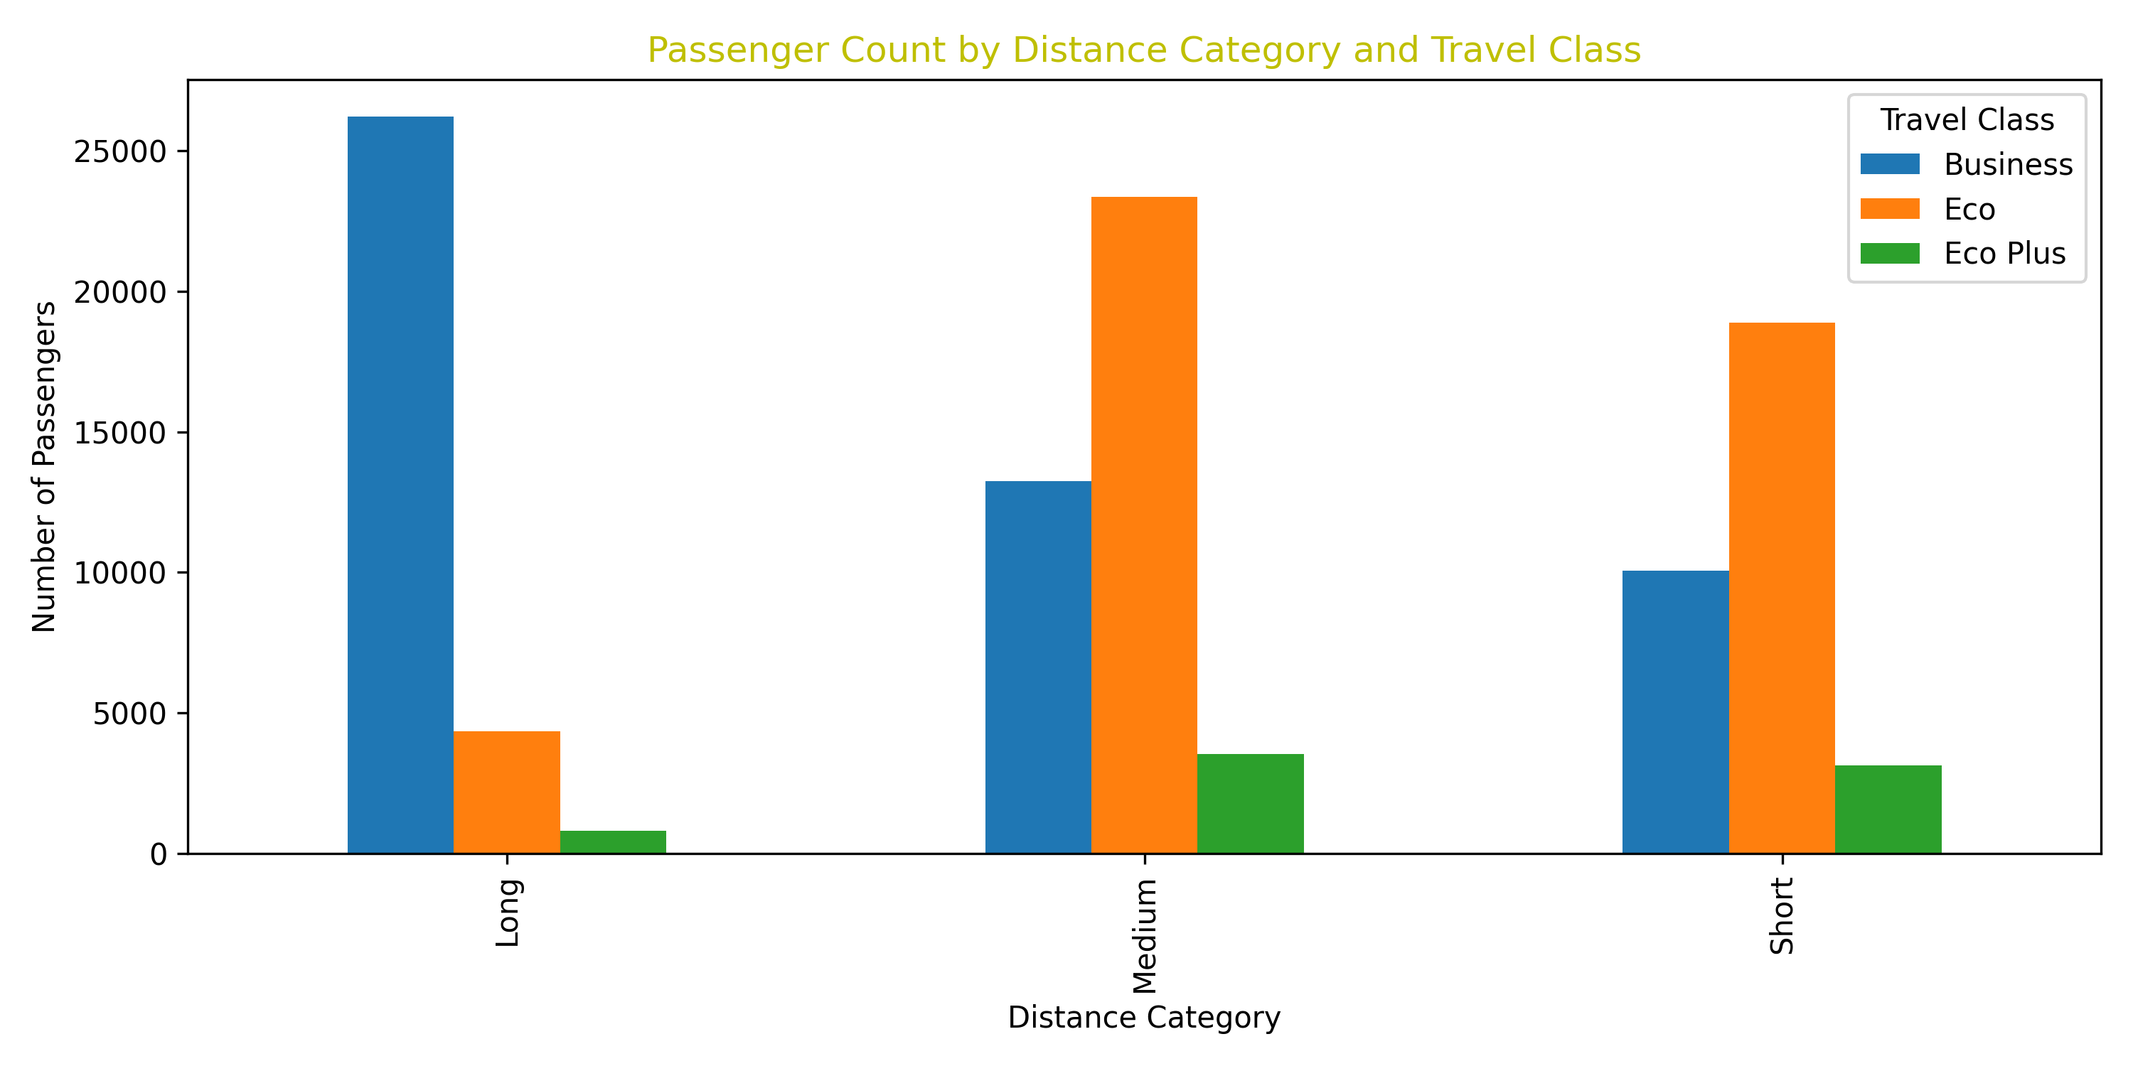
3 | Finding 5: Passenger Count by Distance Category and Travel Class
Long-distance flights are dominated by Business Class passengers.
Economy passengers are the largest group in short and medium-distance flights.
Eco Plus has the lowest passenger count in all distance categories.
There is potential to improve Business Class offers on short and medium-distance routes.

Slide 10
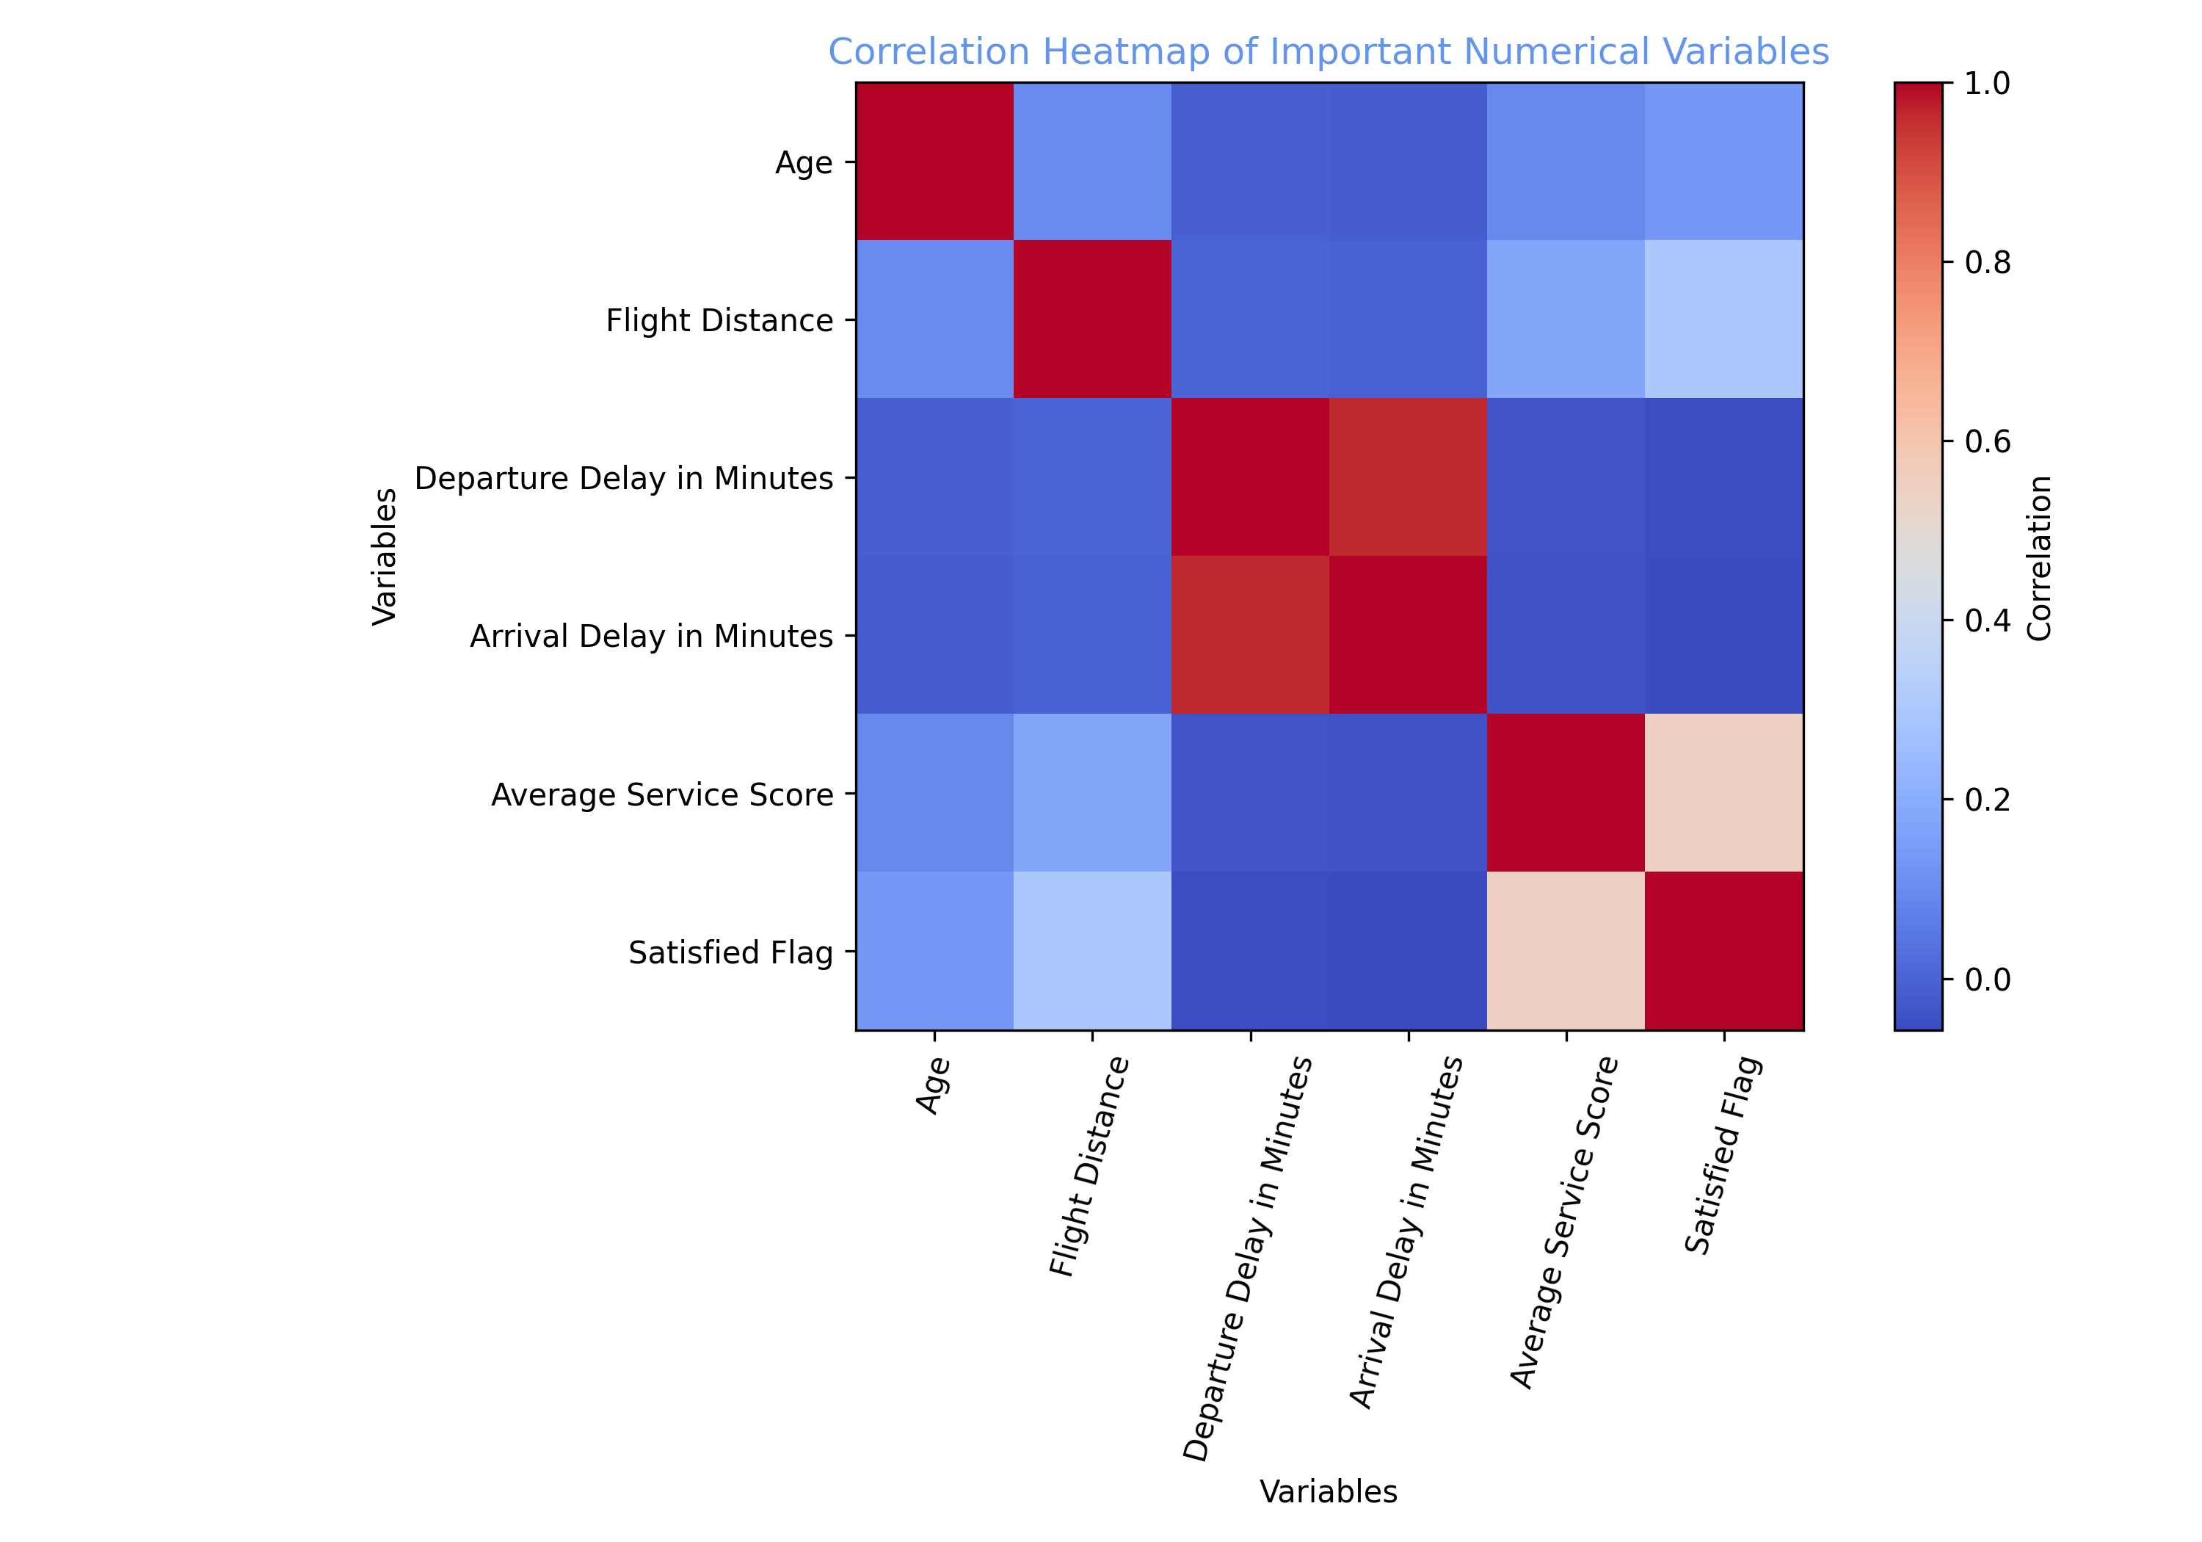
3 | Finding 6: What Correlates with Satisfaction?
Service Quality
Average Service Score has the strongest positive relationship with satisfaction.
This means better service leads to higher passenger satisfaction.
Delays
Departure and arrival delays have a weak negative relationship with satisfaction.
Delays reduce satisfaction, but their effect is lower than service quality.
Conclusion from Heatmap
Service quality should be the main priority.
Delay reduction is still important, but it is a secondary improvement area.

Slide 11
4 | Recommendations for Management
1. Improve Key Service Drivers
2. Improve Economy Class Experience
Online Boarding, Inflight Entertainment, and Seat Comfort have the largest impact on satisfaction.
The airline should improve the mobile boarding process, entertainment system, and seat comfort first.
Economy Class has very low satisfaction, but it carries many passengers on short and medium-distance flights.
Better comfort, cleanliness, and basic service can increase the overall satisfaction rate.
3. Grow Business Class on Short & Medium Routes
4. Reduce Delays, but Focus First on Service Quality
Business Class is strongest on long-distance flights, but short and medium-distance routes also have growth potential.
The airline can offer priority boarding, flexible tickets, and comfort packages to attract more passengers.
Delays have a negative effect on satisfaction.
The airline should continue reducing delays and inform passengers earlier when delays happen.

Slide 12
Final Recommendations
✈
Improve Online Boarding, Inflight Entertainment, and Seat Comfort
Improve Economy Class service, especially on short and medium-distance flights
Protect strong Business Class performance on long-distance flights
Develop better Business Class offers for short and medium-distance routes
Continue reducing departure and arrival delays
Thank you for your attention.
Questions are welcome!

