Slide 1
Instructions to Subjects
Confidence in perceptual decision making

Slide 2
Hi and thanks for taking part in my experiment.
Before we begin, let’s start with some terminology:

Slide 3

A grating is an image of alternating white and black stripes:

Slide 4
Noise is random dynamic patterns of white and black dots:

Slide 5
A noisy grating is a grating merged with noise:

Slide 6
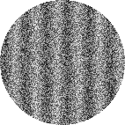
A noisy grating is a grating merged with noise:

Slide 7
Noisy gratings can be difficult or easy to identify, depending on the level of noise:

Slide 8
Noisy gratings can be difficult or easy to identify, depending on the level of noise:

Slide 9
In this experiment, the gratings will be either vertical or tilted

Slide 10
Tilted gratings can come in many different orientations. Some are very close to being vertical.

Slide 11
You will perform three different tasks in this experiment:

Slide 12
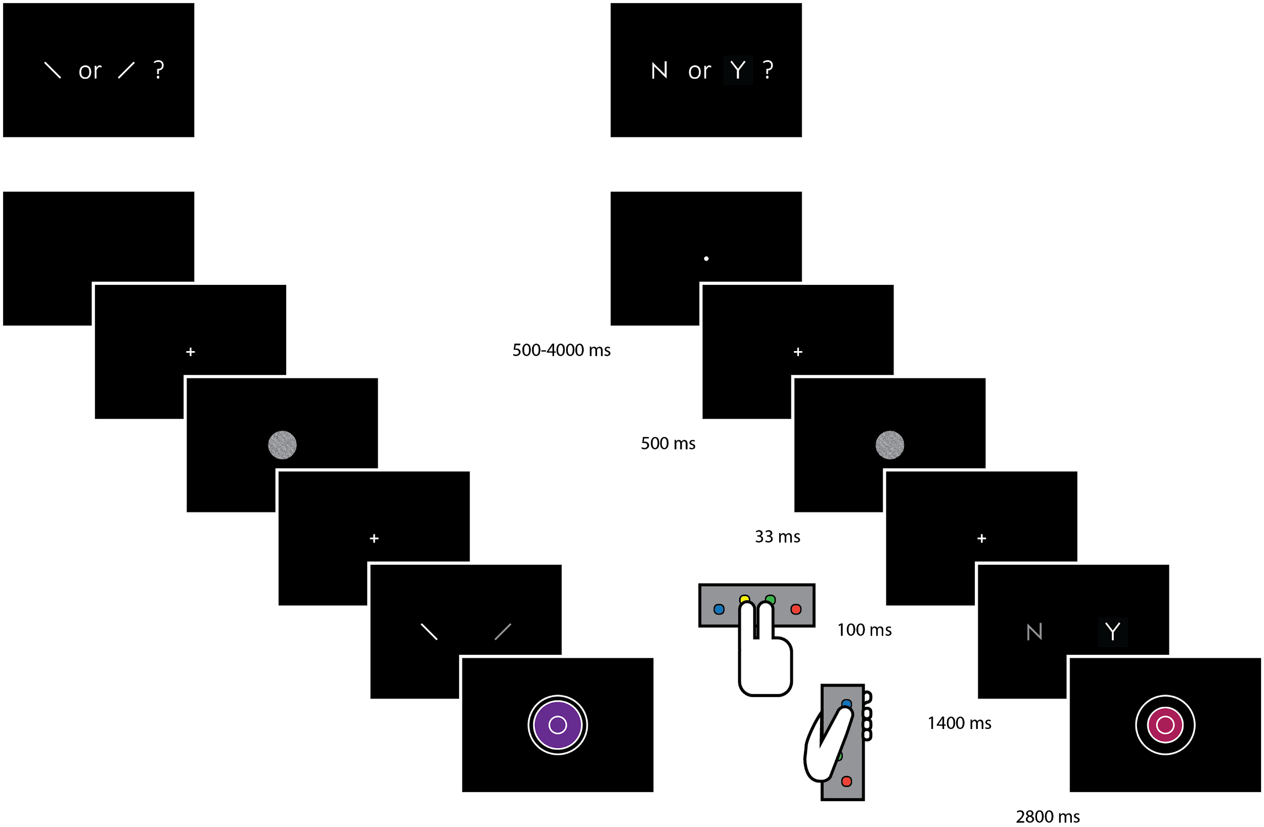
Orientation discrimination
Fixate your eyes at the dot presented in the centre of the screen.
Once in every few seconds, the dot will change to a small cross.
Immediately after the cross a noisy grating will appear on the screen.
You will have 1.5 seconds to use your right hand to indicate whether the grating was tilted clockwise or anticlockwise.
Note that the noisy grating will be tilted clockwise on exactly half of the trials.

Slide 13
Orientation discrimination
Fixate your eyes at the dot presented in the centre of the screen.
Once in every few seconds, the dot will change to a small cross.
Immediately after the cross a noisy grating will appear on the screen.
You will have 1.5 seconds to use your right hand to indicate whether the grating was tilted clockwise or anticlockwise.
Note that the noisy grating will be tilted clockwise on exactly half of the trials.

Slide 14
Orientation discrimination
Fixate your eyes at the dot presented in the centre of the screen.
Once in every few seconds, the dot will change to a small cross.
Immediately after the cross a noisy grating will appear on the screen.
You will have 1.5 seconds to use your right hand to indicate whether the grating was tilted clockwise or anticlockwise.
Note that the noisy grating will be tilted clockwise on exactly half of the trials.

Slide 15
Tilt recognition
Fixate your eyes at the dot presented in the centre of the screen.
Once in every few seconds, the dot will change to a small cross.
Immediately after the cross a noisy grating will appear on the screen.
You will have 1.5 seconds to use your right hand to indicate whether the grating was vertical or tilted.
Note that the noisy grating will be tilted on exactly half of the trials.

Slide 16
Tilt recognition
Fixate your eyes at the dot presented in the centre of the screen.
Once in every few seconds, the dot will change to a small cross.
Immediately after the cross a noisy grating will appear on the screen.
You will have 1.5 seconds to use your right hand to indicate whether the grating was vertical or tilted.
Note that the noisy grating will be tilted on exactly half of the trials.

Slide 17
Tilt recognition
Fixate your eyes at the dot presented in the centre of the screen.
Once in every few seconds, the dot will change to a small cross.
Immediately after the cross a noisy grating will appear on the screen.
You will have 1.5 seconds to use your right hand to indicate whether the grating was vertical or tilted.
Note that the noisy grating will be tilted on exactly half of the trials.

Slide 18
Tilt recognition
Fixate your eyes at the dot presented in the centre of the screen.
Once in every few seconds, the dot will change to a small cross.
Immediately after the cross a noisy grating will appear on the screen.
You will have 1.5 seconds to use your right hand to indicate whether the grating was vertical or tilted.
Note that the noisy grating will be tilted on exactly half of the trials.

Slide 19
Visual detection
Fixate your eyes at the dot presented in the centre of the screen.
Once in every few seconds, the dot will change to a small cross.
On exactly half of the trials, immediately after the cross a noisy grating will appear on the screen. On the other half it will be just noise without a grating in it.
You will have 1.5 seconds to use your right hand to indicate whether a grating appeared or not (Y for ‘yes’, N for ‘no’ ).
Y N

Slide 20
Visual detection
Fixate your eyes at the dot presented in the centre of the screen.
Once in every few seconds, the dot will change to a small cross.
On exactly half of the trials, immediately after the cross a noisy grating will appear on the screen. On the other half it will be just noise without a grating in it.
You will have 1.5 seconds to use your right hand to indicate whether a grating appeared or not (Y for ‘yes’, N for ‘no’ ).
Y N

Slide 21
Visual detection
Fixate your eyes at the dot presented in the centre of the screen.
Once in every few seconds, the dot will change to a small cross.
On exactly half of the trials, immediately after the cross a noisy grating will appear on the screen. On the other half it will be just noise without a grating in it.
You will have 1.5 seconds to use your right hand to indicate whether a grating appeared or not (Y for ‘yes’, N for ‘no’ ).
Y N

Slide 22
Visual detection
Fixate your eyes at the dot presented in the centre of the screen.
Once in every few seconds, the dot will change to a small cross.
On exactly half of the trials, immediately after the cross a noisy grating will appear on the screen. On the other half it will be just noise without a grating in it.
You will have 1.5 seconds to use your right hand to indicate whether a grating appeared or not (Y for ‘yes’, N for ‘no’ ).
Y N

Slide 23
In all three tasks you will be asked to rate your confidence in your decisions immediately after responding. You will have 2.5 seconds to do that. The confidence rating is an important part of the task.

Slide 24
Confidence Rating
You will indicate your confidence level in your last decision by controlling the size of a colored circle. The smaller the circle is, the more confident you are.
The confidence rating phase will start with a random circle size.
By pressing the upper button with your left thumb, you can increase the size of the circle.
Pressing the next button down will decrease the size of the circle.

Slide 25
In addition to the baseline payment of £20, you can earn a bonus of up to £10 by performing well on the task and rating your confidence accurately.

Slide 26
Bonus
We know our task can be tiring and repetitive, but we still want you to make an effort to perform well and rate your confidence accurately. To motivate you, we offer a bonus. The bonus will be calculated in the following way:
For every correct decision, you will earn points proportional to your confidence on that trial. For example, you will get 6 points for a trial in which you were correct and very confident, but only 1 point for a trial in which you were correct but not confident.
For every incorrect decision, you will lose points proportional to your confidence on that trial. For example, you will lose 6 points for a trial in which you were incorrect and very confident, but only 1 point for a trial in which you were incorrect but not confident.
If you fail to respond on time, you will lose 6 points.

Slide 27
Bonus
To maximize your bonus
Respond on time.
Be correct as much as possible.
Rate your confidence higher when you think you are correct.
Rate your confidence lower when you think there’s a good chance you might be wrong.

