Slide 1

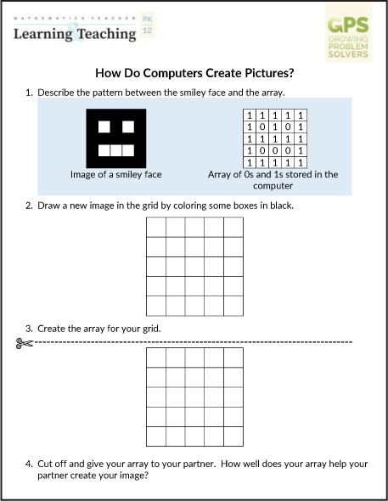
From: Flavin E, Lee JH, Chamberlin MT, Powers RA. GPS: Artificial Intelligence Image Processing. Mathematics Teacher: Learning and Teaching PK-12. 2024;117(11):848-852. doi:10.5951/MTLT.2024.0103
DOI: https://doi.org/10.5951/MTLT.2024.0103
© 2024 by National Council of Teachers of Mathematics, Inc. All Rights Reserved.
Date downloaded: 14/Nov/2024

Slide 2
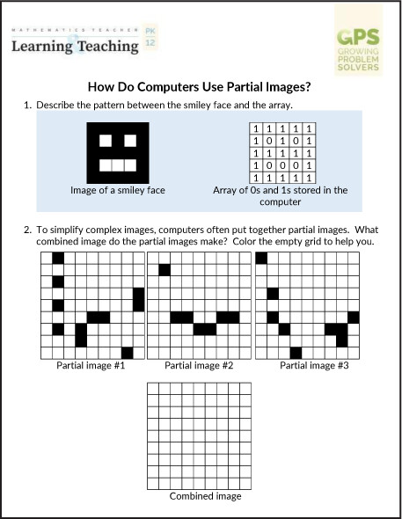
From: Flavin E, Lee JH, Chamberlin MT, Powers RA. GPS: Artificial Intelligence Image Processing. Mathematics Teacher: Learning and Teaching PK-12. 2024;117(11):848-852. doi:10.5951/MTLT.2024.0103
DOI: https://doi.org/10.5951/MTLT.2024.0103
© 2024 by National Council of Teachers of Mathematics, Inc. All Rights Reserved.
Date downloaded: 14/Nov/2024

Slide 3
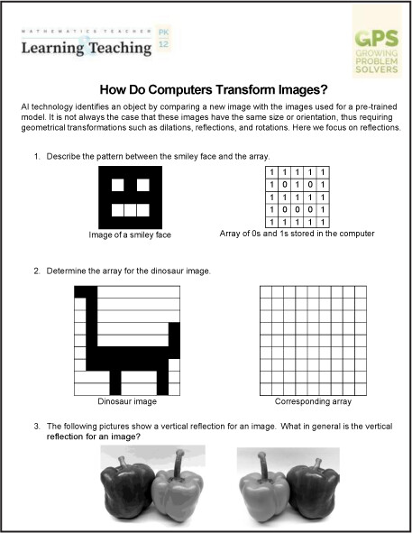
From: Flavin E, Lee JH, Chamberlin MT, Powers RA. GPS: Artificial Intelligence Image Processing. Mathematics Teacher: Learning and Teaching PK-12. 2024;117(11):848-852. doi:10.5951/MTLT.2024.0103
DOI: https://doi.org/10.5951/MTLT.2024.0103
© 2024 by National Council of Teachers of Mathematics, Inc. All Rights Reserved.
Date downloaded: 14/Nov/2024

Slide 4
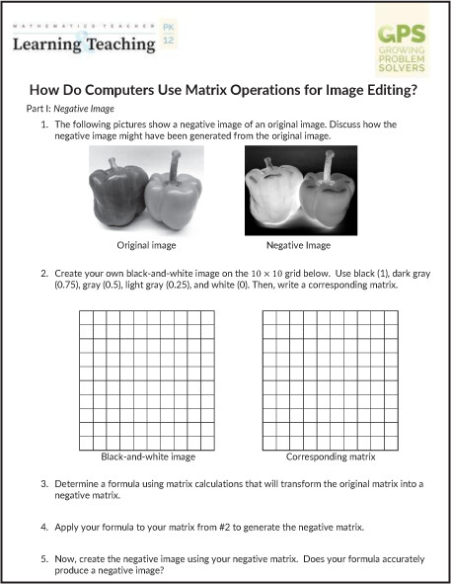
From: Flavin E, Lee JH, Chamberlin MT, Powers RA. GPS: Artificial Intelligence Image Processing. Mathematics Teacher: Learning and Teaching PK-12. 2024;117(11):848-852. doi:10.5951/MTLT.2024.0103
DOI: https://doi.org/10.5951/MTLT.2024.0103
© 2024 by National Council of Teachers of Mathematics, Inc. All Rights Reserved.
Date downloaded: 14/Nov/2024

