Slide 1
Lecture 8: Data Analysis with Python
Introduction to Python
efl Data Science Courses
Dr. Jens Lausen

Slide 2






Overview of what you‘ve learned
Data types – symbols, numbers, booleans
Libraries
Basic python libraries – os, csv, re
Data wrangling libraries – pandas, numpy
Data structures – tuples, lists, sets, dictionaries
Control structures – case distiction (if, else), loops (for, while)
Data visualization
Plot types
Packages for plotting
Functions
→ Fundamental tools for working with data

Slide 3
Table of Contents
Recap Intro to Python course
Pandas cont‘d
Exploratory Data Analysis (Live Coding Case Study)

Slide 4
Pandas – what you‘ve learned so far
The structure and key characteristics of a pandas DataFrame
Reading data to pandas DataFrames
Handling missing values
Data manipulation
Data analysis with pandas
Until now, we concentrated on a single DataFrame
In this lecture: How to deal with multiple DataFrames

Slide 5
Pandas cont‘d
In most data mining tasks, data is provided/retrieved from multiple data sources, and therefore, multiple files (such as csv, txt etc.)
To get the data ready for analysis, we need to merge the relevant information from the different data sources
The pandas package provides various functionalities for easily combining Series and DataFrame objects
In this lecture, we will cover the most important standard techniques:
Concatenate DataFrames along rows and columns
Merge DataFrames on specific keys by different join logics
Sources and further reading:
https://pandas.pydata.org/pandas-docs/stable/user_guide/merging.html
https://www.datacamp.com/community/tutorials/joining-dataframes-pandas

Slide 6
Pandas – Concatenating DataFrames
First, we create some dummy DataFrames on which we will perform all operations in this lecture
 | id | Feature1 | Feature2
0 | 1 | A | B
1 | 2 | C | D
2 | 3 | E | F
3 | 4 | G | H
4 | 5 | I | J
import pandas as pd
#create dummy DataFrames
Ddata1 = {
'id': ['1', '2', '3', '4', '5’],
'Feature1': ['A', 'C', 'E', 'G', 'I’],
'Feature2': ['B', 'D', 'F', 'H', 'J’]}
Ddata2 = {
'id': ['1', '2', '6', '7', '8’],
'Feature1': ['K', 'M', 'O', 'Q', 'S’],
'Feature2': ['L', 'N', 'P', 'R', 'T’]}
Ddata3 = {
'id': ['1', '2', '3', '4', '5', '7', '8', '9', '10', '11’],
'Feature3': [12, 13, 14, 15, 16, 17, 15, 12, 13, 23]}
df1 = pd.DataFrame(Ddata1, columns = ['id', 'Feature1', 'Feature2’])
df2 = pd.DataFrame(Ddata2, columns = ['id', 'Feature1', 'Feature2’])
df3 = pd.DataFrame(Ddata3, columns = ['id', 'Feature3’])
df1
 | id | Feature1 | Feature2
0 | 1 | K | L
1 | 2 | M | N
2 | 6 | O | P
3 | 7 | Q | R
4 | 8 | S | T
df2
 | id | Feature3
0 | 1 | 12
1 | 2 | 13
2 | 3 | 14
3 | 4 | 15
4 | 5 | 16
5 | 7 | 17
6 | 8 | 15
7 | 9 | 12
8 | 10 | 13
9 | 11 | 23
df3

Slide 7
Pandas – Concatenating DataFrames
To simply concatenate DataFrames along the row, we use the concat() function in pandas
Pass the names of the DataFrames in a list [df1, df2] as the argument to the concat() function
#concatenate two DataFrames along the row
df_row = pd.concat([df1, df2])
 | id | Feature1 | Feature2
0 | 1 | A | B
1 | 2 | C | D
2 | 3 | E | F
3 | 4 | G | H
4 | 5 | I | J
Attention!
Since df1 and df2 have the same indexes, this operation results in a DataFrame with duplicative indexes
To automatically adjust the indexes after concatenating both DataFrames, set the argument ignore_index as True
 | id | Feature1 | Feature2
0 | 1 | A | B
1 | 2 | C | D
2 | 3 | E | F
3 | 4 | G | H
4 | 5 | I | J
0 | 1 | K | L
1 | 2 | M | N
2 | 6 | O | P
3 | 7 | Q | R
4 | 8 | S | T
df1
 | id | Feature1 | Feature2
0 | 1 | A | B
1 | 2 | C | D
2 | 3 | E | F
3 | 4 | G | H
4 | 5 | I | J
0 | 1 | K | L
1 | 2 | M | N
2 | 6 | O | P
3 | 7 | Q | R
4 | 8 | S | T
→
df_row
 | id | Feature1 | Feature2
0 | 1 | K | L
1 | 2 | M | N
2 | 6 | O | P
3 | 7 | Q | R
4 | 8 | S | T
df2
Notes:
You use this function when you have multiple DataFrames with the same features (columns) but different observations (rows)

Slide 8
Pandas – Concatenating DataFrames
To simply concatenate DataFrames along the row, we use the concat() function in pandas
Pass the names of the DataFrames in a list [df1, df2] as the argument to the concat() function
#concatenate two DataFrames along the row, ignore_index = True
df_row = pd.concat([df1, df2], ignore_index = True)
 | id | Feature1 | Feature2
0 | 1 | A | B
1 | 2 | C | D
2 | 3 | E | F
3 | 4 | G | H
4 | 5 | I | J
df1
 | id | Feature1 | Feature2
0 | 1 | A | B
1 | 2 | C | D
2 | 3 | E | F
3 | 4 | G | H
4 | 5 | I | J
5 | 1 | K | L
6 | 2 | M | N
7 | 6 | O | P
8 | 7 | Q | R
9 | 8 | S | T
→
df_row
 | id | Feature1 | Feature2
0 | 1 | K | L
1 | 2 | M | N
2 | 6 | O | P
3 | 7 | Q | R
4 | 8 | S | T
df2

Slide 9
Pandas – Concatenating DataFrames
pandas provides the option to label the DataFrames, after the concatenation, with a key so that you know which data came from which DataFrame.
Pass the optional argument keys specifying the labels of the DataFrames in a list
#concatenate two DataFrames along the row using labes for each DataFrame
df_keys = pd.concat([df1, df2], keys = ['df1', 'df2'])
 | id | Feature1 | Feature2
0 | 1 | A | B
1 | 2 | C | D
2 | 3 | E | F
3 | 4 | G | H
4 | 5 | I | J
df1
 |  | id | Feature1 | Feature2
df1 | 0 | 1 | A | B
df1 | 1 | 2 | C | D
df1 | 2 | 3 | E | F
df1 | 3 | 4 | G | H
df1 | 4 | 5 | I | J
df2 | 0 | 1 | K | L
df2 | 1 | 2 | M | N
df2 | 2 | 6 | O | P
df2 | 3 | 7 | Q | R
df2 | 4 | 8 | S | T
→
df_keys
 | id | Feature1 | Feature2
0 | 1 | K | L
1 | 2 | M | N
2 | 6 | O | P
3 | 7 | Q | R
4 | 8 | S | T
df2

Slide 10
Pandas – Concatenating DataFrames
pandas provides the option to label the DataFrames, after the concatenation, with a key so that you know which data came from which DataFrame.
Pass the optional argument keys specifying the labels of the DataFrames in a list
Using the loc method, you can retrieve the data of each DataFrame
#concatenate two DataFrames along the row using labes for each DataFrame
df_keys = pd.concat([df1, df2], keys = ['df1', 'df2'])
 |  | id | Feature1 | Feature2
df1 | 0 | 1 | A | B
df1 | 1 | 2 | C | D
df1 | 2 | 3 | E | F
df1 | 3 | 4 | G | H
df1 | 4 | 5 | I | J
df2 | 0 | 1 | K | L
df2 | 1 | 2 | M | N
df2 | 2 | 6 | O | P
df2 | 3 | 7 | Q | R
df2 | 4 | 8 | S | T
 | id | Feature1 | Feature2
0 | 1 | K | L
1 | 2 | M | N
2 | 6 | O | P
3 | 7 | Q | R
4 | 8 | S | T
→
df_keys
df_keys.loc['df2']

Slide 11
Pandas – Concatenating DataFrames
To concatenate DataFrames along the columns, we specify the axis parameter as 1
This method automatically joins both DataFrames by the index
#concatenate two DataFrames along the column
df_col = pd.concat([df1, df2], axis = 1)
 | id | Feature1 | Feature2
0 | 1 | A | B
1 | 2 | C | D
2 | 3 | E | F
3 | 4 | G | H
4 | 5 | I | J
df1
 | id | Feature1 | Feature2 | id | Feature1 | Feature2
0 | 1 | A | B | 1 | K | L
1 | 2 | C | D | 2 | M | N
2 | 3 | E | F | 6 | O | P
3 | 4 | G | H | 7 | Q | R
4 | 5 | I | J | 8 | S | T
→
df_col
 | id | Feature1 | Feature2
0 | 1 | K | L
1 | 2 | M | N
2 | 6 | O | P
3 | 7 | Q | R
4 | 8 | S | T
df2
Notes:
Sinnvoll, wenn man für gleiche Beobachtungen (row - index) verschiedene Features (columns) kombinieren möchte.

Slide 12
Pandas – Merging DataFrames
Another operation related to DataFrames is the merging operation
Two DataFrames might hold different kinds of information about the same entity and linked by some common feature/column
pandas has full-featured, high performance in-memory join operations similar to relational databases like SQL
pandas provides a single function, merge(), as the entry point for all standard database join operations between DataFrame or named Series objects
The how argument to merge() specifies how to determine which keys are to be included in the resulting table
Merge method | SQL Join Name | Description
left | LEFT OUTER JOIN | Use keys from left frame only
right | RIGHT OUTER JOIN | Use keys from right frame only
outer | FULL OUTER JOIN | Use union of keys from both frames
inner | INNER JOIN | Use intersection of keys from both frames

Slide 13
Pandas – Merging DataFrames
Use the merge function and pass the names of the DataFrames as well as the name of the common column as the argument on
Per default the merge() function will perform an inner join using the intersection of keys from both DataFrames, otherwise the merge method needs to be specified with the how argument
 | key | A | B | C | D
0 | K0 | A0 | B0 | C0 | D0
1 | K2 | A2 | B2 | C2 | D2
left
pd.merge(left, right, on='key')
→
 | key | A | B
0 | K0 | A0 | B0
1 | K2 | A2 | B2
2 | K3 | A3 | B3
 | key | A | B | C | D
0 | K0 | A0 | B0 | C0 | D0
1 | K2 | A2 | B2 | C2 | D2
2 | K3 | A3 | B3 | NaN | NaN
3 | K1 | NaN | NaN | C1 | D1
pd.merge(left, right, on='key', how = 'outer')
→
right
 | key | A | B | C | D
0 | K0 | A0 | B0 | C0 | D0
1 | K2 | A2 | B2 | C2 | D2
2 | K3 | A3 | B3 | NaN | NaN
 | key | C | D
0 | K0 | C0 | D0
1 | K1 | C1 | D1
2 | K2 | C2 | D2
pd.merge(left, right, on='key', how = 'left')
→
 | key | A | B | C | D
0 | K0 | A0 | B0 | C0 | D0
1 | K2 | A2 | B2 | C2 | D2
3 | K1 | NaN | NaN | C1 | D1
pd.merge(left, right, on='key', how = 'right')
→

Slide 14
Pandas – Merging DataFrames
Use the merge function and pass the names of the DataFrames as well as the name of the common column as the argument on
Per default the merge() function will perform an inner join using the intersection of keys from both DataFrames
#merge two dataframes based on a common column
df_merge_col = pd.merge(df_row, df3, on='id')
 | id | Feature1 | Feature2
0 | 1 | A | B
1 | 2 | C | D
2 | 3 | E | F
3 | 4 | G | H
4 | 5 | I | J
5 | 1 | K | L
6 | 2 | M | N
7 | 6 | O | P
8 | 7 | Q | R
9 | 8 | S | T
 | id | Feature3
0 | 1 | 12
1 | 2 | 13
2 | 3 | 14
3 | 4 | 15
4 | 5 | 16
5 | 7 | 17
6 | 8 | 15
7 | 9 | 12
8 | 10 | 13
9 | 11 | 23
 | id | Feature1 | Feature2 | Feature3
0 | 1 | A | B | 12
1 | 1 | K | L | 12
2 | 2 | C | D | 13
3 | 2 | M | N | 13
4 | 3 | E | F | 14
5 | 4 | G | H | 15
6 | 5 | I | J | 16
7 | 7 | Q | R | 17
8 | 8 | S | T | 15
df_row
df3
→
df_merge_col

Slide 15
Pandas – Merging DataFrames
It might happen that the column on which you want to merge the DataFrames have different names
For such merges, you will have to specify the arguments left_on as the left DataFrame’s column name and right_on as the right DataFrame’s column name
#merge two dataframes with different names for the common column
df_merge_difkey = pd.merge(left, right, left_on='key', right_on='id')
left
 | key | A | B
0 | K0 | A0 | B0
1 | K2 | A2 | B2
2 | K3 | A3 | B3
→
df_merge_difkey
 | key | A | B | id | C | D
0 | K0 | A0 | B0 | K0 | C0 | D0
1 | K2 | A2 | B2 | K2 | C2 | D2
right
 | id | C | D
0 | K0 | C0 | D0
1 | K1 | C1 | D1
2 | K2 | C2 | D2

Slide 16
Pandas – Merging DataFrames
You can also use multiple keys to merge DataFrames
Just pass a list of keys ['key1', 'key2’] as an argument to on, left_on, or right_on
#merge two dataframes with multiple keys
df_merge_multkey = pd.merge(left, right, on=['key1', 'key2'])
left
 | key1 | key2 | A | B
0 | K0 | K0 | A0 | B0
1 | K0 | K1 | A1 | B1
2 | K1 | K0 | A2 | B2
3 | K2 | K1 | A3 | B3
→
df_merge_multkey
 | key1 | key2 | A | B | C | D
0 | K0 | K0 | A0 | B0 | C0 | D0
1 | K1 | K0 | A2 | B2 | C1 | D1
2 | K1 | K0 | A2 | B2 | C2 | D2
right
 | key1 | key2 | C | D
0 | K0 | K0 | C0 | D0
1 | K1 | K0 | C1 | D1
2 | K1 | K0 | C2 | D2
3 | K2 | K0 | C3 | D3

Slide 17
Table of Contents
Recap Intro to Python course
Pandas cont‘d
Exploratory Data Analysis

Slide 18
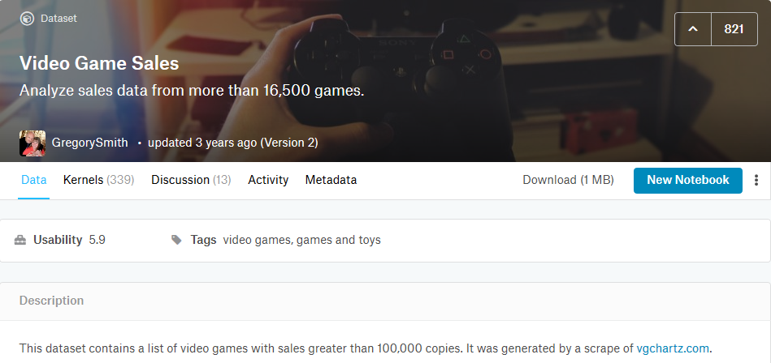
Exploratory Data Analysis
We again use the video game sales data set from kaggle

Slide 19
Exploratory Data Analysis
We again use the video game sales data set from kaggle
This data set contains a list of video games with sales greater than 100,000 copies
The data set contains the following information
Rank - Ranking of overall sales
Name - The games name
Platform - Platform of the games release (i.e. PC,PS4, etc.)
Year - Year of the game's release
Genre - Genre of the game
Publisher - Publisher of the game
NA_Sales - Sales in North America (in millions)
EU_Sales - Sales in Europe (in millions)
JP_Sales - Sales in Japan (in millions)
Other_Sales - Sales in the rest of the world (in millions)
Global_Sales - Total worldwide sales

Slide 20
Exploratory Data Analysis
We import the data and perform the same pre-processing tasks as in lectures 6 and 7 to drop rows with missing values
# Import libraries
import pandas as pd
import numpy as np
#read data to dataframe
df = pd.read_csv("../vgsales.csv")
################# perform cleaning from the pandas lecture ####################
#get information on dataframe
print(df.info())
#check missing values
df_null_values = df.isnull().sum()
print(df_null_values)
#drop missing values
df = df.dropna(axis=0)
df.info()
#convert year to int
df['Year'] = df['Year'].astype('int64’)
df.info()
#reset the index
df = df.reset_index(drop=True)
→
The data is ready for analysis ☺

Slide 21
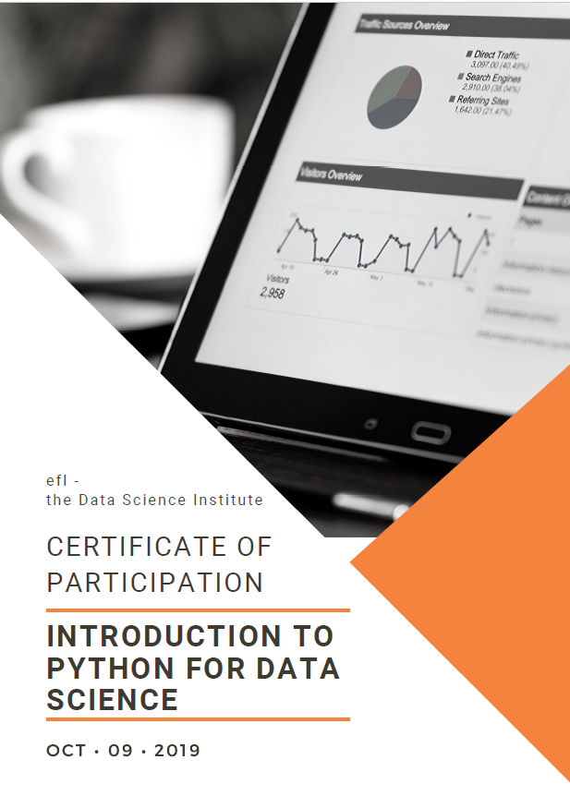
Information for the assignment
Requirements for receiving the course certificate:
Completion of the tasks
Description of the results of the tasks and how the tasks were solved
Formalities:
Python code with comments and answers to the respective questions
Submission deadline: 30.01.2022 – 23:59
Submit to efldatascience@gmail.com with the subject [IntroPython]

Slide 22
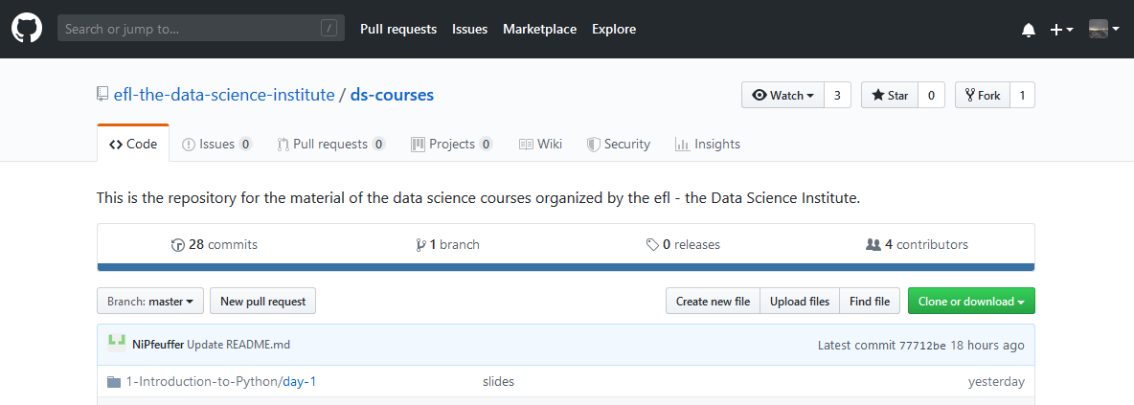
Assignment tasks
The assignment tasks are now available in our course repository:
https://github.com/efl-the-data-science-institute/ds-courses

