Slide 1
Lecture 3: Control Structures in Python
Introduction to Python
efl Data Science Courses
Dr. Jens Lausen

Slide 2
Table of Contents
Program structures in general
Case Distinction
Loops
Notes:
Programmsturkutren im Allgemeinen
Fallunterscheidung
SChleifen

Slide 3
1. Program structures in general
Program structures can be divided into
Simple assignments like variable definitions, value assignments or output commands (Lectures 1 & 2)
Control structures: a construct which enables to control the sequence of a program and allows complex calculation (This lecture)
The structure of a program can be depicted in a so-called Nassi-Shneiderman-diagram or structogram (Nassi & Shneiderman 1972)

Slide 4
1. Program structures in general
Process blocks
Branching blocks
Loops
No conditions
Execute action inside of block and move to next block
Check condition statement
Execute action inside of respective block
Loop a process as long as particular condition is met
Define variable var1
Assign value to var1
Compute E = var1 + 1
Print E
Check condition statement
As long as condition is met
True
False
Subprocess 1
Process for condition True
Process for condition False
…
Notes:
https://en.wikipedia.org/wiki/Nassi%E2%80%93Shneiderman_diagram

Slide 5
Simple program example
Print all even numbers from a given list
→ We will use this example for explaining the Python code in the following sections
Define list: LNumbers = [1, …, 10]
Iterate over list LNumbers
Check if current number
is even
True
False
Print current number
Do nothing

Slide 6
Simple program example
Python code
Define list: LNumbers = [1, …, 10]
# Define list of numbers from 1 to 10
LNumbers = [1,2,3,4,5,6,7,8,9,10]
Iterate over list LNumbers
Check if current number
is even
Process blocks
True
False
No conditions
Execute action inside of block and move to next block
# Alternative:
LNumbers = list(range(1,11))
Print current number
Do nothing

Slide 7
Simple program example
Define list: LNumbers = [1, …, 10]
Iterate over list LNumbers
Check if current number
is even
True
False
Print current number
Do nothing

Slide 8
Table of Contents
Program structures in general
Case Distinction
Loops

Slide 9
2. Case Distinction
In programming, for defining different conditional paths (or branches) for your code, so-called if-statements can be used.
For each statement, the subordinate code will only be executed, if the underlying condition is fulfilled
There are three types of if-statements:
One-sided
Two-sided
if … elif … else ladder
Check condition statement
True
False
Process for condition True
Process for condition False
Branching blocks
Check condition statement
Execute action inside of respective block

Slide 10
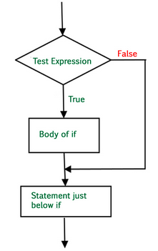
2. Case Distinction
One-sided if-statement
Python syntax
if condition:
statement
Python example
iNumber = 5
if iNumber < 10:
print('Number is less than 10')
Source: https://www.geeksforgeeks.org/decision-making-python-else-nested-elif/
Notes:
https://www.geeksforgeeks.org/decision-making-python-else-nested-elif/#if-elif

Slide 11
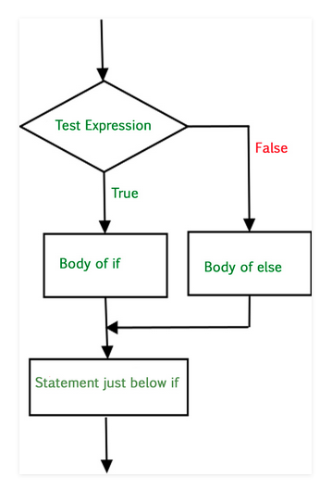
2. Case Distinction
Two-sided if-statement
Python syntax
if condition:
statement if condition True
else:
statement if condition False
Python example
Info:
The statement inside the body of an else-statement can be another if-statement
Such program structures are called “nested if-statements”
iNumber = 5
if iNumber < 10:
print('Number is less than 10’)
else:
print('Number is greater or equal to 10’)
Source: https://www.geeksforgeeks.org/decision-making-python-else-nested-elif/
Notes:
https://www.geeksforgeeks.org/decision-making-python-else-nested-elif/#if-elif

Slide 12
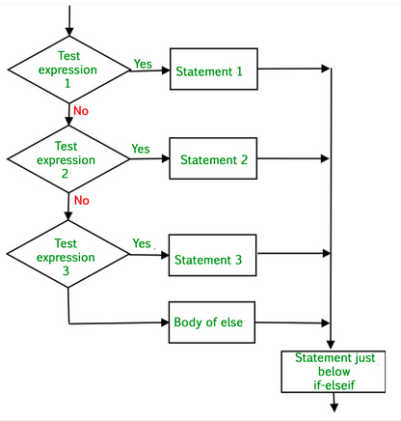
2. Case Distinction
if … elif … else ladder
Python syntax
if condition:
statement
elif condition:
statement
.
.
else:
statement
Check condition statement
True
False
Process for condition True
Check condition statement
True
False
Process for condition True
Process for condition False
Source: https://www.geeksforgeeks.org/decision-making-python-else-nested-elif/
Notes:
https://www.geeksforgeeks.org/decision-making-python-else-nested-elif/#if-elif

Slide 13
2. Case Distinction
The condition in an if-statement is an expression with a boolean (True, False) as a results
The conditional statement can also be a combination of multiple expressions
For combining expressions, different operarators can be used
Python syntax
if condition:
statement
else:
statement
Arithmetic operators
numeric → numeric
Comparative operators
numeric → boolean
Logical operators
boolean → boolean
+ | Addition
- | Subtraction
* | Multiplication
/ | Division
% | Modulus
< | Smaller
<= | Smaller or equal
> | Larger
>= | Larger or equal
== | Equal
!= | Not equal
and | If both operands are True then condition becomes True
or | If any of the two operands is True then condition becomes True
not | Used to reverse the logical state of ist operand

Slide 14
Simple program example
Python code
Define list: LNumbers = [1, …, 10]
# Define list of numbers from 1 to 10
LNumbers = [1,2,3,4,5,6,7,8,9,10]
iNum = LNumbers[0]
if iNum % 2 == 0:
print(iNum)
Iterate over list LNumbers
Check if current number
is even
True
False
Print current number
Do Nothing
Info:
% is the modulo operator
The modulo operation finds the remainder after division of one number by another
Even numbers can always be divided by 2 with a remainder of 0

Slide 15
Exercise 1: Case Distinction
Solution 1.1
1.1 Simple case distinction
Given are two random numbers
Please write a conditional statement, which returns the minimum of both numbers
1.2 Advanced case distinction
Please write a conditional statement, which returns the grade for an exam.
Please use the following thresholds:
Points >= 90: Grade 1
Points >= 75: Grade 2
Points >= 60: Grade 3
Points >= 50: Grade 4
Points < 50: Grade 5
#returns minimum of both numbers
iNum1 = 8
iNum2 = 5
if iNum1 <= iNum2:
print(iNum1)
else:
print(iNum2)
Solution 1.2
#prints grade based on received points
iPoints = 77
if iPoints >= 90:
print('Grade 1’)
elif iPoints >= 75:
print('Grade 2’)
elif iPoints >= 60:
print('Grade 3’)
elif iPoints >= 50:
print('Grade 4’)
else:
print('Grade 5')

Slide 16
Exercise 2: Booleans
Solution 2
True
True
True
False
2. Conditional statements
Given are the following expressions:
(1+2) == 3
True != False
iNum = 4 (iNum != 0) and (20/iNum > 0)
iHour = 12 (iHour < 9) or (iHour > 18)
Please determine the result of each expression

Slide 17
Simple program example
Python code
Define list: LNumbers = [1, …, 10]
# Define list of numbers from 1 to 10
LNumbers = [1,2,3,4,5,6,7,8,9,10]
iNum = LNumbers[0]
if iNum % 2 == 0:
print(iNum)
Iterate over list LNumbers
Check if current number
is even
True
False
Print current number
Do nothing

Slide 18
Table of Contents
Program structures in general
Case Distinction
Loops

Slide 19
3. Loops
Computers are often used to automate repetitive tasks
A repeated execution of a set of statemens is called iteration
Python has two statements for iteration:
The while loop
The for loop
Further, both loop statements can be controlled by three different loop control statements, i.e.:
continue
break
pass
As long as condition is met
Subprocess 1
…
Loops
Loop a process as long as particular condition is met
Notes:
http://www.openbookproject.net/books/bpp4awd/ch04.html

Slide 20
3. Loops
while loop:
Executes a block of statements repeatedly until a given condition is satisfied
When the condition becomes False, the statement immediately after the loop is executed
Python syntax
Be careful!
Avoid infinite loops if not necessary
Avoid loops that increase memory usage by each iteration
while condition:
statement
Python example
Output:
Hello!
Hello!
Hello!
count = 0
while (count < 3):
count = count + 1
print("Hello!")
Notes:
http://www.openbookproject.net/books/bpp4awd/ch04.html

Slide 21
3. Loops
2.1 for in loops:
for loops are used for sequential traversal of iterable objects
The sequence can be a list, tuple, string, dictionary, or any other iterable object
Python syntax
for iterator_var in sequence:
statement
Python example
LNumbers = [1,2,3,4,5,6,7,8,9,10]
for iNum in LNumbers:
print(iNum)
Notes:
http://www.openbookproject.net/books/bpp4awd/ch04.html

Slide 22
3. Loops
2.2 for loops using range
the python build-in function range creates an iterable object which traverses all integer numbers in a pre-defined range
All parameters forwarded to the range function need to be integers
Python syntax
start = number to begin with
stop = loop stops when this value is reached (the loop iterator variable will never reach this value)
step = increment, by which the loop iterator variable increases in each iteration
range(stop)
range(start, stop)
range(start, stop, step)
Python example 1
Python example 2
# Iterate over range
for i in range(1, 10, 2):
print(i)
# Iterating by index of sequences
LWords = ['Iterating', 'by', 'index', 'of', 'sequences’]
for i in range(len(LWords)):
print(LWords[i])
Notes:
http://www.openbookproject.net/books/bpp4awd/ch04.html

Slide 23
3. Loops
Loop control statements
Change execution from its normal sequence
continue: returns the control to the beginning of the loop
break: brings control out of the loop
pass: for empty loops
for letter in 'science’:
if letter == 'e' or letter == ‘c’:
continue
print('Current Letter:', letter)
Output:
Current Letter: s
Current Letter: i
Current Letter: n
for letter in 'science’:
if letter == 'e' or letter == 'c’:
break
print('Current Letter:', letter)
Output:
Current Letter: s
for letter in 'science’:
pass
print('Last Letter :', letter)
Output:
Last Letter: e
Examples based on: https://www.geeksforgeeks.org/loops-in-python/
Notes:
https://www.geeksforgeeks.org/loops-in-python/

Slide 24
3. Loops
Choosing between for and while:
Use a for loop if you know, before you start looping, the maximum number of times that you’ll need to execute the body
For example, if you’re traversing a list of elements, you know that the maximum number of loop iterations you can possibly need is “all the elements in the list”
By contrast, if you are required to repeat some computation until some condition is met, and you cannot calculate in advance when this will happen, you’ll need a while loop
We call the first case definite iteration — we have some definite bounds for what is needed
The latter case is called indefinite iteration — we’re not sure how many iterations we’ll need
Based on: http://www.openbookproject.net/books/bpp4awd/ch04.html
Notes:
http://www.openbookproject.net/books/bpp4awd/ch04.html

Slide 25
Simple program example
Python code
Python code
Define list: LNumbers = [1, …, 10]
# Define list of numbers from 1 to 10
LNumbers = [1,2,3,4,5,6,7,8,9,10]
# Iterate over list
for iNum in LNumbers:
# Check remainder of iNum
if iNum % 2 == 0:
# Print iNum if even
print(iNum)
# Define list of numbers from 1 to 10
LNumbers = [1,2,3,4,5,6,7,8,9,10]
iNum = LNumbers[0]
if iNum % 2 == 0:
print(iNum)
Iterate over list LNumbers
Check if current number
is even
True
False
Print current number
Do Nothing

Slide 26
Exercise 3: Loops
Solution 3
Solution 2
True
True
True
False
Given is the following List of numbers:
LNumbers = [5,23,37,49,50,46,30,46,70]
Please write a code that counts the number of elements in the list that are greater than 30, and prints the result
Use a while loop
Use a for loop
LNumbers = [5,23,37,49,50,46,30,46,70]
# 1. while loop
iCount = 0
iSizeofList = len(LNumbers)
i = 0
while i < iSizeofList:
if LNumbers[i] > 30:
iCount = iCount + 1
i = i + 1
print(iCount)
# 2. for loop
iCount = 0
for n in LNumbers:
if n > 30:
iCount = iCount + 1
print(iCount)

Slide 27
References
Ernesti, J.; Kaiser, P.: Python 3 – Das umfassende Handbuch. 4. 2015.
Schiedermeier, R.: Programmieren mit Java. 2. 2010.
Stahlknecht, P.; Hasenkamp, U.: Einführung in die Wirtschaftsinformatik. 11. 2005.
https://docs.python.org/3/tutorial/
http://www.openbookproject.net/books/bpp4awd/ch04.html
https://www.geeksforgeeks.org/decision-making-python-else-nested-elif/
https://www.geeksforgeeks.org/loops-in-python/

