Slide 1
CAP SAC Hackathon Workshop
Prepared by: Liz Fletcher
Intro to python

Slide 2
Outline
Python basics & examples
Getting started with the problem
Some useful resources

Slide 3
Why Python?
Free & open source, and used widely in physics
Human readable (mostly)
Fairly quick to pick up
Quick to see results
Not too fussy about data types
Lots of useful libraries (numpy, scipy,…)

Slide 4
Python basics – Getting started
If you’re new to Python, I suggest using either Jupyter or Spyder:
https://jupyter.org/install
https://docs.spyder-ide.org/current/installation.html
Both will let you see results “live” and have nice graphics rendering
Demo files have been written in both a Jupyter notebook (.ipynb) and a generic .py version of the same thing for use with Spyder (or any other IDE)

Slide 5
Python basics – Getting started
Some packages I suggest installing if your system does not already have them:
NumPy (https://numpy.org)
SciPy (https://scipy.org)
Matplotlib (https://matplotlib.org)

Slide 6
Python basics – Data types
Python has a number of data types:
Numeric:
Integer (int): counting numbers (1, 10, 453, -2)
Float (float) double precision floating point numbers (1.0, 2.5788932, -3.14159)
Long (long): infinite precision numbers like floats with no limit
Complex (complex): traditional complex numbers (1+2j, 5.7-2.5j)
Boolean (bool): binary values with values of True or False (equivalent to 1 or 0)

Slide 7
Python basics – Data types cont’d
Other:
String (str): text contained in quotes (‘hello’, “World”, ‘Hello world.”)
Tuple (tuple): a set of objects which is immutable/read only – contained in round brackets ((1,303,1.75), (“Hello”,False,-8.75))
List (list): a set of objects which is changeable – contained in square brackets ([1,2,3], [23, True, “Yes”])
Numpy array (numpy.ndarray): similar to list but a different implementation: (np.array([1,2,3]), np.array([23, True, “Yes”]))

Slide 8
Python basics – Data types cont’d
You can determine a variable’s data type by calling type(var)
Python isn’t too picky about combining data types – you can add an int to a float without any trouble
Converting between types can be done manually – but results can be unexpected:
float(1) = 1.0
int(3.14159) = 3
In general, for this workshop we’ll be working with floats in numpy arrays

Slide 9
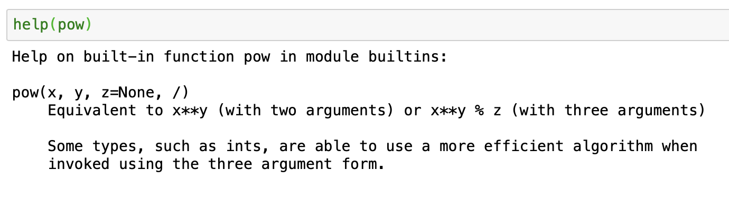
Python basics – Helpful tips
help() is your friend!
If you’re unsure about what a function does or what the input syntax looks like, you can call help(function) and you’ll get a printout like this:

Slide 10
Python basics – Helpful tips
Python is picky about spaces and indenting!
Indents are represented by four spaces
When writing functions or loops, be very careful to make sure things are indented correctly, or you might get errors or unexpected results

Slide 11
Python basics – Examples
See .ipynb or .py files on Github for some Python basics and examples that might help you with the problem: https://github.com/efletcher/CAP_SAC_Workshop
These examples use python3, if you’re using python2 some things may need to be adapted (but you really should be using python3!)

Slide 12
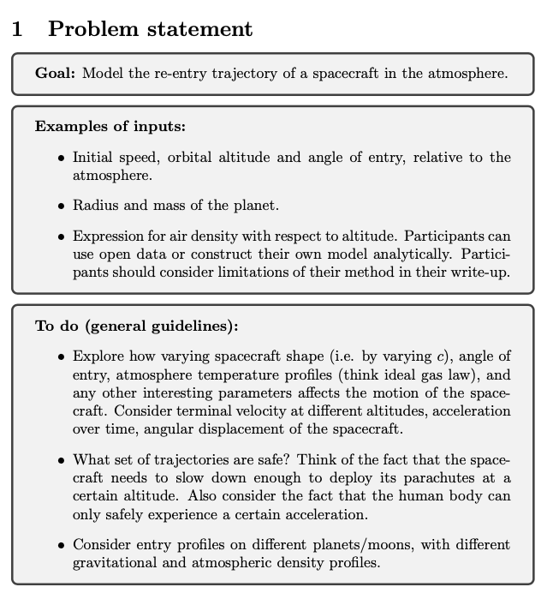
Getting started on the problem

Slide 13






Setting up the problem
Let’s start with a free-body diagram
$F_{d}$ - drag force
$v$ - initial velocity
$F_{g}$- Force of gravity
$F_{c}$ - centripetal force

Slide 14


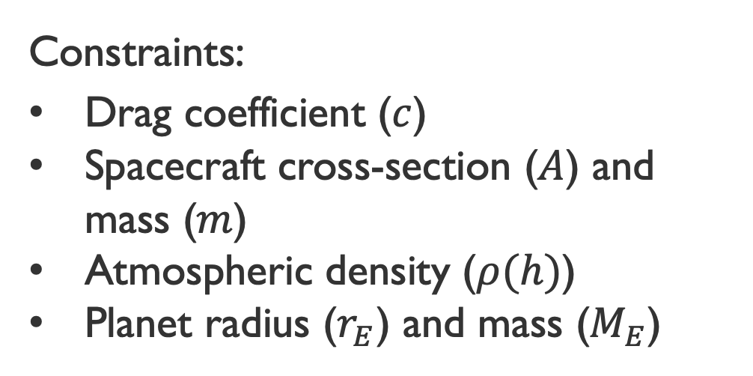

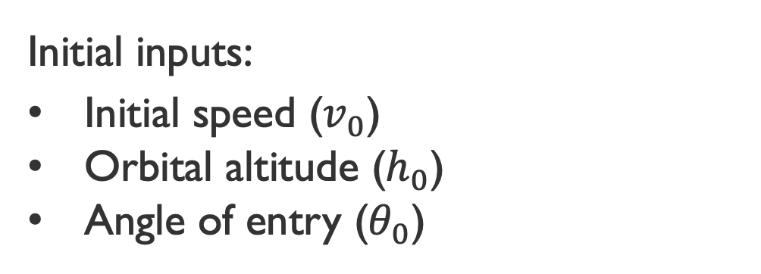
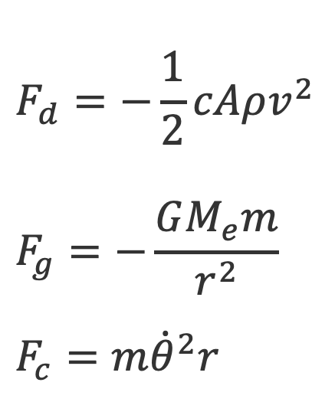

Setting up the problem
Constraints:
Drag coefficient ($c$)
Spacecraft cross-section ($A$) and mass ($m$)
Atmospheric density ($ρ(h)$)
Planet radius ($r_{E}$) and mass ($M_{E}$)
$$F_{d}=−\frac{1}{2}cAρv^{2}$$
$$F_{g}=−\frac{GM_{e}m}{r^{2}}$$
$$F_{c}=m{\dot{θ}}^{2}r$$
$$F_{d}$$
$$v$$
$$F_{g}$$
$$F_{c}$$
Initial inputs:
Initial speed ($v_{0}$)
Orbital altitude ($h_{0}$)
Angle of entry ($θ_{0}$)

Slide 15
Setting up the problem cont’d
$$F_{d}=−\frac{1}{2}cAρv^{2}$$
$$F_{g}=−\frac{GM_{e}m}{r^{2}}$$
$$F_{c}=m{\dot{θ}}^{2}r$$
Assumptions:
Spherical planet
Spherical spacecraft
Subsonic speeds
No impact due to planet’s rotation
Orbiting around a great circle of the planet
$$F_{d}$$
$$v$$
$$F_{g}$$
$$F_{c}$$

Slide 16
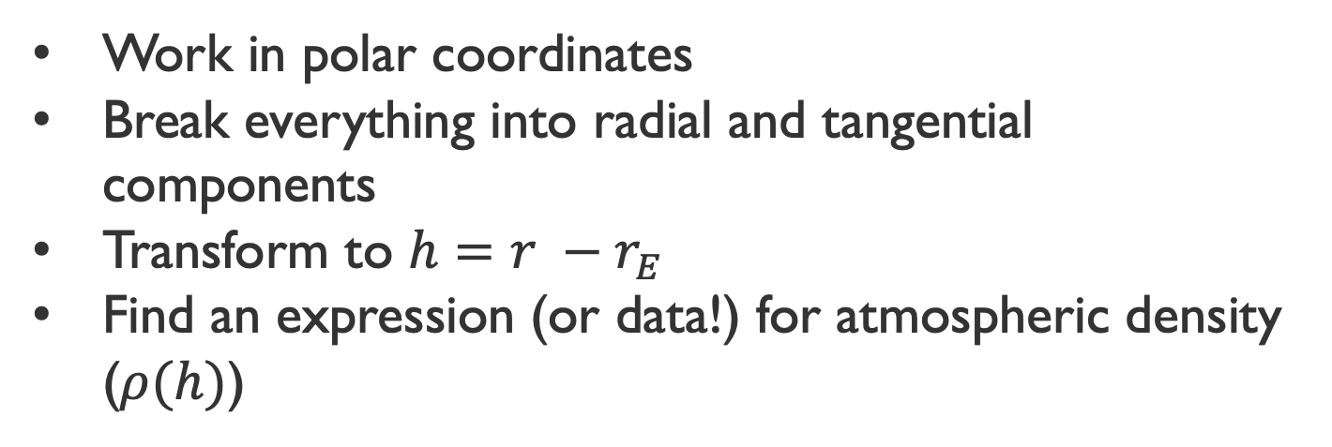
Some Helpful Hints
Work in polar coordinates
Break everything into radial and tangential components
Transform to $h=r −r_{E}$
Find an expression (or data!) for atmospheric density ($ρ(h)$)
$$F_{d}$$
$$v$$
$$F_{g}$$
$$F_{c}$$

Slide 17
Taking it further
Other physics you could explore:
Non-spherical planet
Non-spherical spacecraft
Hypersonic speeds
…
$$F_{d}$$
$$v$$
$$F_{g}$$
$$F_{c}$$

Slide 18
python resources
You can always use help(function) to get a function’s documentation
e.g. help(np.exp)
NumPy documentation
https://numpy.org/doc/stable/
SciPy documentation
https://docs.scipy.org/doc/scipy/index.html
Python Programming and Numerical Methods: A Guide For Engineers And Scientists
https://pythonnumericalmethods.berkeley.edu/notebooks/Index.html

Slide 19
Aeronautics Resources
NASA Glenn Research Center Beginners Guide to Aeronautics
https://www1.grc.nasa.gov/beginners-guide-to-aeronautics/
Rocket & Space Technology – Basics of Space Flight III: Orbital Mechanics
http://www.braeunig.us/space/orbmech.htm

