Slide 1
Data Pipelines and Data Logistics Service
Jedrzej Rybicki – JSC

Slide 2
Data Pipelines: Motivation
eFlows4HPC aims to deliver a workflow software stack and an additional set of services to enable the integration of HPC simulations and modelling with big data analytics and machine learning in scientific and industrial applications. The software stack will allow for the creation of innovative adaptive workflows that efficiently use computing resources considering novel storage solutions.
Computations require (lots) of data
Data Logistics Service (DLS): fuel the scientific calculations with required data
DLS pipelines describe how the data are moved

Slide 3
Data Pipelines: Motivation
  Assumptions about data:
    Right data
    Right place
    Right time
    Often proven wrong! (hacks! “legacy solutions”)
  Requirement to publish the data
    Often forgotten
  Data Pipelines (as part of scientific workflows):
    Formalization
    Reproducibility (FAIR)
    Portability of the workflows

Slide 4
Apache Airflow

Slide 5
Airflow Features
Pipelines as code
Extensible (ready to use operators)
Flexible
Powerful scheduling, restarting, etc
Templating
Various deployment options (standalone → Kubernetes)
Dependency injections (connections, etc)
Monitoring
UI, Rest API

Slide 6
Apache Airflow
Airflow is a platform created by the community to programmatically author, schedule and monitor workflows
    Workflows → Pipelines (Pipelines as Code (Python))
    Defined as DAG (Directed Acyclic Graph), and contains individual pieces of work called Tasks, arranged with dependencies and data flows taken into account
    DAG specifies the dependencies between Tasks
    Tasks themselves describe what to do
    Airflow Scheduler executes your tasks on an array of Workers
    User interface to visualize pipelines, monitor progress, and troubleshoot issues when needed
    created by: Maxime Beauchemin at Airbnb
    Apache incubation program (2016), Apache Top Level (2019)

Slide 7
from datetime import datetimefrom airflow import DAG
from airflow.operators.bash import BashOperator
from airflow.operators.python import PythonOperator
def myfunc():
print("And hello from Python!")
with DAG( "simple", description="simple DAG example", schedule="@daily", start_date=datetime(2023, 4, 1), catchup=False) as dag:
task1 = BashOperator(task_id="print", bash_command="echo 'Hallo world!'")
task2 = PythonOperator(task_id="myfunc", python_callable=myfunc)
task1 >> task2

Slide 8
from airflow.decorators import dag, task
import pendulum
@dag(dag_id="simpleft", schedule="@daily", catchup=False, start_date=pendulum.datetime(2023, 4, 1, tz="UTC"))
def simpletf():
@task
def task1():
print("Hello world")
return "Prompt"
@task
def task2(prompt):
print(prompt)
prompt = task1()
task2(prompt)
simpletf()

Slide 9
DAG
start_date and schedule required
→ series of intervals for which DAG will be ran
  manual trigger is also possible)
By default (catchup=True) a run for each interval
Backfill: rerun for all intervals
Trigger rules: all_success (default), all_failed, all_done, etc
Arguments: inputs (with defaults)

Slide 10
@dag(
start_date=pendulum.datetime(2023,1,4, tz='UTC'),
schedule=”@daily”, # timedelta(days=1), “0 * * * *"
end_date=pendulum.datetime(2023, 1, 20),
depends_on_past=True,
catchup=True,
tags = [‘isc’, ‘tutorial’]
Params={
'name': Param('John', type='string'),
'age': Param(16, type='integer', minimum=16) })
def mydag():
. ...

Slide 11
Tasks
Task: basic unit of work
Kinds:
  Operators (Task templates)
  Sensors (Task waiting for something)
  Decorated Python functions
Task has up- and down-stream
Communication with XComs (small messages)

Slide 12
Operators
BashOperator, PythonOperator
DockerOperator, HiveOperator
DB: MySqlOperator, PostgresOperator, MsSqlOperator, OracleOperator, JdbcOperator
SimpleHttpOperator, S3FileTransformOperator
Messaging: EmailOperator, SlackAPIOperator
BaseOperator: use to build your own
More:
  https://airflow.apache.org/docs/apache-airflow/stable/operators-and-hooks-ref.html

Slide 13
Sensors
Examples:
  BashSensor (arbitrary command for sensing)
  FileSensor
  TimeSensor
Modes: poke vs. reschedule

Slide 14
TaskFlow Tasks
Decorated Python functions
Internally: PythonOperator + XComs
New feature in Airflow 2.0

Slide 15
from airflow.decorators import dag, task
import pendulum
from airflow.sensors.base import PokeReturnValue
@dag( dag_id="simpleft", schedule="@daily", catchup=False, start_date=pendulum.datetime(2023, 4, 1, tz="UTC"))
def simpletf():
@task.sensor(poke_interval=60, timeout=3600, mode="reschedule")
def waitfor():
return PokeReturnValue(is_done=True, xcom_value="xcom_value")
@task.virtualenv(task_id='python_in_venv',
requirements=['scikit-learn'],
system_site_packages=False)
def task1():
import sklearn
return "Prompt"
prompt = task1()
waitfor() >> prompt
simpletf()

Slide 16
Tasks attributes
execution_timeout – define maximal running time
timeout – maximal tries for sensor
slas and sla_miss_callback – define SLA
params – execution context
Differentiate:
Dag vs DagRun
Operator vs Task vs TaskRun

Slide 17
“Dependency injection”
Parameters (for particular DagRun)
Variables (global constants)
Hooks (interact with external entities) and Connections (credentials, etc)

Slide 18
@dag( schedule=None, catchup=False, start_date=pendulum.datetime(2023,1,4, tz='UTC'),
params={ 'name': Param('John', type='string'), 'age': Param(16, type='integer', minimum=16) })
def mydag():
@task
def setup_db():
….
@task
def insert_data(**context):
hook = SqliteHook(conn_name_attr='sqlite_default') # goto: admin/connections to see/add connections
parms = context['params']
name = parms['name']
age = parms['age']
rows = [(name, age)]
hook.insert_rows(table="Customers", rows=rows, target_fields=["first_name", "age"])

Slide 19
Architecture
Scheduler: handles both triggering scheduled workflows, and submitting Tasks to the executor to run
Executor: responsible for running tasks (part of the Scheduler or separate instance)
Worker(s): execute Tasks, communicate with Executor
Webserver: User interface to inspect, trigger and debug the behavior of DAGs and tasks, and API for integration
A folder of DAG files, read by the Scheduler and Executor
Metadata database: used by the scheduler, executor and web server to store state

Slide 20
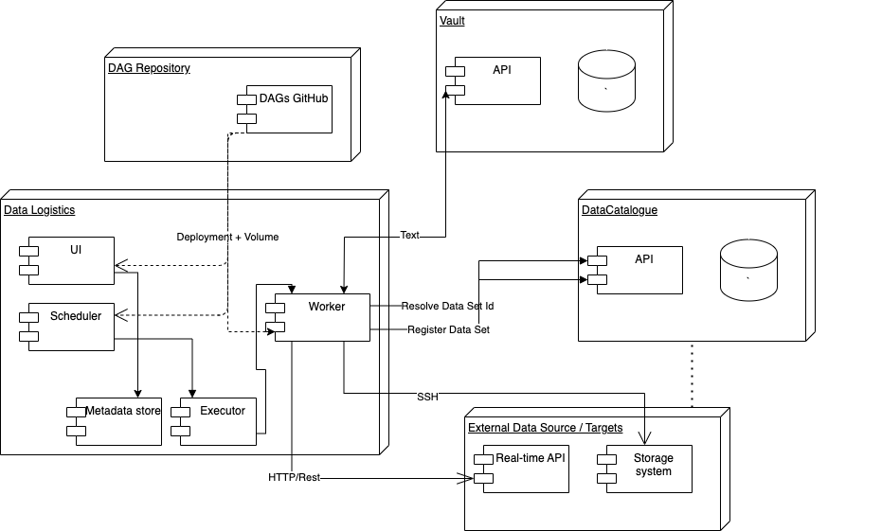

Slide 21
Link to the project
Prepare recovery (if people show up without laptop)

Slide 22
eFlows4HPC examples

