Slide 1
ET 583
App Design Planning

Slide 2
App Planning
Planning is the most important aspect.
Success has everything to do with preparation.
Start with a storyboard
Don’t start with a Java editor
Use storyboard to diagram your proposed ideas.

Slide 3
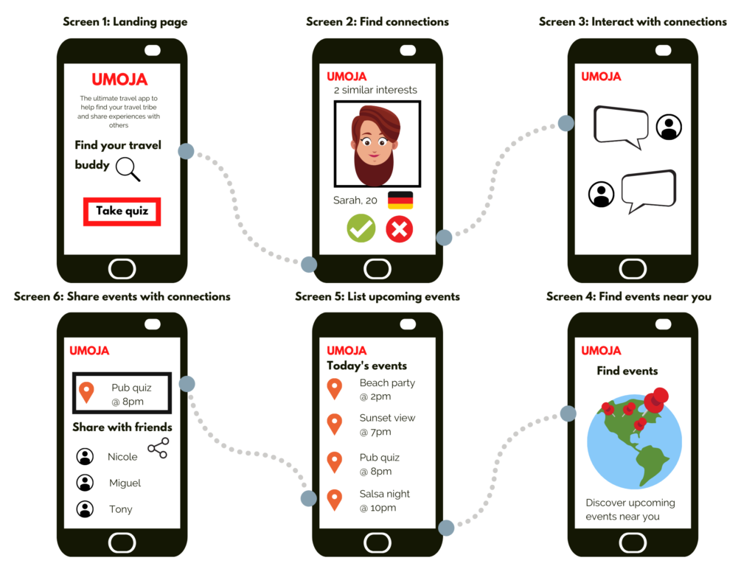
App Planning
Sample Storyboard

Slide 4
App Planning
Storyboards give important information.
How many views will be required?
How do these views link with each other?
Determine if anything is missing.

Slide 5
App Planning
Storyboards will show exactly what to expect.
They can let your customer or client know if they need more or less.
Offer them several different templates (page layouts) and color schemes.
Don’t fret criticism- get as much input as possible.
Make them sign off on design before investing too much effort.
Saves time in the long run.
Prevents Johnny come Lately from making major changes.

Slide 6
App Planning
Tips for a good template.
KISS principle.
Consistency of the interface.
Multiple navigational tools.
Key information should be right in front.
Avoid scrollbars.
No animated GIFs

Slide 7
App Planning
No black pages.
Simple backgrounds
Contrast your text and background.
Not too much text.
Keep graphics small and quick loading.
Template graphics will remain in cache for quick access to related pages.

Slide 8
App Planning
Text
Background does not interrupt the text
Text is big enough to read, but not too big
The hierarchy of information is perfectly clear

Slide 9
App Planning
Navigation
Navigation buttons and bars are easy to understand and use
Navigation is consistent throughout app
Navigation buttons and bars provide the visitor with a clue as to where they are, what view of the app they are currently on

Slide 10
App Planning
General Design
Views load quickly
Every view in the app looks like it belongs; there are repetitive elements that carry throughout the views

Slide 11
Bad App Design Features
Backgrounds
Default gray color
Color combinations of text and background that make the text hard to read
Busy, distracting backgrounds that make the text hard to read

Slide 12
Bad App Design Features
Text
Text that is too small to read
Text crowding against the left edge
Text that stretches all the way across the screen
Paragraphs of type in all caps
Paragraphs of type in bold
Paragraphs of type in italic
Paragraphs of type in all caps, bold, and italic all at once
Underlined text that is not a link

Slide 13
Bad App Design Features
Graphics
Overly large graphic files that takes lots of memory
Meaningless or useless graphics
Graphics that don't fit on the screen

Slide 14
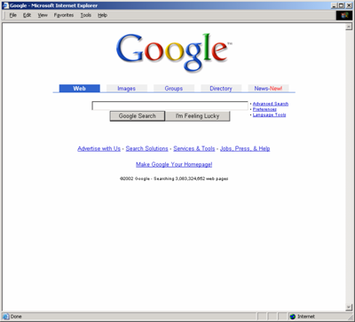
Use Visual Design to Enhance, not Define, Interaction Design
Don't over-format critical content, such as navigation areas
Use meaningful graphics

Slide 15
Designing GOOD App from the Start
It is easy, as long as you follow a few basic steps.

Slide 16
The “Paper” Rule
The first step to good app design is to turn off your computer and pull out a couple of pieces of paper.
Most poorly designed sites are poorly designed from the start.

Slide 17
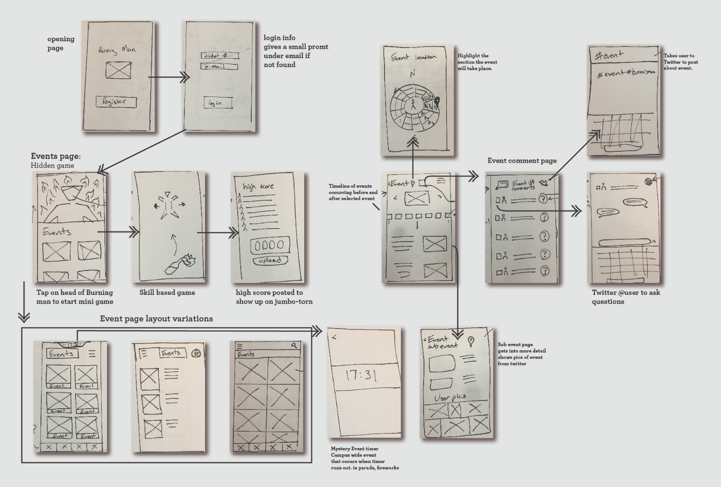
The “Paper” Rule
Sample Storyboards

Slide 18
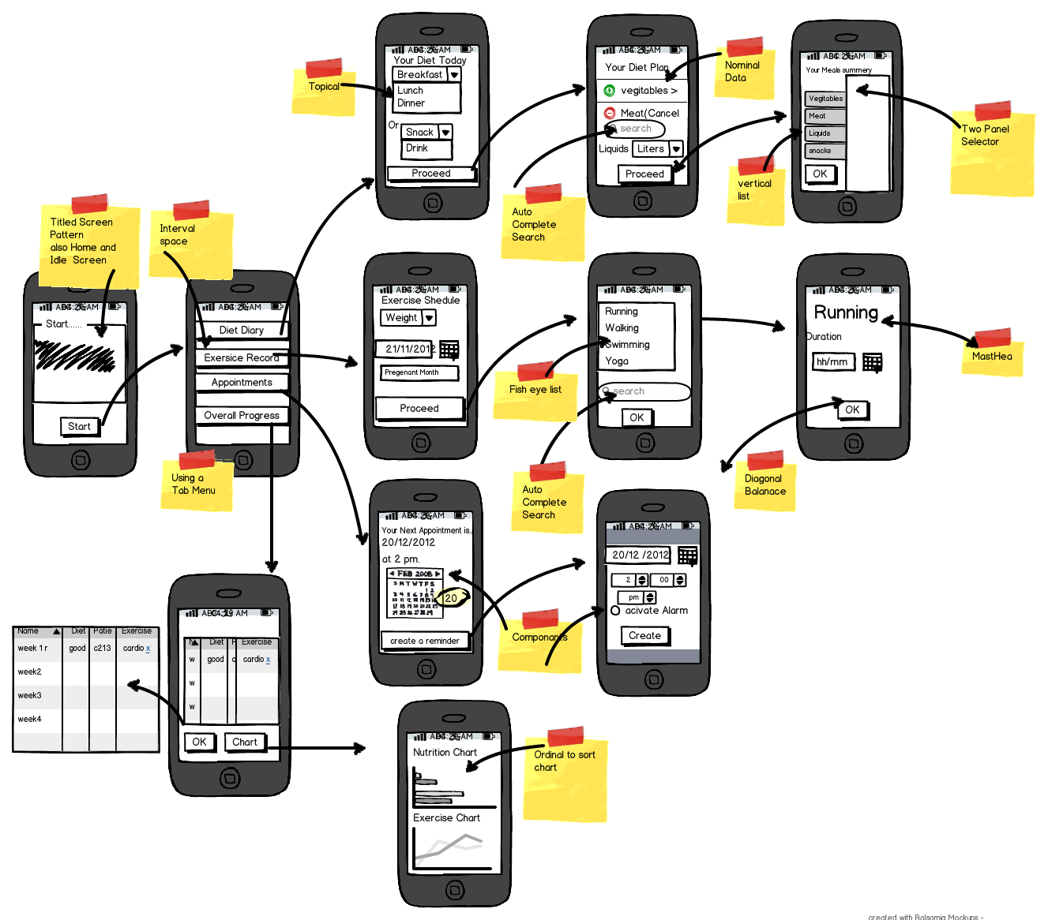
The “Paper” Rule
Sample Storyboards

