Slide 1
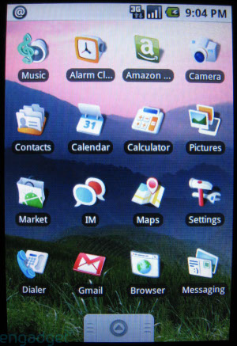
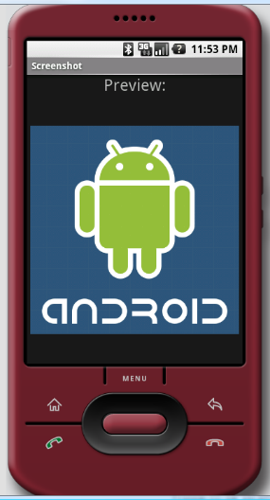
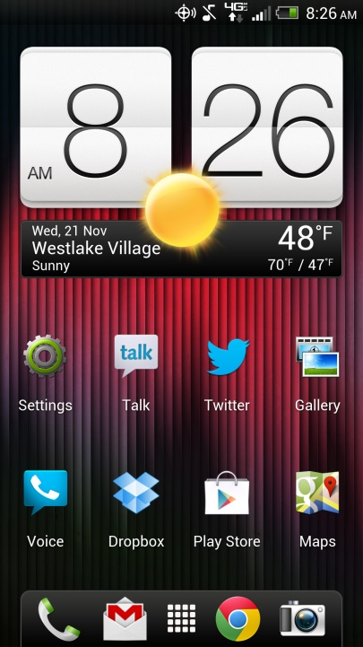
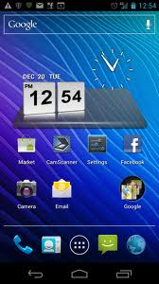
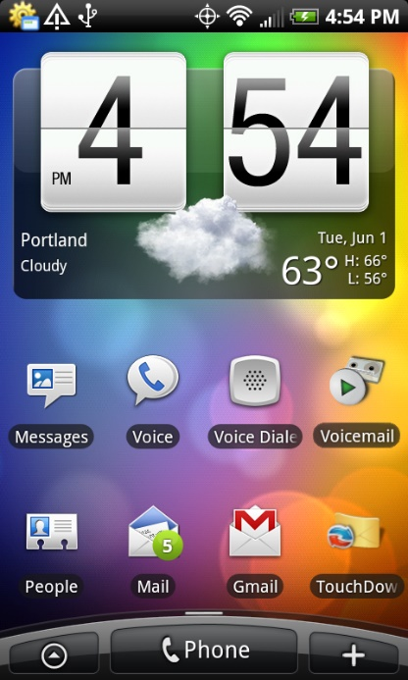
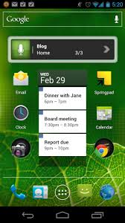
ET 583 App Programming and Development
Dr. Rolfe Sassenfeld

Slide 2
Chapter 1: Overview of Mobile Applications
Mobile App Development for iOS and Android

Slide 3
Learning Objectives
After completing this chapter, students should be able to do the following:
Discuss the advantages of a mobile device compared to traditional desktops and laptops.
Explain the major features of mobile devices that distinguish them from traditional computers (small size, hardware sensors, network capability).
Understand why mobile devices have the potential to disrupt most business sectors.
Discuss different ways that a mobile app can be used to reach consumers.
Discuss different ways that an app can create revenue for its developer.
Explain how a mobile app can be a part of business process transformations.

Slide 4

Smartphones are everywhere!

Slide 5

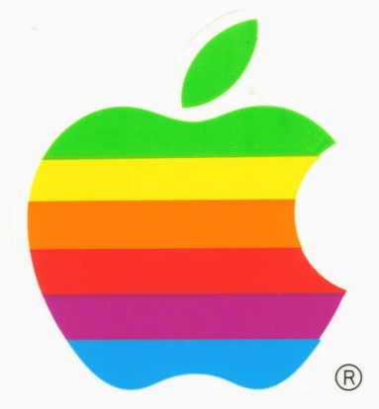
Android vs. ios design philosophy
Android is designed around an open platform philosophy
IOS is proprietary and belongs only to Apple.
Open source promotes innovation and independent development
Closed source ensures product consistency and protects income streams

Slide 6
‘Smart’ Device capabilities
What makes these devices different from a desktop computer?
It can feel you
It can hear you
It can see you
It knows where it’s at
It knows which way it is pointing/moving
What else?

Slide 7
‘Smart’ Device capabilities
These smart device abilities is what allows developers to be highly creative.
Health tracking apps
Hiking apps
Music apps
Social media – Multimedia integration.

Slide 8
Why Mobile Apps Transformative Devices
Aware of Environment (Sensors)
Communication with other devices
Mobile computing platform
= Disruptive technology

Slide 9
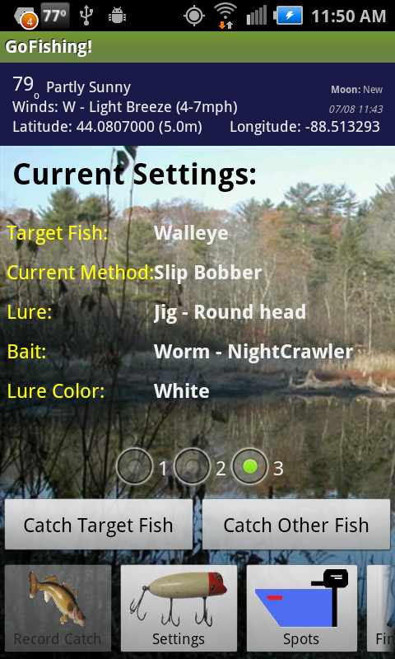
Innovation Using Device Capabilities
Take Advantage of
Location awareness
Mapping
Mobility
Camera
Internet Connectivity

Slide 10
Why Mobile Apps? Opportunity
Reach Customers
Changing Business Process
Making Money

Slide 11
Making Money
App Stores
Google Play Store
Apple App Store
Strategies
One-time fee
Ad-supported
In-app purchases
Subscription
Challenge: Many free or low-cost apps

Slide 12
Class Project
The project for this class will be an Android mobile app.
If you want to create an income stream remember there are multiple ways to generate revenue.
Sales
In app purchases
Ad revenue

Slide 13
Class Project
HW 1 – App Ideas
When coming up with you app idea, keep in mind the functionality that the mobile device offers.
The idea doesn’t have to be your own, you can be working on someone else’s idea if you like.
Think of unique ways to integrate the phone’s capabilities.
Make use of the device’s camera, microphone, GPS, and networking capabilities.

Slide 14
Class Project
HW 1 – App Ideas
Discuss the audience for your app and how it will be used.
What do you think the market for your app will be?
Additional details and parameters for the class project will be provided as the semester progresses.

