Slide 1
ET 583 The Lean LaunchPad Approach to Business creation and Entrepreneurship
Dr. Rolfe J. Sassenfeld

Slide 2
Intro
Entrepreneurship – More than an Idea
Shark Tank what do they invest in?
Idea vs Company
What’s the difference?
Executing on the idea and connecting with customers
We are going to discuss and utilize an innovative tool for startups and business growth

Slide 3
The Lean LaunchPad
What is the LLP?
It is a methodology for discovery.
What is new about LLP?
It recognizes the differences between new product development within current businesses and that of a startup.
An example would be a new company vs a new division within an existing company.

Slide 4
The business Plan Approach
Typically what are persons with new business ideas told?
Create a business plan.
But what is in the business plan?
A bunch of guesses some good, some way off.
Once the business tries to startup, everyone sticks to the business plan.
How many business plans fit the actual execution?
Few
Whose fault?
Plan or the people?

Slide 5
Flexibility in Design
The typical business plan is doomed because it isn’t flexible or based in observed fact.
This is the big idea about the LLP
Have a Business Model Canvas that can be changes and layered.
This is the methodology of the LLP – Business Plan discovery.

Slide 6
Introduction to the Business Model Canvas
Business Model Canvas Explained (2 minutes)
http://www.youtube.com/watch?v=QoAOzMTLP5s&feature=player_embedded
How to innovate your business plan
(3 minutes)
http://www.youtube.com/watch?v=hozC9lM4ltA

Slide 7
Flexibility in Design
Using this approach your actual business plan will have much better odds of success since it’s design has been challenged, tested, refined, and verified before execution.
Changes will still take place, the process doesn’t become static until it has been optimized and utilized.

Slide 8
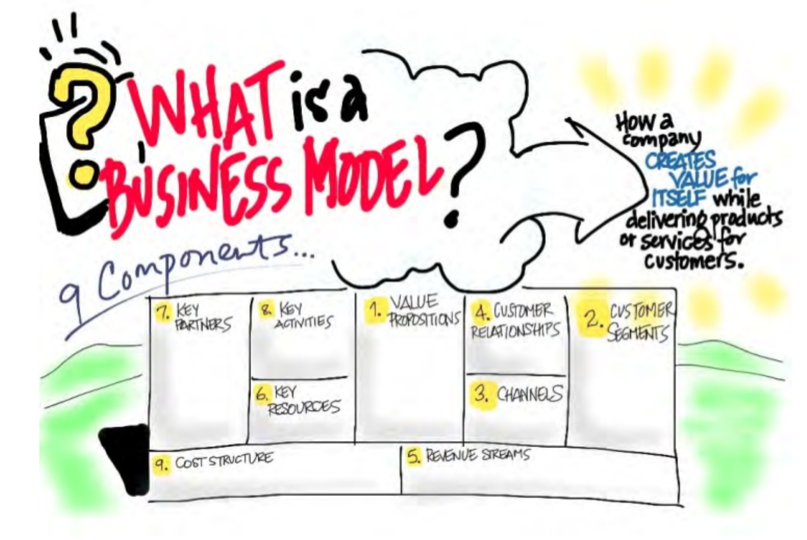

Slide 9
