Slide 1
Chapter 2: App Design Issues and Considerations
ET 483/ET583 App Programming and development

Slide 2
Learning Objectives
After completing this chapter, students should be able to do the following:
Explain the phases of the Android and iOS life cycle.
Identify the major tasks that should be performed in different phases of the life cycle.
Identify the issues associated with designing for a very small screen that can change its orientation at any time.
Identify the issues associated with data connections that can be acquired and lost without notice due to changes in the user’s location and configuration of the device.
Explain why designing for battery life is important and identify good practices for ensuring that the app doesn’t unnecessarily drain the battery.
Identify the issues associated with using the hardware and sensors available on mobile devices.
Identify the differences in Android and iOS devices and the potential impact of those differences on an app.

Slide 3
Design Issues
Operating System Design: App Life Cycle
Screen Size and Orientation Issues
Connectivity
Battery
Hardware
Multitasking
Testing

Slide 4
Android App Life Cycle

Slide 5
iOS App Life Cycle - Launch

Slide 6
iOS App Life Cycle - Running

Slide 7
App Design Issues Other Issues
Screen Design and Orientation: Real estate is at a premium. App interface must be designed with limited controls. Interaction must be planned and controlled. Orientation of screen can change and must be planned for.
Connectivity: it may be lost or not available or slow. App design has to plan for and handle these situations.
Battery: batteries can be drained. A device without power has no business value.

Slide 8
App Design Issues Other Issues
Hardware: availability, speed, accuracy, situational problems.
Multitasking: mobile platforms do not multitask like traditional computing platforms. Only one application can be active at a time. Apps may be interrupted by other apps (e.g. a phone call comes in). Understanding and planning for app life cycle important.
Testing: Most development platforms include a simulator however testing must also be performed on the actual device. This presents different challenges in Android and iOS.

Slide 9



Device Differences – Android and iOS
Android Buttons
Hardware buttons
Virtual buttons
Action Bar
iOS Hardware
Home Button

Slide 10
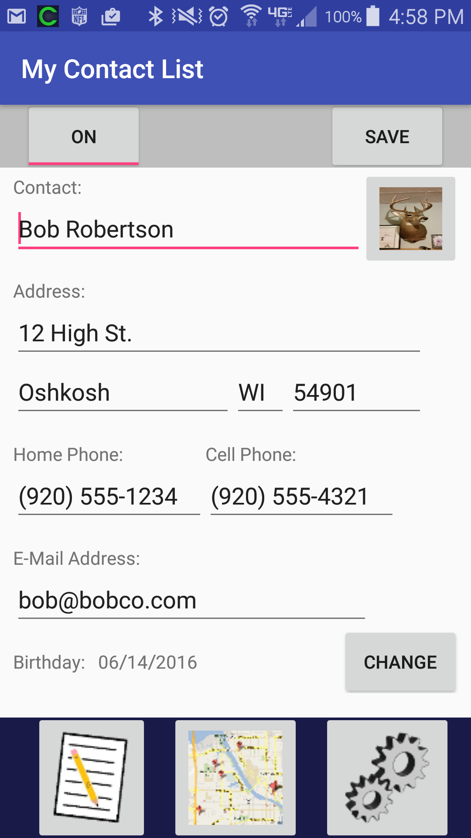
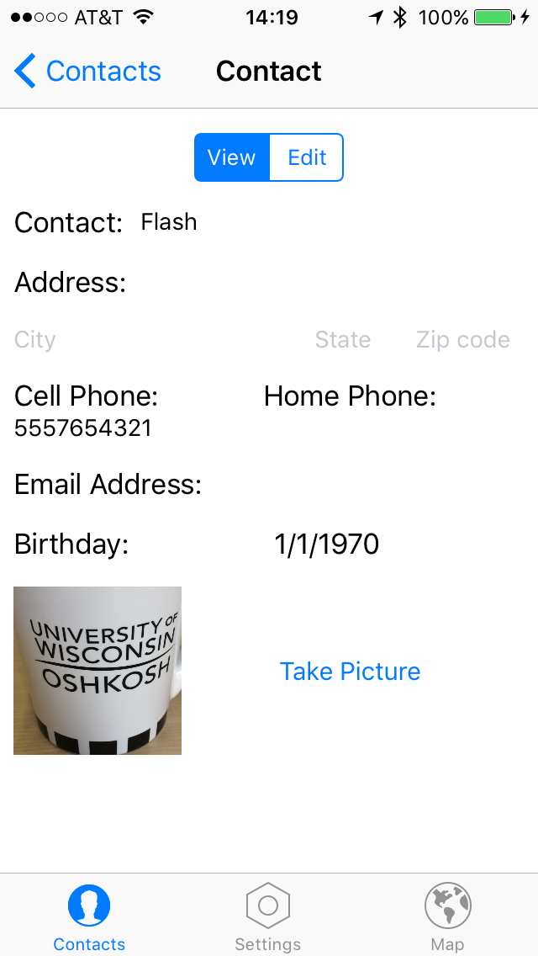
MyContactList: Contact Screen
Android
iOS

Slide 11
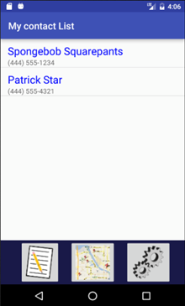
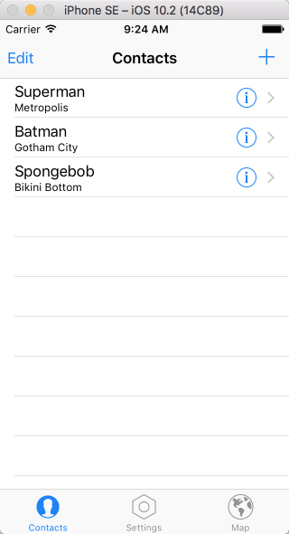
MyContactList: Contact List Screen
Android
iOS

Slide 12
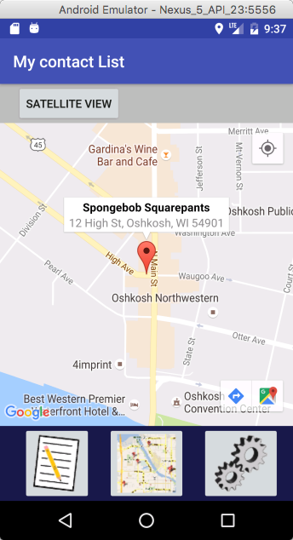
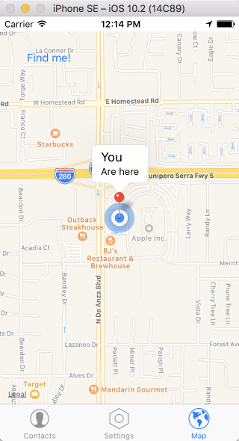
MyContactList: Map Screen
Android
iOS

Slide 13
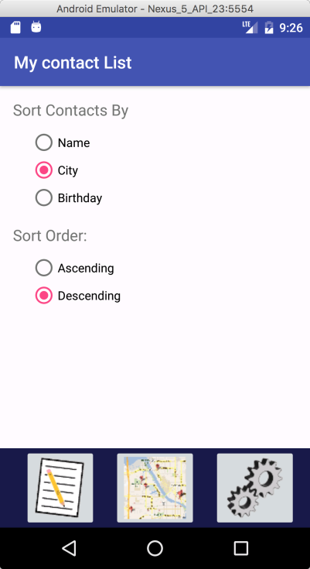
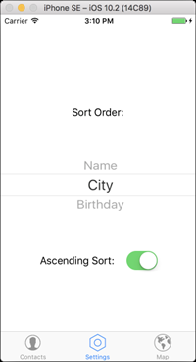
MyContactList: Settings Screen
Android
iOS

