Slide 1
ET 583 The Lean LaunchPad Approach to Business creation and Entrepreneurship
Dr. Rolfe J. Sassenfeld

Slide 2
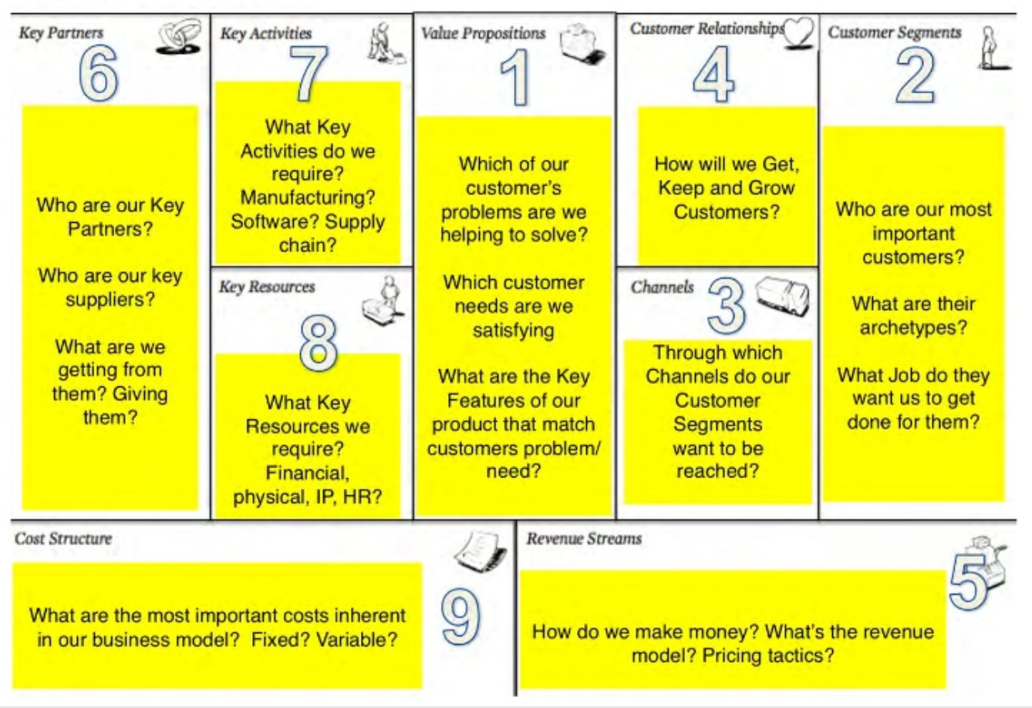

Slide 3
Value Proposition.
Today we will focus on the first two steps in the business model canvas.
The value Proposition
Customer Discovery
Let’s look more in depth at the first aspect of the canvas, and that is the VP.
Let’s look at some possible VP and discuss the differences.

Slide 4
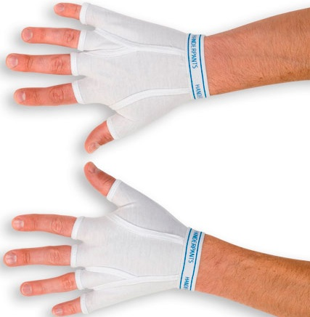
Value Proposition.
HanderPants
What is the difference between innovation for innovations sake (novelty) and actual value?

Slide 5
Value Proposition
Steve Blank introduces the idea of a value proposition. (3 minutes)
http://www.youtube.com/watch?v=6d0E3ydoN8s

Slide 6
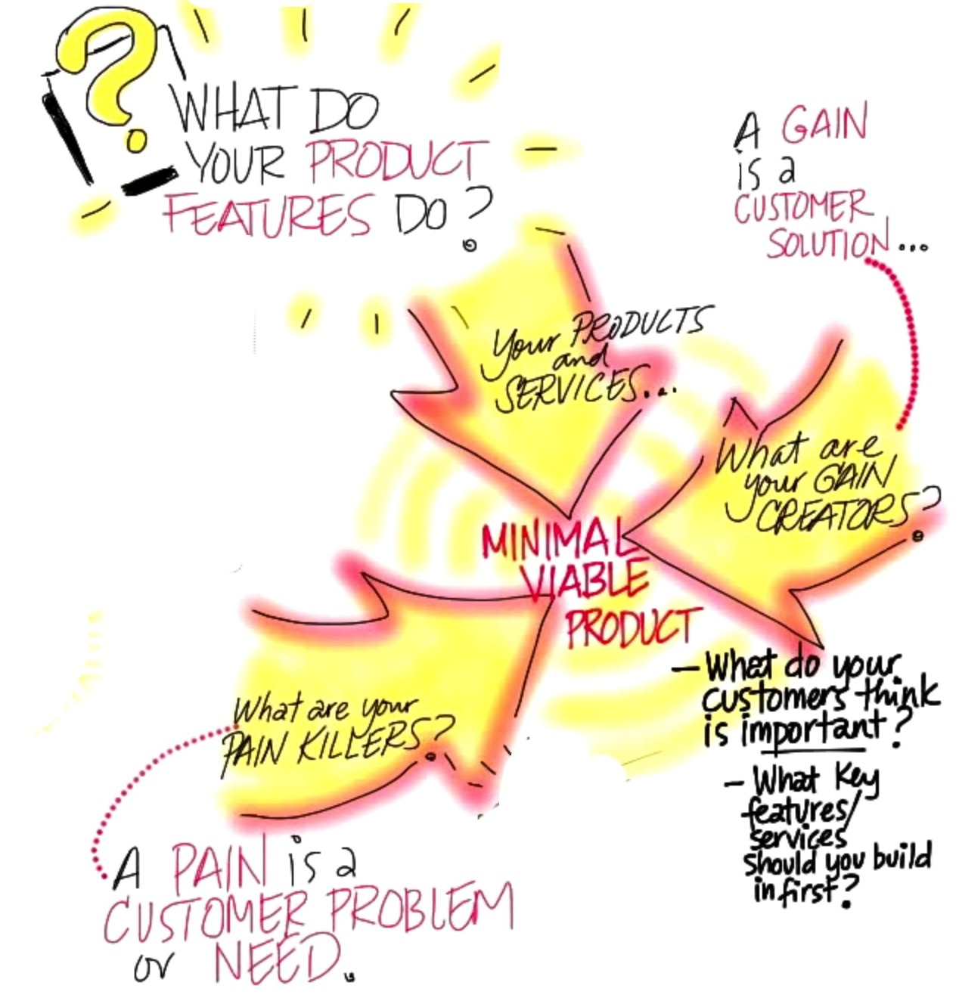

Slide 7
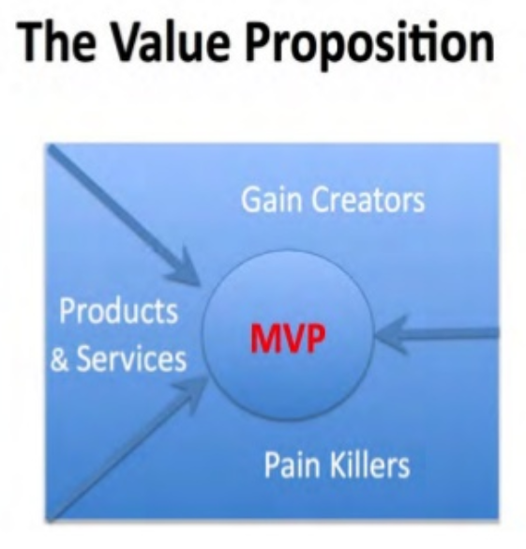
The Minimal Value Proposition

Slide 8
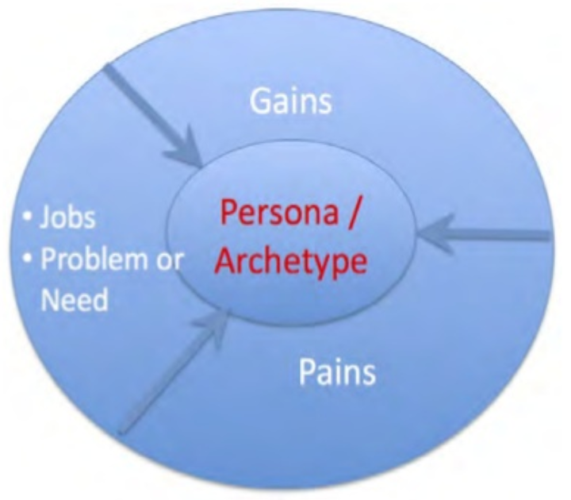
Your Customer

Slide 10
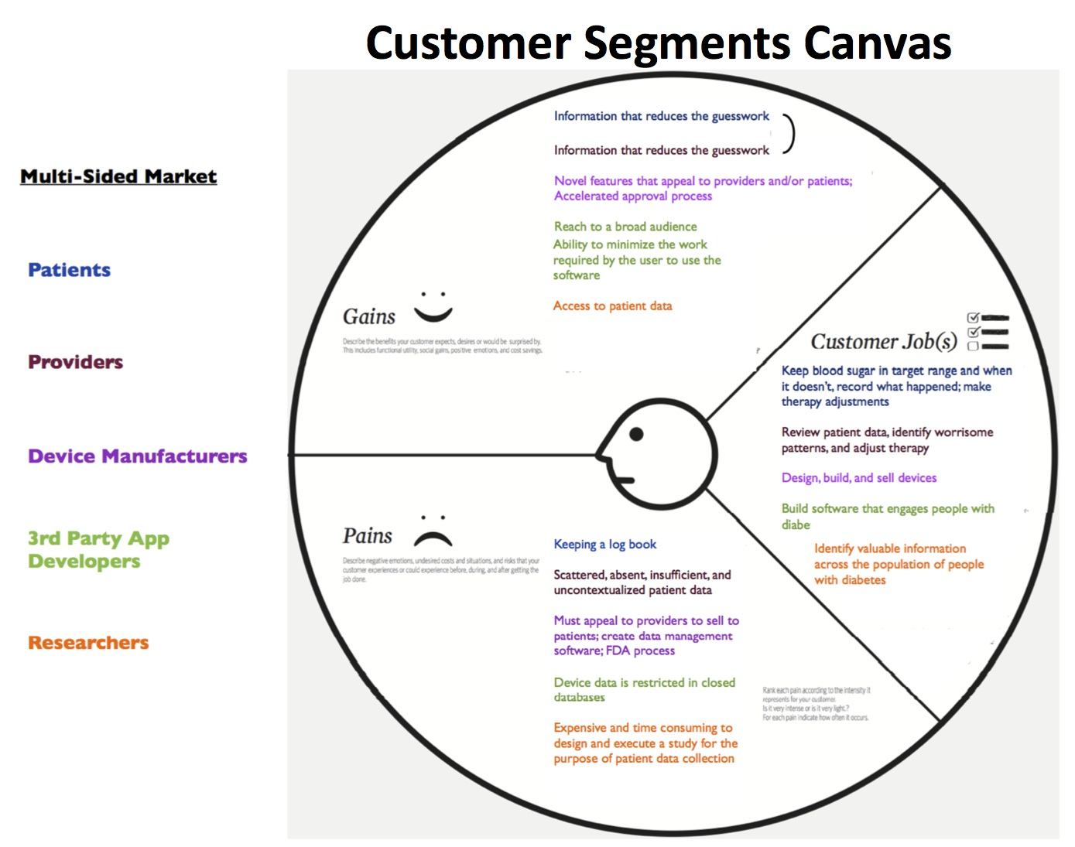

Slide 11
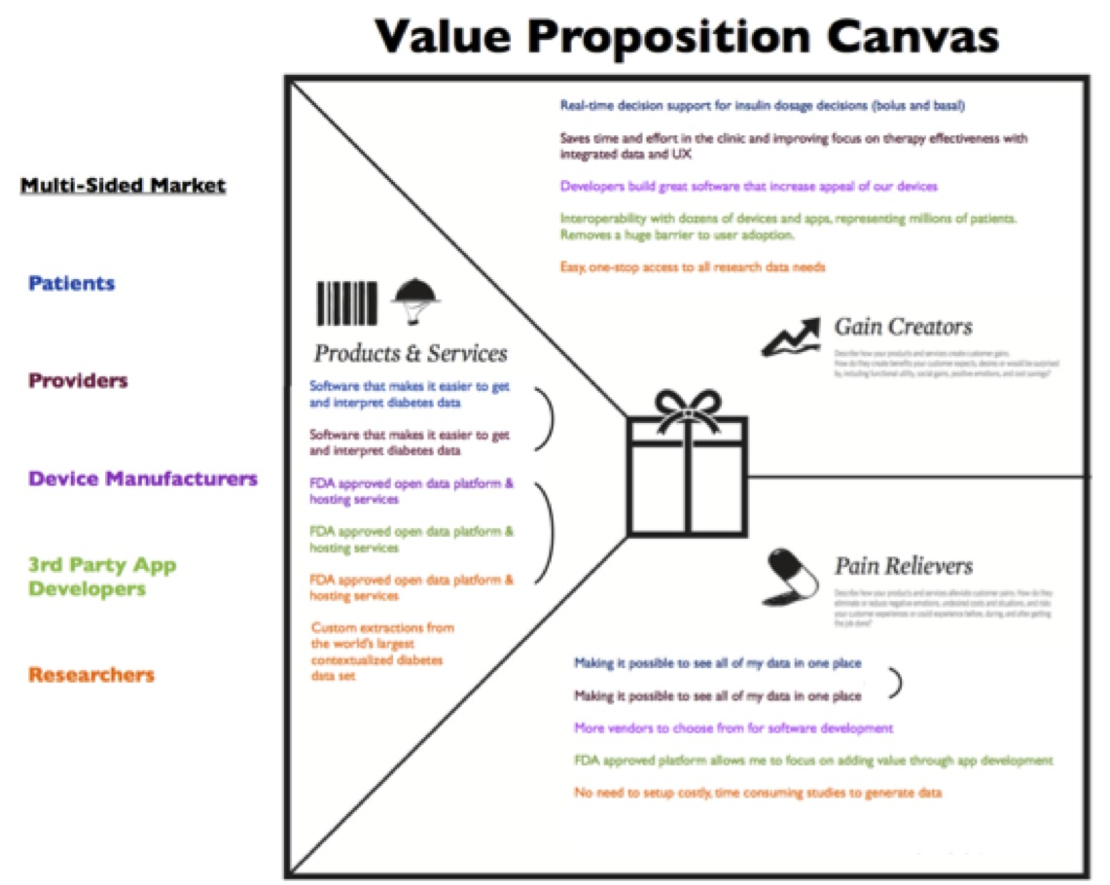

Slide 12
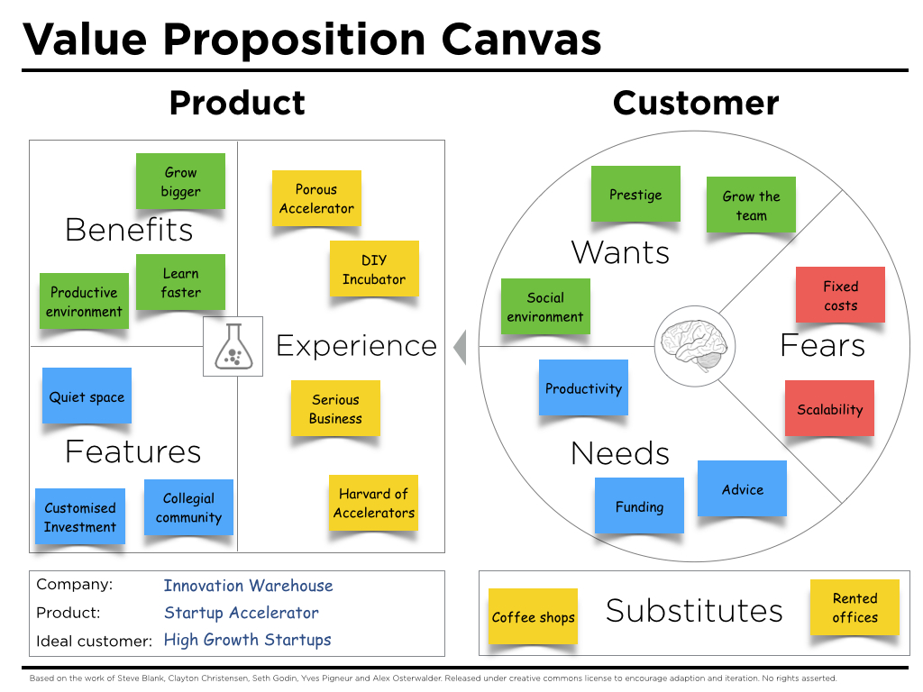

Slide 13
Value Proposition Mistakes
Below is a list of common student errors within the LLP course regarding their understanding of the value proposition
Most teams start with a Value Proposition equal to the feature set.
Confusing product features with pains and gains.
Forgetting to understand what pains their Value Propositions are solving, what gains they are creating:
Not articulating pain-killers, gain creators, and their idea of what their MVP should be.
What is the MVP required to prove the validity of their Value Proposition hypotheses?
Not enough customer calls.
No hypothesis testing, just demos or product pitches to potential customers.
Did not articulate experiments to test their hypotheses.
Did not articulate pass/fail tests for each hypothesis.
Vague data from the calls.
Little to no insight derived from the data.

