Slide 1
Patterns of Project Sharing in Scratch
COM 521 Project - Emilia Gan

Slide 2
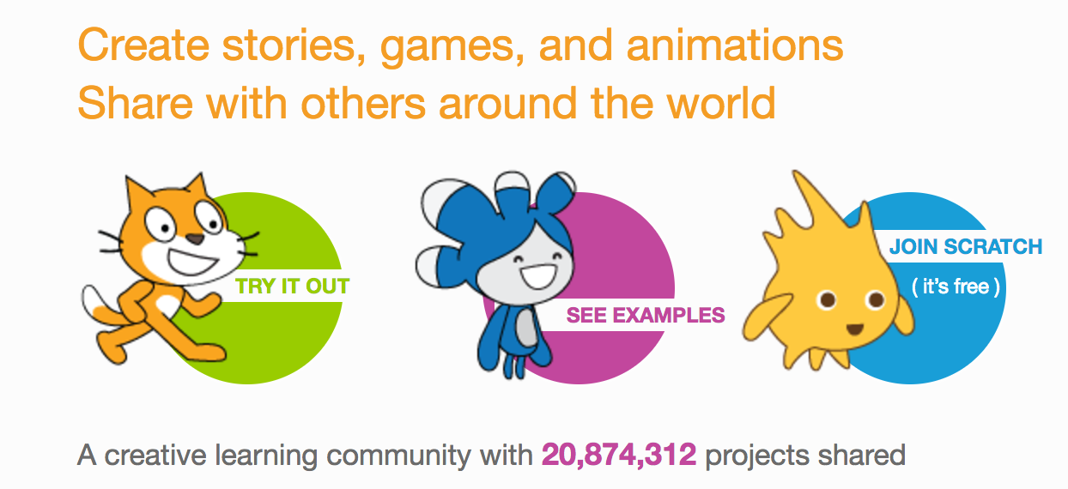
What is Scratch?
Lifelong Kindergarten Group at the MIT Media Lab
Online social programming platform
Designed especially for ages 8 to 16
Block language
https://scratch.mit.edu/projects/149776015/

Slide 3
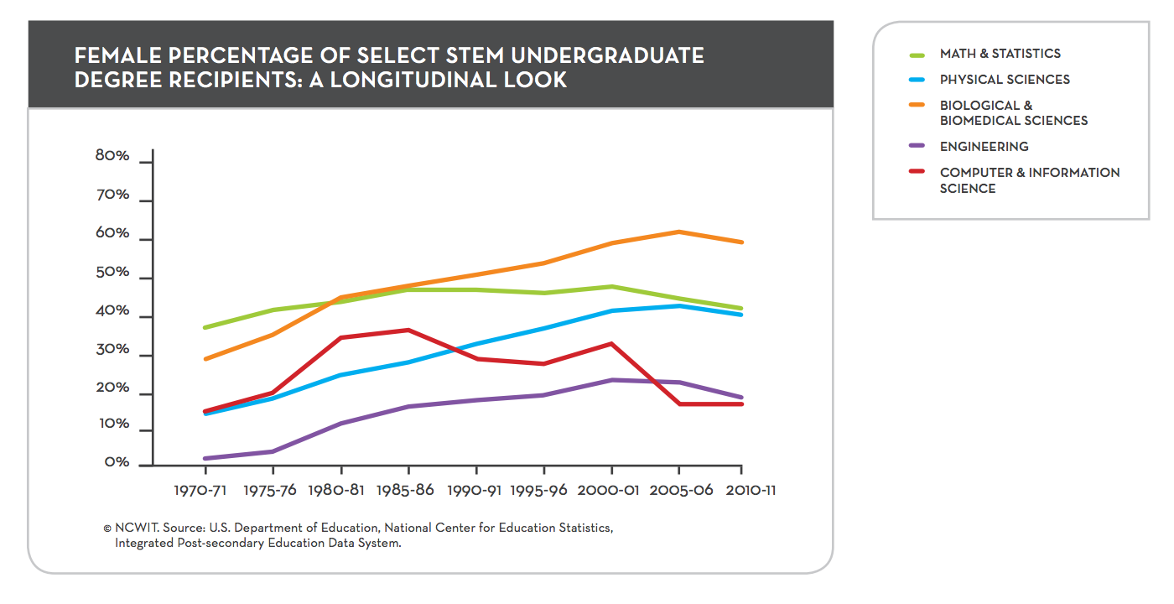
Background & Motivation

Slide 4
Possible Outcomes After Creating a Project
Scratch Projects
Not Completed
Completed
Not Shared
Shared
Comments/Feedback Absent
Comments/Feedback Present
No Constructive Criticism
Tone Negative
Tone Positive
Contain Constructive Criticism
No Constructive Criticism
Contain Constructive Criticism

Slide 5
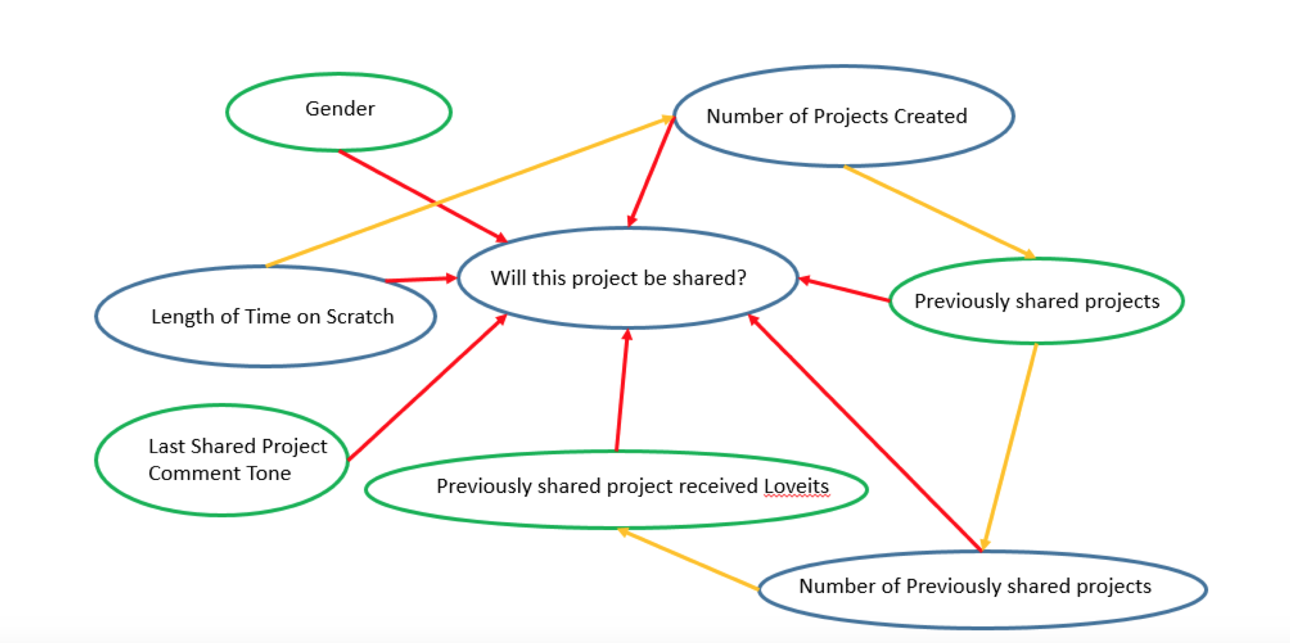
Factors Potentially Affecting Sharing

Slide 6
Research Questions
Are there differences in the pattern of Scratch project creation and sharing between male and female users of the Scratch online programming platform?
Is there a difference in the frequency of receiving peer feedback between projects created by female users and projects created by male users?
Does receiving peer feedback (e.g. love-its and comments) affect the future sharing behavior of the project creator?

Slide 7
Null Hypotheses
Projects created by females are just as likely to be shared as projects created by males.
Projects created by females are just as likely to receive peer recognition as projects created by males.
Scratchers whose shared projects receive no peer recognition are just as likely to share future projects as are Scratchers whose earlier shared projects did receive peer recognition.
Female Scratchers whose shared projects receive no peer recognition are just as likely to share future projects as are male Scratchers whose shared projects receive no peer recognition.

Slide 8
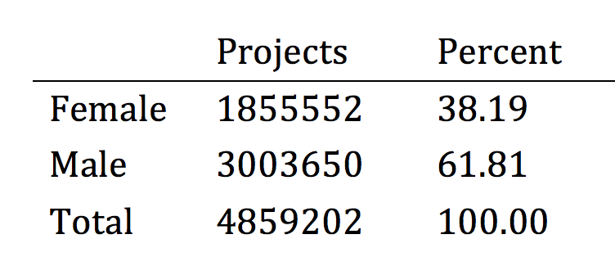
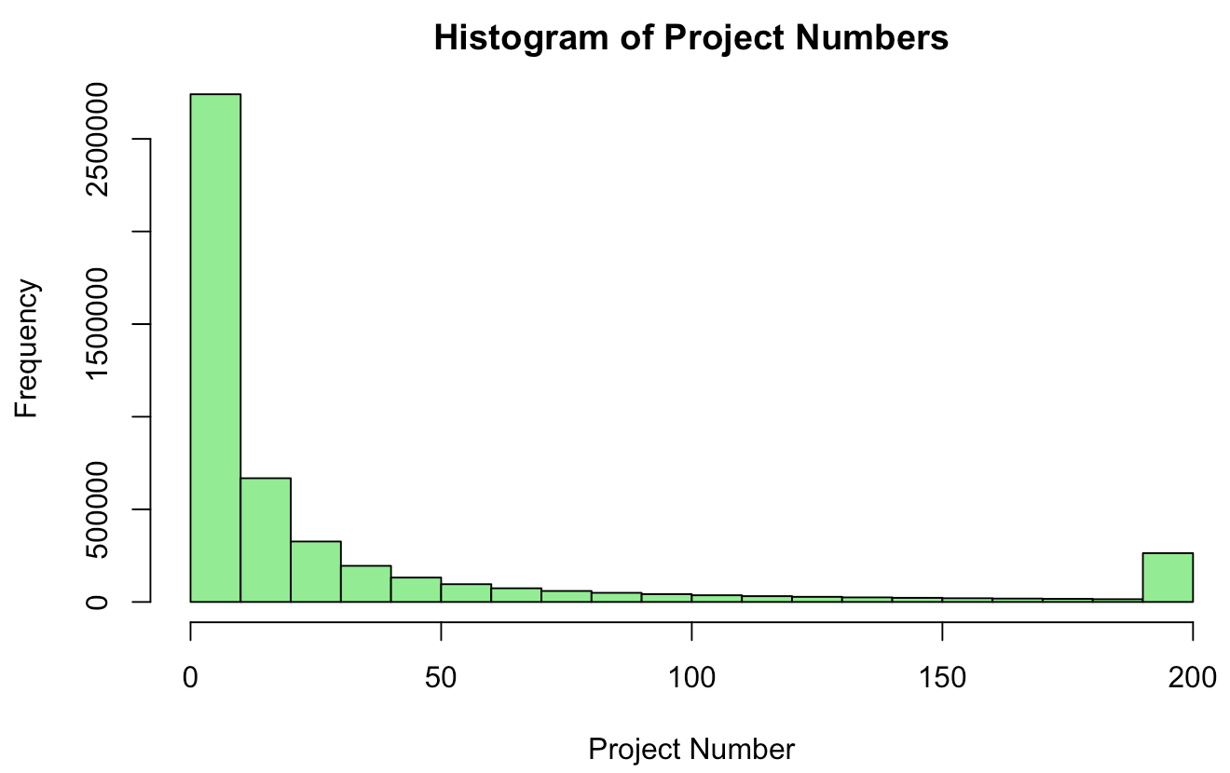
Data Set
Random selection of ~ 871 K users
4.86 MILLION projects

Slide 9
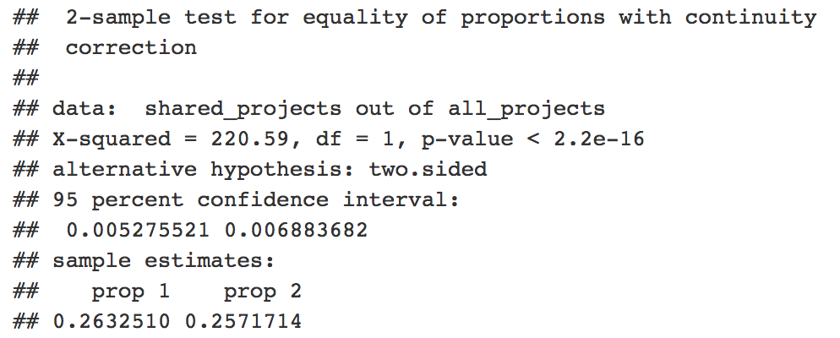
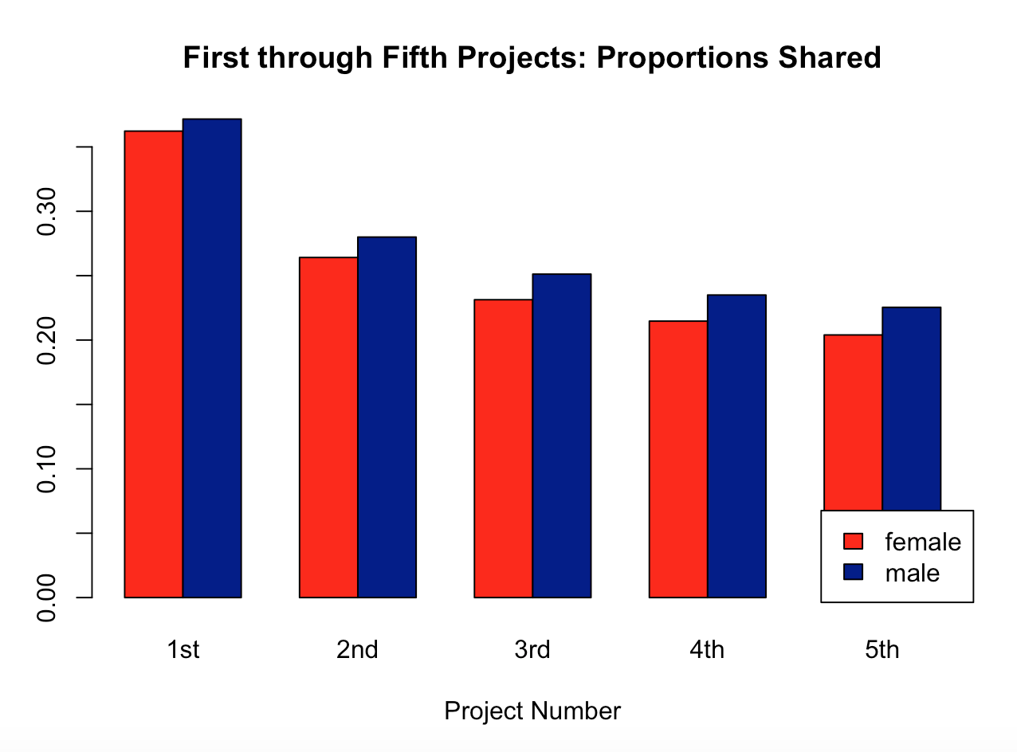
Exploring the Data: First 5 Projects
Project Sharing by Gender
At some point, females begin to share with greater likelihood than males

Slide 10
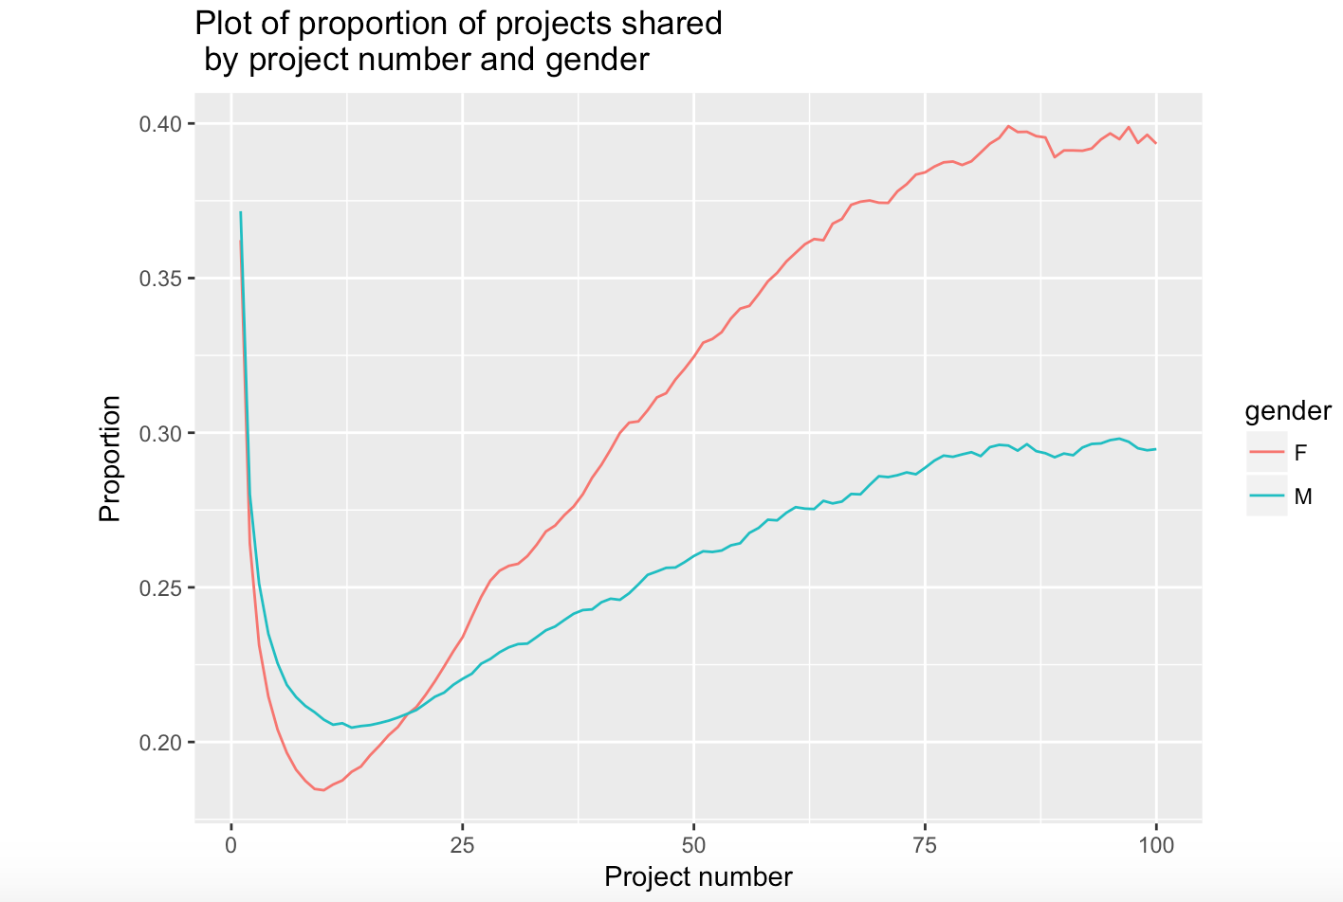
Exploring the Data: Looking at a Longer Trend
Crossover occurs
at
20 projects

Slide 11
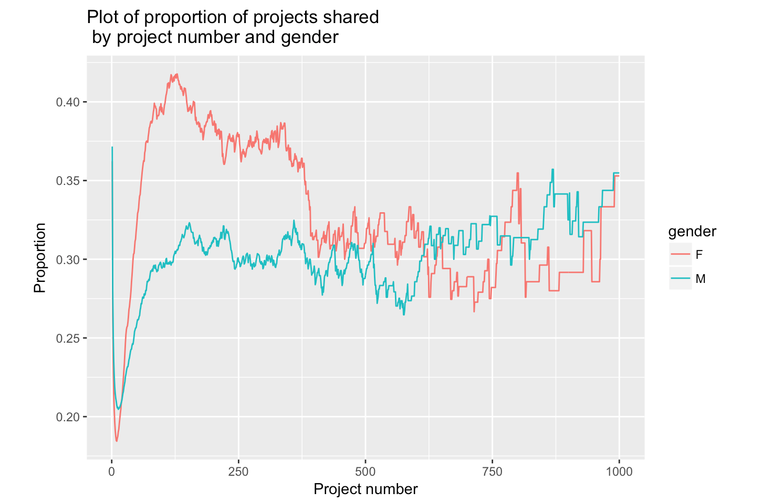
Exploring the Data: And even further on…
Greater sharing by females persists from 20 to >300 projects

Slide 12
Hypothesis Testing: Hypothesis 1
Projects created by females are just as likely to be shared
as projects created by males.
Y = ln(p-hat/(1 - p-hat))
Y = -0.96 - 0.18 FEMALE - 0.044log(PREVIOUS) + 0.09 (FEMALE:log(PREVIOUS))
boy, no projects: 0.2768 girl, no projects: 0.2423204
boy, 3 projects: 0.2689414 girl, 3 projects: 0.2516183

Slide 13
Hypothesis Testing: Hypotheses 2 - 4
2) Likelihood of receiving peer recognition (Love-its)
Y = -3.57 - 0.19 FEMALE + 1.17 log(PREVIOUS)
3) Likelihood of sharing
Y = -0.51 - 0.57 log(PREVIOUS) + 0.7 log(LOVE)
4) Likelihood of sharing
Y = -0.62 - 0.17 FEMALE - 0.66 log(PREVIOUS) + 0.48 log(LOVE) + 1.2 PREV.LOVE + 0.18 (FEMALE:PREV.LOVE)

Slide 14
Conclusions and Future Directions
Original assumption that females share less frequently than males was true for low numbers of created projects, but dramatically false beyond 20 projects
Original assumption that females are more sensitive to peer recognition appears to have some validity -- will be looking into this further
Want to examine patterns of persistence on Scratch platform

