Slide 1
TLC for Dummies
How WiFi firmware picks the fastest reliable speed — in plain English
Transmit Link Control • Rate Scale Manager • 2026

Slide 2
What is TLC?
Think of a driver choosing a gear
The problem
WiFi can send data at many speeds. Fast speeds need a clean, strong signal. If the signal is weak, fast data gets lost and must be re-sent — which is slower.
What TLC does
TLC is the “auto gearbox” of WiFi. It constantly watches how many packets get through and shifts the speed up or down to stay fast AND reliable.
The golden rule
Send as fast as possible — but only as fast as the link can reliably carry.
🚗 Driving analogy
Open road (strong signal)
→ high gear, go fast (high MCS, MIMO)
Traffic / hills (weak signal)
→ low gear, stay safe (low MCS, SISO)
Skidding (packets lost)
→ shift down immediately

Slide 3
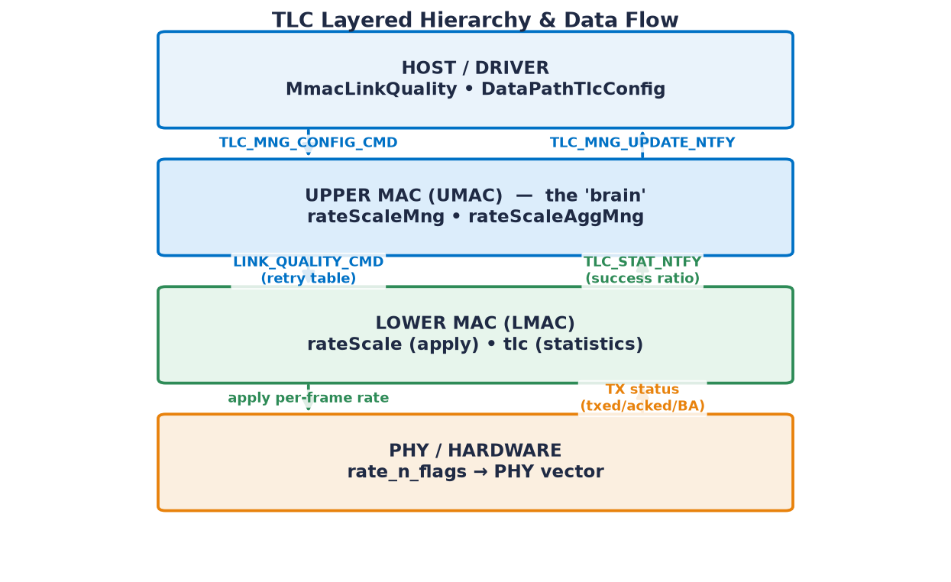
Who does what?
Four layers working together
Driver — tells TLC what the device can do
Upper MAC (the brain) — decides the speed
Lower MAC — applies the speed & counts wins/losses
PHY / Radio — actually transmits
Control flows down ⬇, results flow back up ⬆.

Slide 4
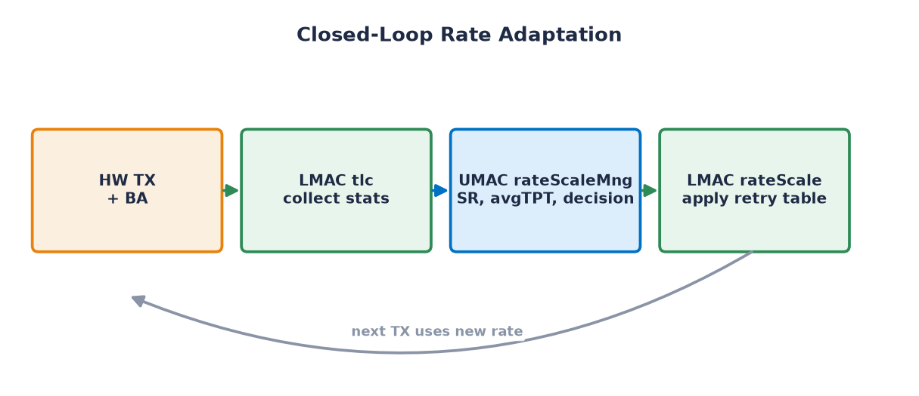
The magic: a feedback loop
Try → Measure → Adjust → repeat
Every time a batch of packets is sent, TLC checks how many were acknowledged, recalculates the Success Ratio, and re-tunes the next transmission. This repeats thousands of times per second.

Slide 5
What TLC watches (Inputs)
Mostly one number rules them all
⭐ Success Ratio (SR) = packets acknowledged ÷ packets sent
Like a mail carrier tracking “how many letters were delivered vs. sent.” High SR = link is healthy = try faster. Low SR = slow down.
Success Ratio
PER
RSSI / SNR
Timers
0-100%
= 100% - SR
signal strength
~10 s idle
how many got through
how many were lost
helps pick a start speed
re-check even when quiet
Refresh: every ~20 packets normally; only every ~2000 once locked on the best speed (saves power).

Slide 6
What TLC decides (Outputs)
The recipe for each transmission
Speed (MCS)
Streams (NSS)
Bandwidth
how dense the data is
1 lane (SISO) or 2 (MIMO)
20 - 320 MHz road width
Guard Interval
TX Power
Aggregation
gap between symbols
turn down when close
bundle packets together
All of these are packed into one number called rate_n_flags that the radio understands, plus a retry table (plan B, C, D…).

Slide 7
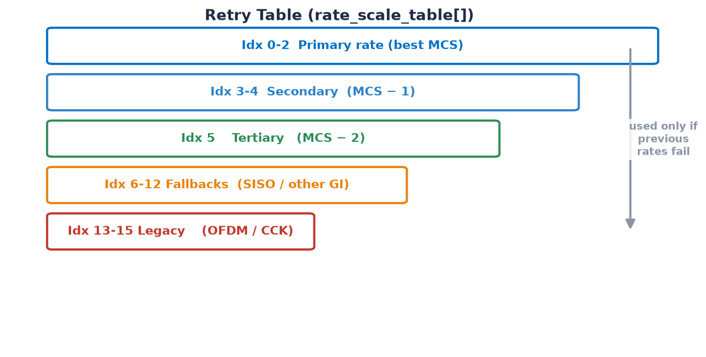
Plan B, C, D… the Retry Table
If the fast speed fails, fall back instantly
Why?
If the best speed fails for a packet, the radio doesn’t give up — it instantly retries at a slower, safer speed.
Top of ladder = fastest
Bottom of ladder = most robust (legacy)
This keeps data moving even during a quick fade, before the algorithm reacts.

Slide 8
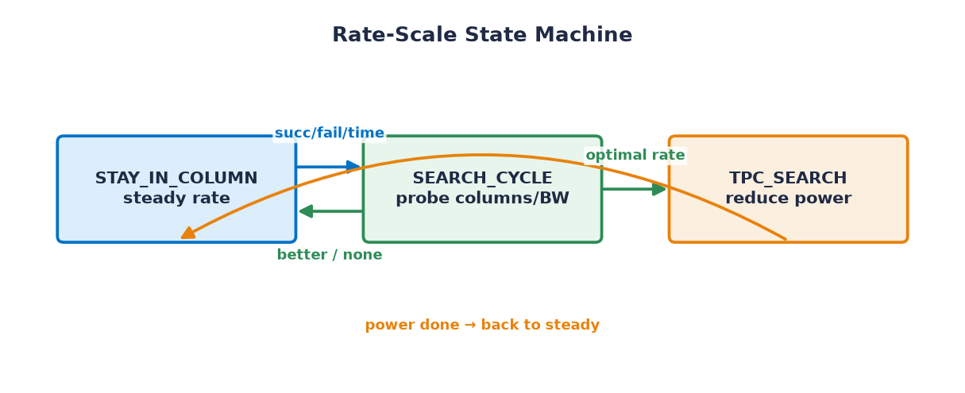
TLC's three moods
Cruise • Explore • Save power
STAY (cruise)
SEARCH (explore)
TPC (save power)
Happy on a proven speed. Small nudges up or down.
Curious — tries other speeds/widths to find something better.
At top speed already — now trims TX power to save energy.

Slide 9
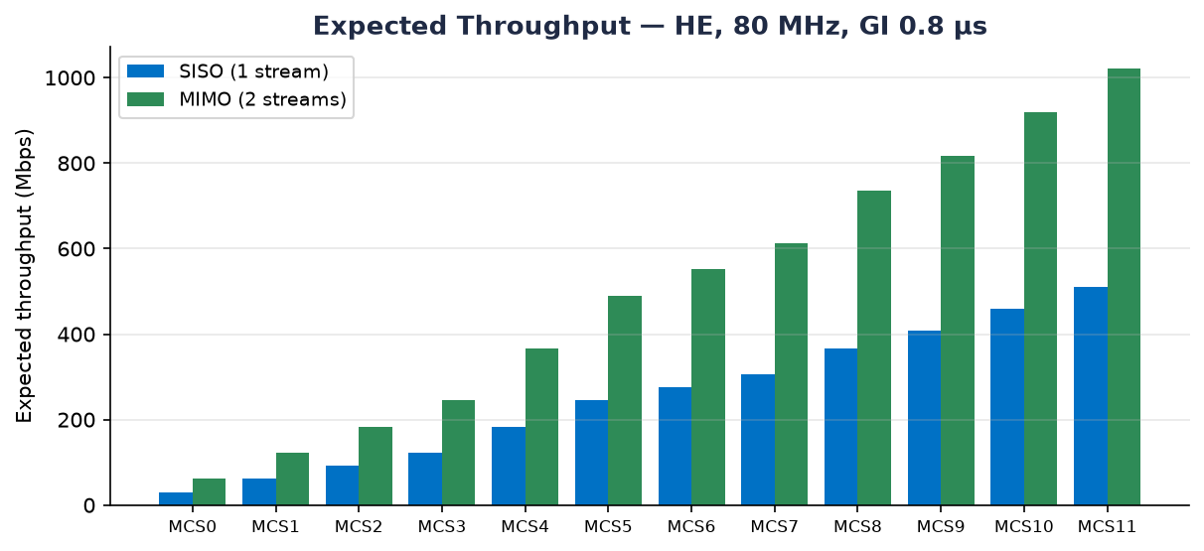
Faster settings = more throughput
Real firmware numbers (HE, 80 MHz)
Higher MCS and 2 streams (MIMO) roughly double the speed — but need a cleaner signal. TLC climbs this chart only as far as the link allows.

Slide 10
Cheat sheet: the numbers that matter
95%
“Perfect” success ratio — above this, never slow down
90% / 15%
No-decrease / force-decrease thresholds
94% / 50%
Turn A-MSDU bundling on / off
200 ms
Minimum time between speed-up attempts
20 → 2000
Packets between checks (normal → locked on best)
2 dB
Power back-off step when saving energy (TPC)

Slide 11
🎮 Now play with it!
Open tlc_playground.html in any browser.
Drag the signal-quality slider and watch TLC choose the speed, width, streams, power and retry ladder — live.

