Slide 1

Microorganisms effects analysis
Efrat kohen, Guy Weintraub
Sagol School of Neuroscience,
Data Science Hackathon,
July 2020
[https://github.com/efratkohen/Project.git]

Slide 2
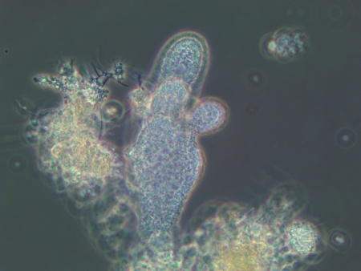
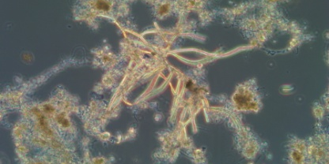
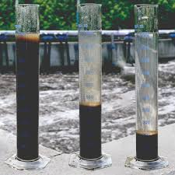
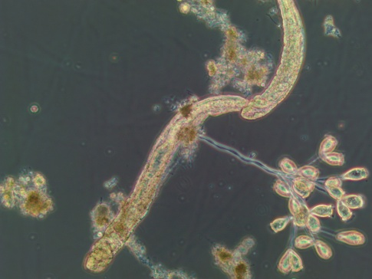
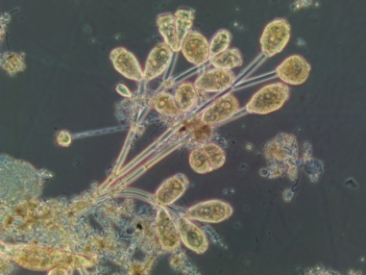
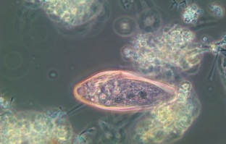
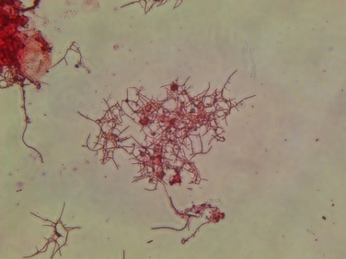
Project Goal
Create an application predicts SVI test from microscopic observation on microorganisms in activated sludge.
SVI test -> effluent quality
Fingered Zooglea
Branching fungi
Epistylis
Bristle worm
Blephrisma
Nocardia

Slide 3
Major Components
Component 1: files_process_save.py – [Guy and Efart] –
The files_process_save.py handles with data cleansing and split the data to 4 reactors. Then save new files in clean table folder.
Component 2: ml_prepare.py – [Guy] - preparing sutubale dataframes to the ML models with choosen delay hyper paramater and section of microorganisms
Component 3: supervised.py– [Efrat] –
The supervised.py runs two supervised models: LinearSVC and KNeighborsClassifier
Component 4: regression.py – [Guy] -
The regression.py runs 5 unsupervised regression models: need to add

Slide 4
Major Components - Flowchart
Clean data
microscope
Supervised
ML models
Files process
save
ML prepare
Regression
ML models
Clean data
SVI

Slide 5
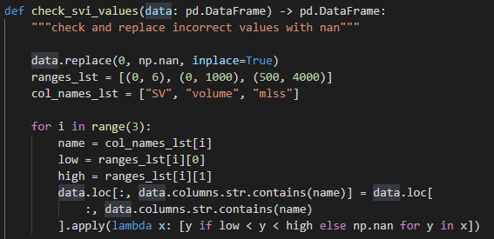
Files process save Features and Examples
The “Files process save” uplode 2 raw CSV data of SVI test and microorganisms observation. The files cleans incorrect values and split to 4 reactors.

Slide 6
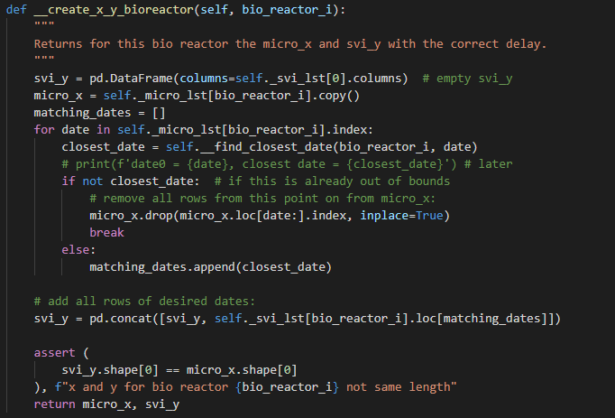
ML prepare Features and Examples
The “ML prepare” is a Class which prepar sutubale dataframes to the ML models with choosen delay hyper paramater and section of microorganisms

Slide 7
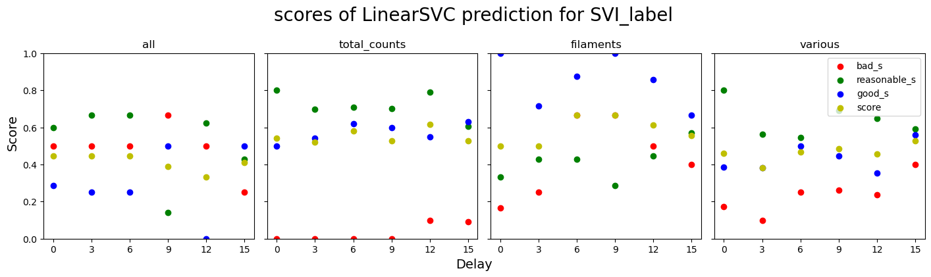
Supervised LinearSVC -
Supervised.LinearSVC.py runs the model and creates graph results which are saved in figures file.

Slide 8
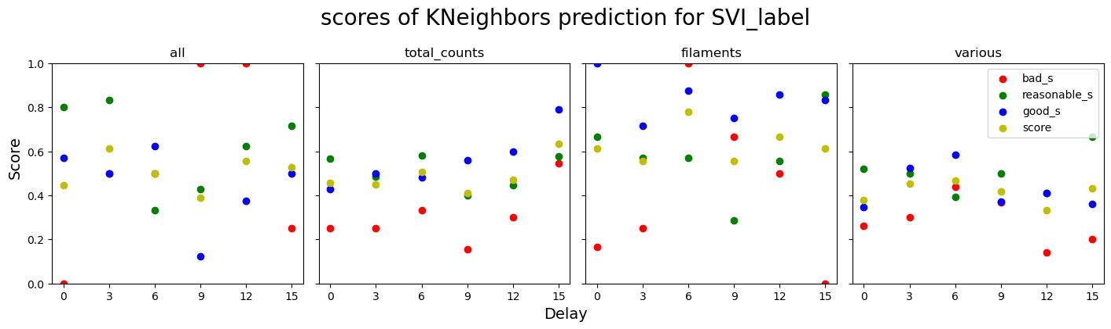
Supervised KNeighborsClassifie -
Supervised.Kneighbors.py runs the model and creates graph results which are saved in figures file. This model predict better by filaments data, SVI, and delay of 6 days

Slide 9
Regression Features and Examples
.

Slide 10
Main Challenges and Difficulties
Parsing the log file turned out to be a hassle. Finally we found a pip-installable library that…

Slide 11
Concluding Remarks
Is the project usable?
What’s left to do?
Run model who give back results of which organisms are the most influence.
Run the models we checked with spesipic microorgamisms and not not neccecerly by groups of microorganisms famalies as done in this project.

