Slide 1

Microorganisms effects analysis
Efrat kohen, Guy Weintraub
Sagol School of Neuroscience,
Data Science Hackathon,
July 2020
[https://github.com/efratkohen/Project.git]

Slide 2
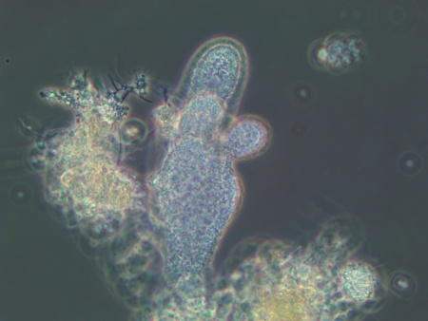
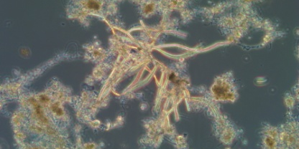
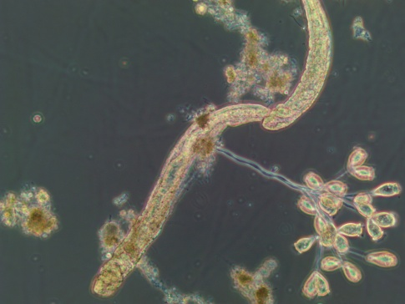
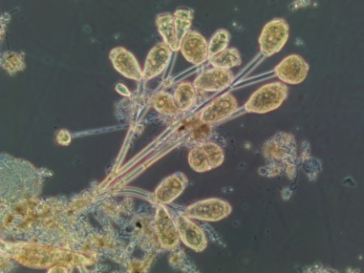
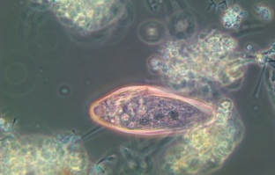
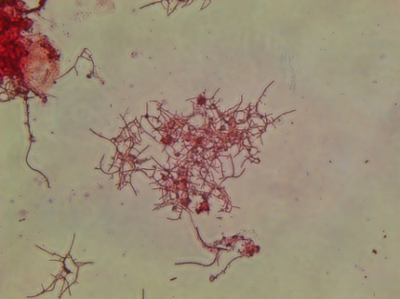
Project Goal
Create an application predicts SVI test from microscopic observation on microorganisms in activated sludge.
SVI test -> effluent quality
Need to add SVI an SV figure
Fingered Zooglea
Branching fungi
Epistylis
Bristle worm
Blephrisma
Nocardia

Slide 3
Major Components
Component 1: files_process_save.py – [Guy and Efart] –
The files_process_save.py handles with data cleansing and split the data to 4 reactors. Then save new files in clean table folder.
Component 2: ml_prepare.py – [Guy] - preparing sutubale dataframes to the ML models with choosen delay hyper paramater and section of microorganisms
Component 3: supervised.py– [Efrat] –
The supervised.py runs two supervised models: LinearSVC and KNeighborsClassifier
Component 4: regression.py – [Guy] -
The regression.py runs 5 unsupervised regression models: need to add

Slide 4
Major Components - Flowchart
Supervised
ML models
Files process save
ML prepare
Regression
ML models

Slide 5
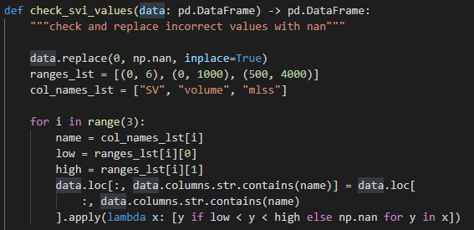
Files process save Features and Examples
The “Files process save” uplode 2 raw CSV data of SVI test and microorganisms observation. The files cleans incorrect values and split to 4 reactors.

Slide 6
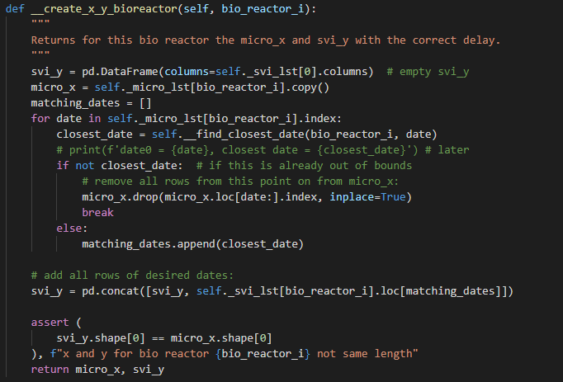
ML prepare Features and Examples
The “ML prepare” is a Class which prepar sutubale dataframes to the ML models with choosen delay hyper paramater and section of microorganisms

Slide 7
Supervised Features and Examples
The supervised runs two supervised models: LinearSVC and KNeighborsClassifier. The results are saved in figures file.

Slide 8
Regression Features and Examples
.

Slide 9
Main Challenges and Difficulties
Parsing the log file turned out to be a hassle. Finally we found a pip-installable library that…

Slide 10
Concluding Remarks
Is the project usable?
What’s left to do?

