Slide 1
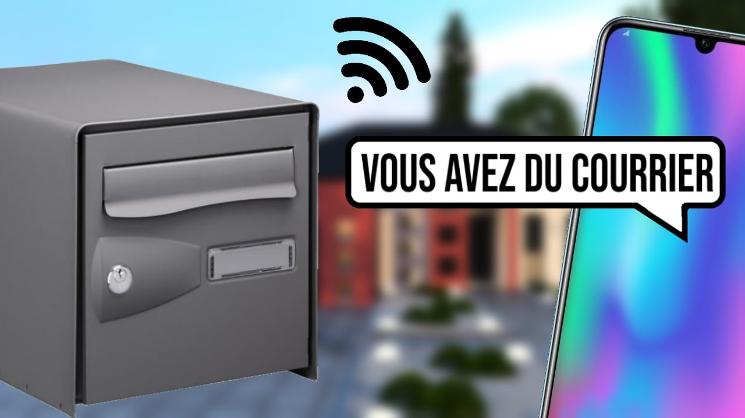
connected mailbox
Thierry NGANKOUE

Slide 2
Problem Definition
- Useless back and forth to an empty mailbox
- Not being aware when the postman has passed
- The phases of impatience and anxiety when we are waiting for a letter
- Do not know the type of mail posted

Slide 3
Project Summary
Develop a connected mailbox capable of sending a notification each time a new mail is deposited in the mailbox via a push notification system such as PushOver or Telegram and also send an email to a Gmail mailbox in order to 'to be further processed in the google cloud via google script.
The notification and email must include a photo of the inside of the mailbox.

Slide 4
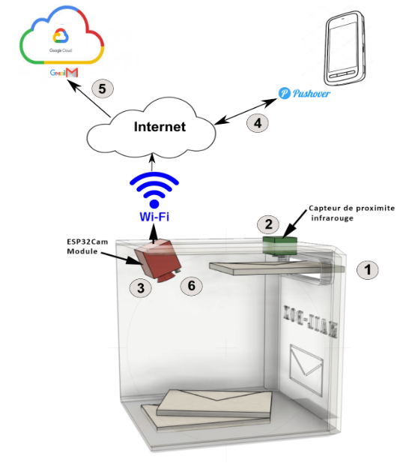
Technical Description

Slide 5
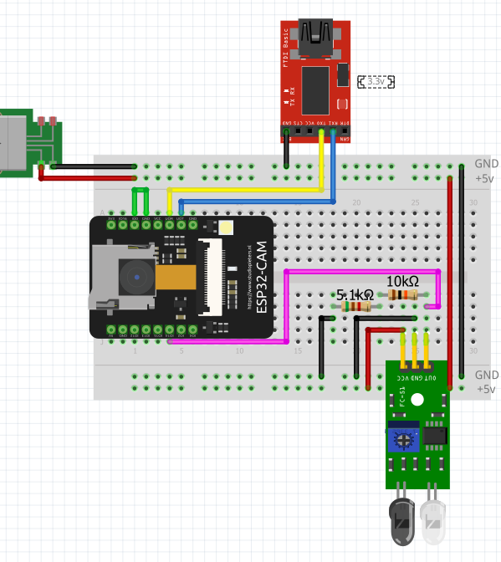
Schematic

Slide 6
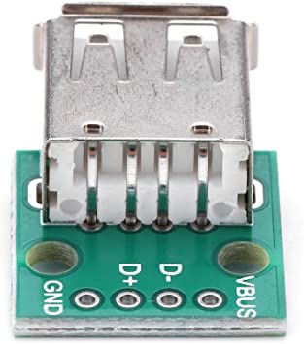
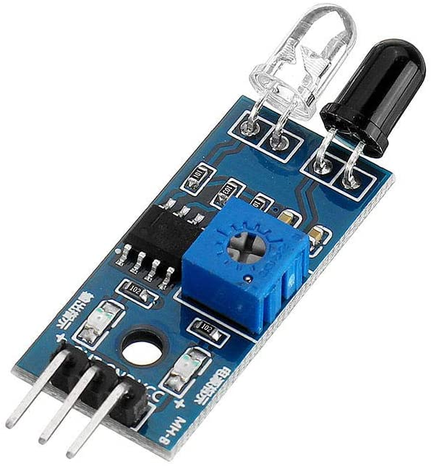
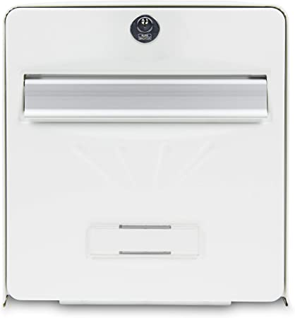
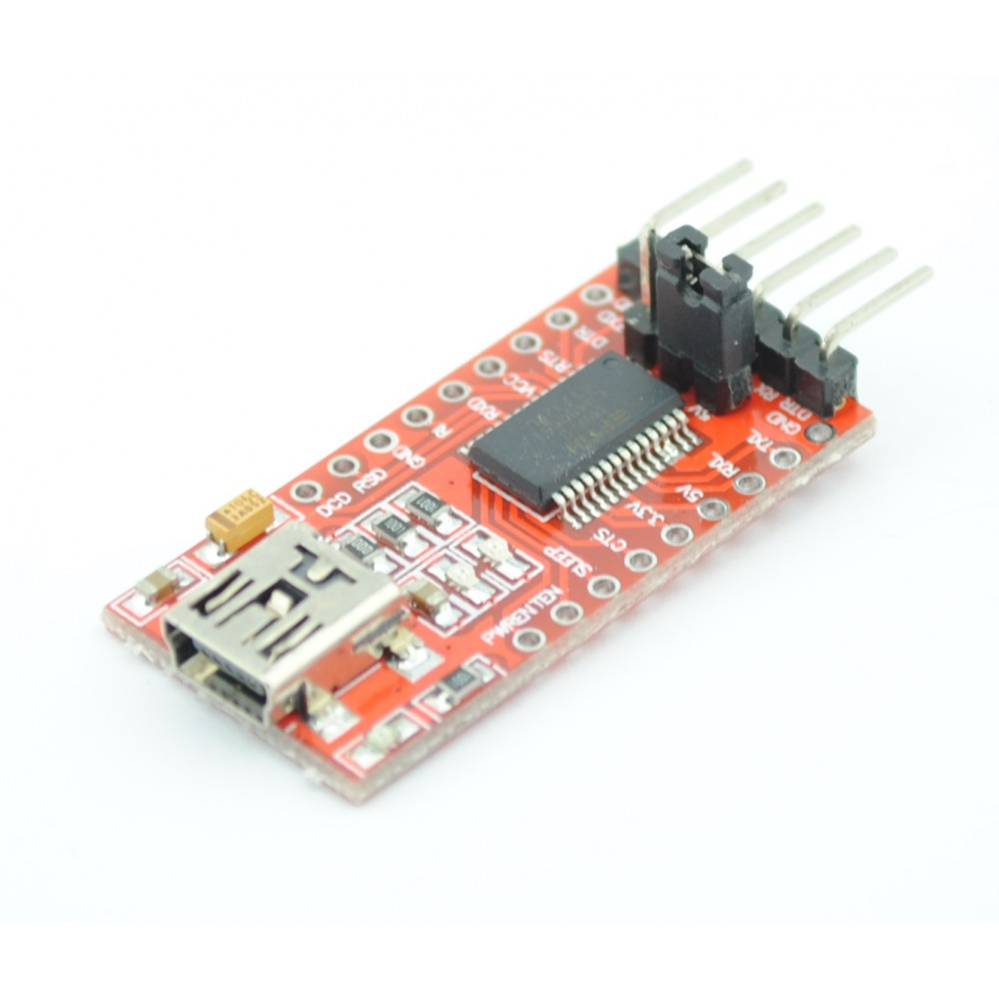
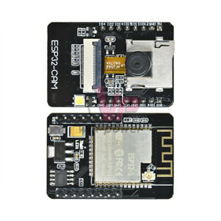
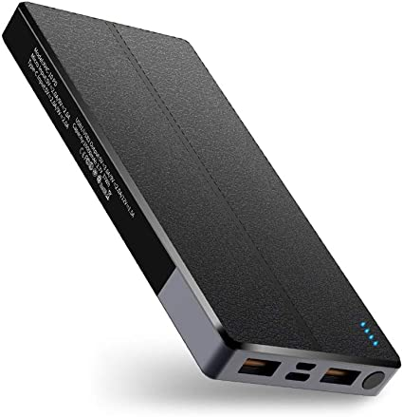
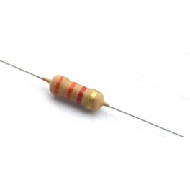
Matrials

Slide 7
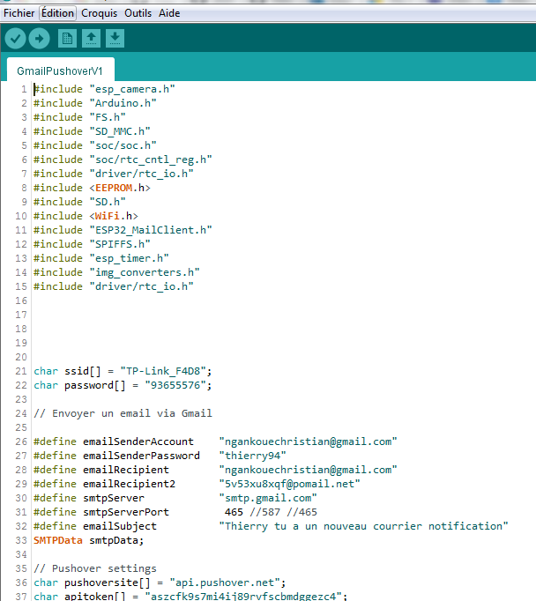
Codes

Slide 8
Difficulty
Materiel
Code

Slide 9


Thank's

