Slide 1
INTERNET OF THINGS PROJECT
January 2020
Make Tomorrow Better
Professor: HAMIDI, Massinissa
Students:TOUIHRI, Emna
BEN HLAL, Hatem

Slide 2
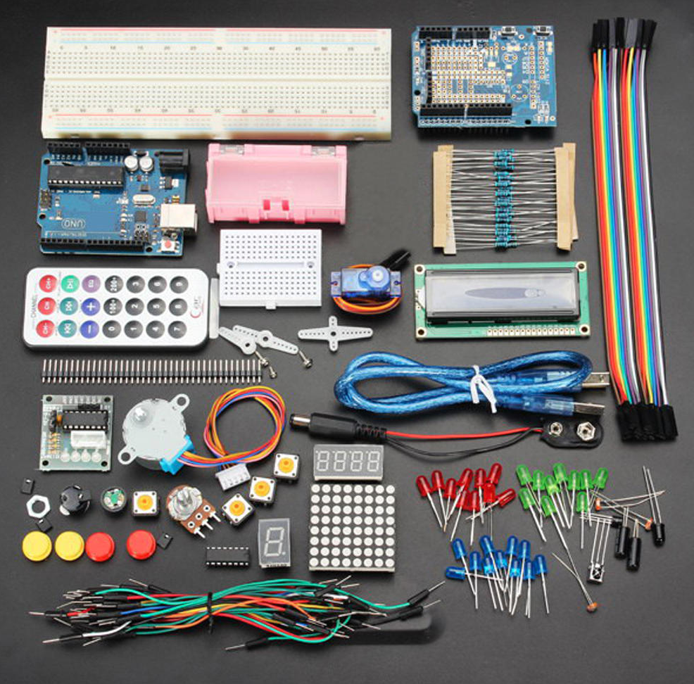
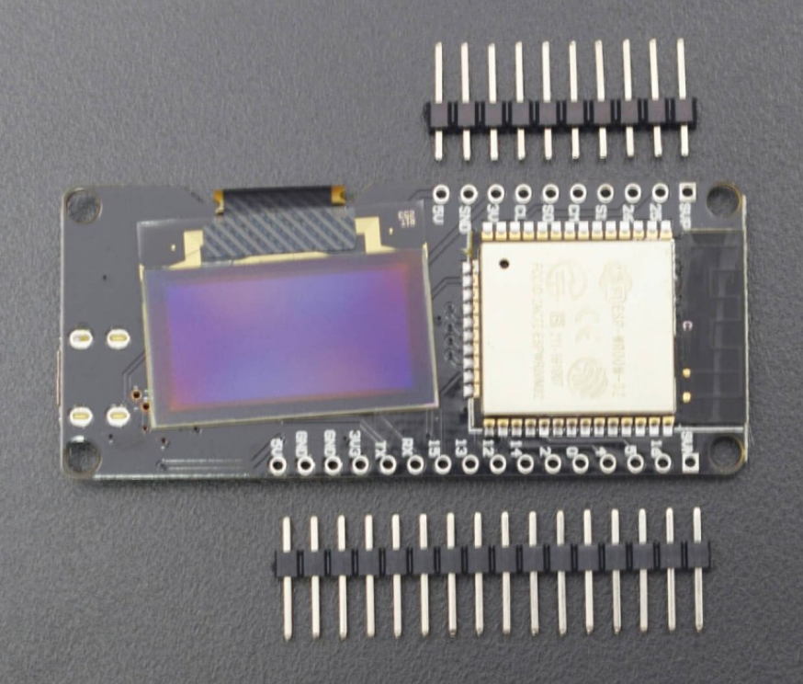
List of components
Arduino kit
ESP WROOM-32

Slide 3
Project description
- Connecting Arduino UNO to internet throm ESP32
- Showing real time data ( Temperature, Light level …)
- Commanding connected devices throw the internet ( Turn off/on light … )

Slide 4
Advantages
- A cost-effective solution to control devices through internet
- User can access and edit real time data from the connected devices
( Temperature, Humidity, Power Consumption ) and perform actions ( Turn on, Turn OFF )

Slide 5
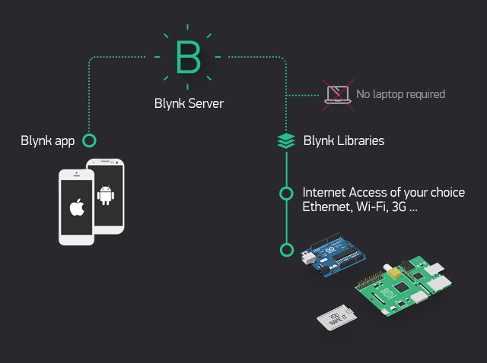

Slide 6
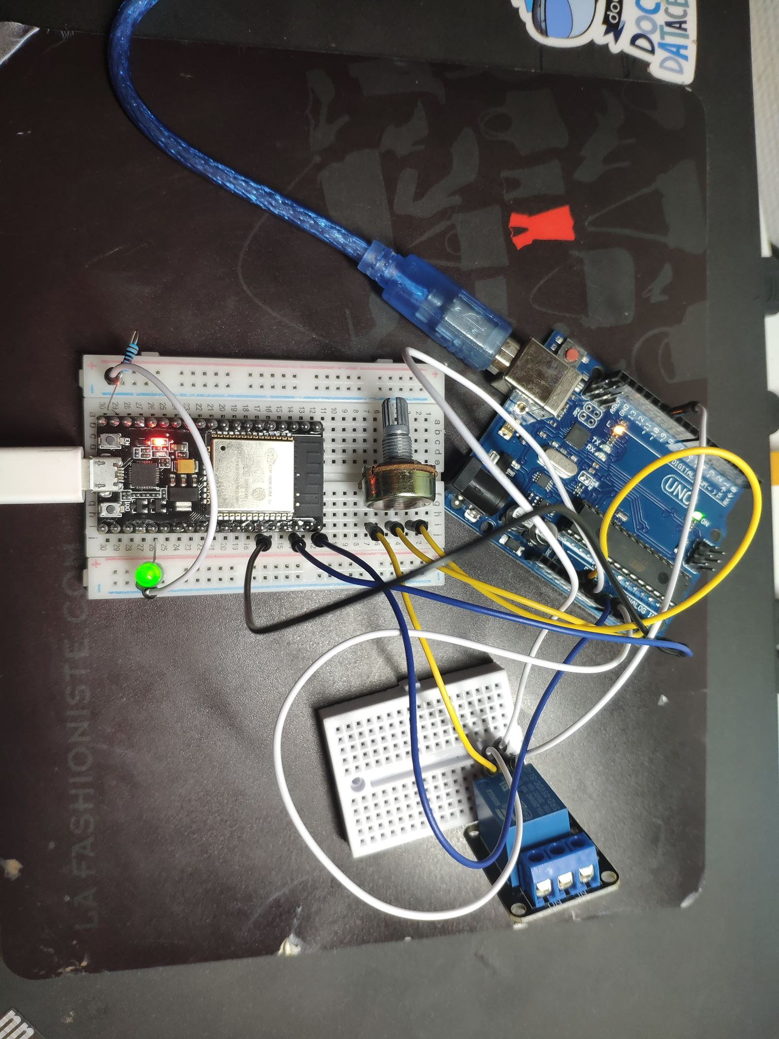

Slide 7
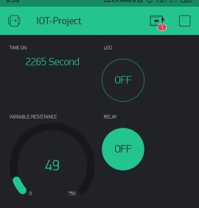

Slide 8
