Slide 1

Presentations of Project IOT
Anti-theft device
Introduction to the Internet of Things
YIN Jiazhong
LU Mingming
CHARAI Hamaza
2
0
1
9

Slide 2
/01
Description of the device

Slide 3

Background of the project
Many students, especially foreign students, choose share rent. This way is cheaper and more suitable for students. But this approach has a lot of security issues. For example burglary. Find ways to solve it. We will eventually design a complete home anti-theft device to make our home safer.

Slide 4
Idea of this project
As we said before,this modules made with ARDUINO and to use ultrasonic ranging to read one data every 0.5 seconds and compare the difference between the two data. If the difference between the two data changes is more than 30%, an alarm will be issued, and the buzzer will sound, and the mobile phone APP will receive the signal.

Slide 5
Materials
Ultrasonic
module
Buzzer
WIFI module
first part
second part
last part

Slide 6
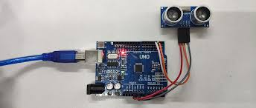
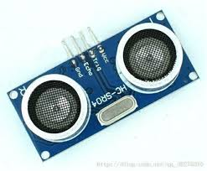
Ultrasonic module
The principle of ultrasonic ranging is to emit sound waves, the sound waves are reflected by the object, the module receives, the time difference is obtained, and then the object distance is calculated according to the sound speed.

Slide 7
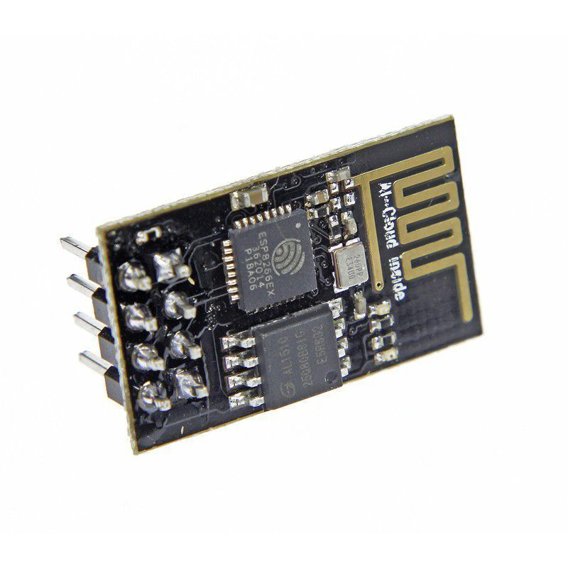
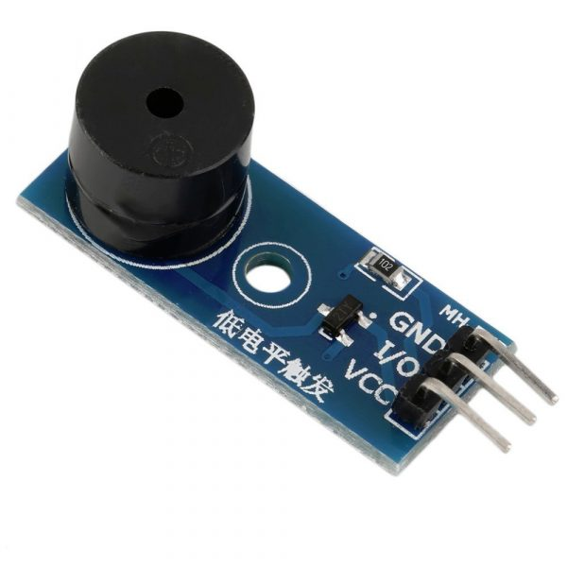
Materials
WIFI module(ESP 8266-01)
Active buzzer

Slide 8
How does it work?
/02

Slide 9
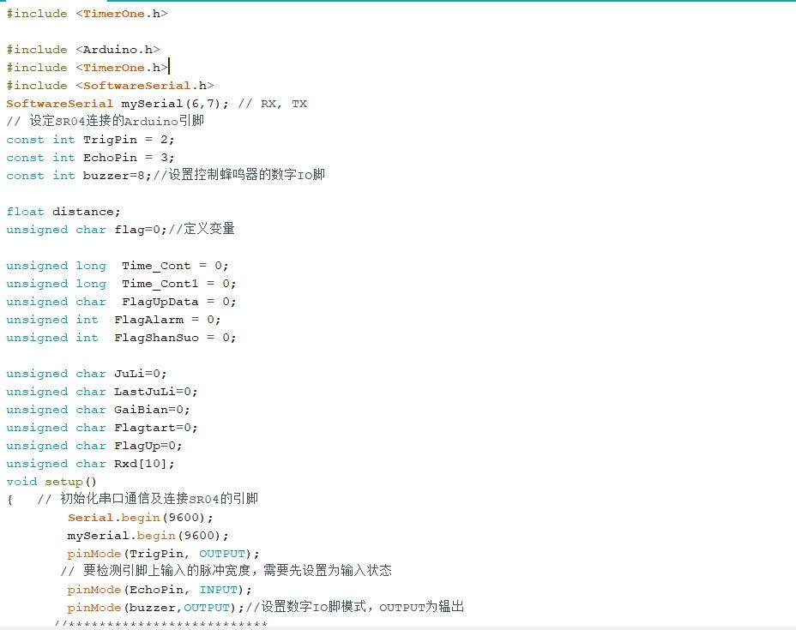
Coding

Slide 10
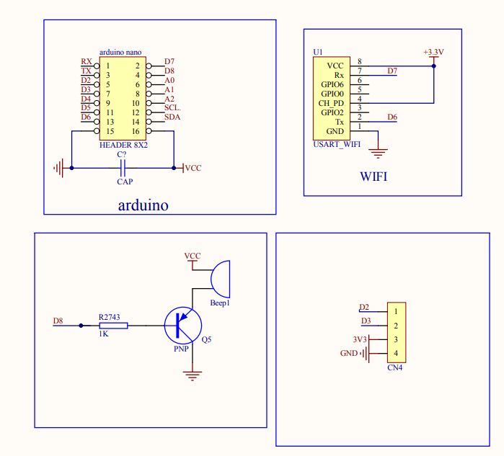
Schematic

Slide 11
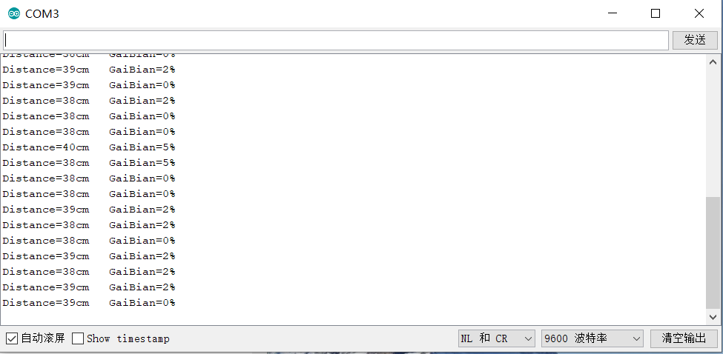
Ultrasonic module
The ultrasonic module can derive the distance of the object. We put the device in the room. This distance is fixed. Once this distance has changed a lot in a short time, the entire device will alarm

Slide 12
Conclusion
/03

Slide 13
Conclusion
To conclude, we can say that with more time and more means we could have done a better work, whatever, we have developed a device that can guarantee more safety to those who have small budgets. Our device is reliable and cheaper than other devices on the market.

