Slide 1

Internet of things
Smart Lamp
-SUN YUDONG & KAMAL MIRI & kang jIANYI

Slide 2

Background
Light waste
Inappropriate light intensity

Slide 3
Ideas
Easy to Use
1.detect the people while coming in and coming out
2.adjust the brightness based on the current light
Save Energy
avoid many energies waste conditions(careless,unrealized..etc)

Slide 4
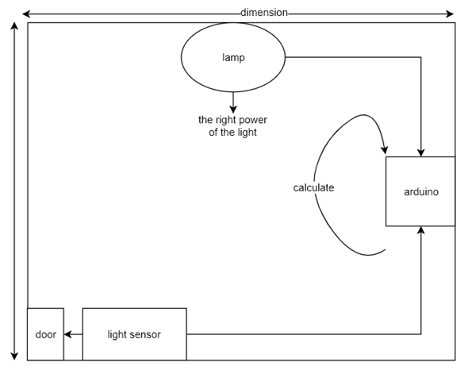
Our Product design

Slide 5
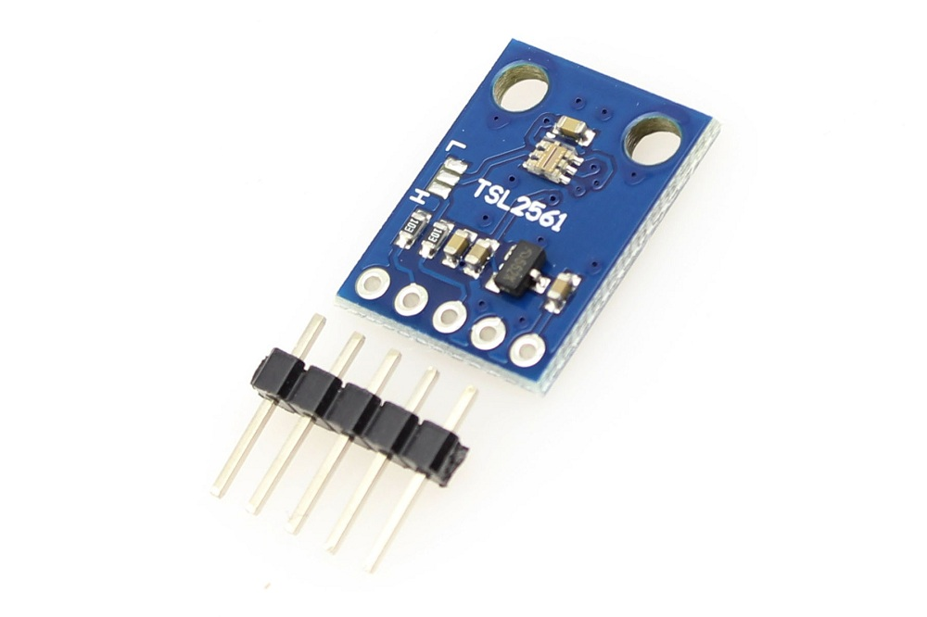
State of the art
Sensor- TSL2561
when the brightness change
this sensor may change the voltage

Slide 6
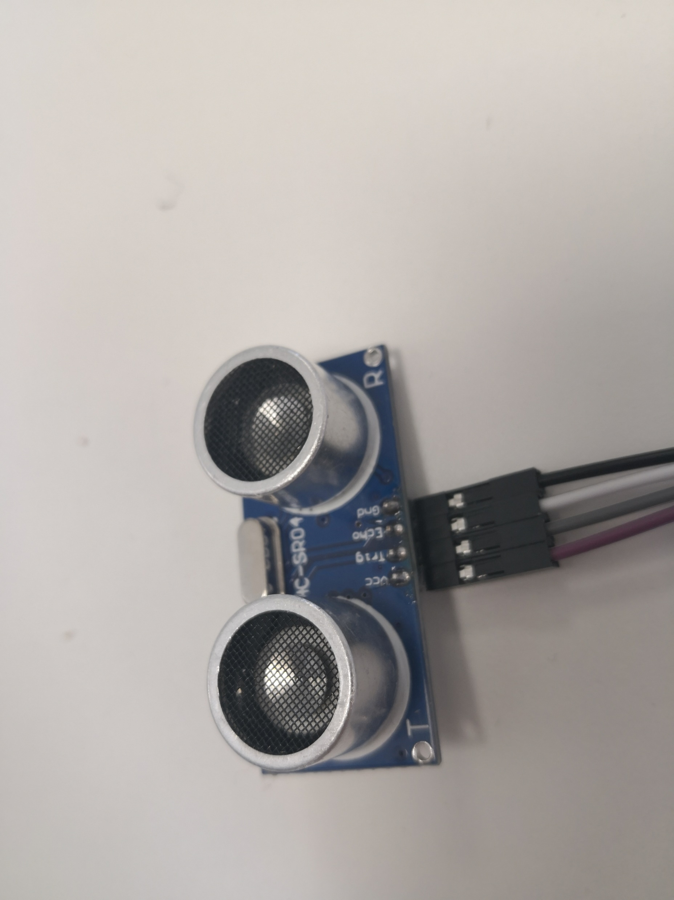
Sensor: HC-SR04
Detect person come in or come out

Slide 7
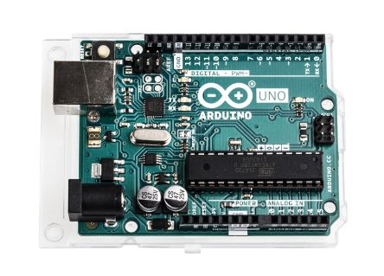
Arduino

Slide 8
Business Plan
1) Activity & Domain :
- there is a strong need of this type of products .
-Our product is sufficiently attractive to trigger an act of purchase.
- Our product concerns a large number of potential customers .
-this activity will generate a significant turnover and will be profitable.

Slide 9
2) Competition :
- proven or potential competitors are identified , such as :
- AwoX , european leader in connected lighting .
- PHILIPS.
- Xiaomi.
Prices :
- Philips Hue : 20 Euros.
- Xiaomi Yeelight : 25 Euros.
- TP-Link LB130 : 45 euros.

Slide 10
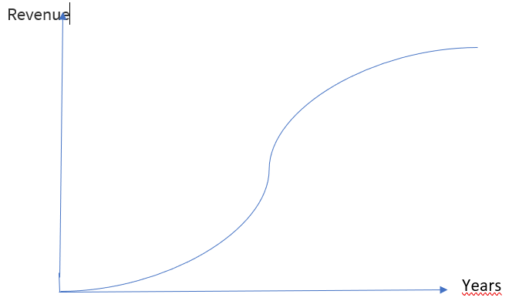
3) Profit's expectations :
- The price of our product will be around 12 euros .

Slide 11

Technical, Implement & Future Develop
Main design for HC-SR04
Loop:
Always detect 2 times.
Make a minus value of length
If the value is no more than 0
We infer that the person is coming in
1
2

Slide 12
Main Code
void loop() {
long cm1 = ping();
if( cm1 < 100){
delay(100);
long cm2 = ping();
long cm = cm2 - cm1;
if (cm < 0) { // person come in}
else{ //person come out}
}

Slide 13
Day & Night Changing
The solution instead of light sensor.
Detect daytime
Change the brightness according to the daytime
Problems: It can be hard to detect the daytime by Arduino itself.

Slide 14
Solution for the weather
Not yet
Solution for the Curtain
Add a switch to detect it.

Slide 15
Demonstration

