Slide 1
The PIllbox
Alexandre BONY
François HERVE
Charles ROBICHON

Slide 2
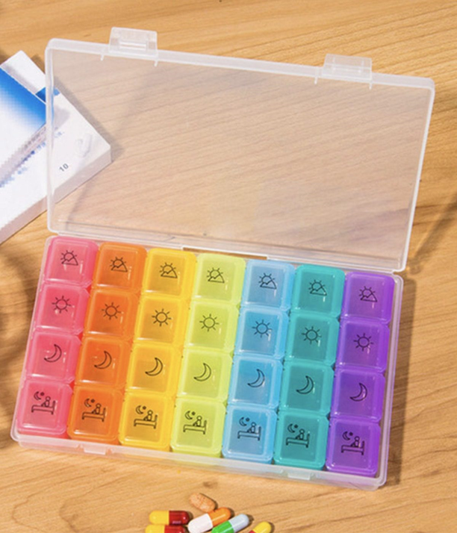
Goal of the project
Alarm and light signal to take the pills
Control if pill was taken
Alarm on the user’s smartphone

Slide 3
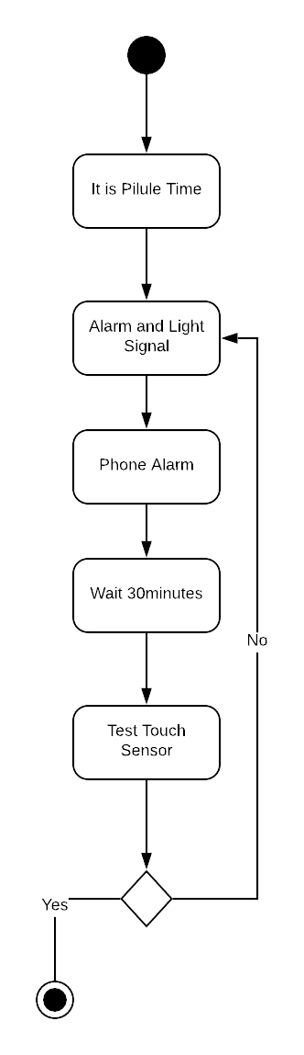
ACTIVITY DIAGRAM

Slide 4
Functions in detail

Slide 5
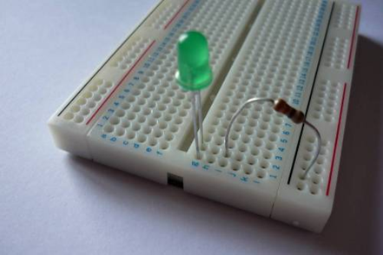
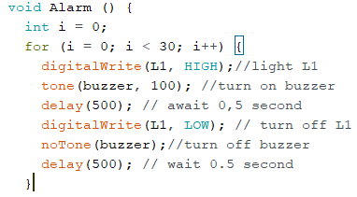
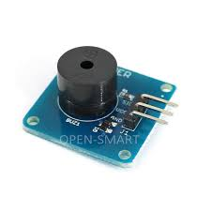
alarm and light signal
LED and resistance
Arduino speaker

Slide 6
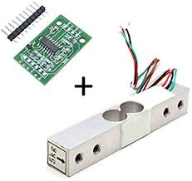
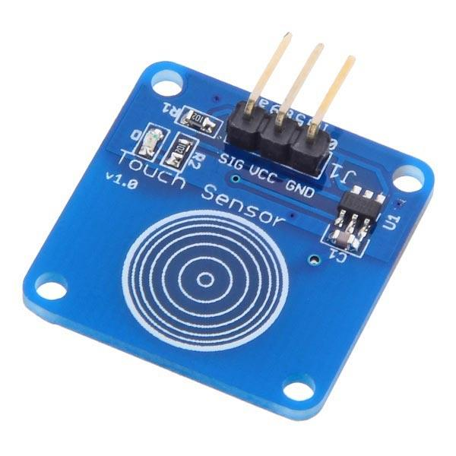
Controlling the pill was taken
Or
Weight measurement: Load Cell and HX711
Touch Sensor

Slide 7
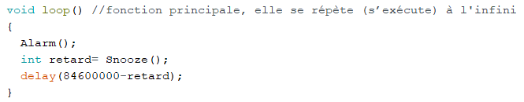
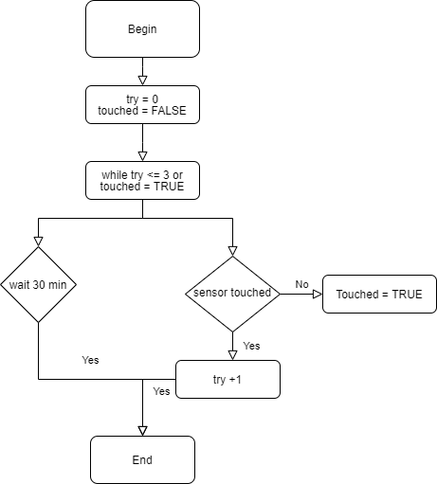
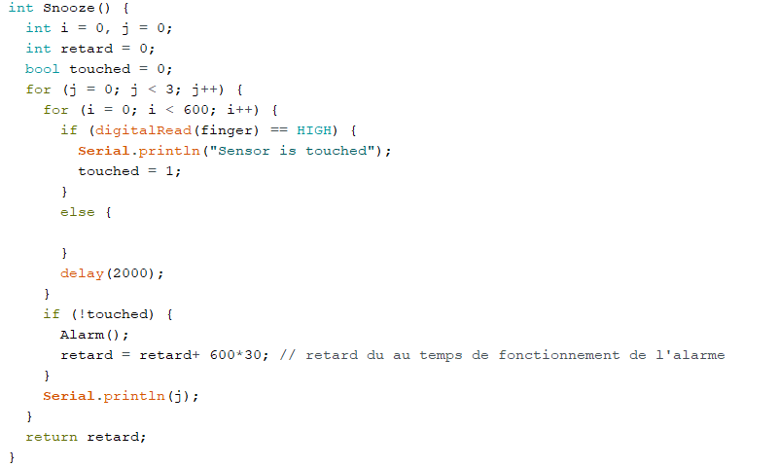
Touch sensor utilisation
The user needs to touch the sensor for two seconds when he takes his pills

Slide 8
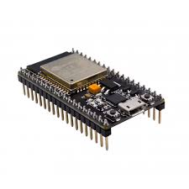



Phone alarm
ESP32 for WIFI connection
App development

Slide 9
Thank you for your attention !

