Slide 1
Extracting Data From Visualizations
Kevin Johnson, David Huang, Erin Friesen

Slide 2
Introduction
Goal: Build an algorithm that can automatically convert data visualizations into raw data
Our final product is a mixture of theory and practical demonstration in order to extract the information out of a visualization

Slide 3
Overview
Procedure:
Import data visualization
PIL, numpy
Identify key features
Shape identification
Determine graph type
Eigenvectors!
Extract data based on graph type
Pixel analysis and OCR

Slide 4
Identify Key Features
Find objects
Create {0,1} matrix A
Determine feature types
Axes, data points, labels
Based on feature shapes

Slide 5
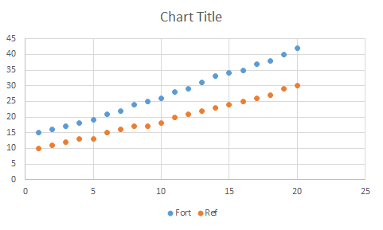
Original Graph

Slide 6
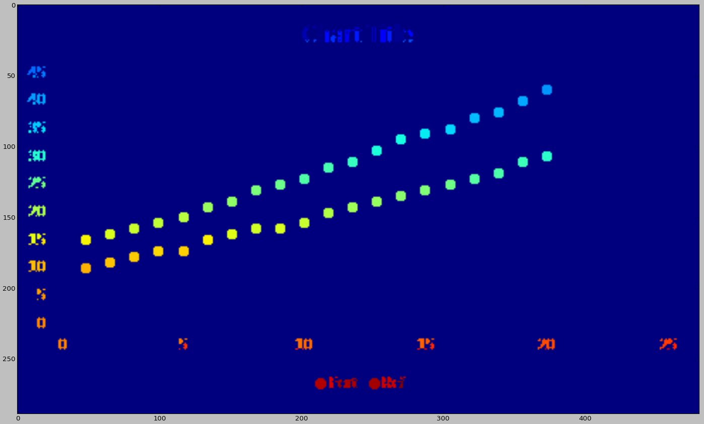
Indexed Features

Slide 7
Identify Graph Type
Create a set of eigenvectors B
Each represents type of graph
Repeatedly analyze known graphs
∀ v∈B
Find Av that changes v least
This gives the graph type

Slide 8
Extracting Data
Pixel analysis
Find data positions in scatterplot
Scale to match axes
Optical Character Recognition
Automatically read axis labels

Slide 9
Conclusion
Theoretical algorithm for graph type
Working algorithm for scatterplots
Future work:
Extract data from other graph types

