Slide 1
Extracting Data From Visualizations
Kevin Johnson, David Huang, Erin Friesen

Slide 2
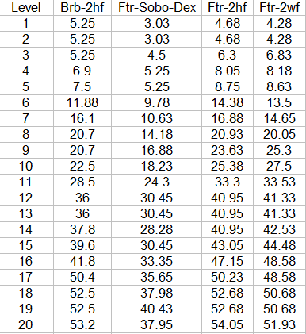
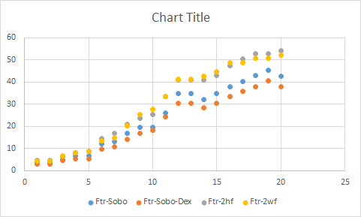
Introduction
Goal: Automatically convert data visualizations into raw data

Slide 3
Overview
Procedure:
Import data visualization
Identify key features
Shape identification
Determine graph type
Eigenvectors!
Extract data based on graph type
OCR and pixel analysis

Slide 4
Identify Key Features
Find objects
Filter irrelevant information
Create {0,1} matrix A
Determine feature types
Axes, data points, labels
Based on feature shapes

Slide 5
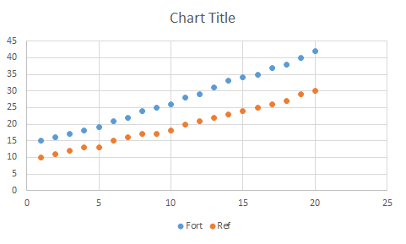
Original Graph

Slide 6
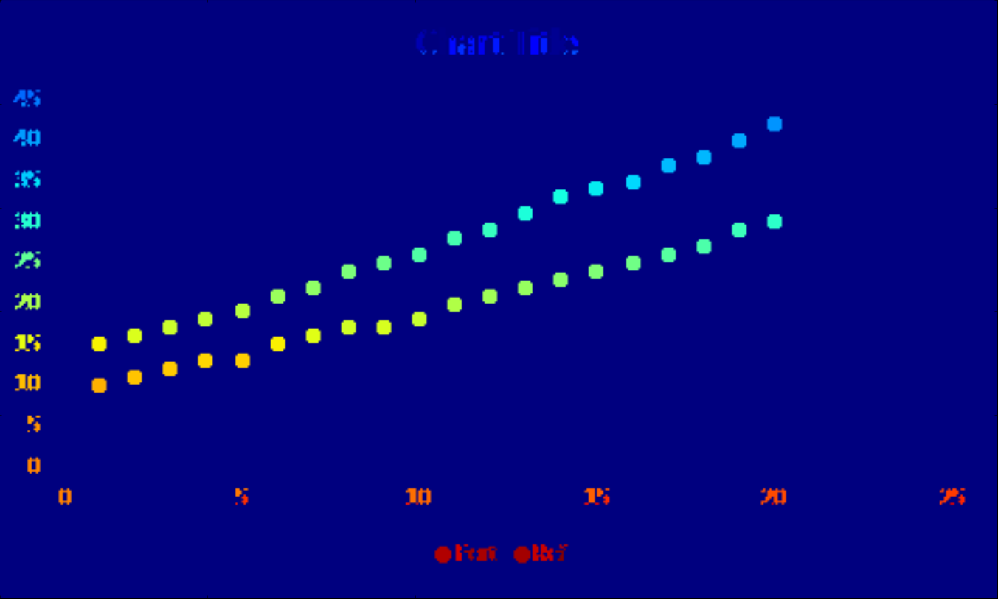
Indexed Features

Slide 7
Identify Graph Type
Create a set of eigenvectors B
Each represents type of graph
Generate by repeatedly analyzing known graphs
∀ v∈B
Find Av that changes v least
This gives the graph type

Slide 8
Extracting Data
Optical Character Recognition
Automatically read axis labels
Pixel analysis
Find data positions in scatterplot
Scale to match axes

Slide 9
Conclusion
Theoretical algorithm for graph type
Working code (95%) for scatterplots
https://github.com/efriesen/CS270-Visualization
Future work:
Extract data from other graph types

