Slide 1
Interactive Art Roadmap
Week 1: Play with Processing
Generate patterns, play sounds, manipulate images
Week 2: More fun with Processing
Animation, video input
Create a proposal (document) for your art project
Week 3: Work on your art project
Get your project working end-to-end
Revise your project specification document
Week 4: Polish your project
Here's your chance to take risks and be really creative!
Art Demo Days! (June 6th & 9th)

Slide 2
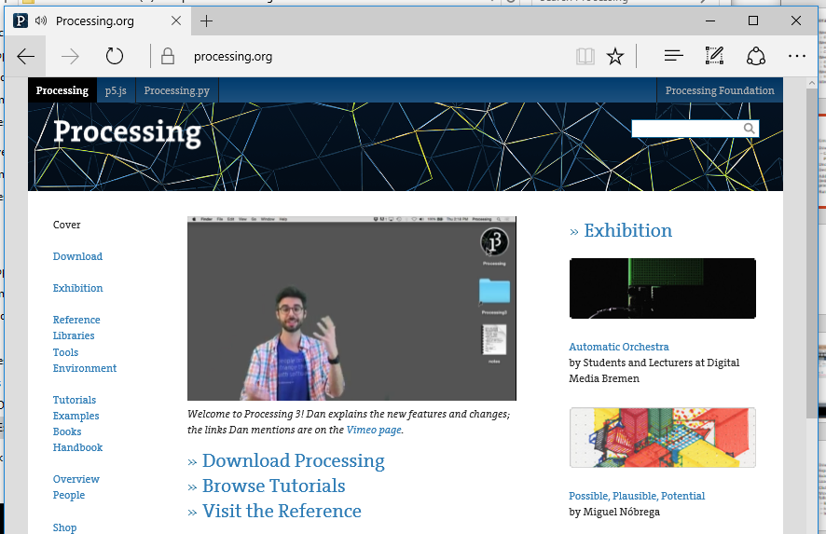

Processing
Java library
2d & 3d Graphics
Easy to program
Interactive & Generative Art
Free
Open-Source
Processing.org

Slide 3
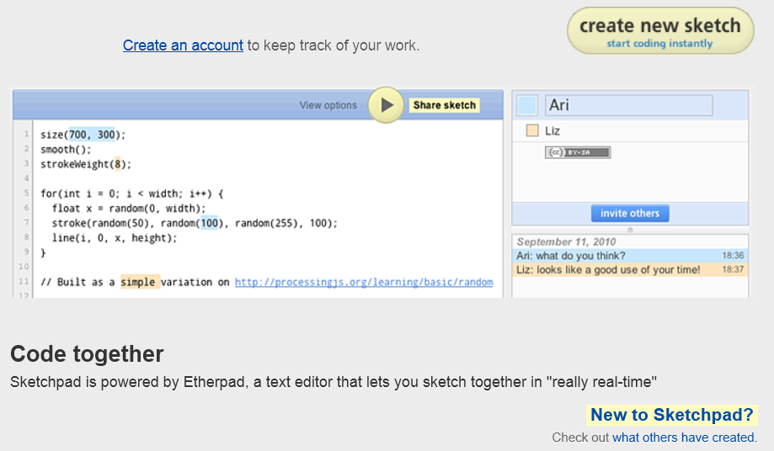
Introduction to Processing
Go to http://sketchpad.cc, create a new sketch
Notes:
Need to decide on location for Processing on each laptop.

Slide 4
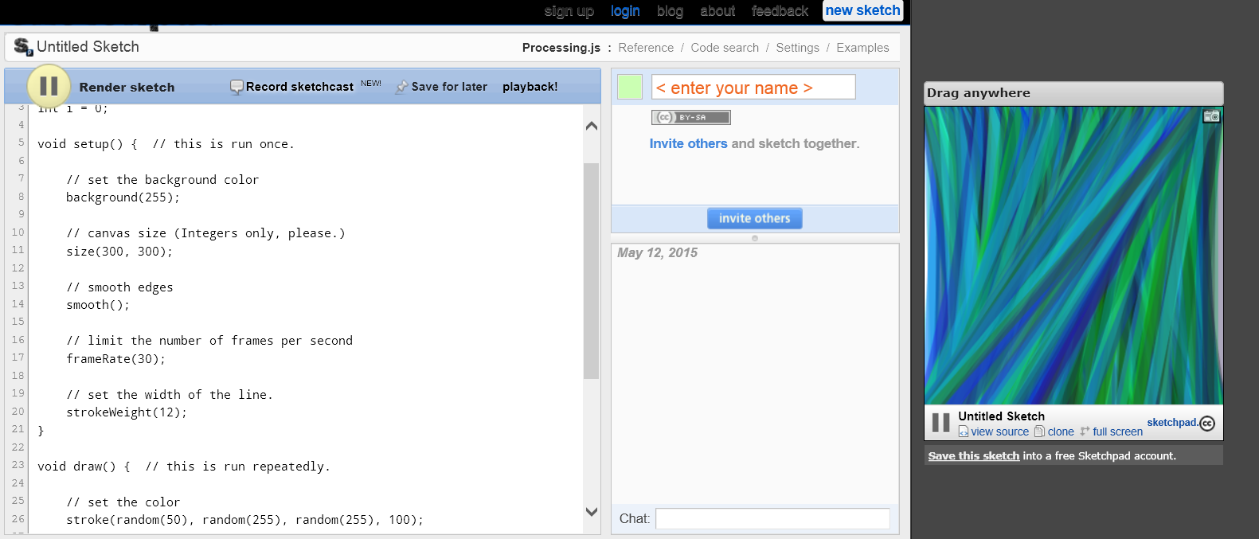
Introduction to Processing
Try out the sample Processing example
Notes:
Need to decide on location for Processing on each laptop.

Slide 5
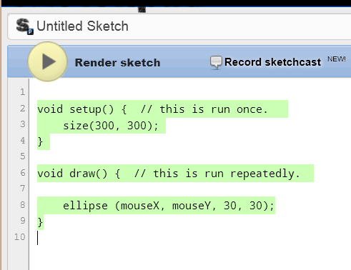
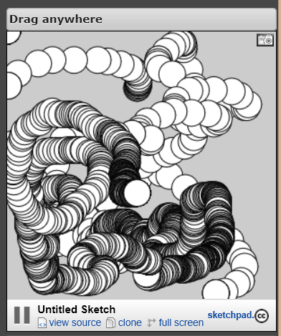
Introduction to Processing
Clear the code window and type in the following Java code, then click on the play icon and move the mouse on the right window
Notes:
Need to decide on location for Processing on each laptop.

Slide 6
Installing Processing
(Option 1) Install Processing from school server
(Option 2) Download processing from OneNote​
processing-3.0.2-windows64.zip
Uncompress and place under ​ Documents\Processing​
Add a shortcut to the Start menu​ Documents\Processing-3.0.2\processing.exe​
Run Processing

Slide 7
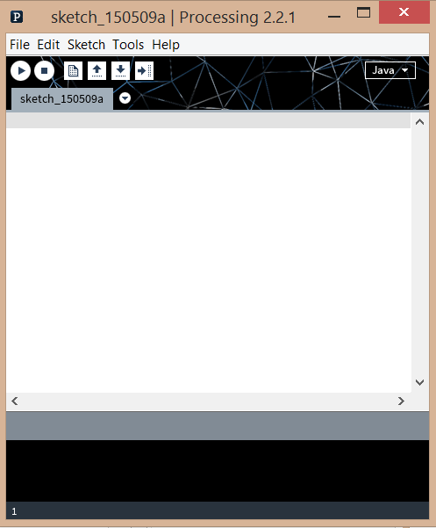

Slide 8
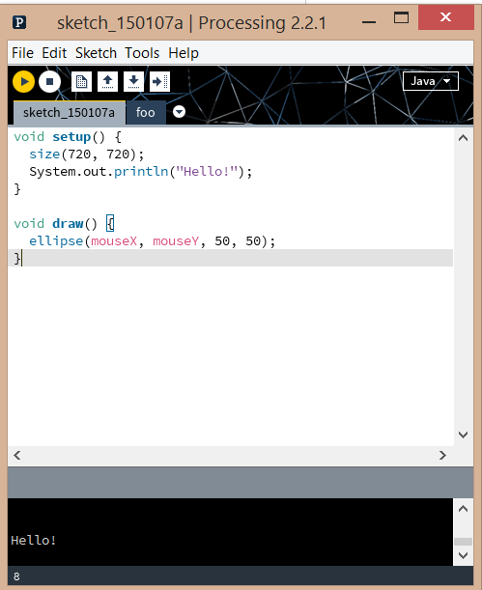
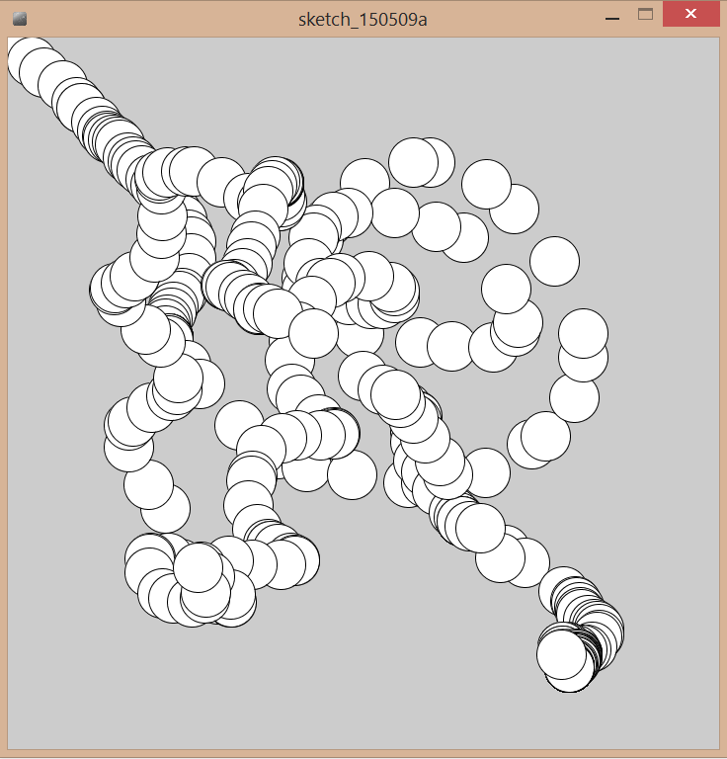
Notes:
Ask students to enter the code above and click on the play icon to run the program.
Any syntax errors will be reported in the black window below.
Note that console output is also reported to the bottom window.
Running the program should cause a 2nd window to popup – and moving the mouse around should cause drawing such as in the attached screenshot.

Slide 9
Introduction to Processing
Download Lab00.Intro from OneNote (your choice)
BlueJ: Processing.Lab00.Intro.BlueJ.zip
Eclipse: Processing.Lab00.Intro.Eclipse.zip
Processing: Processing.Lab00.Intro.Processing.zip
Download HowTo from OneNote
Follow the steps to get Lab00.Intro running
Notes:
Need to decide on location for Processing on each laptop.

Slide 10



Lab: Colors
Click on the play icon in Processing.
Move the mouse around – you should see the following changing:
Background color
Foreground color
Size of the center square
Notes:
Next slide has the complete code…

Slide 11
Lab: Colors
// Adapted from Generative Design
import java.util.Calendar;
void setup() {
size(720, 720);
//noCursor(); // try this
}
void draw() {
colorMode(HSB, 360, 100, 100);
rectMode(CENTER);
noStroke();
background(mouseY/2, 100, 100);
fill(360-mouseY/2, 100, 100);
rect(360, 360, mouseX+1, mouseX+1);
//try ellipse(360, 360, 1.5*mouseX+1, // mouseX+1);
}
void keyPressed() {
if (key=='s' || key=='S') saveFrame(timestamp()+"_##.png");
}
String timestamp() {
Calendar now = Calendar.getInstance();
return String.format(
"%1$ty%1$tm%1$td_%1$tH%1$tM%1$tS", now);
}
Look up Processing methods online.
Eg.: search for "processing noCursor".
TODO: Press 's' and capture PNG images of some patterns (same dir as the Processing code file.)
Notes:
Have students spend some time analyzing this code for themselves. Ask people to experiment commenting out the code and/or making other changes – what happens?
Ask students to search for "processing noCursor" online. What does it do? They should try uncommenting it and seeing what happens.
Ask students to change the rect to ellipse as indicated, and try other changes.
Ask students to explain what timestamp does (at a high level)? How is it used?
Note: The mouseX and mouseY control size of the central square, and hue of the background and foreground.
Pressing ‘s’ saves the current view to a PNG file (in same directory as the processing file).

Slide 12
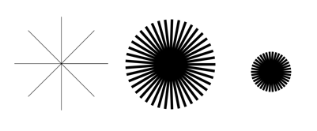
Lab: Shapes
Click on the play icon in Processing.
Move the mouse around – you should see the following changing:
Number of spokes
Size of disk
Thickness of spokes
Notes:
Next slide has the complete code…

Slide 13
Lab: Shapes
void draw(){
strokeCap(SQUARE); // try ROUND, PROJECT
smooth();
noFill();
background(255);
translate(width/2,height/2);
int circleResolution = (int) map(mouseY, 0,height, 2,80);
float radius = mouseX-width/2 + 0.5;
float angle = TWO_PI/circleResolution;
strokeWeight(mouseY/20);
beginShape();
for (int i=0; i<=circleResolution; i++){
float x = cos(angle*i) * radius;
float y = sin(angle*i) * radius;
line(0, 0, x, y);
// vertex(x, y);
}
endShape();
}
Look up Processing methods online.
Eg.: search for "processing strokeCap".
TODO: Press 's' and capture PNG images of some patterns (same dir as the Processing code file.)
Notes:
Have students spend some time analyzing the code for themselves. Ask people to experiment commenting out the code and/or making other changes – what happens?
Ask students to search for "processing strokeCap" online. What does it do? They should try changing SQUARE to ROUND and report what happens.
Ask students to change the rect to ellipse as indicated, and try other changes.
Note: The mouseX and mouseY control size of the central square, and hue of the background and foreground.
Pressing ‘s’ saves the current view to a PNG file (in same directory as the processing file).
Note: online docs for begin/endShape say that only vertex() is allowed, but here line() is used and seems to work fine.
(begin/endShape defines an integral shape to be drawn – I suppose it is only rendered once completely defined.)
Explain the geometry (basic trig, that all students should know but some will have forgotten) using the whiteboard.

