Slide 1
Processing Lab 01: Click Detection
Download Lab01.Click from OneNote (your choice)
BlueJ: Processing.Lab01.Click.BlueJ.zip
Eclipse: Processing.Lab01.Click.Eclipse.zip
Download HowTo from OneNote
Follow the steps to get Lab01.Click running
Learning objectives:
Detect when mouse clicks on an object

Slide 2
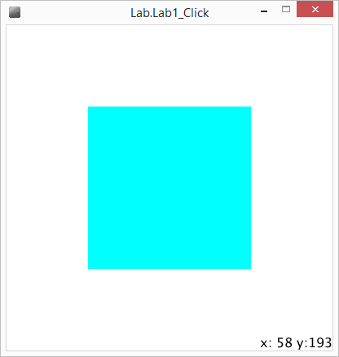
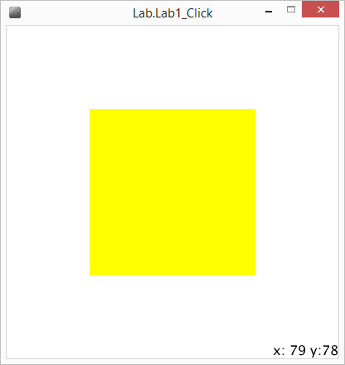
Goals
Square in the center changes color whenever you hold down the mouse.
Mouse location in screen space is in lower right corner.
Goal: Square changes color only when you click on the square.

Slide 3
Code Overview
public class YourClass extends PApplet
main(String args[])
Calls superclass main (initializes Processing)
setup()
Initialization of YourClass (replaces constructor)
draw()
Fills the screen once per frame (default is 60 frames per second)

Slide 4
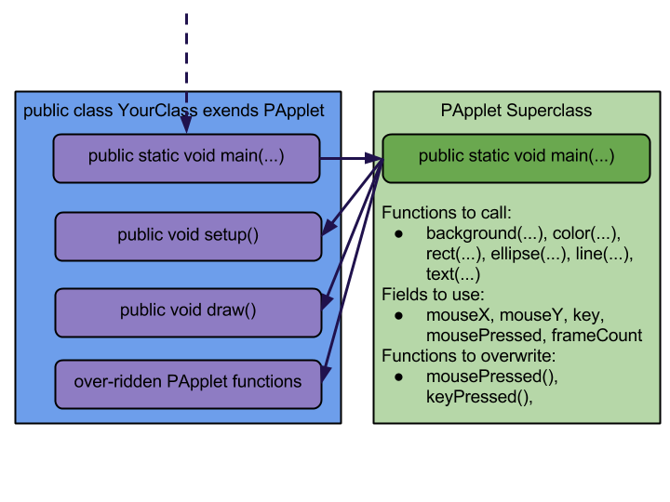
Click extends PApplet (Processing Applet)

Slide 5
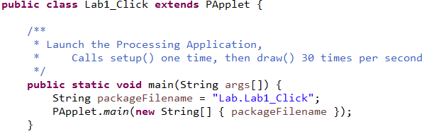
Code Overview: main(…)
public class Click extends PApplet
main(String args[])
Calls superclass main (initializes Processing)

Slide 6
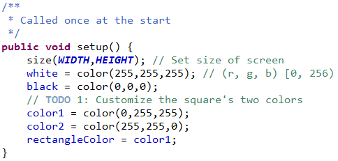
Code Overview: setup()
setup()
Initialization of Click (replaces constructor)

Slide 7
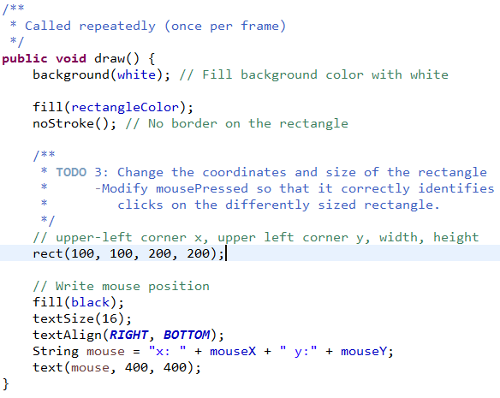
Code Overview: draw()
draw()
Fills the screen once per frame
Default is 60 frames per second

Slide 8
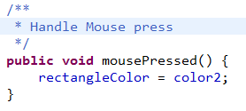
Code Overview: mousePressed()
mousePressed()
Called whenever the user pushes the left-mouse button down.
Changes the color of the rectangle.
TODO: Using the variables mouseX and mouseY, determine if the user has clicked on the rectangle.

Slide 9
Lab01: Click Detection
Run the Lab01 application and get a feel for it.
Open Click.java
In setup(), customize the rectangles colors
In mousePressed(), add logic so that the color only changes when the mouse clicks the rectangle.
In draw(), modify the size and position of the rectangle. Then make your mousePressed() work with the new dimensions.
Notes:
Lab Time! 20min

