Slide 1
Processing Lab 03: File Input
Download Lab03.FileInput from OneNote (your choice)
BlueJ: Processing.Lab03.FileInput.BlueJ.zip
Eclipse: Processing.Lab03.FileInput.Eclipse.zip
Download HowTo from OneNote
Follow the steps to get Lab03.FileInput running
Learning objectives:
Import and play a sound file in Processing
Import and display an image in Processing

Slide 2
Content
Download Processing.Lab03.Files.zip from OneNote
Art resources for future reference:
http://opengameart.org/
http://freesound.org/
http://game-icons.net/
https://commons.wikimedia.org/wiki/Main_Page

Slide 3
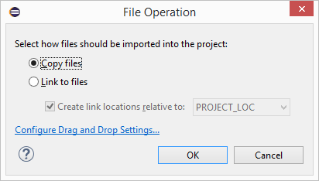
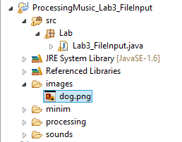
Adding files to the project (Eclipse)
Drag dog.png file to the /images/ folder of the project.
Select ‘Copy Files’
Check folder contents
Drag dog_bark.wav to the /sounds/ folder of the project.

Slide 4
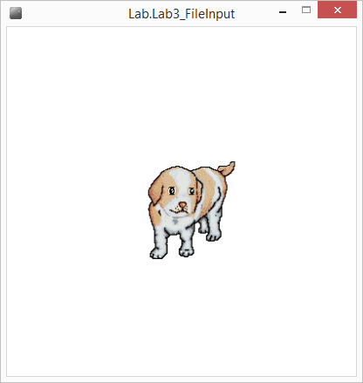
Lab03: File Input
Open Lab03_FileInput.java
In setup():
Load the image dog.png
Load the sound dog_bark.wav
In draw():
Display the image when the mouse is pressed
In mousePressed():
Play the sound (then rewind)
Try your own images/sounds
Notes:
Lab Time! 20min

