Slide 1
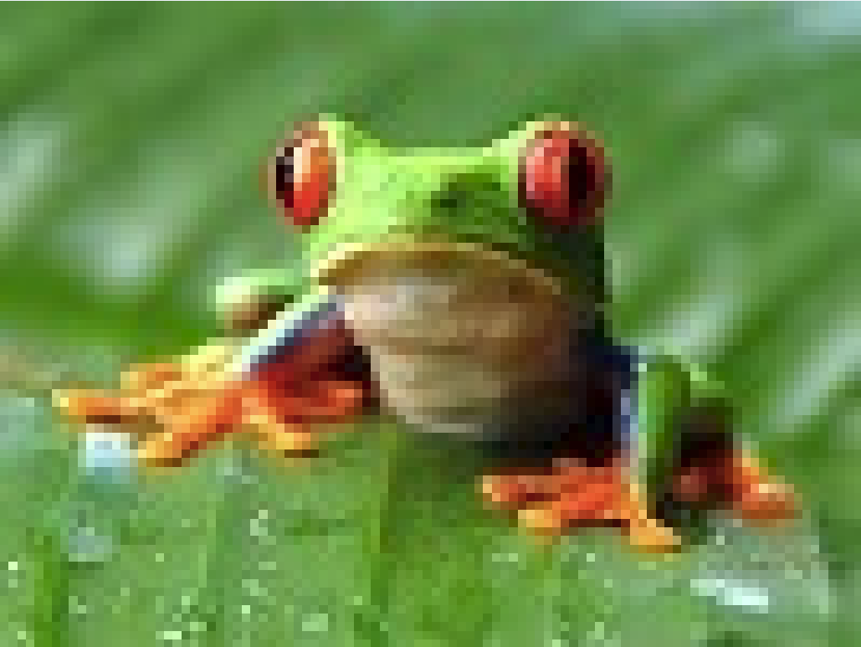

Processing Lab 04: Images are Data
Notes:
Images are data. An image is nothing but a 2D array of integers. Each integer encodes the color of one pixel.

Slide 2
Processing Lab 04: ImagesAsData
Download Lab04.ImagesAsData from OneNote (your choice)
BlueJ: Processing.Lab04.ImagesAsData.BlueJ.zip
Eclipse: Processing.Lab04.ImagesAsData.Eclipse.zip
Download HowTo from OneNote
Follow the steps to get Lab04.ImagesAsData running
Learning objectives:
Detect when mouse clicks on an object

Slide 3
Images are Data
// Define field pixelArray to be a a 2D array to hold pixel values
int [][] pixelArray = null;
PImage img; // Image object
...
public void setup() {
... img = loadImage("../images/frog.jpg");
pixelArray = new int[img.width][img.height];
for (int i = 0; i < img.width; i++)
{
for (int j = 0; j < img.height; j++)
{
pixelArray[i][j] = img.pixels[j * img.width + i];
}
}
...
}
Notes:
Here is processing code that declares a 2D array of integers, loads an image, and extracts each pixel in the image into the 2D array. Note that img.pixels is a 1D array – rows are laid out one after the other in single file. (Draw a picture on the white board illustrating the pixelArray[i][j] = img.pixels[j * img.width + i] statement.)

Slide 4
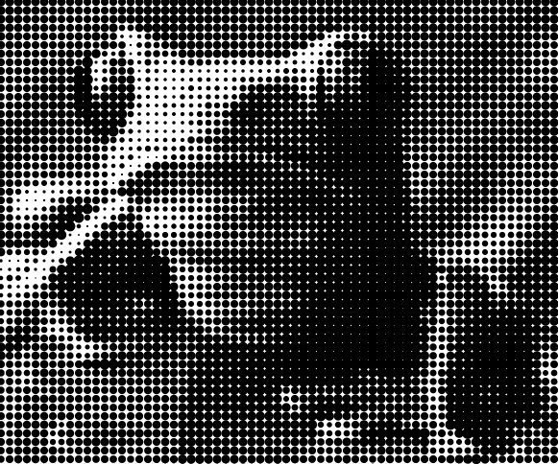
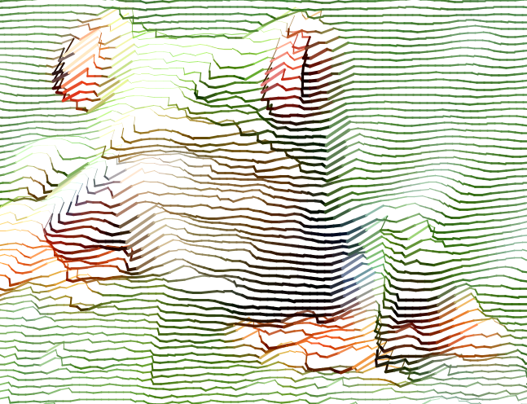
Images are Data
Notes:
Once we have read the image into an array of integers, we can do anything we want with this array. Here the array is used to generate completely new images. The one on the left is composed of black disks whose size depends on the brightness of each pixel. The one on the right is a more involved computation – lines whose color is set by the pixel color, but whose position is more subtly influenced by the pixel value.
Let's look at we can create the left hand side output in some detail…

Slide 5
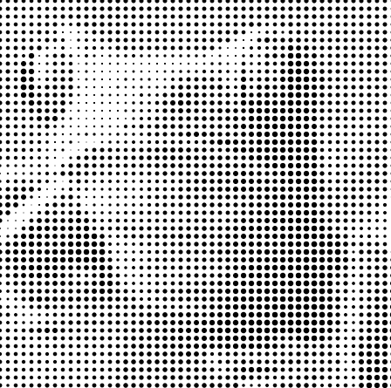

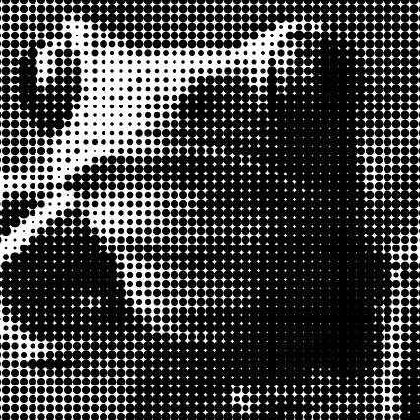
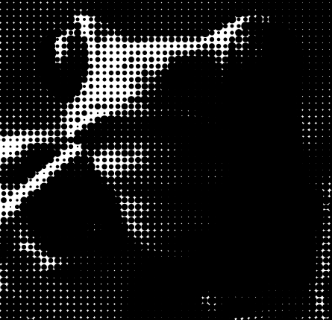
public void draw() {
background(255);
float mouseXFactor = map(mouseX, 0, width, 0.05f, 1);
float mouseYFactor = map(mouseY, 0, height, 0.05f, 1);
for (int gridX = 0; gridX < img.width; gridX++) {
for (int gridY = 0; gridY < img.height; gridY++) {
// grid position + tile size
float tileWidth = width / (float)img.width;
float tileHeight = height / (float)img.height;
float posX = tileWidth*gridX;
float posY = tileHeight*gridY;
// get current color
int c = pixelArray[gridX][gridY];
// greyscale conversion
int greyscale =round(red(c)*0.222f+green(c)*0.707f+blue(c)*0.071f);
if (drawMode == 1) {
// greyscale to ellipse area
fill(0);
noStroke();
float r2 = 1.1284f * sqrt(tileWidth*tileWidth*(1-greyscale/255.0f));
r2 = r2 * mouseXFactor * 3;
ellipse(posX, posY, r2, r2);
}
... } }
}
Notes:
NOTE: use of float – 32-bit version of double. Many processing functions take floats, not doubles, so you have to watch out. To declare a float constant add an "f" to the end. Or use (float) to cast a double value to a float value.
Overview of code – ellipses are drawn in a grid pattern – the grid at location (gridX, gridY) is tileWidth*tileHeight pixels wide, and the size of the ellipse is determined by the grayscale value of the corresponding pixel in pixelArray.
The final size of each disk is a function of the mouseX value and the grayscale value. The actual formula seems to be computing the area of the disk to be equal to relative brightness of the pixel – pi/2 r^2 is the disk area.
NOTE: the integer representation of color is 0xrrggbb rr==red, gg==green, bb is blue (hex). There are various helper methods such as red(c), green(c) and blue(c). It is often useful to compute the grayscale value of a color pixel because it can be meaningfully used to set design parameters of the generated design that produces intuitive results.

Slide 6
Processing Lab 04: Image As Data
Press keys 1 through 5 and move the mouse – what do you observe? Look at the code to figure out what it is doing.
Try loading a different image
Create your own image manipulation.
Notes:
Make sure students get to try 1 through 5 before moving to the next slide.

Slide 7
Processing Lab 4: Image As Data
Things to try:
Try other images – make sure they are small images (less than 100x100 pixels – use MSPaint to reduce the image if needed.)
Add the following to the drawMode == 4 case – what does it do?
if (Math.random()<0.1) {
pixelArray[gridX][gridY] = lerpColor(c, 0xff0000, 0.1f);
}
Add your own drawMode cases, for example…
Try modifying the pixel array itself,
Try drawing different shapes/colors depending on ranges of values of the c and grayscale local variables (that correspond to each pixel in the array).
Try to add other forms of animation
Notes:
Note that lerpColor is a color interpolator – the example above returns a color "between" c and 0xff0000 (red) – it is 0.1, i.e., 1/10th of "the way" to becoming fully red, i.e., it is much closer to c than red.
Since this code is called on every render cycle, what we see is that the entire array eventually becomes reddish pixels.

