Slide 1
Lab 5: Animation
Download Lab05.Animation from OneNote (your choice)
BlueJ: Processing.Lab05.Animation.BlueJ.zip
Eclipse: Processing.Lab05.Animation.Eclipse.zip
Download HowTo from OneNote
Follow the steps to get Lab05.Animation running
Learning objectives
How to change the shape and position of objects as time progresses
How to animate using a sprite sheet.

Slide 2
Design
Mathematical representation of an amoeba
r[POINTS-1]
r[0]
r[1]
Represented by an array of "r" values, each representing the distance of one point from the center of a unit circle.
Points joined by a smooth curve (a spline)
To change shape, just make small changes to the r values.
r[POINTS-2]
r[2]
r[…]
Notes:
[Design (2-4 slides, 1 minute): A high-level description of the code, and the interactions between the Java objects and the user. Call out areas that may be challenging to implement.]
Note: more details in backup slides.

Slide 3
Code: Drawing the Curvy Outline
beginShape();
// first point isnitial guide - it is not drawn …
curveVertex(getVertexX(POINTS-1), getVertexY(POINTS-1));
for (int i=0;i<POINTS;i++) {
curveVertex(getVertexX(i), getVertexY(i));
}
// close the loop...
curveVertex(getVertexX(0), getVertexY(0));
// last point is final guide, it is not drawn
curveVertex(getVertexX(1), getVertexY(1));
endShape();
getVertexX(i): x_{center} + width * rValues[i] * cos(2*π*i/POINTS) getVertexY(i): y_{center} + height * rValues[i] * sin(2*π*i/POINTS)

Slide 4
Motivation
Explore more "organic" shapes
See how to make a shape change over time
Create motion
Notes:
[Motivation (1 slide, 0.5 minutes): What is it about the project that interests you, as the creator?]

Slide 5
Learnings [this section to be added to as the project progresses]
It's very important to get simple things working first
My first amoebas were simple squares – got the dynamic creation and deletion parts working with these simple non-animated squares
Getting amoeba animation to look "lifelike" is tricky
The polar-coordinate representation was a good representation
However, needed to play with various factors and timings
Debugging techniques helpful
Print things out to console! (Eg., when an amoeba is created, or is beginning to "die" and when it finally "dies".)
TODO: Haven't figured out how to actually remove objects from the list – so currently "dead" amoebas are a waste of resource. Need to some methods to the ProcessingObject for this
Notes:
[Learnings (1 slide, 0.5 minute): What are three things you have learned from this project?]
Note that it's fine (an encouraged) to have things in here that are un-resolved. It should represent the genuine state of the project.

Slide 6
Future [this section to be added towards the end, but feel free to add ideas here as you get them!]
Make the amoeba more realistic and/or crazy
Add organelles (nucleus, etc.)
Make it follow the movement of pseudopods (currently it's movement – position of its center – is unrelated to pseudopods)
Interesting soundscapes, interesting (and varied) sounds when it "dies"
Explore the idea of a game
Amoebas potentially "eat" bona fide keys.
Amoebas potentially reproduce?
Points for killing off amoebas
Explore the idea of amoebas themselves contributing to adding to the music
The idea of each amoeba being a dynamically created, self-playing instruments.
Notes:
[Future (1 slide, 0.5 minutes): How could you or others extend this project given enough time?]

Slide 7
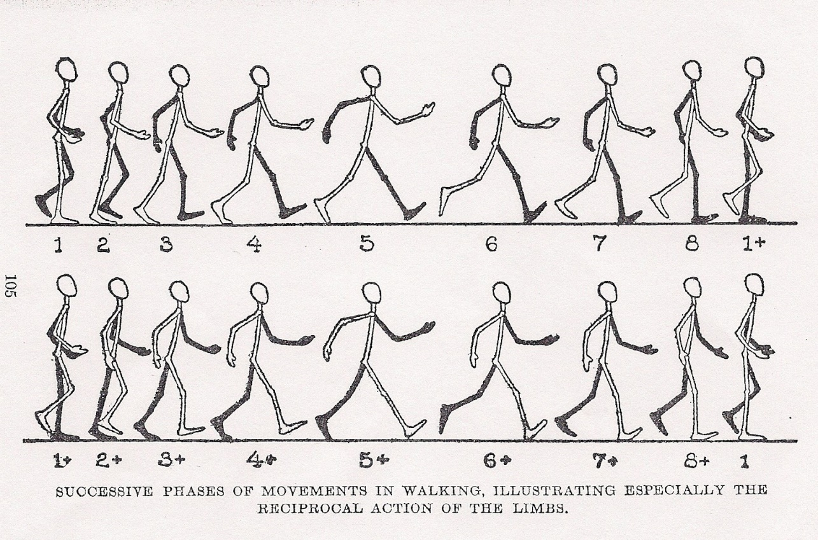
Animation: Part 2
Uncomment the TODO 3 block.
Each click of the mouse advances the cat one frame forward.

