Slide 1
Lab 6: Video
Download Lab06.Video from OneNote (your choice)
BlueJ: Processing.Lab06.Video.BlueJ.zip
Also need VideoAndOpenCVJarsForBlueJ.zip
In BlueJ, add those Jars to the Libraries
Eclipse: Processing.Lab06.Video.Eclipse.zip
Download HowTo from OneNote
Follow the steps to get Lab06.Video running
Learning objectives
Reading in video from the camera.
Use OpenCV to modify the image.

Slide 2
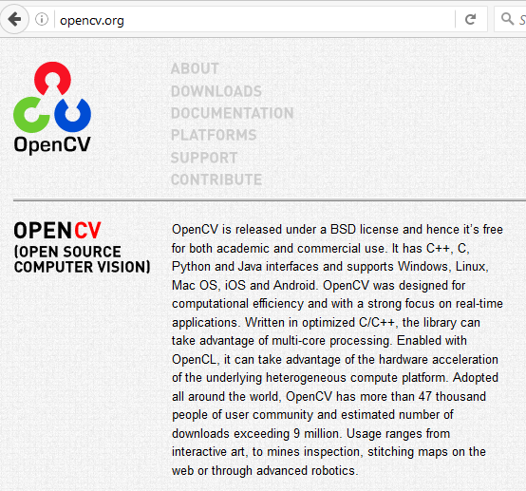
OpenCV
Open Souce Computer Vision
http://opencv.org/

Slide 3
TODO #0
Line 52: String cam = cams[0];
Pick a different camera number, I think the default one is 1 frame per second.
Notes:
[Motivation (1 slide, 0.5 minutes): What is it about the project that interests you, as the creator?]

Slide 4
Objectives
Replace box around face with the antlers.
Hint: look at previous labs for displaying images.
Switch from face to contours.
Try Eye detection (instead of face)
See the other two video manipulations

