Slide 1
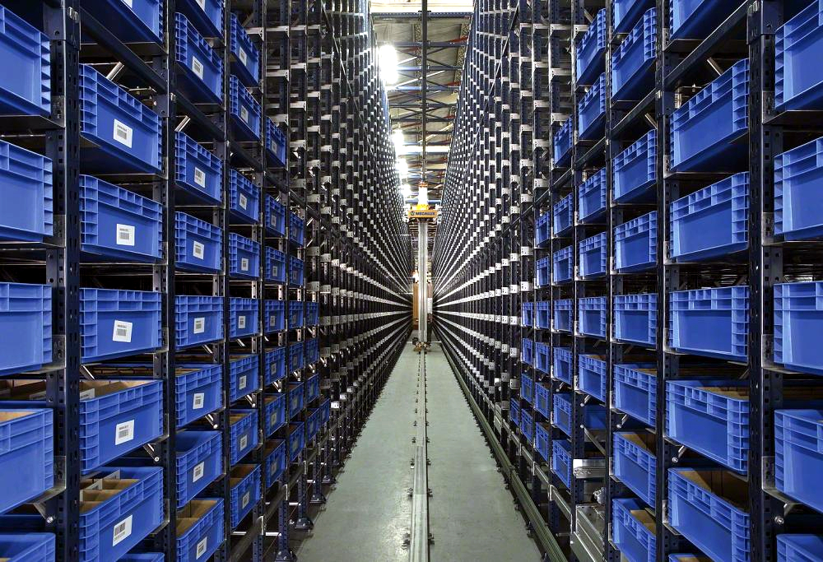

MDFO ANALYSIS
PT. MEKAR ARMADA JAYA TAMBUN

Slide 2
SALES ORDER & MDFO
▲ TOP 10 ACCUMULATION TERTINGGI (SALES ORDER > MDFO)
1-7 AGUSTUS 2026
NO | CUSTOMER | MODEL | ROUTE | JOB NUMBER | MDFO | SALES ORDER | ACCUM
1 | DPM | TD | S/A - IFPD | ATDJ3 | 2.765 | 3.300 | 535
2 | HMMI | KS | S/A - IFPD | 71510-I6500 | 99 | 420 | 321
3 | TMMIN | D26A | WSS - IFPD | T013 / 3995 | 2.875 | 3.150 | 275
4 | HMMI | KS | S/A - IFPD | 71520-I6500 | 251 | 450 | 199
5 | HPM | 2MD | - | 17215-5EAA-K00 | 0 | 180 | 180
6 | ADM PLANT 5 | D74A | S/A – IFPD | AA-3407 | 216 | 378 | 162
7 | ADM PLANT 1 | D40D | S/A – IFPD | GK-0091 | 55 | 190 | 135
8 | ADM PLANT 1 | D40D | MGL – IFPD | GK-0016 | 100 | 200 | 100
9 | ADM PLANT 4 | D40D | WSS – IFPD | GT-1555 | 465 | 555 | 90
10 | ISI | SP | - | 59211-61J02 | 78 | 160 | 82
—
▼ TOP 10 GAP TERENDAH (SALES ORDER < MDFO)
No | Customer | Model | MDFO | Sales Order | GAP
1 | — | — | — | —
2 | — | — | — | —
3 | — | — | — | —
4 | — | — | — | —
5 | — | — | — | —
6 | — | — | — | —
7 | — | — | — | —
8 | — | — | — | —
9 | — | — | — | —
10 | — | — | — | —
▼ TOP 10 ACCUMULATION TERENDAH (SALES ORDER < MDFO)
NO | CUSTOMER | MODEL | ROUTE | JOB NUMBER | MDFO | SALES ORDER | ACCUM
1 | GAYA MOTOR | D40D | MGL - IFPD | NZ-076 | 6.876 | 6.300 | -576
2 | ADM PLANT 5 | D30D | ISA - IFPD | AA-0247 | 6.400 | 6.000 | -400
3 | HMMI | SU2ID | S/A - IFPD | 65181-I7000 | 1.295 | 912 | -383
4 | HMMI | SU2ID | S/A - IFPD | 66700-I7500 | 1.131 | 768 | -363
5 | MKM | TD | MGL - IFPD | ATDAF10 | 1.920 | 1.560 | -360
6 | MKM | TD | MGL – IFPD | ATDAF4 | 1.920 | 1.560 | -360
7 | MKM | TD | MGL - IFPD | ATDAF5 | 1.920 | 1.560 | -360
8 | MKM | TD | WSS - IFPD | ATDAF7 | 1.920 | 1.560 | -360
9 | MKM | TD | WSS - IFPD | ATDAF6 | 1.920 | 1.560 | -360
10 | HMMI | SU2ID | S/A - IFPD | 65171-I7000 | 1.295 | 936 | -359
Catatan: prioritaskan tindak lanjut pada TOP 10 GAP TERTINGGI — order berpotensi melebihi kapasitas rencana.
4

Slide 3
SALES ORDER & MDFO
ACCUMULATION BY CUSTOMER & MODEL
1-7 AGUSTUS 2026
CUSTOMER | MODEL | MDFO 1-7 AUG | SALES ORDER 1-7 AUG | ACCUM 1-7 AUG | SALES ORDER ACHIEVEMENT
ADM PLANT 1 | D40D | 16.580 | 16.160 | -420 | 97%
ADM PLANT 4 | D14N | 25.659 | 25.367 | -292 | 99%
 | D40D | 60.813 | 59.711 | -1.102 | 98%
ADM PLANT 5 | D30D | 39.240 | 38.280 | -960 | 98%
 | D55L | 75.962 | 74.142 | -1.820 | 98%
 | D74A | 17.704 | 16.786 | -918 | 95%
 | D26A | 9.352 | 9.464 | 112 | 101%
TMMIN | D26A | 23.834 | 23.856 | 22 | 100%
 | D03B | 2.800 | 2.840 | 40 | 101%
MMKI | SL | 34.764 | 34.764 | 0 | 100%
HMMI | SU2ID | 17.218 | 15.612 | -1.606 | 91%
 | KS | 2.553 | 2.616 | 63 | 102%
MKM | SL | 11.340 | 10.860 | -480 | 96%
 | TD | 113.100 | 111.300 | -1.800 | 98%
HPM | 2MD | 0 | 180 | -180 | 0%
SIM | YL0 | 546 | 428 | -118 | 78%
TOTAL |  | 451.465 | 442.366 |  | 98%
—
▼ TOP 10 GAP TERENDAH (SALES ORDER < MDFO)
No | Customer | Model | MDFO | Sales Order | GAP
1 | — | — | — | —
2 | — | — | — | —
3 | — | — | — | —
4 | — | — | — | —
5 | — | — | — | —
6 | — | — | — | —
7 | — | — | — | —
8 | — | — | — | —
9 | — | — | — | —
10 | — | — | — | —
4

Slide 4
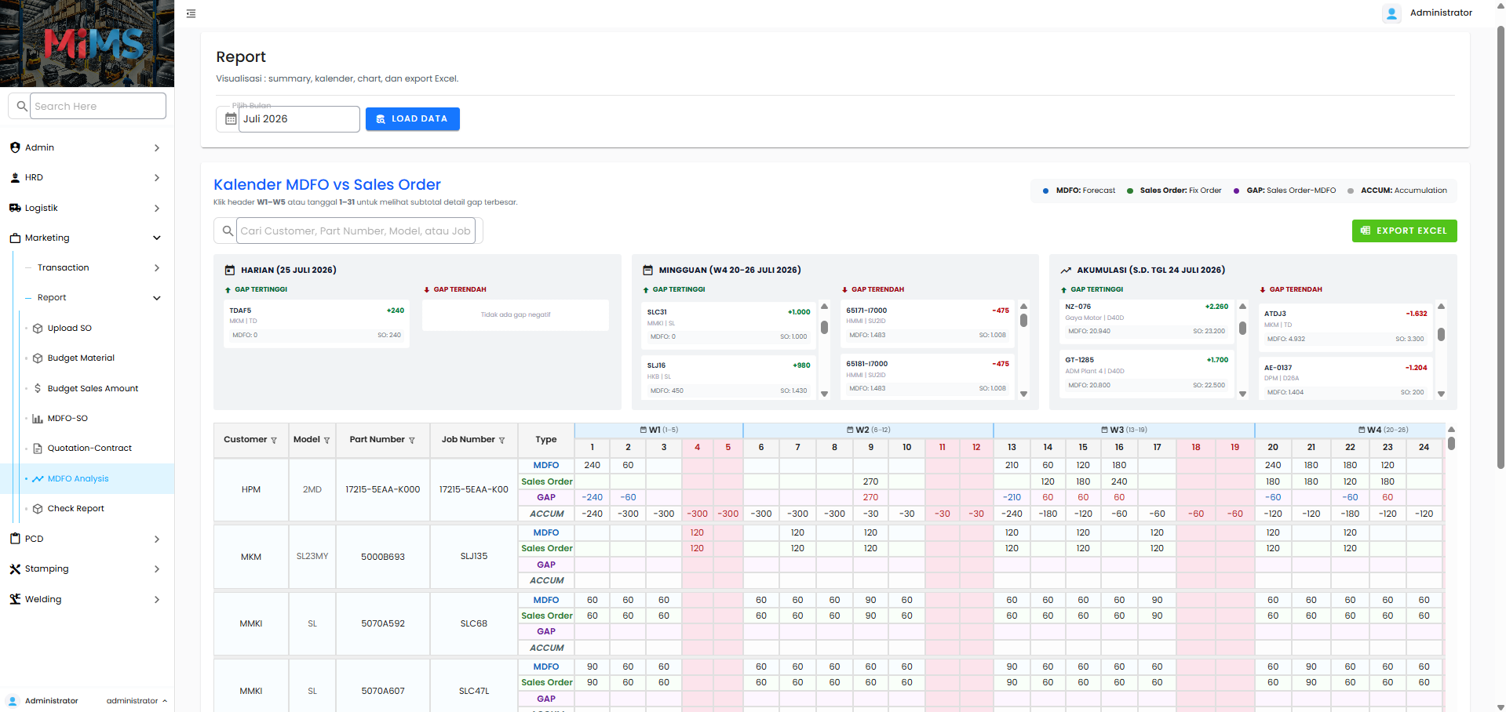
SALES ORDER & MDFO
4
1
2
3
1
MARKETING
3
MDFO ANALYSIS
2
REPORT
4
PILIH BULAN & LOAD DATA
🔗 http://192.168.10.67/mims/mkt/report/mdfo-analisis

Slide 5
SALES ORDER & MDFO
1
2
1
SUMMARY
2
DETAIL
🔗 http://192.168.10.67/mims/mkt/report/mdfo-analisis

Slide 6


Notes:
Added tutorial to use the website (user manual) and added ttd atau persetujuan assignment from atasan like pak rohman, pak dody, pak rudy

