Slide 1
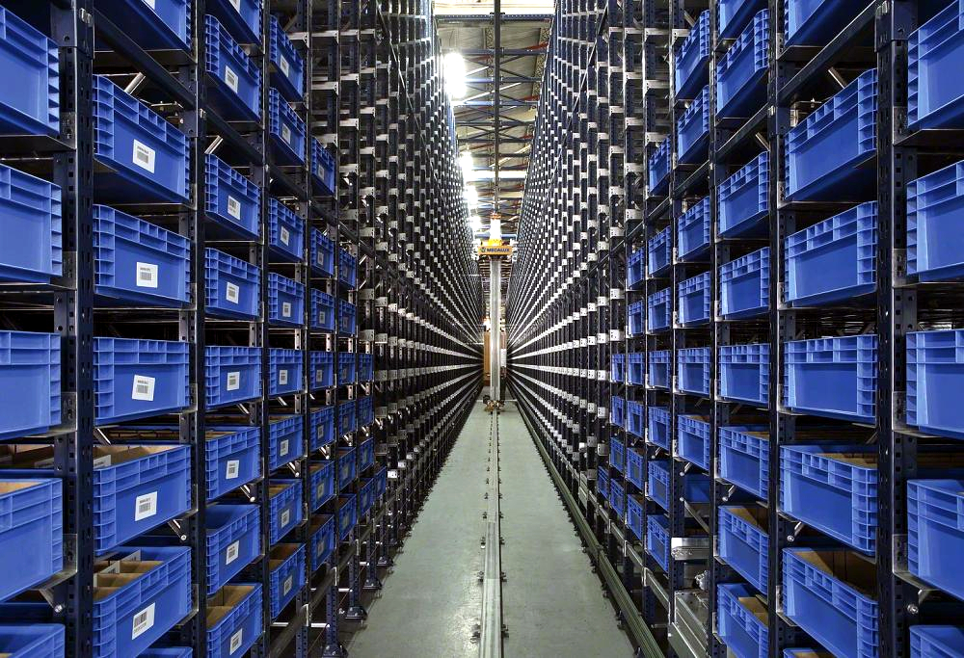

MDFO ANALYSIS
PT. MEKAR ARMADA JAYA TAMBUN

Slide 2
SALES ORDER & MDFO
▲ TOP 10 ACCUMULATION TERTINGGI (SALES ORDER > MDFO)
1-7 AGUSTUS 2026
NO | CUSTOMER | MODEL | ROUTE | JOB NUMBER | MDFO | SALES ORDER | ACCUM | %
▼ TOP 10 ACCUMULATION TERENDAH (SALES ORDER < MDFO)
NO | CUSTOMER | MODEL | ROUTE | JOB NUMBER | MDFO | SALES ORDER | ACCUM | %
Catatan: prioritaskan tindak lanjut pada TOP 10 GAP TERTINGGI — order berpotensi melebihi kapasitas rencana.
4

Slide 3
SALES ORDER & MDFO
ACCUMULATION BY CUSTOMER & MODEL
1-7 AGUSTUS 2026
CUSTOMER | MODEL | MDFO | SALES ORDER | ACCUM | %
ADM PLANT 1 | D40D
ADM PLANT 4 | D14N
 | D40D
ADM PLANT 5 | D30D
 | D55L
 | D74A
 | D26A
TMMIN | D26A
 | D03B
MMKI | SL
HMMI | SU2ID
 | KS
MKM | SL
 | TD
TOTAL

Slide 4
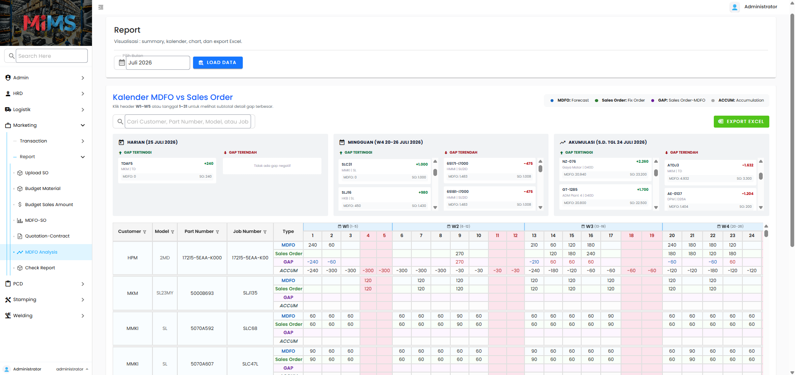
SALES ORDER & MDFO
4
1
2
3
1
MARKETING
3
MDFO ANALYSIS
2
REPORT
4
PILIH BULAN & LOAD DATA
🔗 http://192.168.10.67/mims/mkt/report/mdfo-analisis

Slide 5
SALES ORDER & MDFO
1
2
1
SUMMARY
2
DETAIL
🔗 http://192.168.10.67/mims/mkt/report/mdfo-analisis

Slide 6


Notes:
Added tutorial to use the website (user manual) and added ttd atau persetujuan assignment from atasan like pak rohman, pak dody, pak rudy

