Slide 1
washiato
…..because Laundry matters!
Arya Banait
Denny Delp
Eric Fritz
Tom Owlett

Slide 2
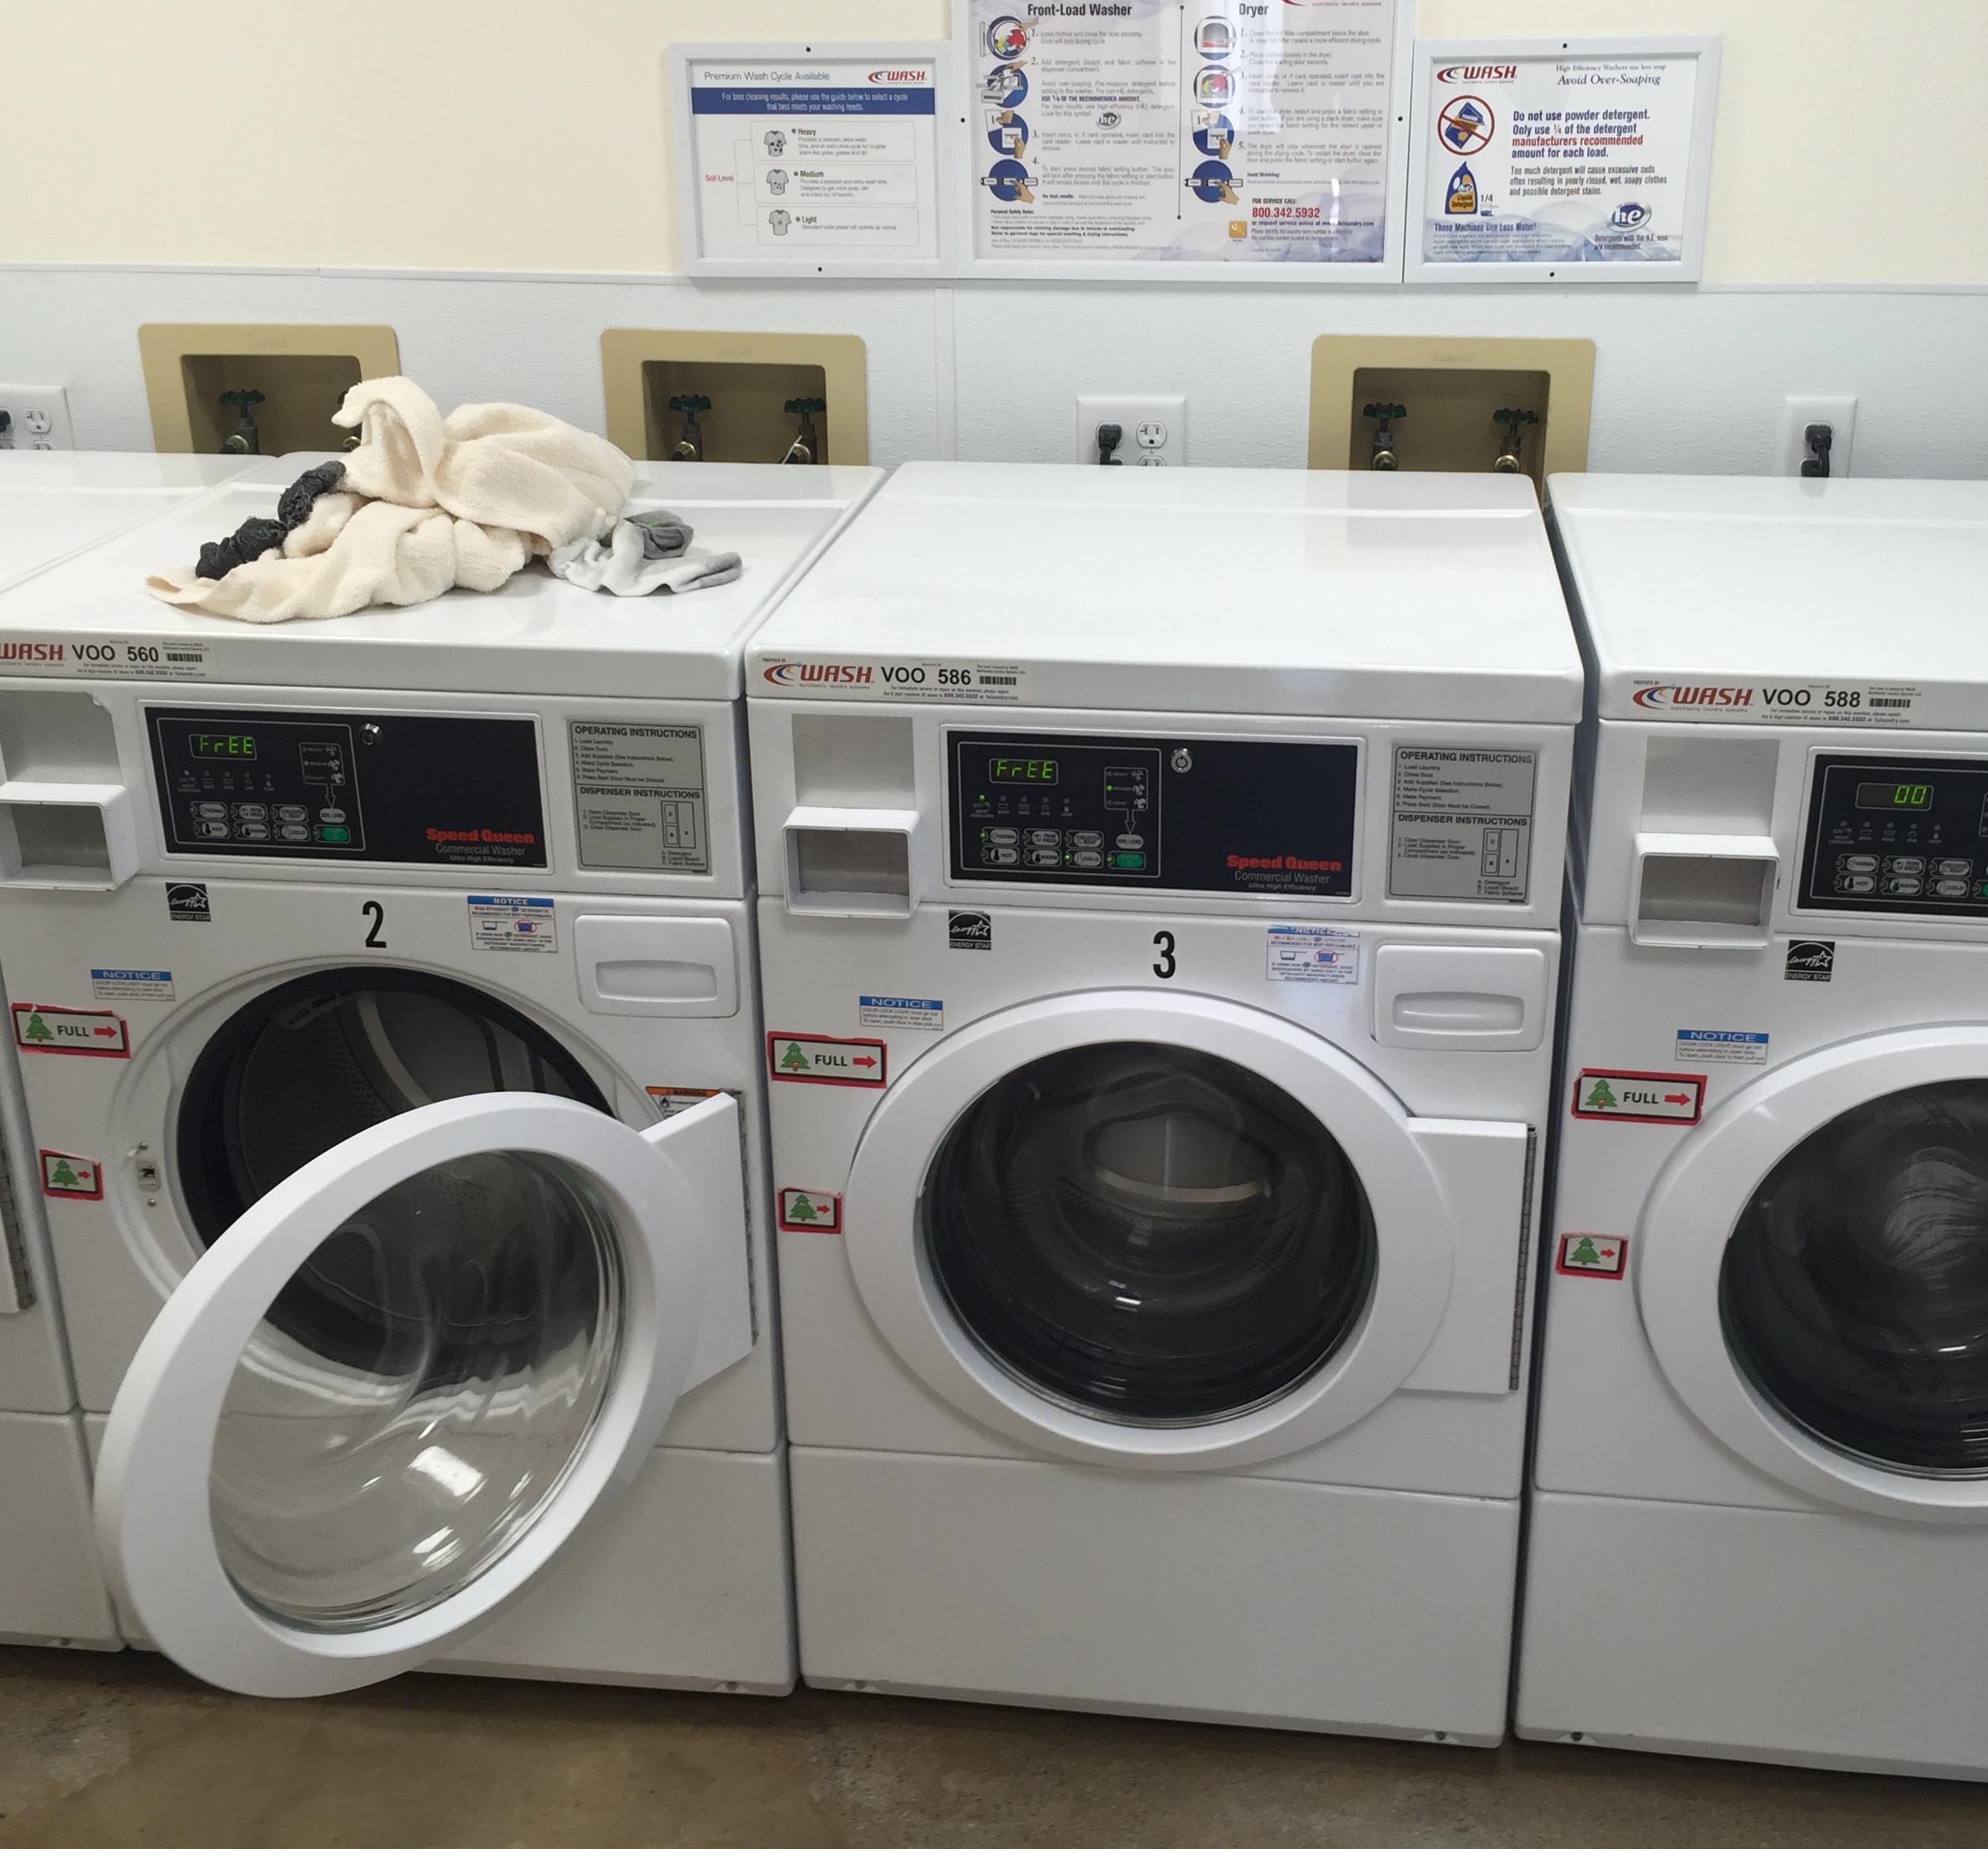
Shared Laundry Is a Mess
Impossible to check idle machines
No reminders to move clothing
Laundry gets moved soon after cycle completes

Slide 3
Washiato Demo

Slide 4
Coin Laundry is a Big Business
There are 35,000 coin-operated laundries serving an estimated 100 million Americans
These laundromats pull in $5B a year in gross revenue
Come up with some bullshit sales stuff
Notes:
These numbers include both coin laundromats and coin operated laundry machines in buildings

Slide 5
Sales
Target college campuses and apartment buildings
Improve laundry room efficiency and provide analytics to the building owners
Provide value for building residents.
Retrofit means that apartments can provide this amenity for a much lower cost than replacing machines

Slide 6
Team
We’re all Stanford mechatronics wizards
If you guys knew half the shit that we know, your fuzzy little heads would explode

Slide 7
Go to Market

