Slide 1

Database of Thrones
Collin Trowbridge, Katie Lee, Trent Punt, Ben Efron

Slide 2

Problem Statement:
Organize and store data on Game of Thrones in a clear and logical manner.
Ability to search for characters, houses, and battles
An interactive map of Westeros
A feature to display family trees of select houses.
A user polling system for users to vote on changing polls.
An ability for users to declare their progress in the series in order to protect them from potential spoilers.
Notes:
In searching for characters we wanted to be able to return whether the character was alive or dead, their house, and their relationships with other characters.
In searching for houses we wanted to be able to return where they were located, the members of them, their slogan, and their symbol if they have one.
In searching for battles we wanted to be able to return where the battle occurred, who participated in it, and who won the battle.
Some additional features that we added as we worked on the project were:
The ability to search for regions
The ability to “like” a character/house/etc…
An about the authors page

Slide 3
Our Approach:
Interactive website
Gathered data with a web-scraper
Began in MS SQL but switched to MySQL

Slide 4
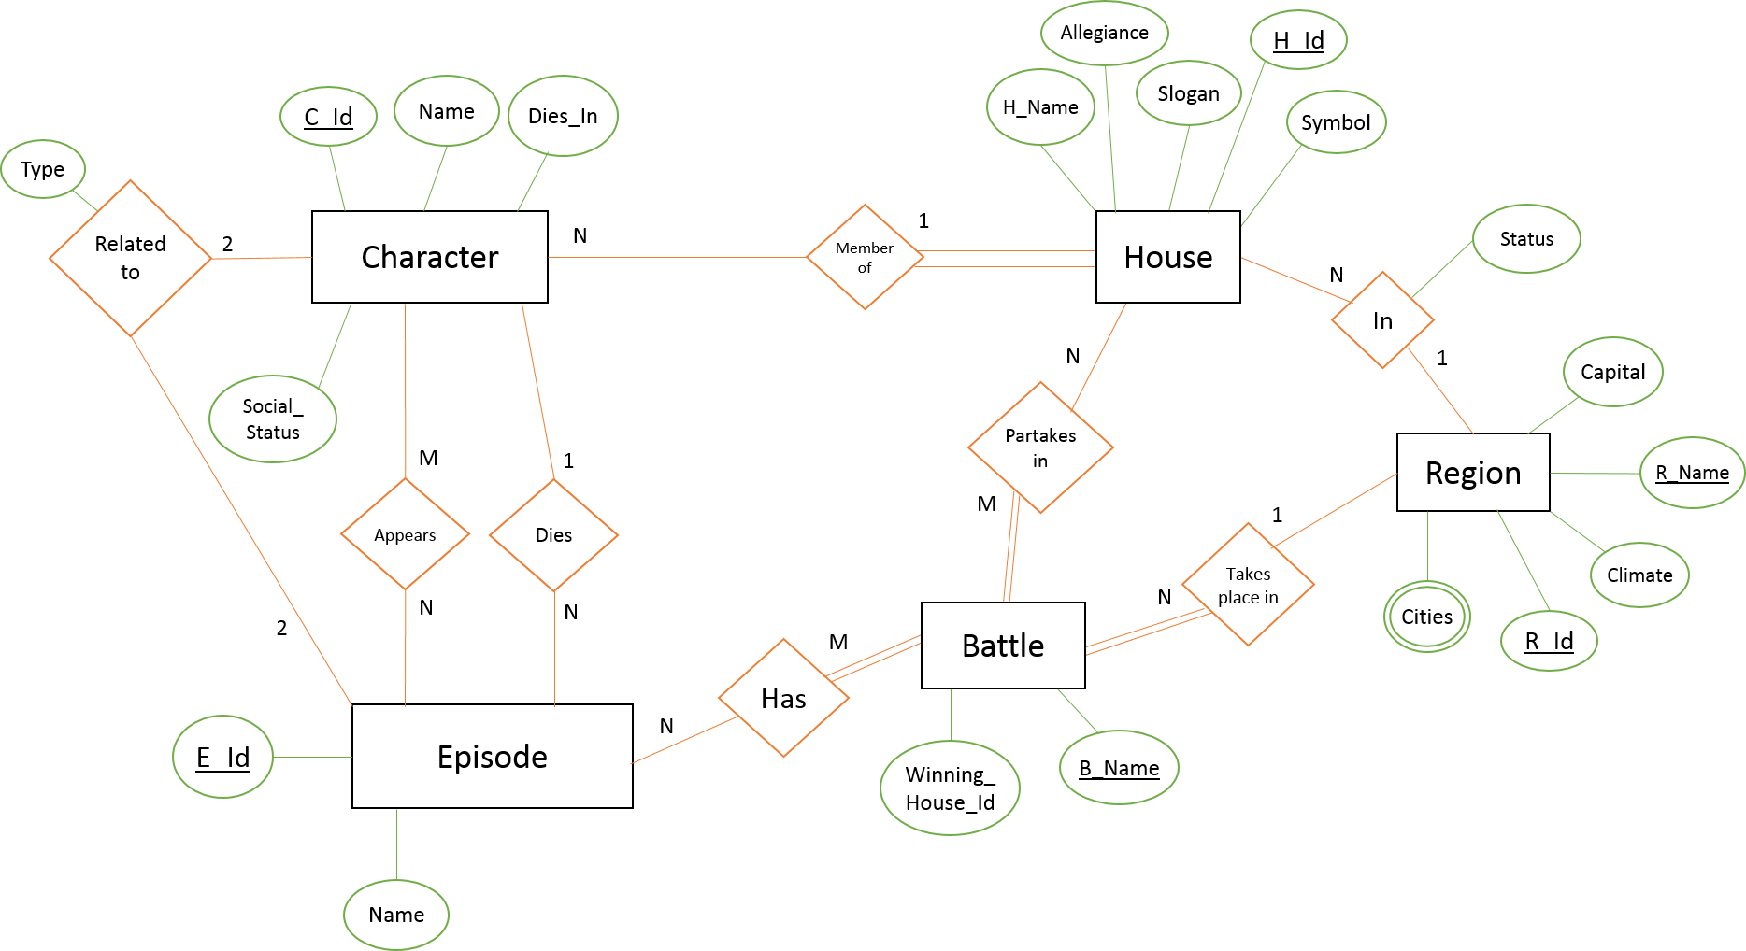
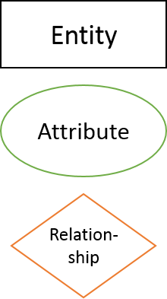
ER Diagram:
Legend:

Slide 5
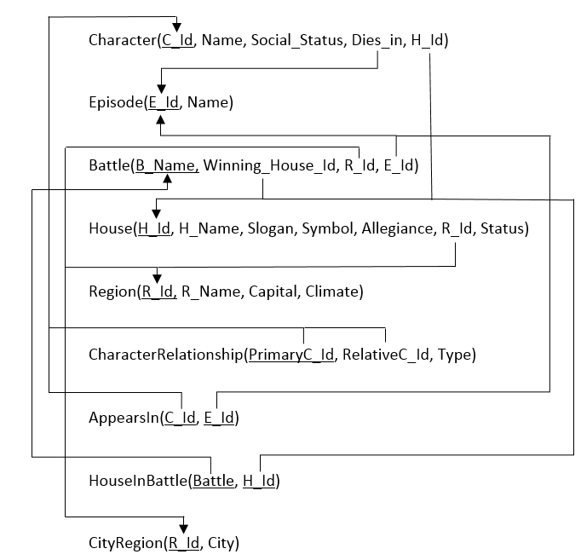
Relational Schema:

Slide 6
Html/Java Script/php Internal Structure:

Slide 7
Problems/Conflicts?
Switching to MySQL from MS SQL
Learning how to use AJAX

Slide 8
DEMOOOOOOOO:
Look how cool our database is.
So much cooler than yours.

