Slide 1

Who Can Turn Off
Your Ethereum App?
A Full Stack Walk Away Test
James Carnley
Ethereum File System
Notes:
Planned 0:00-0:15
I'm James, and I build Ethereum File System. I want the things we build to remain useful long after we are gone. Today we'll look at what that asks of the whole application.

Slide 2
Why make an app you can walk away from?
Building Cypherpunk Apps
Notes:
Planned 0:15-0:20
Why put the work into making an app people can keep using without you?

Slide 3
What happens when an app disappears?
Users lose their work and trust
Other developers can’t rely on that functionality
Communities splinter
Notes:
Planned 0:20-1:05
Imagine years of notes, attachments and shared work inside an app. The company closes, or a new owner changes the deal. Your work still matters, but you lose the tools you need to use it.
I want users to keep their work and builders to rely on each other. We can make choices now that give both a better future.
Communities and network effects take years to build and need to be nurtured.
Optional detail (not part of the timed route)
Illustrative human stakes, not a customer testimonial. Shutdown and hostile changes create different recovery problems.

Slide 4
Software worth building on
For people
Keep years of useful work
Choose better tools
For builders
Reuse dependable capabilities
Build bigger things together
Notes:
Planned 1:05-1:40
I want people to keep their work, choose better tools and trust software with important parts of their lives. And I want developers to build on useful capabilities without asking whether the original company will still exist next year.
That is why this work matters to me. Each dependable component gives the next builder somewhere to start. Over time, those components can support bigger shared projects and even the institutions our communities depend on.

Slide 5
Hyperstructures: build on each other
Community social app
Team F
DAO app
Team D
Moderation
Team E
Membership
Team A
Voting
Team B
Treasury
Team C
Independent teams work together via stable interfaces
Notes:
Planned 1:40-2:35
Hyperstructures give a name to this ambition: lasting public protocols that anyone can use and build on without depending on their creators.
Different teams provide membership, voting and treasury components. A DAO app combines them. Another team builds a social app using that DAO and a moderation module.
Each team adds a useful capability instead of rebuilding everything beneath it. Stable interfaces and dependable operation let their work accumulate.
That is the future I want us to build. CROPS brings our values: censorship resistance, open source, privacy and security.
Optional detail (not part of the timed route)
Illustrative composition, not a deployed DAO or a claim that every module meets the full hyperstructure definition. Arrows point from a reusable capability to its consumer. Moderation changes an interface's selection, not all retained records or the DAO's shared rules. Jacob Horne's definition has additional economic conditions. Ethereum operation, storage, funding and participants remain assumptions.
Sources
https://jacob.energy/hyperstructures.html
https://ethereum.org/foundation/mandate

Slide 6
A walk away test
Single points of failure and control
The team disappears
Can users keep working?
Can others run the services?
Control becomes hostile
Can users keep their work?
Can they keep the rules they chose?
TEST
Choose one important user task.
Try it without your team’s services or help.
Notes:
Planned 2:35-3:10
Pick one task your users rely on. Keep it in mind as we go through the stack.
First, imagine your team disappears. Can people keep working, and can others run the services? Then imagine control becomes hostile. Someone takes the admin keys or changes the rules. What can users still keep using?
These are single points of failure and control. The test boxes turn each layer into a small exercise you can try on your own app. Use test accounts and copies, not production outages.
Optional detail (not part of the timed route)
Absence and hostile control are separate scenarios. Several operators only help when they have the inputs and authority to act independently. Use test accounts and copied data for exercises.
Sources
https://vitalik.eth.limo/general/2024/09/28/alignment.html

Slide 7
The application stack
Interface
Data
Rules
Names and discovery
Runnable software
Accounts and recovery
Storage and formats
State and indexes
Background work
Contracts and governance
Network and settlement
Notes:
Planned 3:10-3:30
There are eight jobs to consider, grouped into three chapters: getting into the app, continuing the work, and keeping dependable rules.
For each, we'll look at an improvement you can make and something you can check. People, documentation and funding support the whole picture.

Slide 8
Finding and using the app
Interface
Notes:
Planned 3:30-3:35
First, can someone still get into your app and do that task?

Slide 9
Can people find and use your app?
Find a saved release
Run it without your servers
Recover access without your help
Notes:
Planned 3:35-3:45
They need a way to find a release, run the software and recover their access. Those are three useful checks before we even reach the app's data.

Slide 10
More than one way into the app
DNS + HTTP
DNS name
ethereum.org
Hosted website endpoint
104.18.176.152
Page in
your browser
ENS + IPFS
Operator A copy
ENS name
efs.eth
IPFS release
bafybeicrisk…p5ku
Operator B copy
Operator C copy
IPFS gateways: efs.eth.limo (or .link) or your own IPFS node
TEST
Block the usual website. Can you open
a trusted release through another route?
Notes:
Planned 3:45-4:55
Here are real names and lookup values. Ethereum dot org resolves to addresses for a hosted website. EFS dot eth points to an IPFS identifier for a particular release.
Different people can retain that release and serve the same files. Users can reach it through a gateway or their own IPFS node.
Now imagine someone takes control of the name and points it at a malicious release. A user with the previously trusted identifier can bypass that changed name and open a retained copy of the release they chose.
Keep that identifier, independent copies and clear opening instructions. Test an ordinary task without the usual website. Later, we'll ask whether its underlying contracts still keep the rules the user accepted.
Optional detail (not part of the timed route)
Lookup snapshot: 2026-10-26. ethereum.org returned A records 104.18.176.152 and 104.19.239.224 through both 1.1.1.1 and 8.8.8.8. These are Cloudflare network endpoints, not proof of one physical server; the slide groups the hosted service, not its internal machines. ENS mainnet at block 26279986 (hash 0xd812e26824d24b4ef54112803d47e0fdb7b6c5ffabe1631d624ab2cb1c349b0e, 22:54:35Z) resolved efs.eth through resolver 0xF29100983E058B709F3D539b0c765937B804AC15 to ipfs://bafybeicrisk74xwozdpx4v5kaqjmimzjqsrp74r5tsrgdyv5kju3dnp5ku. The shortened CID on the slide is explicitly an abbreviation. Three retained copies are an illustrative deployment pattern, not a measured EFS operator count. .link and .limo share the eth.limo operator; do not count them as independent retention. ENS controller, resolver and renewal powers and browser verification remain relevant.
The compromised-name scenario is illustrative, not a reported EFS incident. A retained trusted CID and a working retrieval route bypass a changed name. This protects selection of the UI release, not mutable contract powers, external dependencies or a compromised device. Newly arriving users still need a trustworthy way to find the accepted release.
Sources
https://docs.ens.domains/dweb/intro/
https://docs.ens.domains/ensip/7/
https://docs.ipfs.tech/concepts/content-addressing/
https://docs.ipfs.tech/concepts/persistence/
https://discuss.ens.domains/t/eth-limo-update/19707
https://developers.cloudflare.com/dns/proxy-status/

Slide 11
A complete runnable release
Keep every file the client needs to start
Incomplete release
Complete release
index.html on IPFS
IPFS bundle
index.html
app.js + styles + assets
Team server: app.js
Offline
Client cannot start
Client starts
TEST
Block your team’s server, then reload the client.
Does it start?
Notes:
Planned 4:55-5:40
A saved page is only useful if people can run the client behind it.
On the left, the HTML lives on IPFS, but it still loads JavaScript from the team's server. When that server disappears, the client cannot start.
On the right, the release contains its code, styles, assets and configuration. Someone can retain and serve that complete release.
Try blocking your team's host in a test environment, clear the browser cache and reload. Does the client start? We will check its data and network dependencies separately.
Keep the source, locked dependencies and build instructions too, so another developer can maintain it.
Optional detail (not part of the timed route)
Running a saved release and reproducing a build are separate checks. Inspect dynamic imports, remote configuration, wallet connectors and deep links. The Ledger Connect Kit compromise is an optional historical example of distribution becoming an attack path.
This slide tests the client release, not all external services. Bundle or independently retain essential scripts, lazy-loaded code, assets and configuration. Runtime RPCs, indexes and authorization paths are assessed in their own layers. Build source and dependency inputs must remain obtainable; a lockfile alone is insufficient. Diagram is illustrative.
Sources
https://docs.ipfs.tech/how-to/websites-on-ipfs/single-page-website/
https://www.ledger.com/blog/security-incident-report

Slide 12
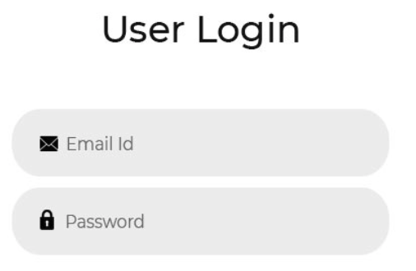
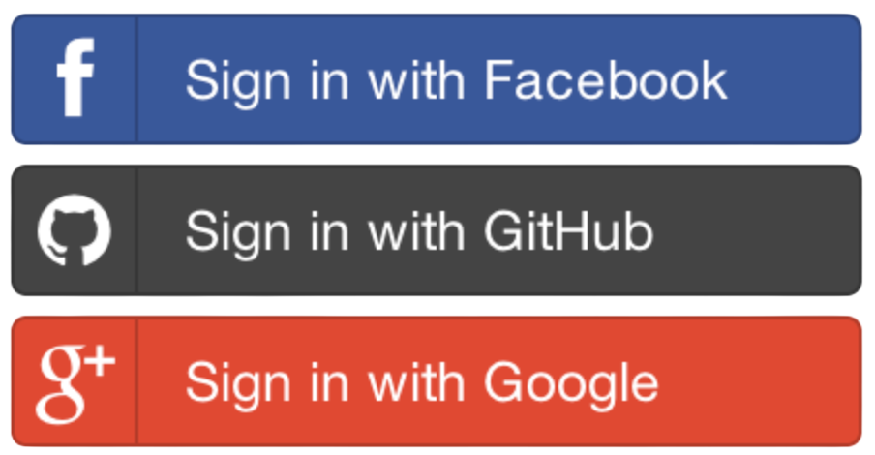
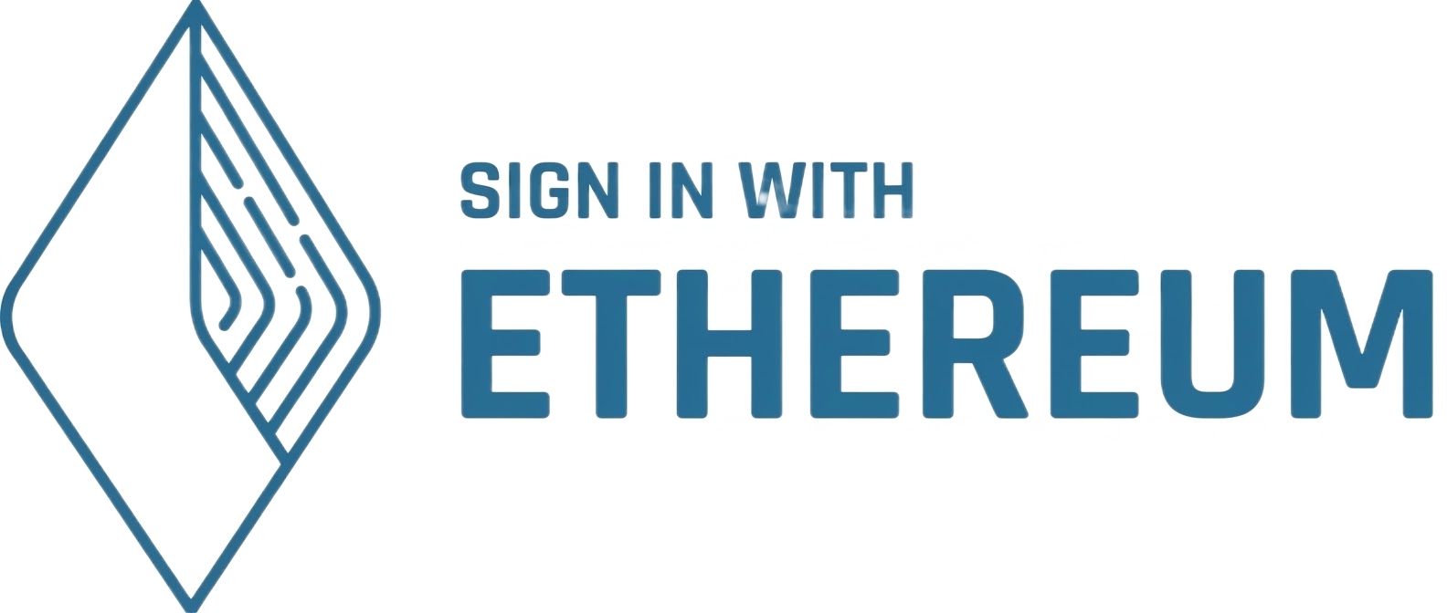
Access without the company
The client starts. Can the user actually get in?
App
Locked out
An account another service can recognize
User’s wallet
Same account
and permissions
TEST
Disable company login. Can the user complete
the same action through another client?
Notes:
Planned 5:40-6:25
The previous test showed that the client starts. Now can the user actually work?
The company’s login service can disappear even while the app and data survive. A user-controlled account gives another compatible service an identity it can recognize. Sign-In with Ethereum, or SIWE, standardizes proving control of an Ethereum account.
Whether you use SIWE or OAuth, try the complete authorized task through an independent route with the company offline. Recovery should work too, including recovery of the keys needed to decrypt private files.
We will examine the team’s administrative keys in the Rules chapter.
Optional detail (not part of the timed route)
The diagram contrasts company-mediated login with independently usable account authority. A wallet signature alone does not make a company API replaceable. The alternative requires compatible software, independently reachable services, and permission rules that recognize the same account. Safe is an optional recovery example: a configured two-of-three account can replace one lost signer using the remaining authorized signers, provided those signers and the execution path do not depend on the company. Account recovery does not reconstruct file-decryption keys. Standard encryption needs compatible formats and user-controlled key recovery. Keep sensitive data private and preserve authorization across clients. Team admin-key loss/compromise belongs in Rules and the explicit powers checklist.
SIWE authenticates an Ethereum account to an offchain service. It does not make that service independent or replaceable. OAuth/OIDC is not inherently incompatible with portability. The illustrated alternative must preserve authorization through a compatible, independently usable service or contract path.
Sources
https://docs.safe.global/advanced/smart-account-overview
https://docs.safe.global/advanced/cli-overview
https://eips.ethereum.org/EIPS/eip-4361

Slide 13
Continuing the work
Data
Notes:
Planned 6:25-6:30
Next, could they keep using the data that task depends on?

Slide 14
Is the data portable?
Keep the files and their meaning
Use them through another app
Let others run the supporting services
Notes:
Planned 6:30-6:40
Keep the files, keep their meaning, and give another app or operator the information needed to continue the task.

Slide 15

Data another app can understand
Example shared record
Shared meaning
{
id: note-17
author: 0xDEADBEEF…
text: Meeting at 10
body: Review proposals.
file: agenda.md
vers: 2
}
What each field means
Who can change it
How versions fit together
Who can read and decrypt it
Shared schemas with EAS Documented exports from your database.
TEST
Hand over an export and its format.
Can another developer read it without asking you?
Notes:
Planned 6:40-7:40
Another app needs to understand what your data means. This example has a stable identifier, an author, some text and an attachment. Publish the field meanings and the rules for reading and changing the record.
EAS, the Ethereum Attestation Service, makes this explicit through schemas for structured statements and a record of who made them.
Your existing database can benefit too. Export a documented format with identifiers, relationships, attachments and the encryption information an authorized reader needs.
Give another developer an export and its format documentation. Can they read it without asking you what you meant?
Optional detail (not part of the timed route)
The displayed note is illustrative, not a deployed EAS schema or EAS/EFS integration. EAS has separate schema, attester and data fields and supports onchain and offchain attestations. An attester is not a proof of truth. Stable IDs, author identity, references, schema versions and permission rules must retain meaning across implementations. Export offers a migration/recovery path; ongoing shared writes additionally need agreed synchronization, conflict handling and authorization. A database does not have to move onchain for these improvements.
Sources
https://attest.org/
https://github.com/ethereum-attestation-service/eas-contracts/blob/master/contracts/SchemaRegistry.sol
https://github.com/ethereum-attestation-service/eas-contracts/blob/master/contracts/IEAS.sol

Slide 16
Different tools. The same work.
Notes
Community
MY NOTES
Edit Format Attach
Following Community
Meeting
Meeting at 10
0xDEADBEEF…
Shared note / note-17
Ideas
Projects
Archive
0xDEADBEEF…
Meeting at 10
Review proposals.
Review proposals.
agenda.md revision 2
Open agenda.md (rev 2)
Saved as note-17
Reply Share Save
Same record: note-17 and agenda.md (revision 2)
TEST
Open the same record in another app.
Can the user continue their work?
Notes:
Planned 7:40-8:30
Here is the same work in two different tools. On the left, a person edits a note. On the right, their community reads it in a feed. The author, note and attachment retain their meaning.
These are illustrative interfaces, not a requirement to use these particular apps. Your users should be able to choose another tool without losing their work.
The check goes beyond whether a file imports. Can the user open the attachment and continue the task? Shared formats make that possible. Agreed permissions and synchronization matter when both apps also write to the same records.
Optional detail (not part of the timed route)
Illustrative mockups, not screenshots of deployed products. note-17 and 0xDEADBEEF… are visibly abbreviated example identifiers. A copied export supports recovery/migration; two live clients sharing edits need common authority, synchronization and compatible versions. Neither path requires EAS or EFS. Private clients must preserve authorized access and compatible decryption.

Slide 17
Who keeps a usable copy?
Files and databases
IPFS host
Files + attachments
Database export
Independent Arweave copy
User saved backup
Onchain records
Contract state
Ethereum full nodes
TEST
Block the primary storage provider.
Can you recover the record and attachments elsewhere?
Notes:
Planned 8:30-9:25
Where will a usable copy come from when the main provider disappears?
For files and databases, arrange independently retained copies. That could be an IPFS host, a copy on Arweave, or a backup the user controls. Keep attachments and the format information needed to restore useful work.
For records on Ethereum, full nodes replicate the state. Your app still needs a route to those nodes and any history it uses.
Give retention a budget and an owner. Block the primary provider in a test setup, recover through an alternative, and open the result.
Optional detail (not part of the timed route)
The diagram shows two storage arrangements, not a prescription to move every database to Ethereum. Offchain copies are illustrative and must be refreshed under a defined policy. A chain state commitment is not an archive of every historical state or offchain file. Rebuilding indexes may require retained event history and suitable node access. IPFS persistence requires providers to retain content. Backups alone do not preserve a live multiwriter service; independent deployment/sync and authorization may also be needed.
Sources
https://docs.ipfs.tech/concepts/persistence/
https://ethereum.org/developers/docs/nodes-and-clients/
https://www.inkandswitch.com/essay/local-first/

Slide 18
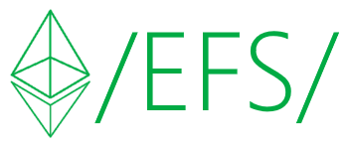
Shared paths, data verifiability
Example path: /notes/meeting.md
Onchain file record
File details + fingerprint
Retrieval references
Contract reads
file details
IPFS copy
Web client retrieves a copy
and checks its fingerprint
Arweave copy
TEST
Fetch from another source. Does its fingerprint
match the accepted file record?
Notes:
Planned 9:25-10:30
This is one job I built Ethereum File System to help with. A readable path leads to an onchain record with file details, retrieval references and a fingerprint for verifying its bytes.
A contract can read the file details. A web client can retrieve a copy from IPFS or Arweave and check its fingerprint against the expected value.
Ethereum provides metadata. Any provider can serve the same file, and another app can use its reference. What identifies the accepted version in your app, and how can someone obtain and check a replacement copy?
Optional detail (not part of the timed route)
The /notes/meeting.md path is illustrative. The EFS Sepolia proof package supplies historical evidence for retrieving and checking the same artifact through IPFS and Arweave, not a fresh run in this revision. A digest is a cryptographic hash, called a content fingerprint in the spoken explanation. It checks byte integrity relative to an accepted reference, not semantic truth, freshness or retention. Onchain contracts read metadata; clients fetch offchain bytes. Include chain, deployment and exact revision in a stable reference. No public EFS version or new deployment promise.
Visible historical summary source: EVIDENCE.md at pinned commit e86e6e77fcb5cda31374e07c5f582b502455ba80. It records a July 29, 2026 capture for efs-sepolia-deployment-reference-v0.tar.gz, 63,245 bytes, SHA-256 9c5bbda410deea8714a37b5ab82d3e22982cee79d1d1320cd43a91d562f34d39. Both retrieval rows say VERIFIED. The retained evidence is a dated results table, not raw timestamped verifier stdout. The illustrative note path above is not that archive. This pass inspected the record and did not rerun retrieval or verify present availability.
Sources
https://github.com/efs-project/contracts/tree/e86e6e77fcb5cda31374e07c5f582b502455ba80/packages/walk-away-proof
https://efs.eth.limo/
https://github.com/efs-project/contracts/blob/e86e6e77fcb5cda31374e07c5f582b502455ba80/packages/walk-away-proof/EVIDENCE.md

Slide 19
The data survives. Can your app read it?
Read a wallet balance
Ethereum
Chain state
RPC provider
or your own node
Balance
2.40 ETH
Light clients such as Helios can verify supported chain reads.
Show a transaction history
Published
records + history
Independent indexers
Example: The Graph
Recent transfers
0.20 ETH received
TEST
Switch data providers. Can users still find
their records and latest changes?
Notes:
Planned 10:30-11:40
The data can survive while your app loses its way to read it.
Reading a wallet balance is a chain-state query. An RPC connects the app to a node. Make that provider replaceable, with a route to your own node. A light client such as Helios can verify supported chain reads.
A useful transaction-history view often comes from an index. The Graph is one Ethereum example. Another operator needs the recipe and retained history to recreate that view.
Test the two jobs separately. Switch the RPC, then try another index or rebuild it. Can users still find known records and their latest changes?
Optional detail (not part of the timed route)
The Graph network is live; this is a mechanism example, not a blanket reliability assessment of every subgraph. Its normal gateway/API-key/billing path has its own dependencies. A replacement needs the subgraph definition, linked files, schema, chain history, RPC and database. Helios verifies supported Ethereum consensus/execution responses with checkpoint and RPC assumptions; it does not automatically verify arbitrary index queries or retain offchain files. Multiple RPCs offer alternatives, not verification by majority vote. For completeness checks, compare an expected set of known records as well as the indexed block height. No EFS light-client integration is claimed.
The wallet balance and transfer amounts are invented UI examples, not live account data. Test RPC replacement and index replacement separately. A known-record check and sync height are bounded evidence, not proof that every result is complete.
Sources
https://thegraph.com/docs/en/indexing/overview/
https://thegraph.com/docs/en/gateways/subgraphs/components/overview/
https://thegraph.com/docs/en/subgraphs/providers/subgraph-studio/managing-api-keys/
https://github.com/a16z/helios

Slide 20
Who sends the next transaction?
Tornado Cash: replaceable relayers
Relayer A
Offline
User authorizes
a withdrawal
Pool contract
Checks the proof
Relayer B
Submits proof
TEST
Stop your transaction service. Can another
operator complete the user’s request?
Notes:
Planned 11:40-12:35
A contract still needs someone to submit a transaction to move important business processes forward. Many apps also need background services to supply inputs or do work.
Tornado Cash Classic gives one focused example. A relayer submits a user's withdrawal proof and pays the transaction's gas. The pool contract checks the proof. The user can choose another relayer and generate a proof for that choice.
Ask the same question about your workers. Could another operator get the code and inputs, pay the costs and complete the job? Could the user take over?
Try a replacement in a test environment before the original service disappears.
Optional detail (not part of the timed route)
Technical mechanism only, not instructions to use the service or a current legal/availability claim. Classic pool withdrawal checks the proof, known root and unspent nullifier rather than a privileged caller allowlist. The proof binds recipient, relayer payment address, fee and refund; a replacement paid relayer may require a new proof. UI registry/listing rules are distinct from pool-level permissionless submission. Pool contracts, relayer registry and upgradeable governance are separate components. Oracles, provers, bundlers and paymasters have different inputs, economics and authorities; test the actual job instead of assuming every worker is interchangeable.
Sources
https://github.com/tornadocash/tornado-core/blob/master/contracts/Tornado.sol
https://github.com/tornadocash/tornado-core/blob/master/contracts/ETHTornado.sol
https://github.com/tornadocash/docs/blob/en/general/how-to-become-a-relayer.md

Slide 21
Keeping dependable rules
Rules
Notes:
Planned 12:35-12:40
Finally, can users keep the rules they accepted for that task?

Slide 22
Who chooses the changes?
Stable core contracts
User-controlled app upgrades
Clear rules for shared governance
Notes:
Planned 12:40-12:50
Stable contracts give builders a foundation. Users should be able to choose app upgrades. Shared systems need clear agreements about how their rules change.
Check who can change those rules, and what users can keep using if that power is abused.

Slide 23

Immutable contracts
UNIX mindset: Do one thing and do it well
A stable core
Keep contract code fixed
Let other apps build on it
Room to improve
Deploy a new version
Let users choose to migrate
Uniswap: fixed code, shared exchange logic
TEST
Keep the old app release and contract address.
Can users complete the task without upgrading?
Notes:
Planned 12:50-14:15
Remember the saved app release? Keeping that interface is useful. Keeping the contract rules it relies on makes the choice meaningful.
I want to encourage immutable core contracts. When the logic at an address stays fixed, another developer can build on it without asking what the original team will change next year.
Uniswap v2 core is a useful example. Other apps can call its fixed exchange logic. Release new contract versions and let users choose to migrate. Keep the old version usable for people who stay. Most app upgrades can offer that choice. Shared networks coordinate protocol changes differently.
Start with a small core you can test carefully and keep stable. Check what happens if the team loses its keys, and inspect any remaining powers that can change behavior.
Optional detail (not part of the timed route)
Fixed core code does not freeze external inputs, fees or all dependencies. v2 Factory has bounded feeTo/feeToSetter powers and no arbitrary core upgrade. Official docs describe v2/v3/v4 core as non-upgradeable; v4 hooks can introduce separate custom and upgradeable behavior. Use v2 as the simple slide example. A canonical v2 USDC/WETH Swap receipt was independently checked October 26, 2026: transaction 0xd5cc225a285adc402669af3930dca1e486e5508feb1289be447a3d1660aaa4f7, block 26280293, status 1. This establishes activity, not general safety. Zerion cites liquidity and execution benefits, not immutability as its selection motive; its API integration adds an offchain dependency. Immutability removes in-place repair, so scope/audit carefully and plan voluntary migration. No new EFS immutability verification.
Sources
https://developers.uniswap.org/docs/get-started/concepts/how-uniswap-works
https://github.com/Uniswap/v2-core/blob/master/contracts/UniswapV2Factory.sol
https://github.com/Uniswap/v2-core/blob/master/contracts/UniswapV2Pair.sol
https://developers.uniswap.org/docs/protocols/v4/security
https://zerion.io/blog/zerion-wallet-now-offers-swaps-powered-by-uniswap-api/
https://etherscan.io/tx/0xd5cc225a285adc402669af3930dca1e486e5508feb1289be447a3d1660aaa4f7

Slide 24
The network beneath the app
Ethereum and L1
Use another node
Keep required history
Check inclusion and finality
L2 and settlement
Who orders transactions?
Can users submit through L1?
How can users withdraw?
TEST
Rehearse a documented network outage.
Can the user complete the recovery steps?
Notes:
Planned 14:15-15:15
Your app inherits the chain beneath it. On Ethereum, preserve a usable node connection and the history your app needs. Understand when a transaction is included and final.
On an L2, learn who orders transactions, where the data lives and how it settles on L1. Choose one concrete failure to rehearse. For a sequencer outage, OP Stack documentation describes submitting through L1. Withdrawal and a hostile upgrade are different cases.
Use your chain’s documented path and your app’s actual account. Can the user complete the recovery steps? Record the delay, cost and anything they must prepare beforehand.
Optional detail (not part of the timed route)
An unavailable sequencer, a faulty prover, missing data and a hostile upgrade are distinct failure modes. OP Stack forced inclusion through OptimismPortal is not a universal exit guarantee or a cure for hostile upgrades. Withdrawal rules, bridges, security councils, upgrade controls and deployment configuration need separate inspection. Inherited token, oracle, bridge and other protocol dependencies can change an otherwise fixed application. Nodes need peer connectivity and required history. This is an app design check, not a performed recovery test.
The network test starts with one named failure and its chain-specific documented response. Sequencer outage, withdrawal and hostile upgrade are distinct. Do not perform production disruption or wallet transactions during the presentation.
Sources
https://ethereum.org/developers/docs/nodes-and-clients/
https://docs.optimism.io/op-stack/protocol/outages

Slide 25
Could someone run it without you?
No private help from the team
Public handoff
software + license
data + instructions
configuration + costs
Independent
operator
User’s task
completed
Their own keys
and hosting
A working service
users can choose
TEST
Give an outsider the docs. Can they run it
and complete the task without contacting you?
Notes:
Planned 15:15-15:55
The code may be public, but can someone actually take over?
Give an outsider the published software, license, inputs, configuration and instructions. Then stop helping. They use their own accounts and hosting to start a replacement and help a test user complete the task.
Record every missing instruction, permission or secret. Include the running costs and how an operator can cover them. This dry run finds knowledge that otherwise lives only in your team’s heads.
The result we want is a service users can choose, without asking the original team for permission.
Optional detail (not part of the timed route)
Illustrative handoff, not a completed operator exercise. Three participants is James's resilience ambition, not a universal safety threshold. Shared cloud accounts, credentials, funders and undocumented privileges can defeat apparent redundancy. Include licenses, documentation, funding and compatible standards so a willing operator can act.
The dry run is proposed audience practice, not a completed EFS operator handoff. An outsider must complete the actual user task using their own accounts and accessible inputs, not merely install the software.

Slide 26
A walk away test for your app
Putting this into practice
Notes:
Planned 15:55-16:00
Here is the checklist to take back to your own app.

Slide 27
Your walk away checklist
Interface
Data
Rules
Open a saved release
Recover access and keys
Restore usable records
Switch clients and providers
Run essential background jobs
Identify who can change rules
Keep using accepted rules
Try the chain’s outage or exit path
TEST
Remove one team dependency. Repeat the user’s task.
Improve what stops it, then try again.
Notes:
Planned 16:00-16:45
Return to the task you chose at the start.
Interface: can someone open a saved release and recover access? Data: can they restore usable records, choose another provider and keep required background work running? Rules: who can change them, what can users refuse, and what happens during a chain outage?
Remove one team dependency in a test setup. Repeat the task, fix what stops it, and try again.
Optional detail (not part of the timed route)
A practical exercise, not certification or a maintained scoring tool. Keep an explicit inventory of upgrade, pause, routing, account and data-writing powers. Record time, cost, privacy, required inputs and remaining assumptions. The next slide shows an illustrative export/import failure, not an observed EFS outage.

Slide 28
A walk away test in practice
Test a saved export with the original app blocked.
1. Import saved data
2. Fix the export
3. Import again
Meeting at 10
Complete export
Meeting at 10
Review proposals.
notes.json
agenda.md
Review proposals.
agenda.md
Attachment missing
agenda.md opens
Review proposals
Reconnect. Save all files.
Block the app again.
Task blocked
Task completed
TEST
Import a saved export into another app.
Can you open the note and its attachment?
Notes:
Planned 16:45-17:45
Here is one small test you could run: import a saved export into another client, then open a note and its attachment with the original app unavailable.
The first attempt imports the note, but the attachment is missing. The user cannot finish. That is a useful failure.
While the original system is still available, improve the export to include the attachment. Retain the complete copy, repeat the outage, and import again. Now the note and its attachment open.
This is an illustrative example. The method is what matters: choose a task, expose one dependency, improve it, and repeat the same task.
Optional detail (not part of the timed route)
The export, notes, attachment and application states are illustrative. No live import, runtime verification or measured recovery is claimed. The complete export must be prepared and retained while the source data is still accessible, before repeating the outage. An import is a migration/recovery path; ongoing shared edits need agreed authorization and synchronization. Use test accounts and copies.

Slide 29
Our work can outlive us
Notes:
Planned 17:45-18:30
I envision future where people can trust software with the important parts of their lives. Where their work remains theirs, they choose their own tools, and developers keep adding to foundations everyone can build on.
That is what draws me to Ethereum and what I am trying to contribute with EFS.
Start with one important task. Make it easier for someone else to keep it working. Every dependable piece gives the next person more to build with.
Our work can outlive us.

Slide 30
Thank you!
Let’s build reliable and long lasting apps together 🖖
James Carnley
Ethereum File System
efs.eth.limo
JamesCarnley@gmail.com
@JamesCarnley
Notes:
Q&A
Thank you. Which part of your app would you most like to make independent of your team?
Optional detail (not part of the timed route)
Q&A and public contact slide. No live demo or new protocol deployment is claimed.
Sources
https://efs.eth.limo/
https://app.efs.eth.limo/
https://youtu.be/gZl711IriSM

