Slide 1
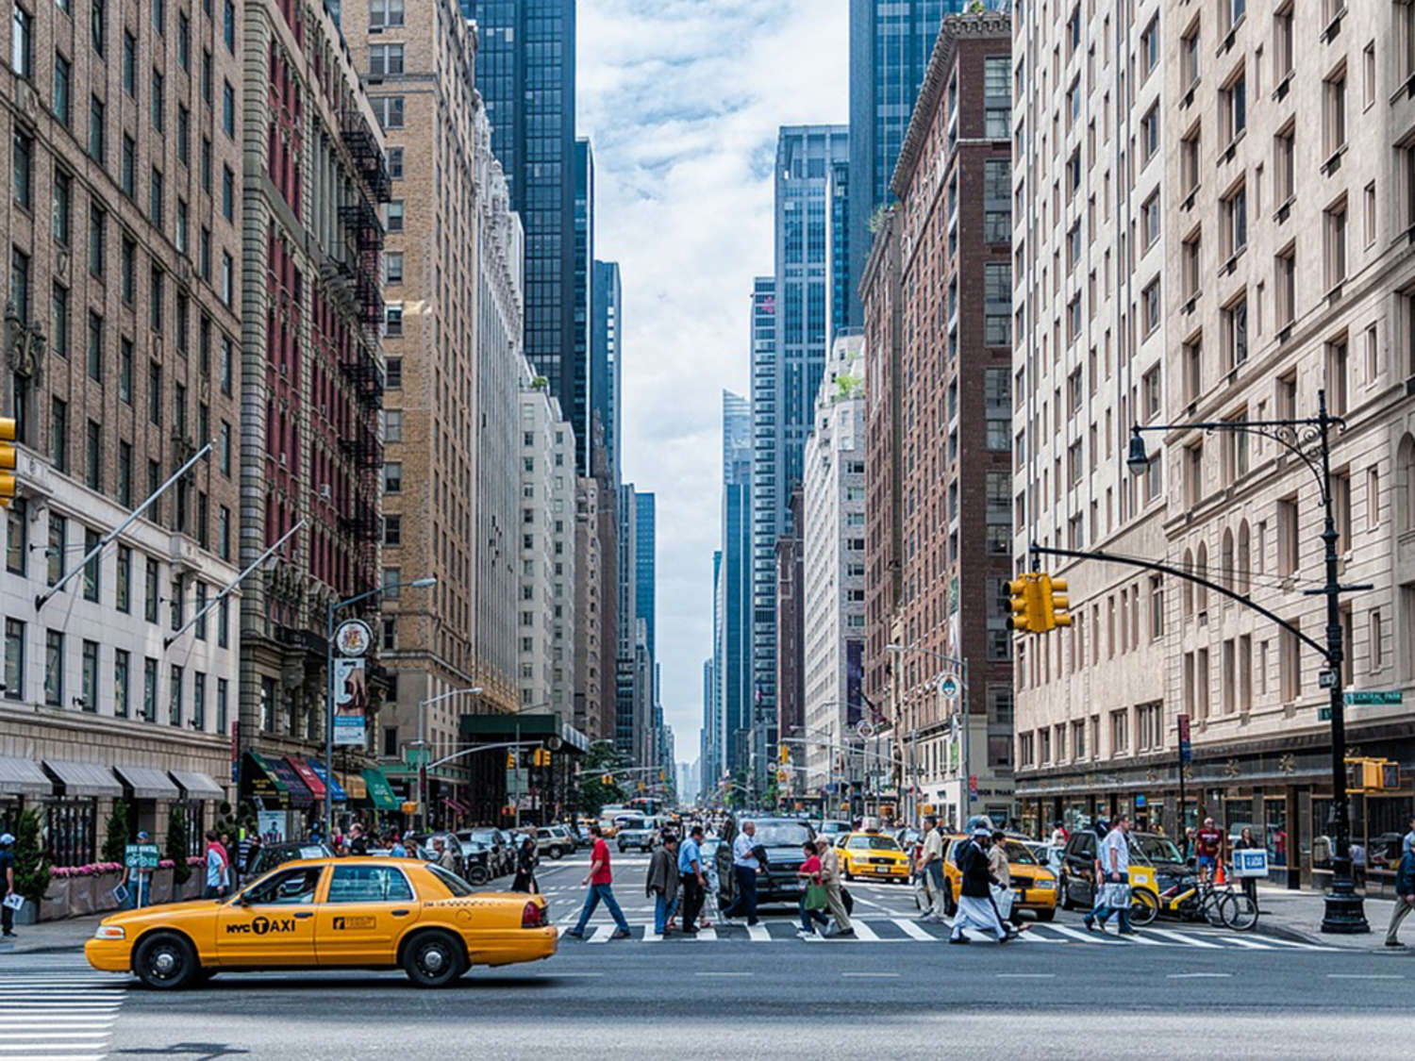
NYC Shooting Incidents: A Data-Driven Analysis (2006 – 2024)
Eric Fuentes Rico
29/04/2025
UC Boulder

Slide 2
1. Objective and motivation
Why?: NYC is one of the biggest and most populous cities with lots of data.
Violence can be understood and prevented: Where? How? When?
Impact: Make better policies and prevention.

Slide 3
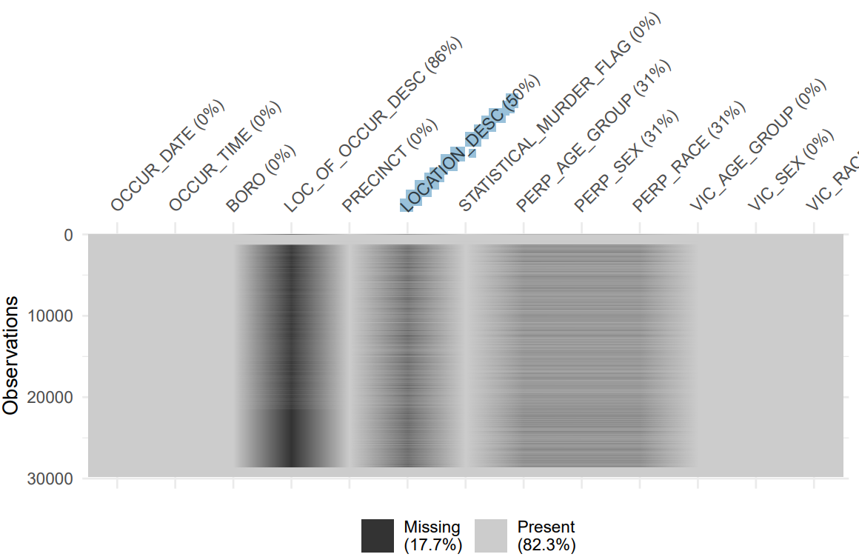

2. About the data
Source: https://catalog.data.gov/dataset/nypd-shooting-incident-data-historic
Variables and missing values:
Years covered: 2006-2024

Slide 4
3. Methodology
Tools: R, Rstudio
Visualizations: Scatter plots, line plots, heatmaps, pie charts and bar charts
Analysis: Spatial, geographical and outcome-based
Libraries used: R, tidyverse, lubridate, dplyr, naniar, hms, scales, patchwork, kableExtra

Slide 5
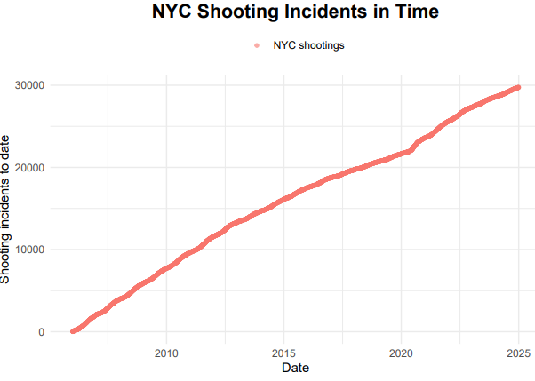
4.EDA Results:Temporal Analysis
Shooting incidents in time
Consistent increase
Population is growing

Slide 6
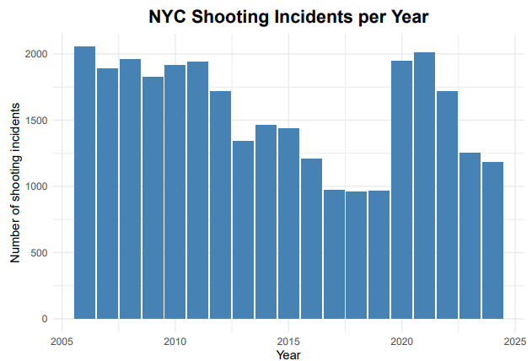
4.EDA Results:Temporal Analysis
How have shootings evolved year to year?
Violence was actually decreasing on a yearly basis!
COVID-19 seems to have made gun violence in NYC go up again.

Slide 7
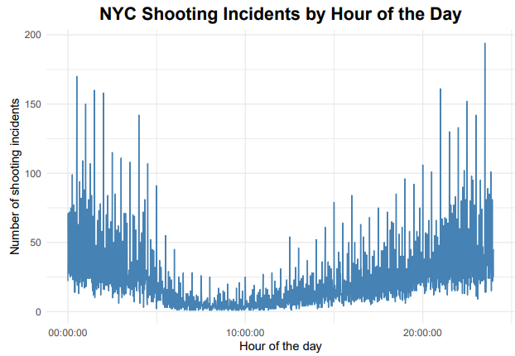
4.EDA Results:Temporal Analysis
Which are the “hot” hours for gun violence in NYC?
Safest between 6:00 AM and 10:00 AM
Unsafest between 10:00 PM and 2:00 AM

Slide 8
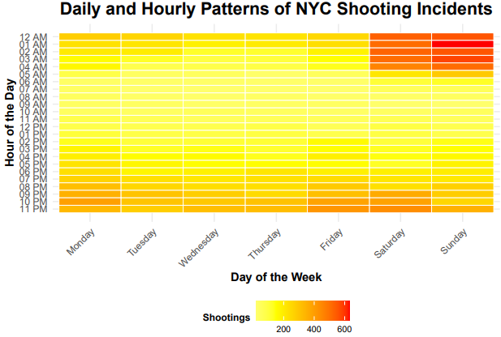
4.EDA Results:Temporal Analysis
Which are the “hot” days for gun violence in NYC?
Safest Monday to Friday in the morning.
Unsafest Saturday and Sunday past midnight.

Slide 9
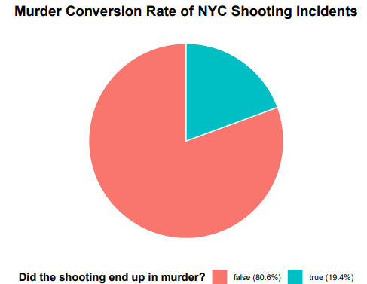
4.EDA Results: Murder Conversion Rate
Did the shooting end up in murder?
1/5 shottings end up with someone dead

Slide 10
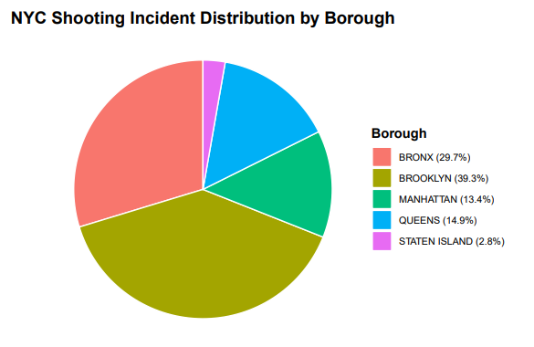
4.EDA Results: Spatial Analysis
Shootings per neighbourhood
Brooklyn has the highest number of shootings
Staten Island has the least

Slide 11
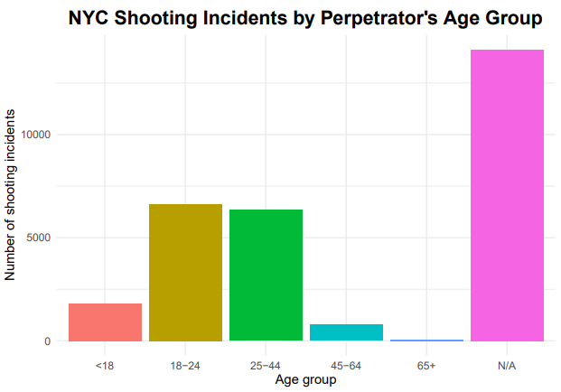
4.EDA Results: Demographics
What is the age of the perpetrators?
Mostly between 18 and 44 yrs
Most data is unknown

Slide 12
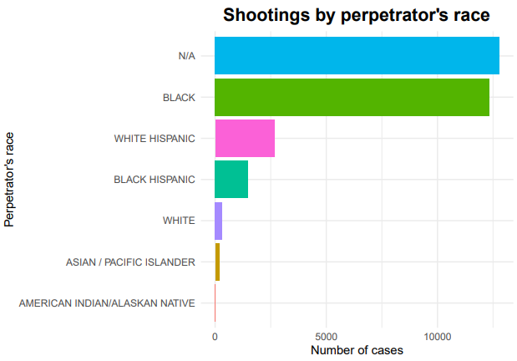
4.EDA Results: Demographics
What is the race of the perpetrators?
Mostly black and White hispanic
Most data is unknown

Slide 13
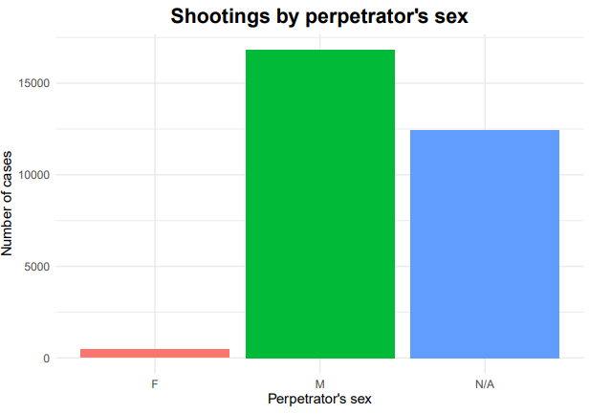
4.EDA Results: Demographics
What is the sex of the perpetrators?
Mostly men
Most data unknown

Slide 14
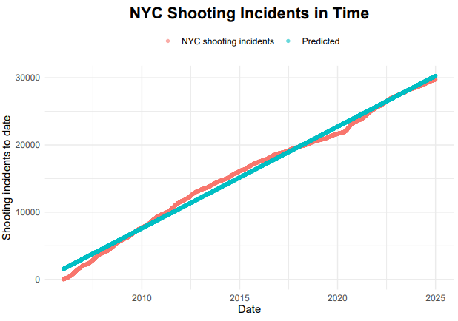
5.Predictive Model
Evolution of shootings in time
Linear regression
Only shows the bigger picture
Expected growth

Slide 15
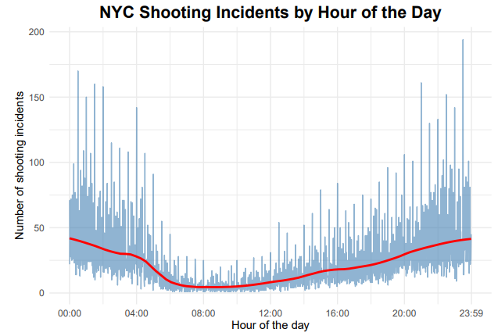
5.Predictive Model
Relation between shootings and hour of the day
Polynomial regression
Cyclical pattern reflecting daily schedules of New Yorkers.

Slide 16
5.Conclusions
Temporal trends: Population and shootings grow. Unresolved causes of violence.
Daily and weekly cycles: Late night weekend unsafe, mornings of business days safe.
Geographic disparities: Brooklyn and the Bronx have the most shootings by far.
Demographic patterns: Perpetrators are predominantely males between ages of 18 and 44.
Lethality: 1/5 shootings kill at least someone.

Slide 17
THANK YOU!

