Slide 1
PCHIP Interpolation
CAP-418 Numerical Methods I
2023-05-09

Slide 2
Contents
Objectives
Gauss-Hermite quadrature method (GHQ)
Shape-preserving piecewise cubic interpolation (PCHIP)
Burgers' equation toy problem
1D Burgers solution using GHQ
Comparison of PCHIP and GHQ curves
Conclusion
Future works (GPA, 2D Burgers, PINN)

Slide 3
Objectives
Discretization and resampling of functions by bootstrap: PCHIP method
Application of the PCHIP method to simulate the 1D Burgers equation
Compare with Gauss-Hermite Quadrature method (GHQ)
A second phase of the project (work in progress) foresees the use of GPA, 2D Burgers, and PINN

Slide 4
Gauss-Hermite Quadrature rule (GHQ)
A Gaussian quadrature form for approximating integral values
The solution of the Burgers equation use estimated values calculated using GHQ, as described in the Basdevant et al. (1986) article Spectral and finite difference solutions of the Burgers equation
The implementation is based on that of John Burkardt https://people.sc.fsu.edu/~jburkardt/

Slide 5
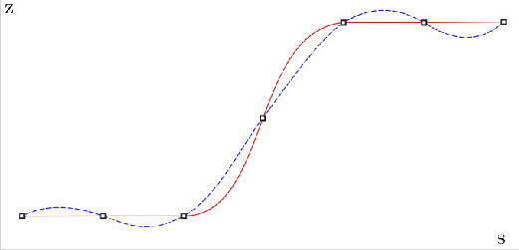
Shape-preserving piecewise cubic interpolation (PCHIP)
PCHIP takes the same form as the GHQ, but with the first derivatives defined in a special way
The new function values do not exceed the function values at the end of each range
PCHIP
Spline

Slide 6
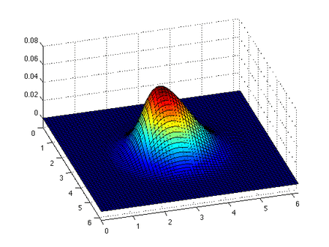


Burgers’ equation toy problem
Is a fundamental partial differential equation and convection–diffusion equation
GHQ uses Burgers to generate
a dataset
This dataset is then used in
PCHIP
I.C.
B.C.
Viscosity

Slide 7
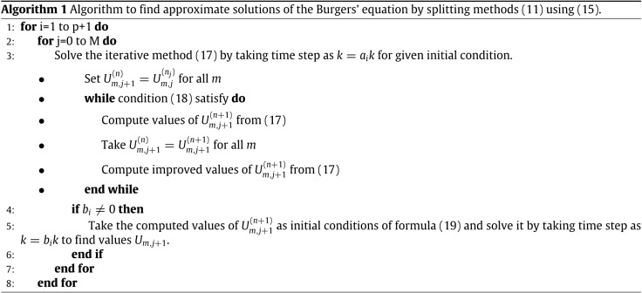
GHQ implementation
While some algorithms are available, this work has not focused on GHQ

Slide 8

GHQ implementation
The implementation is adapted from the work of J. Burkardt
Uses an algorithm by Elhay and Kautsky
The abscissas are the zeros of the N-th order Hermite polynomial
The integral and the quadrature rule are given by

Slide 9
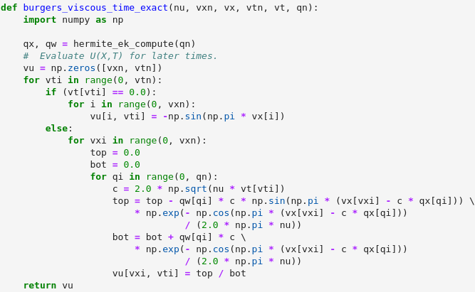
GHQ implementation
Implementation uses Python and Jupyter Notebook
A part of the code is shown below:

Slide 10
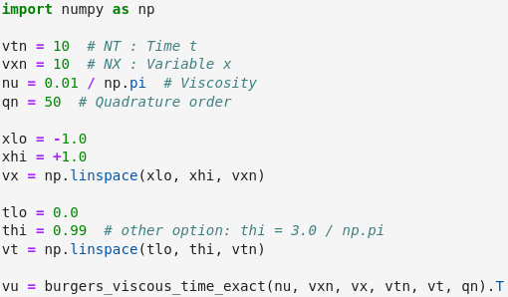
Parameters

Slide 11
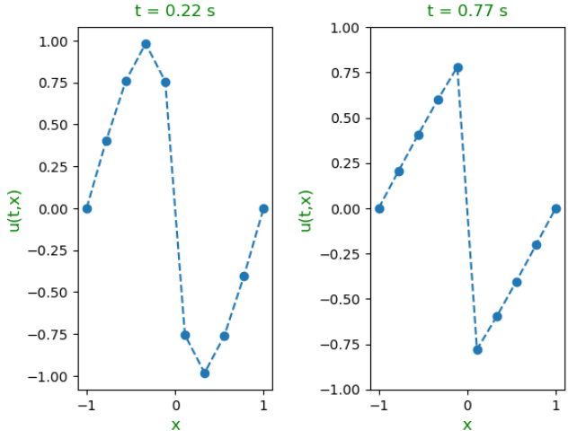
Result

Slide 12
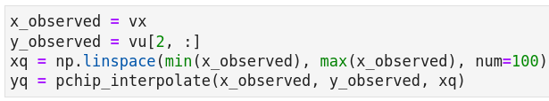
PCHIP interpolation
Uses SciPy and the small dataset generated by GHQ
The points specified in xq (query points) are the x-coordinates for the interpolated function values yq computed by pchip :

Slide 13
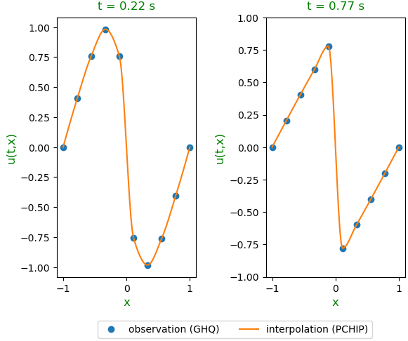
Result
Using a small dataset of 10 points

Slide 14
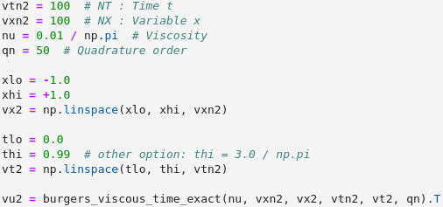
1D Burgers solution using GHQ
Generates a dataset containing 100 points

Slide 15
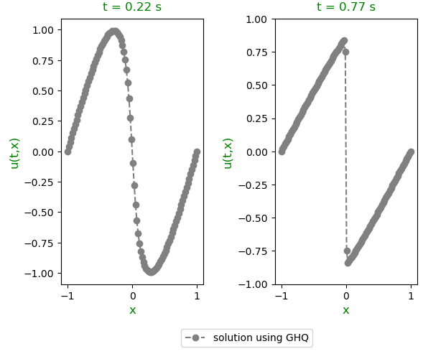
Only CHG

Slide 16
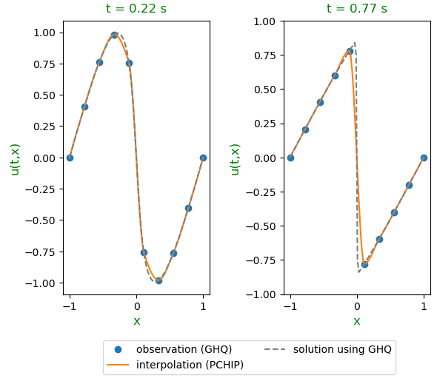
Comparison of PCHIP and GHQ curves

Slide 17
Conclusion
This work compared the PCHIP interpolation method with the Gaussian quadrature method, using the solution of the 1D Burgers equation as a toy problem
The Gauss-Hermite quadrature method was used both to generate the points that were interpolated and to generate the solution that is compared with PCHIP
The result shows that there is a certain special deviation near the sharp edges of curves at local maxima or minima. However, the PCHIP method generally showed good performance to interpolate the selected toy problem

Slide 18
Future works
PCHIP implementation using the algorithm (not the library)
2D Burgers
  Rewrite the work
Gradient Pattern Analysis (GPA)
  https://github.com/rsautter/GPA (Rubens Sautter)
PINN (work in progress, see next slide)
Compare the performances

Slide 19
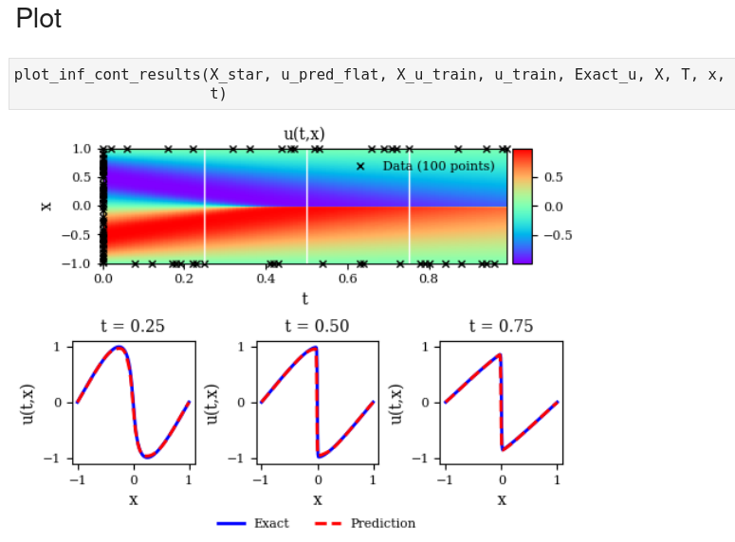
PINN (work in progress)
https://github.com/efurlanm/418/blob/master/burgers-tf-02.ipynb
Burgers
CHG
PINN
TensorFlow v2
Running on GPU
CGH
PINN

Slide 20
Thanks https://github.com/efurlanm/418

