Slide 1

Data-Driven Parameter Discovery of a One-Dimensional Burgers' Equation Using a Physics-Informed Neural Network
Eduardo F. Miranda
CAP-425 Advanced Topics in Environmental Modeling
2023-12-06

Slide 2
Content
1. Introduction
2. Approaches and resources
3. Results: analysis and performance
4. Final considerations

Slide 3
Why PINN?
New ML approach for PDE solution
Is it possible to obtain approximate substitute models
In some cases it can be an alternative to numerical methods
Can increase the efficiency of existing models
Can be used to obtain parametric representation in numerical modeling of atmospheric processes

Slide 4
1
Introduction

Slide 5
Objectives of this work
PINN data-driven PDE parameter discovery approach
Implementation of a test problem (1D Burgers' equation)
From a small set of scattered observations, approximate the parameters that best describe the data
Tuning of hyperparameters and dataset size
Run on GPU on the SDumont supercomputer

Slide 6
Literature (neural network)
Speedup of 7 in atmospheric model
  Chevallier, F., Morcrette, J. ‐J., Chéruy, F., & Scott, N. A. (2000). Use of a neural‐network‐based long‐wave radiative‐transfer scheme in the ECMWF atmospheric model. Quarterly Journal of the Royal Meteorological Society, 126(563), 761–776. https://doi.org/10.1002/qj.49712656318
Speedups from 10 to 10⁵ using parameterization of physical models in ocean and atmospheric numerical models
  Krasnopolsky, V. M., & Fox-Rabinovitz, M. S. (2006). A new synergetic paradigm in environmental numerical modeling: Hybrid models combining deterministic and machine learning components. Ecological Modelling, 191(1), 5–18. https://doi.org/10.1016/j.ecolmodel.2005.08.009

Slide 7
2
Approach and resources

Slide 8
Resources
TensorFlow 1.15: open source library for ML and AI
Python 3.7: environment and programming language
JupyterLab: interactive and web environment
SDumont: LNCC supercomputer
  Sequana X Node: 2x Xeon 6152 22-core + 4x Volta V100 GPU

Slide 9
Physics-Informed Neural Network (PINN)
PINN embeds PDE as part of the Deep Neural Network
Converts the model into an optimization problem
Can generate approximate surrogate models
In some cases it can be an alternative or complement to the numerical method
Data-driven PDE parameter discovery
Colocation Points (CPs) are used to train the network

Slide 10
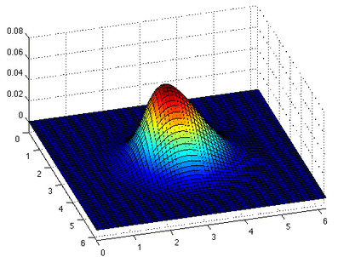


1D Burgers Equation
Fundamental PDE and a convection-diffusion equation
  Can be derived from the Navier-Stokes equations
Used in turbulence models and shock wave theory, fluid mechanics, nonlinear acoustics, gas dynamics, etc.
Fluid speed
Diffusion coefficient
Other representation

Slide 11

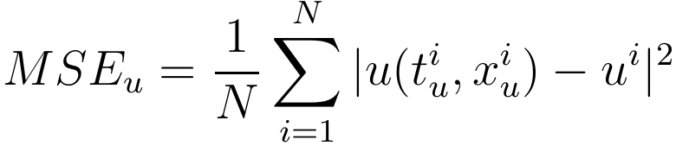
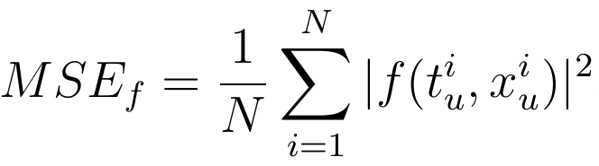
Training minimizes MSE loss
Mean squared error
Uses CPs to obtain equation parameters
Uses CPs to obtain DNN parameters

Slide 12
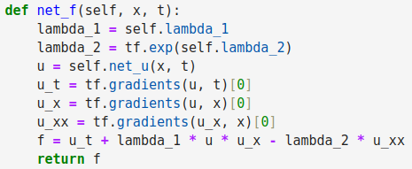
Simplified implementation example
(TensorFlow)

Slide 13
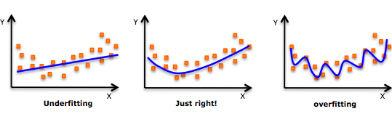
Underfitting/Overfitting
Overfitting: difficulty in generalizing, and poor performance
Underfitting: difficulty modeling data, and poor performance

Slide 14
3
Results: analysis and performance

Slide 15
Configuration and environment
MLP network with 2 input and 1 output neurons
1 to 8 hidden layers
10 to 30 neurons per hidden layer
400 to 2,000 CPs for training and to check the result
  Random, within the PDE domain
Optimization function: L-BFGS
Activation function: hyperbolic tangent
SDumont Sequana X Node with Volta V100 GPU, TensorFlow 1.15, Python 3.7

Slide 16
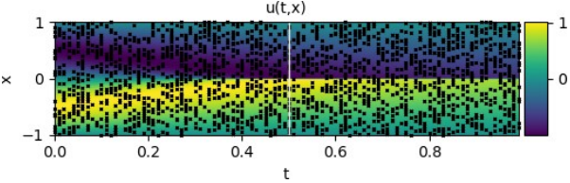
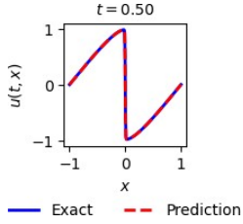

PINN’s predictive accuracy
2,000 CPs
λ1 = 1
λ2 = 0.01/π
4 hidden layers
20 neurons each
Obtained by PINN:
Used to train:

Slide 17
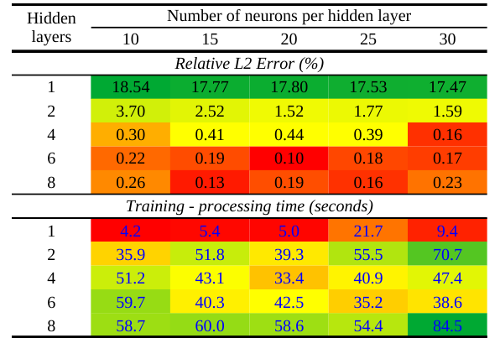
Relative L2 error & Trainig time / Hidden layers
On the color scale, the best values are highlighted in red

Slide 18
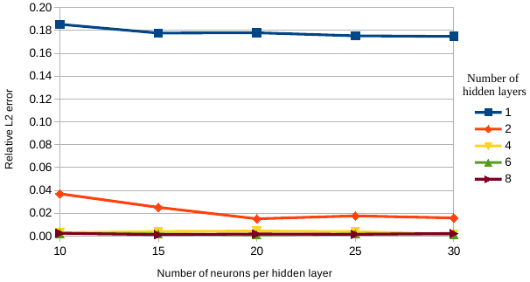
Relative L2 error

Slide 19
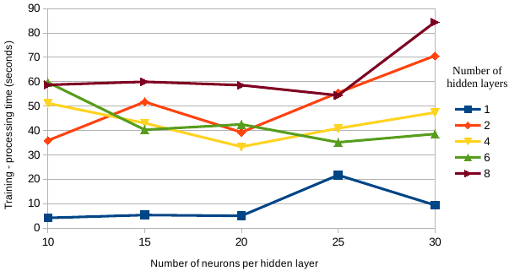
Training time

Slide 20
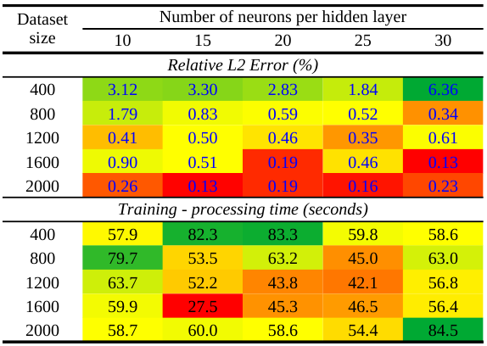
Relative L2 error & Training time / Dataset size
On the color scale, the best values are highlighted in red

Slide 21
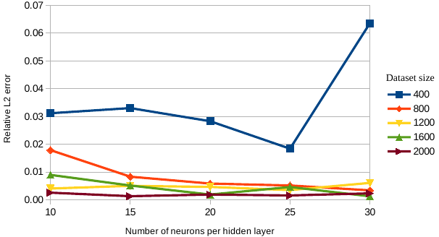
Relative L2 error

Slide 22
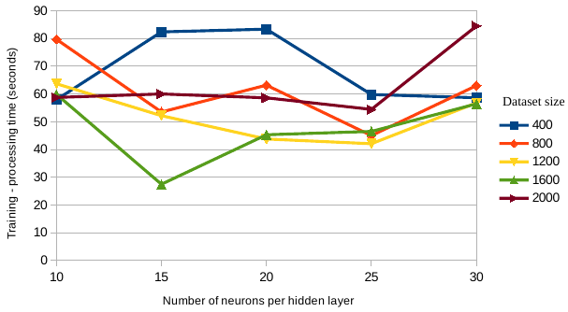
Training time

Slide 23
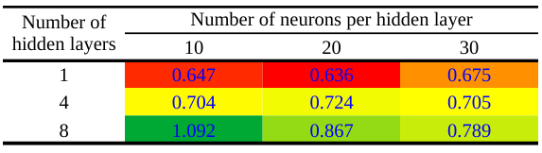
Number of neuros / Hidden layers
On the color scale, the best values are highlighted in red

Slide 24
4
Final considerations

Slide 25
Final considerations
Data-Driven Parameter Discovery of a 1D Burgers' Equation, executed on SDumont
Error and training time evaluation, for different hyperparameters and dataset sizes
Tuning hyperparameters and dataset size for performance
Simple implementation, easy to get results
Future works
  Evaluate the use of other PINN architectures
  Take advantage of the parallel use of GPU

Slide 26
Thanks!
Source code: https://github.com/efurlanm/425

