Slide 1
Data-driven Parameter Discovery of One-dimensional Burgers' Equation Using Physics-Informed Neural Network
Eduardo Furlan Miranda
Stephan Stephany
Roberto Pinto Souto
Qualification Exam - Doctorate CAP/INPE
Notes:
Observação importante: para ver corretamente esta apresentação, voce precisa ter a fonte tipográfica Calibri instalada. Essa fonte está disponivel no Windows Vista. Você também pode baixar o Power Point Viewer 2007, que contém a fonte Calibri, no site da Microsoft. Custe o que custar, não deixe o Windows substituir a fonte Calibri pela fonte Arial, que é indecente.

Slide 2
Table of Contents
Introduction
Approaches
Toy Problem
Results
Final Considerations

Slide 3
Why PINN ?
Physics-Informed Neural Network (PINN)
  Data-driven model derived using law of physics described by general nonlinear PDEs and constraints (ICs and BCs)
PINN performs PDE parameter discovery (inverse problem) or PDE solution (direct problem)
Suitable for sparse, limited, incomplete, or noisy data, irregular domains and complex non-linear patterns
No solver or discretization/grid required

Slide 4
Why PINN ?
Recent approach for identifying and solving dynamical systems involving PDEs
The literature show promising speedups by porting a standard module to PINN in a weather numerical model
Availability of frameworks like NVIDIA Modulus and Uber Horovod for GPU execution

Slide 5
1
Introduction

Slide 6
Objectives
Comparing accuracy of PINN and a numerical method (SINDy) for PDE parameter discovery of a toy problem
Evaluate PINN performance for different CP sizes and hyperparameters
The PINN is trained resulting in a model then used for solution (parameter discovery & solution)
Visual evaluation of the PINN solution using the exact solution as reference

Slide 7
Related work
Speedup of 3 by refactoring the solver and replacing the gas optics module with a PINN (Ukkonen et a., 2020)
Speedup of 7 in the ECMWF Long-wave Radiative Transfer model (Chevallier et al., 2020)
10 to 10⁵ times acceleration of the Longwave Radiation parameterization for the NCAR CAM and NSIPP GCM (Krasnopolsky et al., 2006)

Slide 8
Challenges
Lack of public documentation for PINN downloadable implementations
New PINN implementations for real-world applications
Porting parts/modules of existing code to PINNs
PINN execution on GPUs, using new frameworks like Modulus

Slide 9
Two parts in this work
Comparison of accuracy and processing time of PINN and a standard numerical method (SINDy) in the inverse and direct problem (toy problem) - execution on a local PC
Analysis of size of the CP set and hyperparameters in the PINN performance - execution on the LNCC SDumont supercomputer

Slide 10
2
Approaches
Notes:
Abordagens

Slide 11
PINN - some approaches and resources
MLP: the most common architecture
Other architectures
  Convolutional Neural Networks (CNNs), Recurrent Neural Networks (RNNs), Auto-Encoder (AE), Deep Belief Network (DBN), Generative Adversarial Network (GAN) and Bayesian Deep Learning (BDL)
PINN variations
  Variational hp-VPINN, conservative PINN (CPINN), and physically constrained DNNs (PCNN), Conservative PINN (CPINN), Conservative PINN (CPINN)

Slide 12
PINN - some approaches and resources
Current research on PINNs explores architectures, activation functions, loss functions, and gradient optimization techniques
The PINN mainstream is still the PDE direct problem
The number of works PINNs to solve PDE inverse problems has been increasing

Slide 13
PINN - some approaches and resources
PINNs may model the PDE with unknown IC and BC (called soft BC)
PCNNs, a class of data-free PINNs, impose known IC and BC (hard BC) via a customized DNN architecture, that also include the PDE in the loss function
Frameworks and implementations
  Deep Ritz Method (DRM), Deep Ritz Method (DRM), Deep Galerkin Method (DGM), hp-VPINN

Slide 14
3
Toy Problem

Slide 15
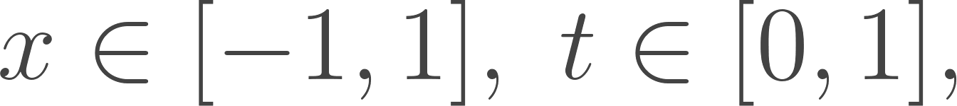
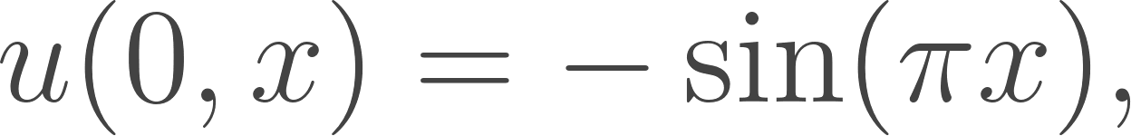
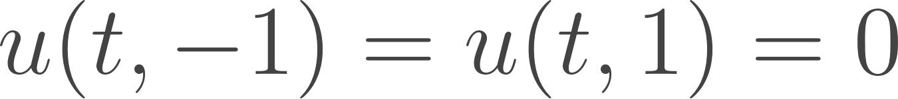
Toy problem - 1D Burgers' equation
Velocity field u of a fluid ( dimension x and time t )
IC:
BC:
Unknown parameters are the coefficients of the differential operators: λ₁ = 1.0, λ₂ = ν = 0.01/π or 0.1/π (smallest viscosity causes discontinuities)

Slide 16
PINN parameter discovery
MLP architecture: 2-neuron input layer, 1-to-8 hidden layers using hyperbolic tangent as activation function, 10-to-30 neurons per hidden layer and a single-neuron output layer
The loss function uses the Mean Squared Error (MSE), being minimized by the Generalized Limited-memory Broyden-Fletcher-Goldfarb- Shanno (L-BFGS) optimization algorithm
Each iteration equals one epoch (singe batch per epoch)

Slide 17
PINN training input data (set of CPs)
Problem sizes (1D grid points x timesteps)
  128x64, 256x100, 256x128, 512x256
  Exact field given by Gaussian Quadrature Method (GQM)
No division of PINN input data into training, validation and test sets (training -> resulting model)
  Random sample of 2,000 CPs from given dataset
  PDE parameters discovery (from training)
  PDE predicted solution (no further training)

Slide 18
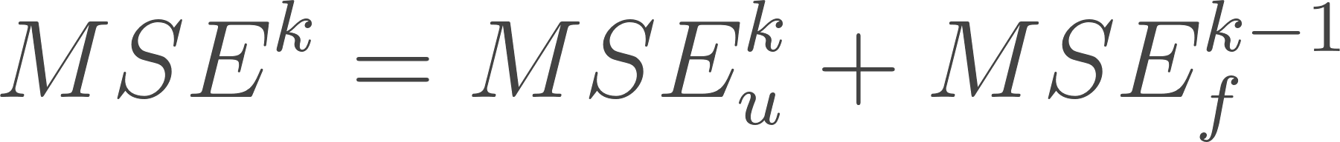
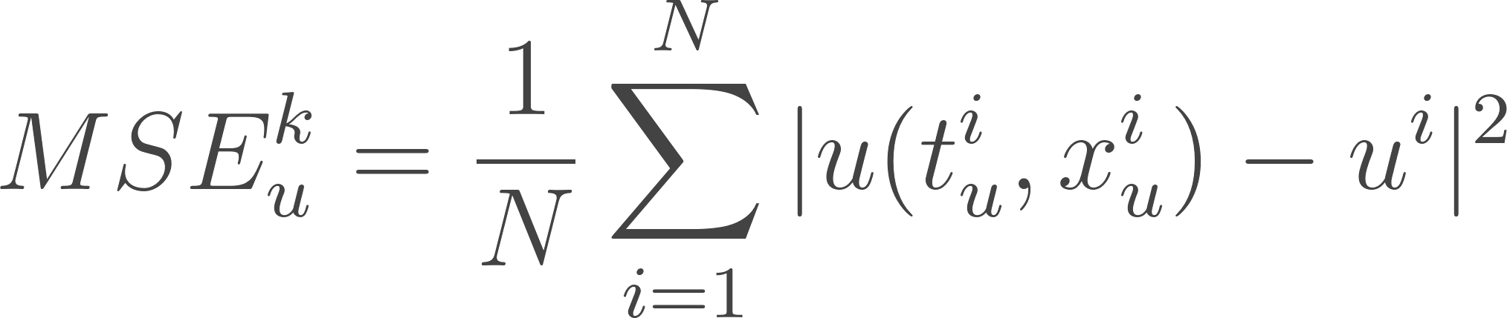
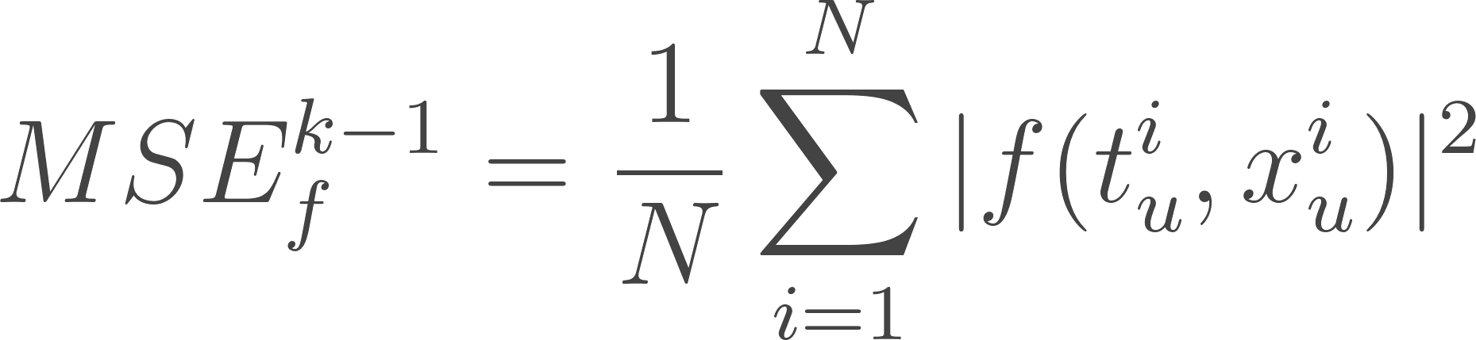
PINN loss function
Two-term MSE (iterations k and k-1)
MSE_{u} - PINN solution matching of the exact data points for the set of CPs at iteration k
MSE_{f} - residual of the known PDE for the set of CPs predicted by the PINN at iteration (k-1)

Slide 19
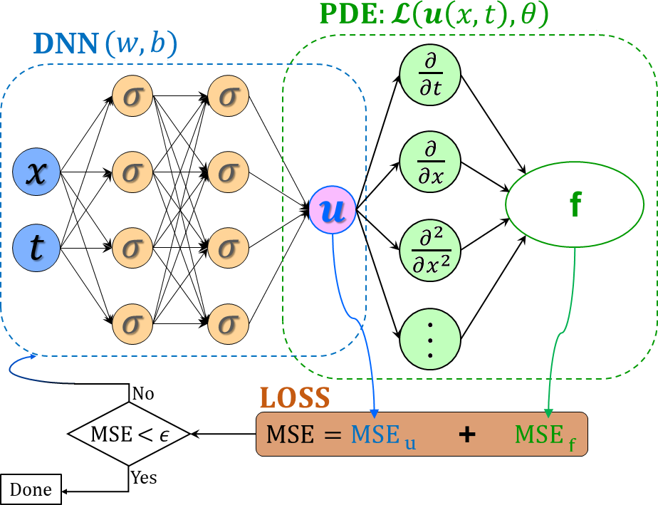
PINN loss function

Slide 20
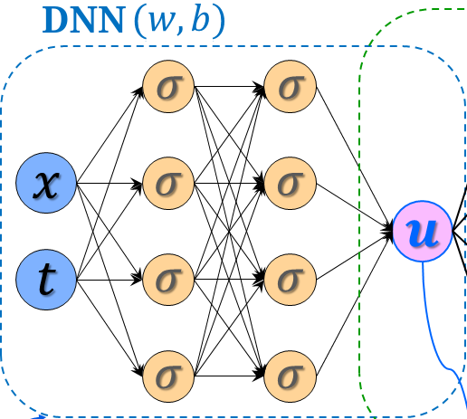
PINN implementation: u(t, x)
Predicted solution using the DNN
def neural_net(X, weights, biases):
num_layers = len(weights) + 1
H = 2.0 * (X - lb) / (ub - lb) - 1.0
for l in range(0, num_layers - 2):
W = weights[l]
b = biases[l]
H = tf.tanh(tf.add(tf.matmul(H, W), b))
W = weights[-1]
b = biases[-1]
Y = tf.add(tf.matmul(H, W), b)
return Y
def net_u(t, x):
u = neural_net(tf.concat([x, t], 1), weights, biases)
return u
TensorFlow 1.15 (GPU)

Slide 21
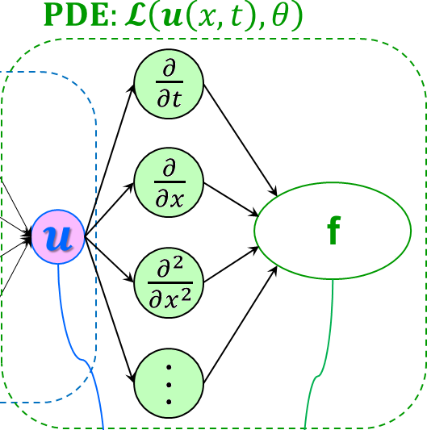
PINN implementation: f(t, x)
Predicted solution using the PDE
def net_f(x, t):
lambda_1 = lambda_1
lambda_2 = tf.exp(lambda_2)
u = net_u(t, x)
u_t = tf.gradients(u, t)[0]
u_x = tf.gradients(u, x)[0]
u_xx = tf.gradients(u_x, x)[0]
f = u_t + lambda_1 * u * u_x - lambda_2 * u_xx
return f
TensorFlow 1.15 (GPU)
tf.gradients is used in the gradient-based training and optimization algorithm, and uses automatic differentiation to compute gradients (derivatives)

Slide 22
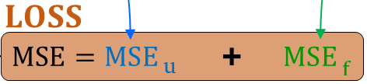
PINN implementation: loss function
u_tf = u # exact solution
u_pred = net_u(t, x) # predicted solution using the DNN
f_pred = net_f(t, x) # predicted solution using the PDE
loss = (tf.reduce_mean(tf.square(u_tf - u_pred)) +
tf.reduce_mean(tf.square(f_pred)))

Slide 23
SINDy parameter discovery
Sparse Identification of Nonlinear Dynamical Systems (SINDy) method (Brunton et al., 2016)
Uses sparse regression to create a linear combination of basis functions to capture the dynamic behavior of the considered physical system
Iterative optimization using an objective function
Applications: linear and nonlinear oscillators, chaotic systems, fluid dynamics, and others

Slide 24
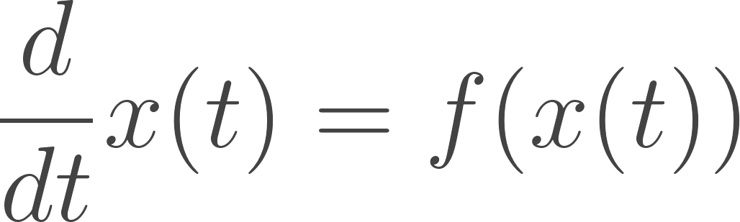
SINDy
The temporal evolution of x(t) is modeled using the nonlinear function
The vector x(t)=[x₁(t), x₂(t), ... xₙ(t)]⊤ represents the state of the physical system at time t

Slide 25
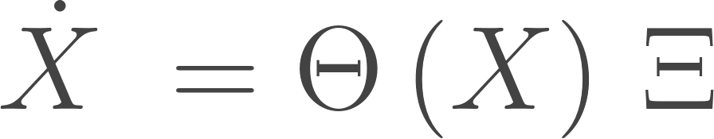
SINDy
The problem solved by SINDy is
Θ : matrix f(x(t)) of basis functions applied to the input data X, i.e. Θ(X)
Ξ : matrix of coefficients that indicates which terms in Θ(X) are significant
  reconstructs the governing equations of the dynamical system
Along the iterations, these coefficients are optimized until achieving convergence
Notes:
Θ = \Theta; Ξ = \Xi; X = state vector; X˙ (dX/dt) represents how the state vector changes over time; X and X˙ are used to identify the most significant terms in the governing equations f(X)

Slide 26
PySINDy implementation of SINDy
Includes 4 different Sparse Regression Optimizers
Sequentially Threshold Least Squares (STLSQ)
Orthogonal Least Squares of Forward Regression (FROLS)
Sparse Relaxed Regularized Regression (SR3)
Sparse Stepwise Regression (SSR)
http://pysindy.readthedocs.io

Slide 27
Python code snippet that implements SINDy
optimizer = ps.STLSQ(threshold=2, alpha=1e-5,
normalize_columns=True)
model = ps.SINDy(feature_library=pde_lib,
optimizer=optimizer,
feature_names=["u"])
model.fit(u, t=dt)
model.print()

Slide 28
Computing environment
PC local machine 6-core Intel i7 9750h CPU, 8 GB of main memory, and an NVIDIA GTX 1050 GPU (768 CUDA cores and 3 GB of memory)
LNCC SDumont single Bull Sequana X1120 processing node with two 24-core Intel Xeon Gold 6252 Skylake 2.1 GHz processors (total of 48 CPU cores), 384 GB of main memory and 4 Nvidia Volta V100 GPUs
Python 3.7, TensorFlow 1.15, PySINDy 1.7.5

Slide 29
4
Results

Slide 30
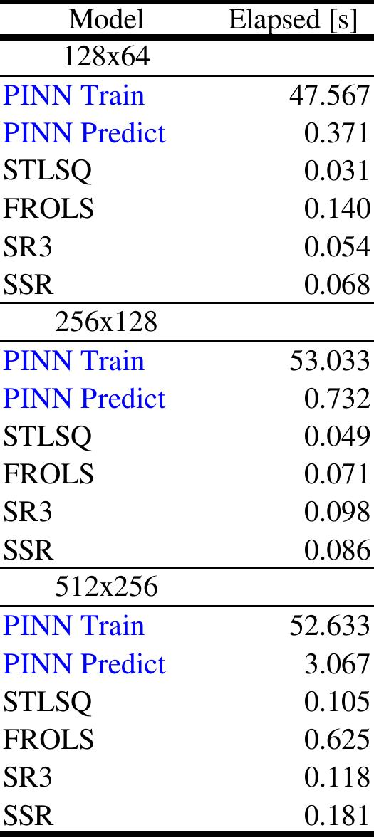
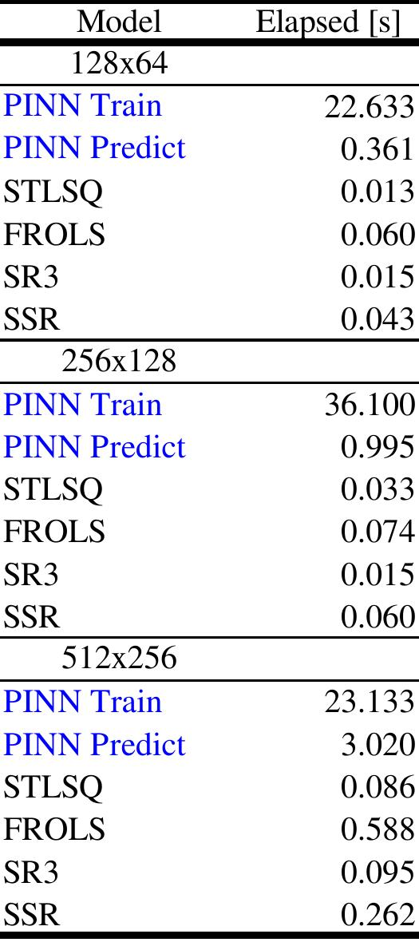
PINN and SINDy models - elapsed time [s]
(local PC machine)
0.01/π
0.1/π

Slide 31
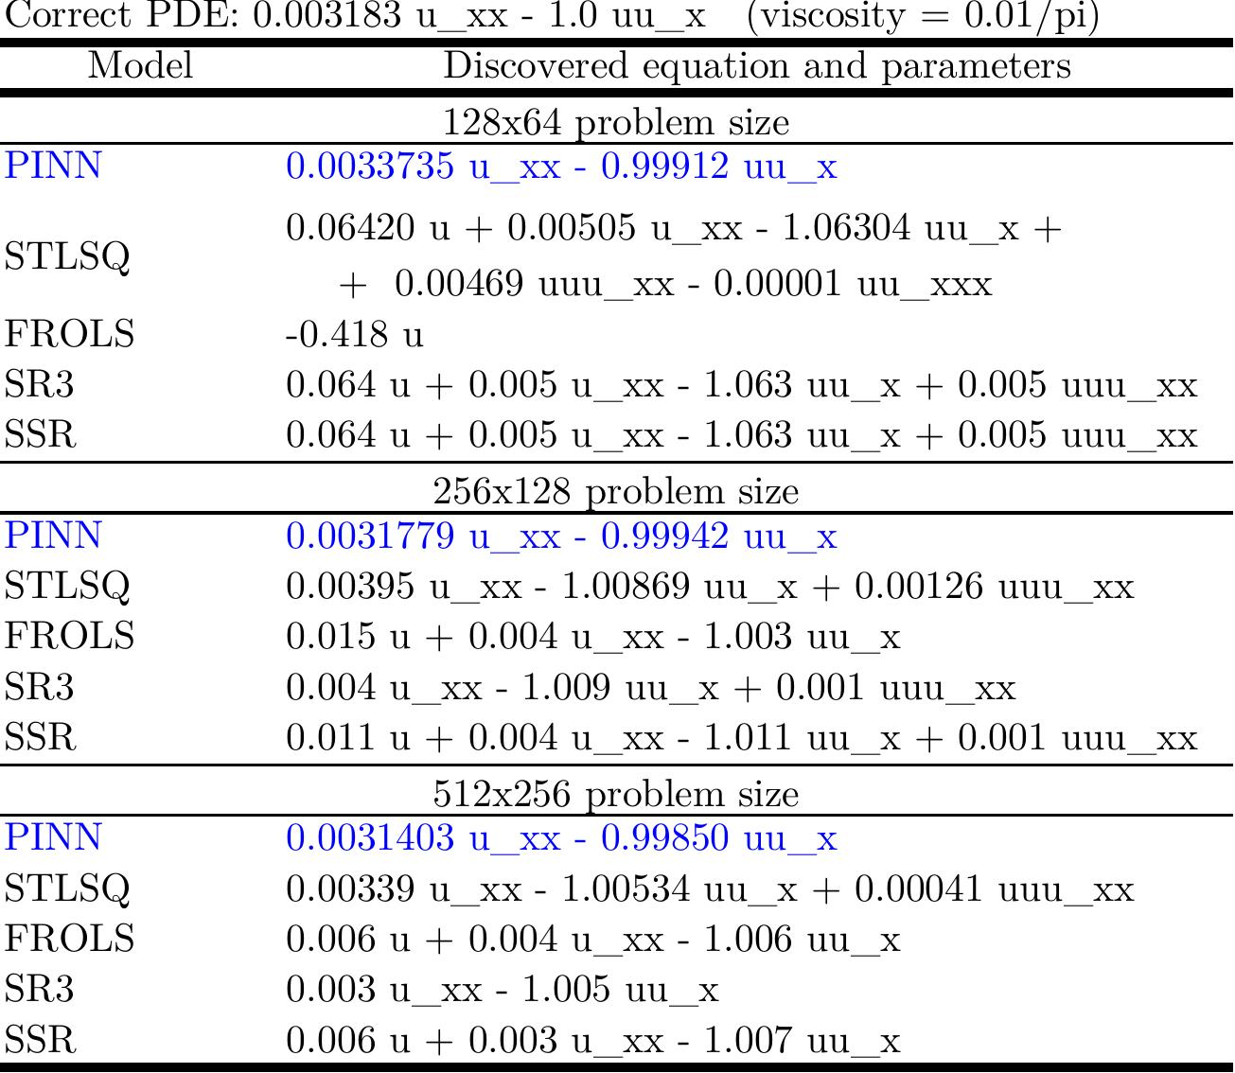
Parameter discovery results

Slide 32
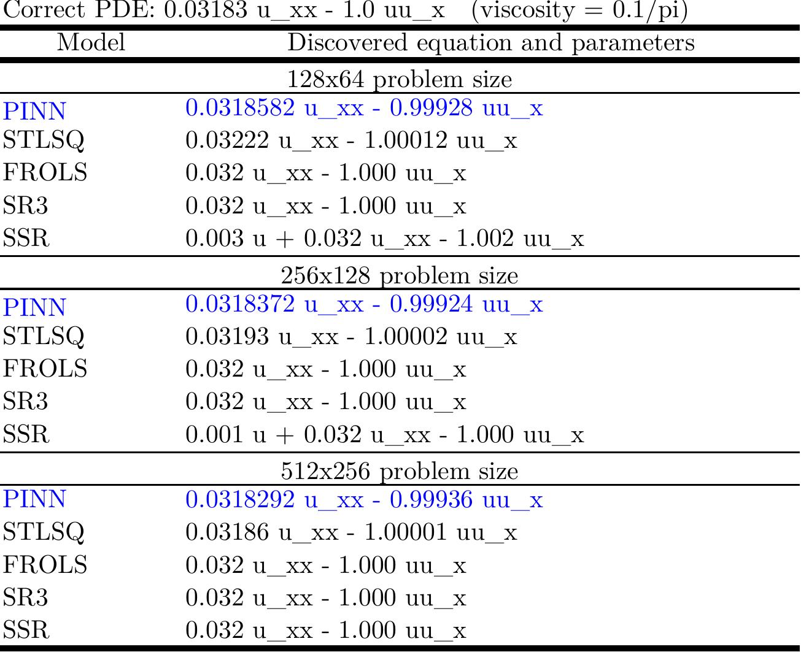
Parameter discovery results

Slide 33
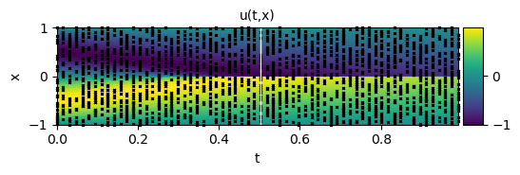
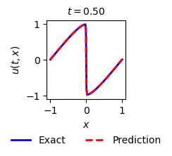
PINN visual assessment - 128x64, 0.01/π (low viscosity)
PINN can accurately capture the non-linear behavior
  SINDy would require a fine discretization for small viscosity values)
The trained model is used for both discovery and solution
No discretization of the spatio-temporal domain
2,000 CPs for training

Slide 34
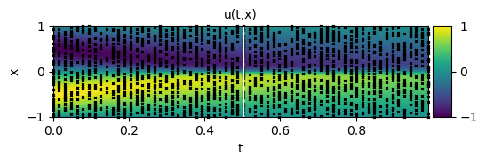
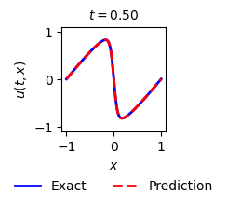
PINN visual assessment - 128x64, 0.1/π (high viscosity)
PINN perform accurately
  SINDy can accurately capture as well

Slide 35
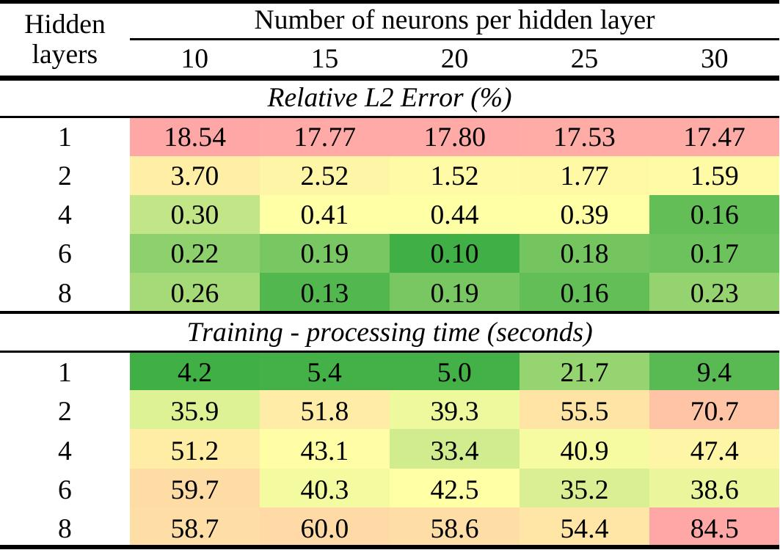
L2 error and training time [s] X Hidden Layers
(SDumont Sequana X1129)

Slide 36
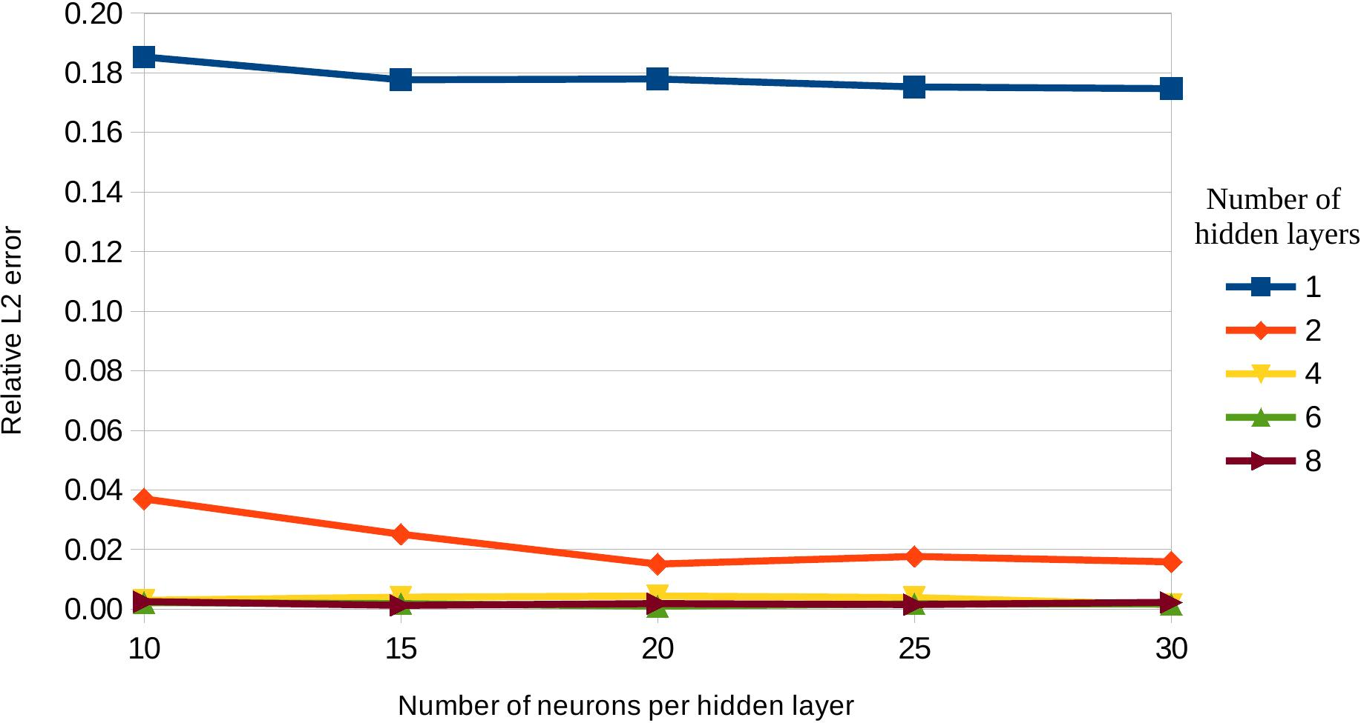
Relative L2 error (%)
(SDumont Sequana X1129)

Slide 37
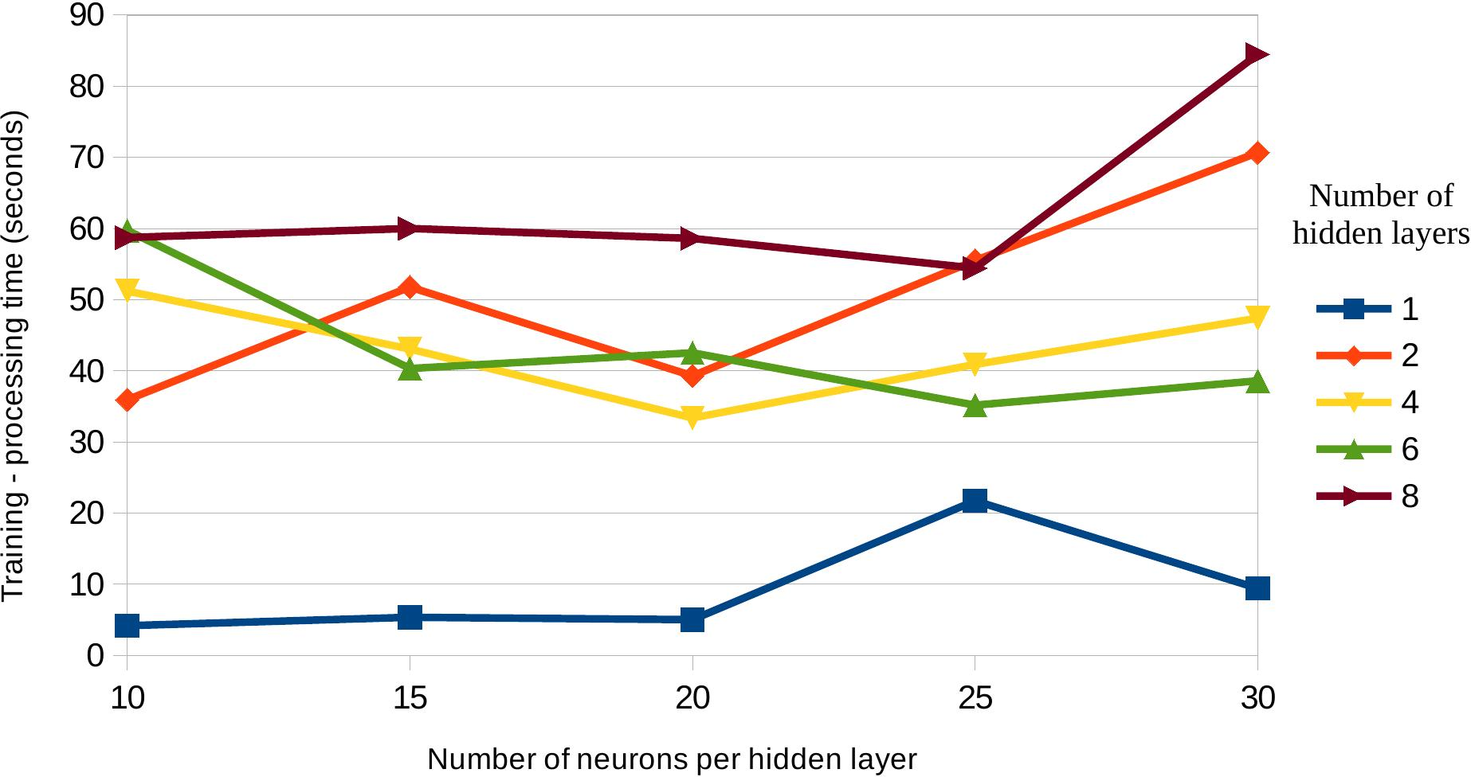
Processing time [s]
(SDumont Sequana X1129)

Slide 38
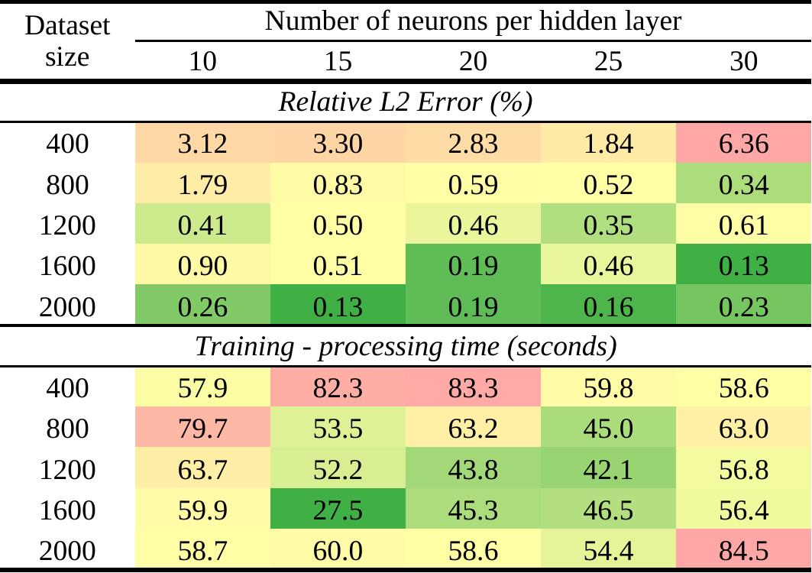
L2 error and training time [s] X CP size
(SDumont Sequana X1129)

Slide 39
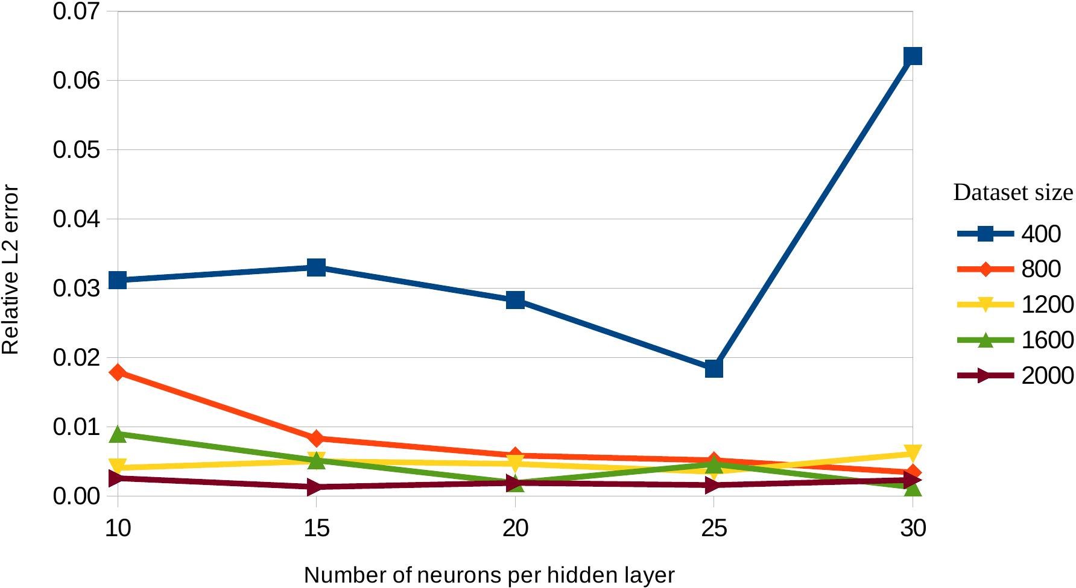
Relative L2 error (%)
(SDumont Sequana X1129)

Slide 40
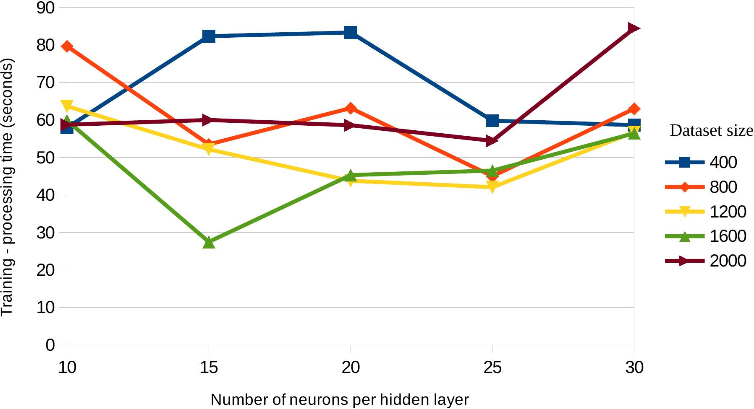
Processing time [s]
(SDumont Sequana X1129)

Slide 41
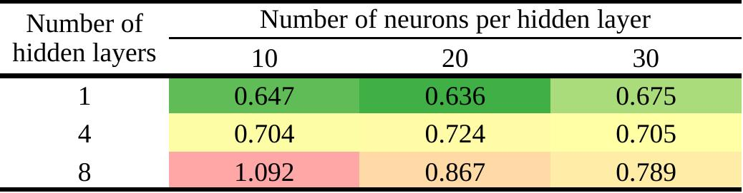
Prediction time [s]
(SDumont Sequana X1129)
(Complements the previous graphs)

Slide 42
5
Final Considerations

Slide 43
Final considerations
PINN is an innovative and promising approach that combines data-driven and physics-based strategies
Toy problem (1D Burgers' Equation) with known exact solution
Comparison of PINN with 4 SINDy versions
PINN assessment of accuracy and performance

Slide 44
Future works
Explore new PINN-based approaches for 2D/3D inverse and direct problems
Choose a new test case related to an INPE application (ecRad radiation module in weather forecast model?)
Real-world problems with limited-size or noisy datasets
Use of GPU frameworks like Modulus and Horovod

Slide 45
Thanks!
Source code: http://github.com/efurlanm/pd1b24/
Eduardo Furlan Miranda. Applied Computing Post-graduation Program (CAP/INPE). <efurlanm@gmail.com>.
Stephan Stephany. Coordination of Applied Research and Technological Development (COPDT/INPE). <stephan.stephany@inpe.br>.
Roberto Pinto Souto. National Laboratory for Scientific Computing (LNCC). <rpsouto@lncc.br>.

