Slide 1
Simulando sistemas distribuídos com o Docker
Sistemas Distribuídos
Eduardo Furlan Miranda
2025-10-01
Adaptado de: PEREIRA, C. S. Sistemas Distribuídos. Londrina: EDE SA, 2019. ISBN 978-85-522-1443-4.

Slide 2
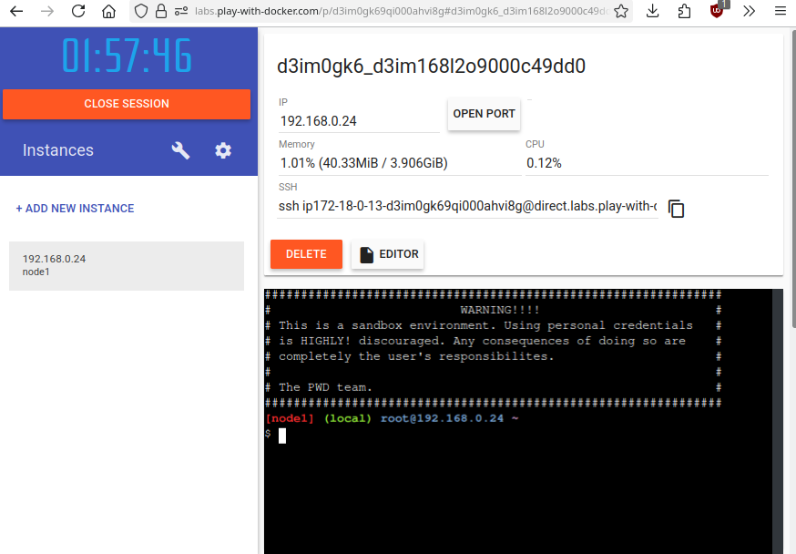
https://labs.play-with-docker.com

Slide 3
Inicializa
[node1] (local) root@192.168.0.24 ~
$ docker run -dp 80:80 docker/getting-started:pwd
Unable to find image 'docker/getting-started:pwd' locally
pwd: Pulling from docker/getting-started
89d9c30c1d48: Pull complete
24f1c4f0b2f4: Pull complete
16542569a10d: Pull complete
08396939143d: Pull complete
Digest: sha256:9156d395e7e41498d5348e95513d61fc7929db720393448306c5d7263d7f2696
Status: Downloaded newer image for docker/getting-started:pwd
cd51836c6a6076754663aee075972ea1860c74866a5440c80985936d20f83b1e

Slide 4
swarm
[node1] (local) root@192.168.0.24 ~
$ docker swarm init --advertise-addr 192.168.0.24
Swarm initialized: current node (y57z5m7uc2g1u5ialtvhcswoa) is now a manager.
To add a worker to this swarm, run the following command:
docker swarm join --token SWMTKN-1-4eb5w9rbzah58f2p7de0giqukpmf5k9hl7kn57ip91n3qjebpa-ajbulfzr4m64nhx9vcv2yxx84 192.168.0.24:2377
To add a manager to this swarm, run 'docker swarm join-token manager' and follow the instructions.
[node1] (local) root@192.168.0.24 ~
$ docker node ls
ID HOSTNAME STATUS AVAILABILITY MANAGER STATUS ENGINE VERSION
y57z5m7uc2g1u5ialtvhcswoa * node1 Ready Active Leader 27.3.1

Slide 5
Criando 3 réplicas
[node1] (local) root@192.168.0.24 ~
$ docker service create --name WEB --publish 85:80 --replicas=3 nginx
1gzcyalsqt3jfvzczr45qcaoq
overall progress: 3 out of 3 tasks
1/3: running [==================================================>]
2/3: running [==================================================>]
3/3: running [==================================================>]
verify: Service 1gzcyalsqt3jfvzczr45qcaoq converged

Slide 6
Criamos um serviço Web através do servidor web Nginx, contendo 3 réplicas
No parâmetro “name” definimos um nome para a execução do serviço (“WEB”)
Através do parâmetro “publish” definimos uma porta de execução para o Docker (85) e uma para o servidor web Nginx (80)
Definimos que o serviço terá 3 réplicas e utilizará o Nginx

Slide 7
docker service ps
[node1] (local) root@192.168.0.24 ~
$ docker service ps WEB
ID NAME IMAGE NODE DESIRED STATE CURRENT STATE ERROR PORTS
yclgjf32kvl4 WEB.1 nginx:latest node1 Running Running 2 minutes ago
ke03kzfrrhze WEB.2 nginx:latest node1 Running Running 2 minutes ago
hb2fpynqx848 WEB.3 nginx:latest node1 Running Running 2 minutes ago

Slide 8
docker node update
[node1] (local) root@192.168.0.24 ~
$ docker node update --availability drain node1
node1
[node1] (local) root@192.168.0.24 ~
$ docker service ps WEB
ID NAME IMAGE NODE DESIRED STATE CURRENT STATE ERROR PORTS
amhwypi6xznc WEB.1 nginx:latest Running Pending 8 seconds ago "no suitable node (1 node not …"
yclgjf32kvl4 \_ WEB.1 nginx:latest node1 Shutdown Shutdown 4 seconds ago
q4jios8hjp0d WEB.2 nginx:latest Running Pending 8 seconds ago "no suitable node (1 node not …"
ke03kzfrrhze \_ WEB.2 nginx:latest node1 Shutdown Shutdown 4 seconds ago
d25p6ff6sadi WEB.3 nginx:latest Running Pending 8 seconds ago "no suitable node (1 node not …"
hb2fpynqx848 \_ WEB.3 nginx:latest node1 Shutdown Shutdown 4 seconds ago

Slide 9
docker system prune
$ docker system prune --all
WARNING! This will remove:
- all stopped containers
- all networks not used by at least one container
- all images without at least one container associated to them
- all build cache
Are you sure you want to continue? [y/N] y
Deleted Containers:
8ec2e4321406c6f932cc38a18f7f3df96e4c2c2941cfba14f4ee1bb70c95184f
06d66dc0a6c92df1aa365064b1f87fcf0e47be88e7be46b5bd71abd7ed7ae656
8e4f67d18d1161d5c980d806b10ae44b241e6705c438fb47f5b8fd949148b236
Deleted Images:
untagged: nginx@sha256:8adbdcb969e2676478ee2c7ad333956f0c8e0e4c5a7463f4611d7a2e7a7ff5dc
deleted: sha256:203ad09fc1566a329c1d2af8d1f219b28fd2c00b69e743bd572b7f662365432d
deleted: sha256:a2d93a3b0194dbe86680b99ab30f521a9fa4de8843ee27213b23123d0dbae7ea
deleted: sha256:b426570453c6490acac1f45f4032cf2dc658af43febbf00b6654b8abf17d38bd
...

Slide 10
Apache em cluster
Nova instância
docker run -dp 80:80 docker/getting-started:pwd
docker swarm init --advertise-addr 192.168.0.34
(define o nó como manager do cluster)
docker service create --name WEB --publish 80:80 --replicas=5 httpd
jeurjd61tp6xxnovxrcrxws3o
overall progress: 5 out of 5 tasks
1/5: running [==================================================>]
2/5: running [==================================================>]
3/5: running [==================================================>]
4/5: running [==================================================>]
5/5: running [==================================================>]
verify: Service jeurjd61tp6xxnovxrcrxws3o converged

Slide 11
docker service ps WEB
[node1] (local) root@192.168.0.34 ~
$ docker service ps WEB
ID NAME IMAGE NODE DESIRED STATE CURRENT STATE ERROR PORTS
xampgd6hok22 WEB.1 httpd:latest node1 Running Running 52 seconds ago
pb21oo93htum WEB.2 httpd:latest node1 Running Running 52 seconds ago
stbhb7nvan49 WEB.3 httpd:latest node1 Running Running 52 seconds ago
shp0j6zmqrhw WEB.4 httpd:latest node1 Running Running 52 seconds ago
j2hm1m8x7xos WEB.5 httpd:latest node1 Running Running 52 seconds ago

