Slide 1
PEOPLE INSIGHTS REPORT |2025-2026
Our People,
Our Priority
A bold look at where we stand — and
where we're headed together.
47%
$335.8M
14,900+
Attrition Rate
Total Impact
Employees Analyzed
Presented by Human Resources |

Slide 2
THE BIG PICTURE
Between 2025 and 2026, nearly half our workforce walked out the door. That number stopped us in our tracks — and it should. But here's the good news: we have the data, we have the insights, and we have a plan.
47%
14,900+
6 Groups
of our workforce
left the company
employees included
in our analysis
identified to help
us take action
💬 Key Points
→ 47% is not just a statistic — it represents real people, real relationships, and real knowledge walking out the door.
→ This is our invitation to listen, learn, and take bold action together.
→ We gathered exit survey data, analyzed sentiment, and grouped employees into 6 clusters so we can target solutions with precision.

Slide 3
HOW WE MEASURED: THE SENTIMENT SCORE
Think of the Sentiment Score as a simple ❤️ health check for how each employee feels about their job.
Job Satisfaction Levels
🔍 How It Works
😄 Very High (0.75–1.0)
1. We collected survey responses from employees who left and have stayed — covering topics like leadership, remote work, recognition, and growth.
2. We converted their answers into a single number between 0 and 1.
3. The closer to 0, the lower the satisfaction. The closer to 1, the higher.
4. We highlighted low scores (< 0.5) so they stand out — because that's where we need to focus.
🙂 High (0.60–0.74)
😐 Medium (0.50–0.59)
😟 Low (< 0.50) ← Focus here
✅ Bottom line: A score below 0.5 is our signal that something needs attention. We used these scores to group every employee — and find exactly where to act.

Slide 4
UNDERSTANDING OUR PEOPLE
We grouped all employees into 6 clusters based on tenure, sentiment, and whether they stayed or left. Each group tells a different story.
AT RISK
MONITOR
ALREADY LEFT
⚠️ Long Tenure Risk
🔵 Neutral/Steady
Newcomers
✈️ Happy Departures
⏱ 3+ years
📊 Score: < 0.5
⏱ < 2 years
📊 Score: 0.5–0.65
⏱ Varied
📊 Score: 0.6+
Loyal veterans showing warning signs. They've given a lot — we need to give back.
Newer employees who are settled but not yet deeply engaged.
Left on good terms — healthy turnover. Alumni who can become ambassadors.
AT RISK
STABLE
ALREADY LEFT
🆕 New Hire Risk
✅ Safe Zone
🚪 Unhappy Exits
⏱ < 1 year
📊 Score: < 0.5
⏱ Varied
📊 Score: 0.65+
⏱ Varied
📊 Score: < 0.5
Brand new and already disengaged. Onboarding and early support are critical.
Our strongest performers — happy, stable, and staying. Protect this group!
Left with unresolved frustrations. Their feedback is our most valuable lesson.

Slide 5
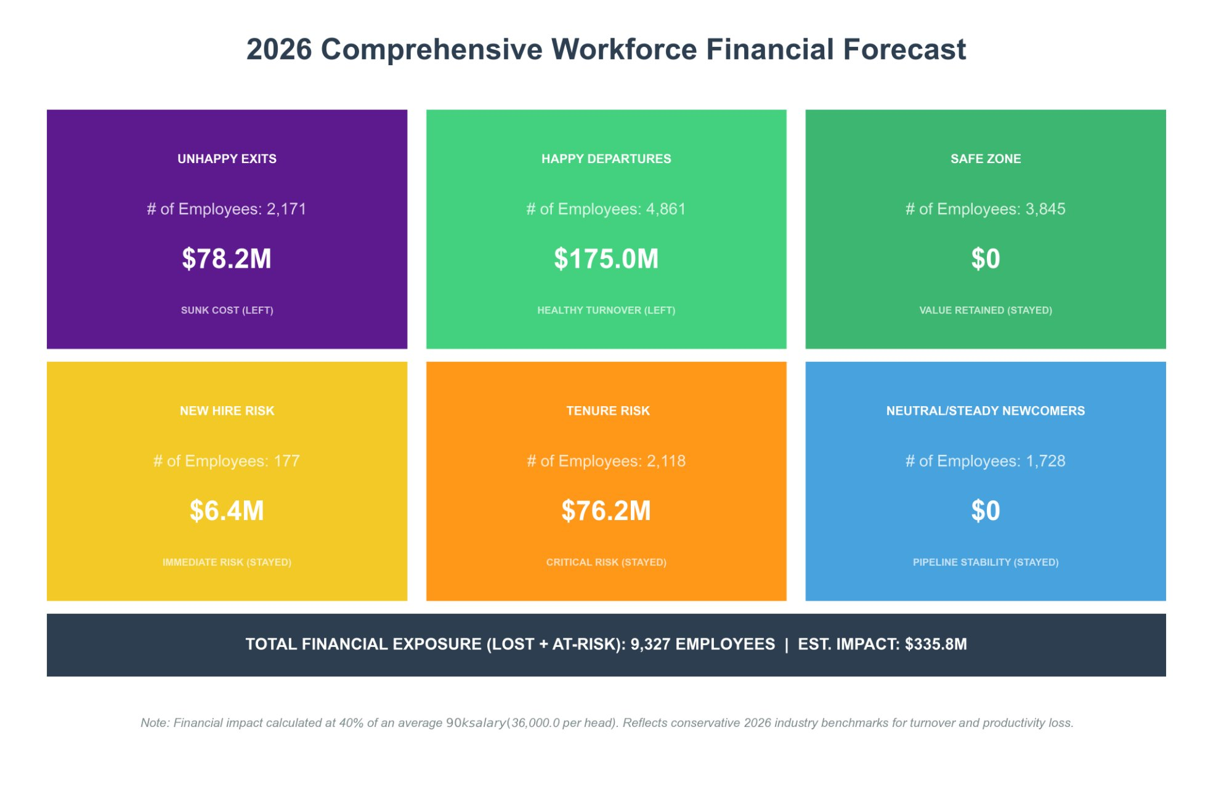
THE COST OF INACTION
Here's what this attrition has already cost us — and what it will cost if we don't act on the groups still at risk.
💬 Each replacement costs ~$36K. The $335.8M total reflects 9,327 employees across lost and at-risk groups. Retaining just 20% of at-risk employees saves ~$16.5M.

Slide 6
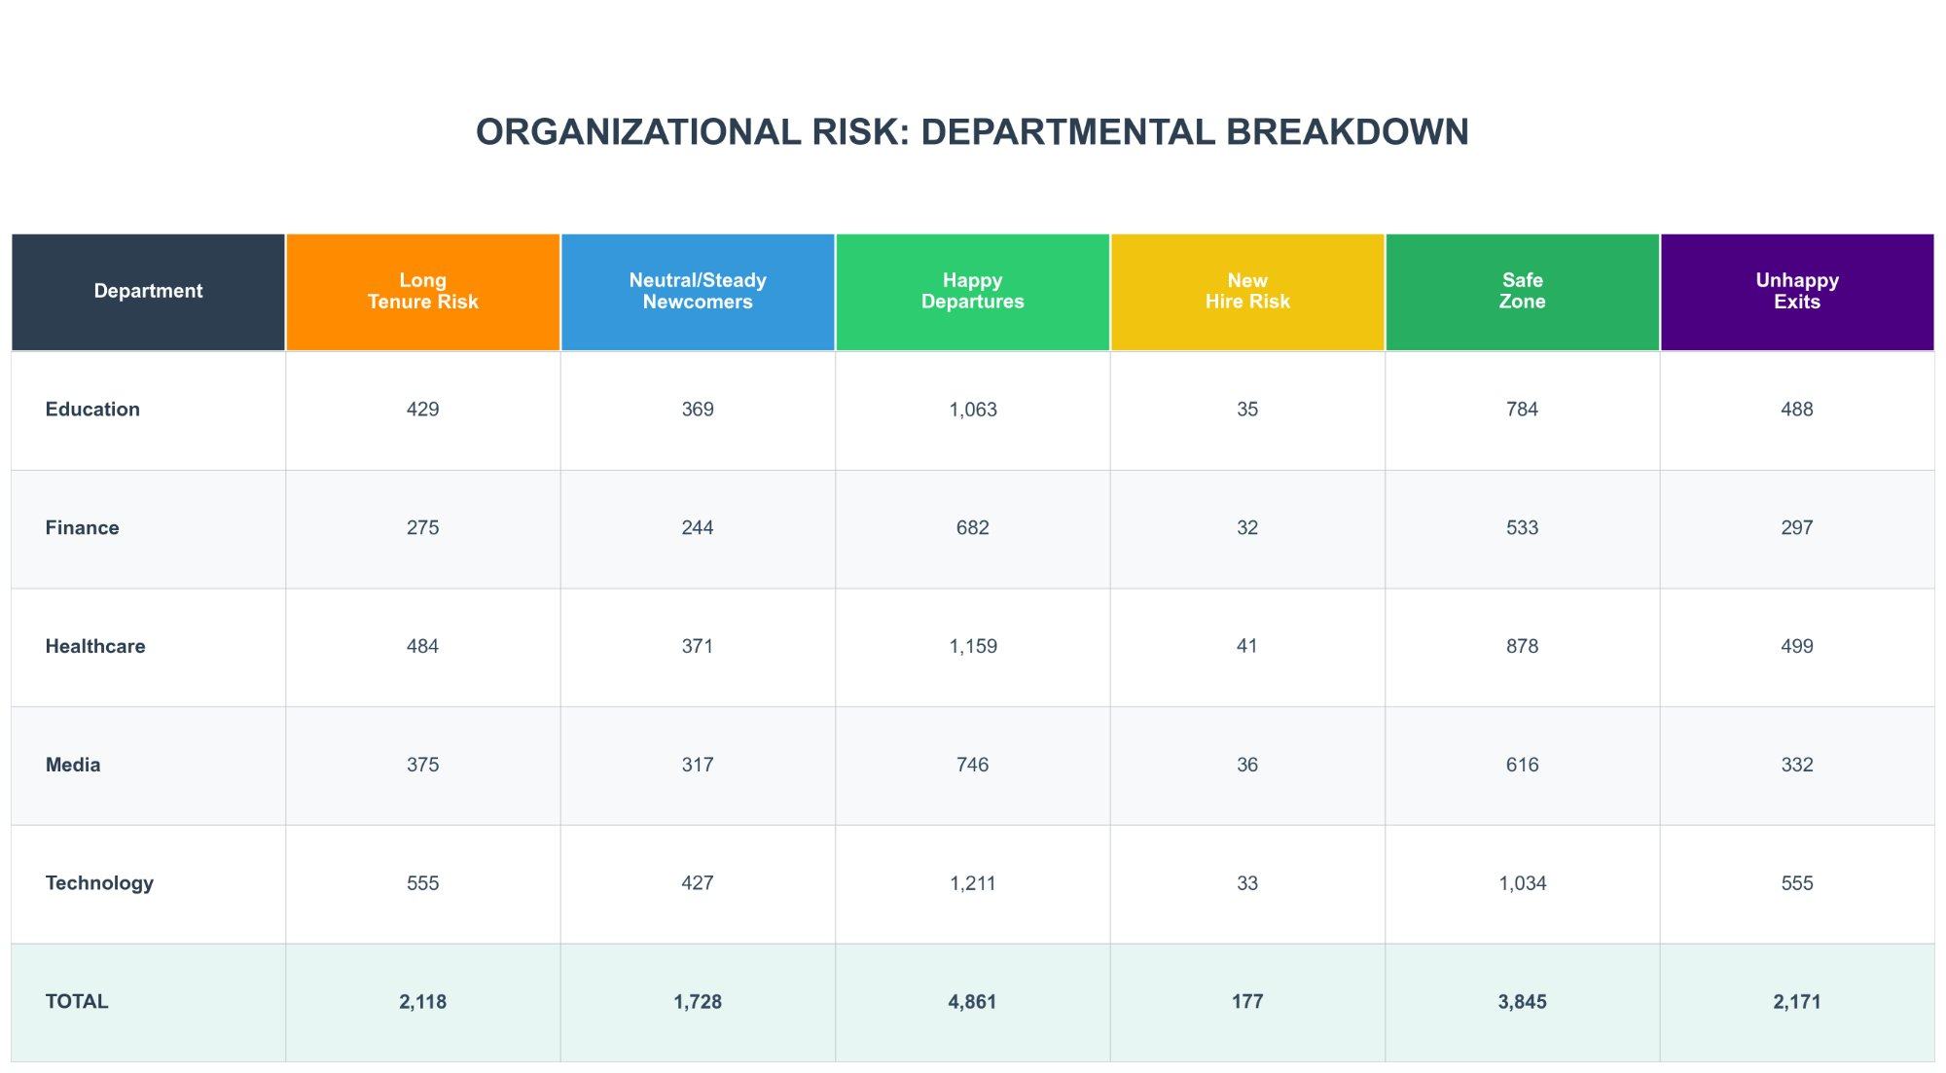
RISK BY DEPARTMENT
Every department is represented across all 6 clusters. No team is isolated from these trends.
💬 Technology has the highest Long Tenure Risk (555) and the largest Happy Departures (1,211) — a department with both wins and warnings.
💬 Healthcare leads in Safe Zone employees (878), showing that some of our strongest culture exists there — let's learn from it.

Slide 7
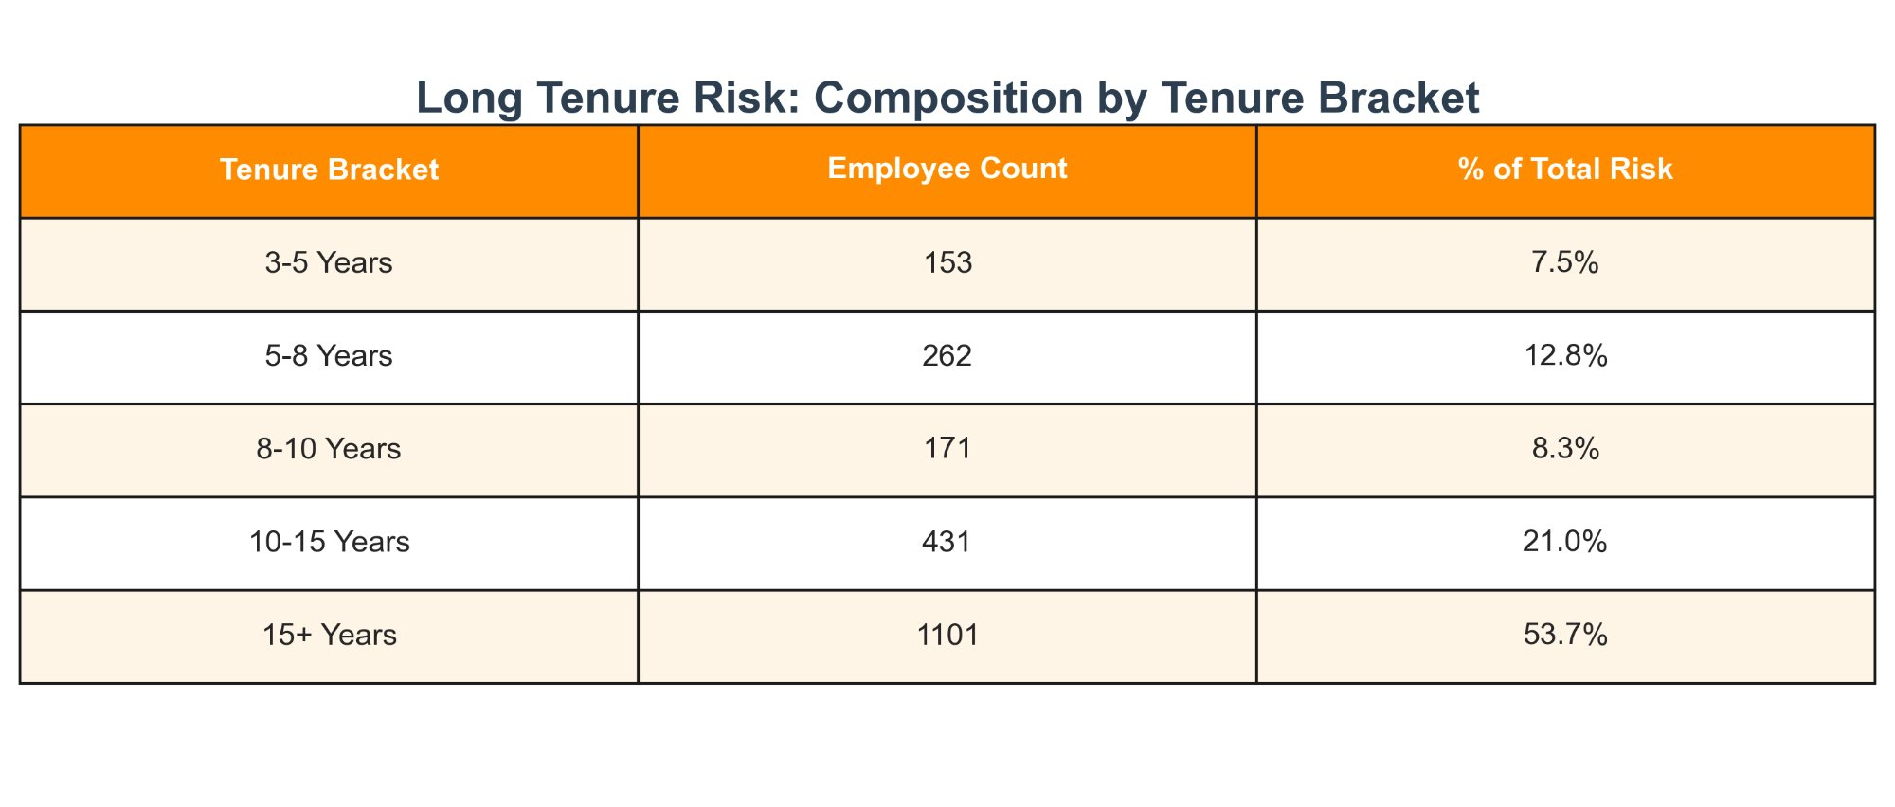
⚠️ LONG TENURE RISK — DEEP DIVE
These are the people who built this company. They've been here 3+ years, they carry deep institutional knowledge — and right now, their satisfaction scores say they're at risk.
What This Tells Us
🏆 53.7% have been here 15+ years
📉 2,118 employees at risk of leaving
💰 Estimated cost if lost: $76.2M
🎯 Sentiment score: below 0.5 — the danger zone
💬 Key Points
→ Losing a tenure employee doesn't just cost money — it costs memory, mentorship, and morale.
→ The good news: they're still here. That means we have a window to act — and we intend to use it.

Slide 8
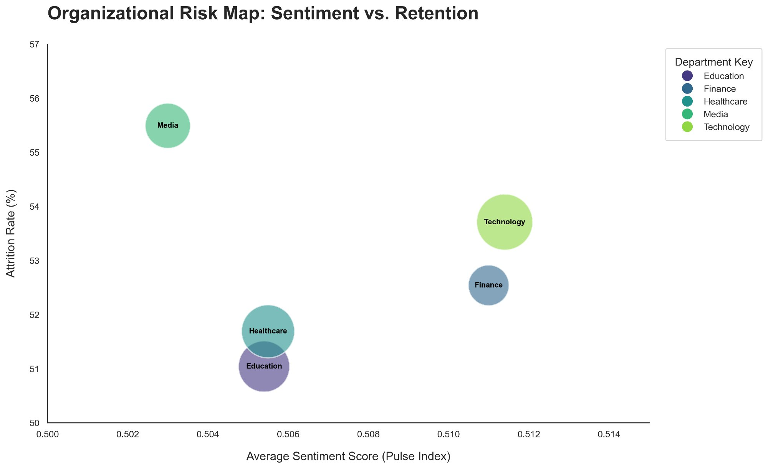
WHERE ARE THE HOT SPOTS?
This map shows sentiment vs. attrition across all departments. The further left and higher up a bubble sits, the more urgent the action needed.
Media
Highest attrition (55.5%) + lowest sentiment — needs immediate attention
Technology
High attrition despite higher sentiment — review growth paths
Healthcare
Close to Education — both near median sentiment, room to grow
💬 Bubble size = headcount. A department in the top-left corner = high attrition AND low sentiment. That's where we start. Media, we see you — and we've got a plan.

Slide 9
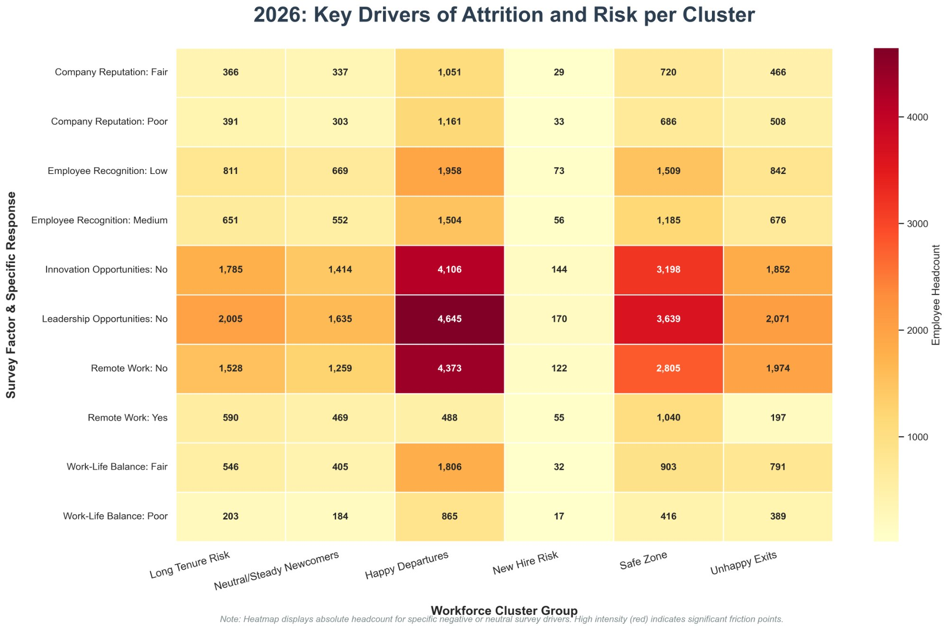
WHY ARE THEY LEAVING? — KEY DRIVERS
The heatmap below shows which issues are most intense for each group. Darker red = more employees affected.
🚀 Innovation / Upskilling
👑 Leadership Opportunities
🏠 Remote Work Flexibility
No growth = no reason to stay
People want to lead, not just follow
Flexibility is now a baseline expectation

Slide 10
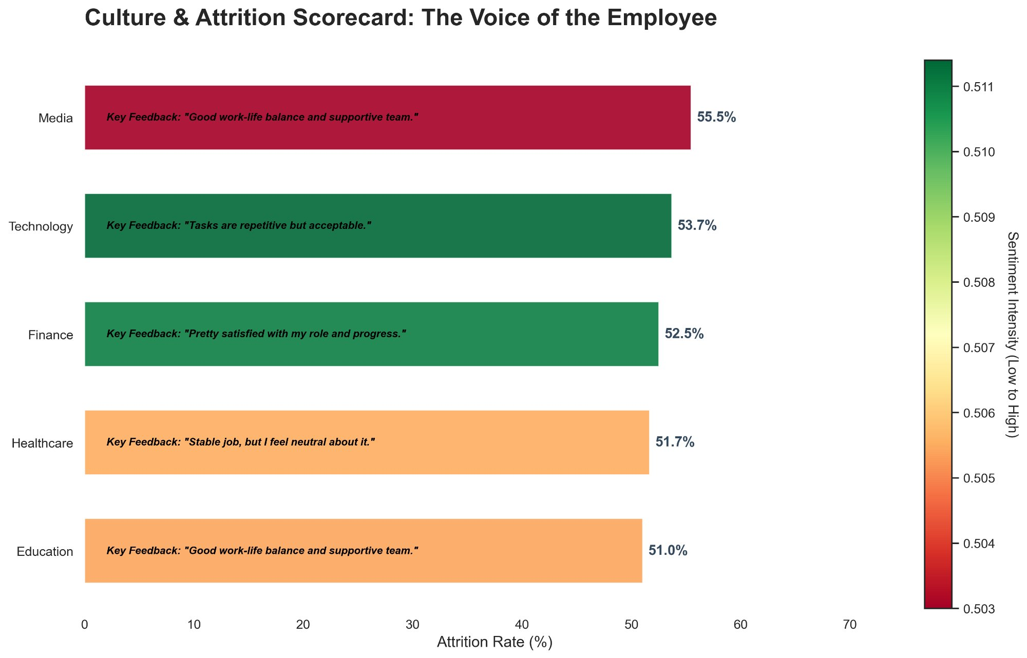
THE VOICE OF THE EMPLOYEE
Survey feedback paired with sentiment intensity and attrition rates — department by department. These are their words. Let's hear them.
Key Takeaways
→ Media tops attrition at 55.5% — despite positive feedback
→ Healthcare & Education feel "neutral" — disengagement is silent
→ Technology employees note repetitiveness — a growth signal
→ No dept is above 0.511 sentiment — room to grow everywhere
💬 Key Points
→ Even "positive" feedback departments have high attrition. Culture is good — but opportunity isn't meeting expectation.
→ Neutral isn't safe. Quiet disengagement is a slow leak — we're here to fix the pipe.

Slide 11
OUR RESPONSE — WHAT WE'RE GOING TO DO
Now that we know what's happening — here's how we're going to fix it. These aren't just ideas; they're commitments.
🚀 Innovation & Upskilling
👑 Leadership Pathways
✓ Launch a company-wide learning portal with role-based tracks
✓ Create an internal leadership pipeline program
✓ Monthly 'Innovation Hours' — protected time for experimentation
✓ Mentorship pairs: senior leaders + high-potential employees
✓ Skills badges and visible career progression maps
✓ Transparent promotion criteria for all levels
🏠 Flexible Work Options
🌟 Recognition & Culture
✓ Pilot hybrid work for eligible roles (30–60 day review)
✓ Monthly peer-recognition program with real rewards
✓ Team-led agreements on work patterns — no one-size-fits-all
✓ Manager training: giving meaningful, specific feedback
✓ Productivity measured by outcomes, not hours
✓ Annual 'Culture Health' survey and public results

Slide 12
90-DAY GAME PLAN — LET'S MOVE!
Three focused sprints. Real milestones. Measurable results. This is how transformation happens.
Days 1–30
Days 31–60
Days 61–90
LISTEN & LAUNCH
BUILD & PILOT
MEASURE & ACCELERATE
1. Present findings to all departments
1. Launch learning portal (Phase 1 tracks)
1. Analyze pulse survey results vs baseline
2. Launch pulse survey for current employees
2. Roll out hybrid work pilot for 2 departments
2. Report on retention changes in at-risk groups
3. Identify 10 high-risk Long Tenure employees for 1:1 conversations
3. Start leadership pipeline cohort 1
3. Expand hybrid pilot based on feedback
4. Announce mentorship program enrollment
4. Implement peer-recognition program
4. Celebrate early wins — publicly!
5. HR partners assigned to each department
5. Review onboarding process for New Hire Risk group
5. Set 6-month milestones with leadership

Slide 13
The Data Is Clear.
The Path Is Ours To Choose.
47% attrition is not the end of our story — it's the beginning of our next chapter. We have the insights, we have each other, and we have an incredible opportunity to build something our people are proud to be part of.
Together, let's make this the year we turned it around. 🚀
Thank you • Questions welcome • Human Resources | 2025–2026 People Insights

