Slide 1










efw framework (flow)
View
Page Event
Outside Sql
eventId
paramsFormat
params
params
result
…
record
Batch Event
Rest API Event
efw framework

Slide 2

efw framework (client)
Tags
Client
Part
Attr
Msg
Prop
elFinder
Chart
Barcode
Attributes
Functions
Dialogs
data-format
data-shortcut
alert
wait
preview
progress
Efw
Js
efw.client
.nopromise
efw.chart
.chartjs
efw.dialog
.jquery-ui
Js.cookie
.format
.messages
.googlechart
.bootstrap
easytimer
UI
COM
JQuery UI
JQuery3.x
Bootstrap
3,4,5
Vue3
JQuery Ajax
base,black-tie,blazer,…
icons

Slide 3





efw framework (server)
Classes
Binary
Reader
Binary
Writer
CSV
Reader
CSV
Writer
Excel
Record
Pdf
Result
Batch
Threads
Modules
context
cookie
file
event
properties
db
mail
rest
session
request
absfile
cmd
brms
Controllers
JavaScript
Customization
efwServlet
efwRestAPI
efwBatch
.debug
.format/.parse
efwFilter
efwWebSocket
[Global]
efw
Math
downloadServlet
uploadServlet
drawServlet
8,…
OpenJDK
Nathorn
8,…,15.6
GraalJS
24.2.2,…
7,8
7,…,11

Slide 4
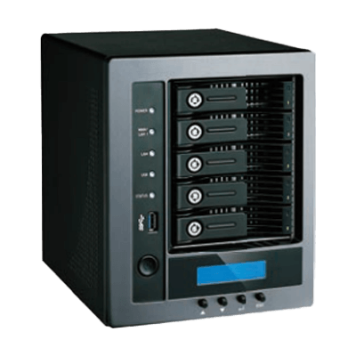









efw framework (Deployment)
Folder or War file
Docker image

