Slide 1
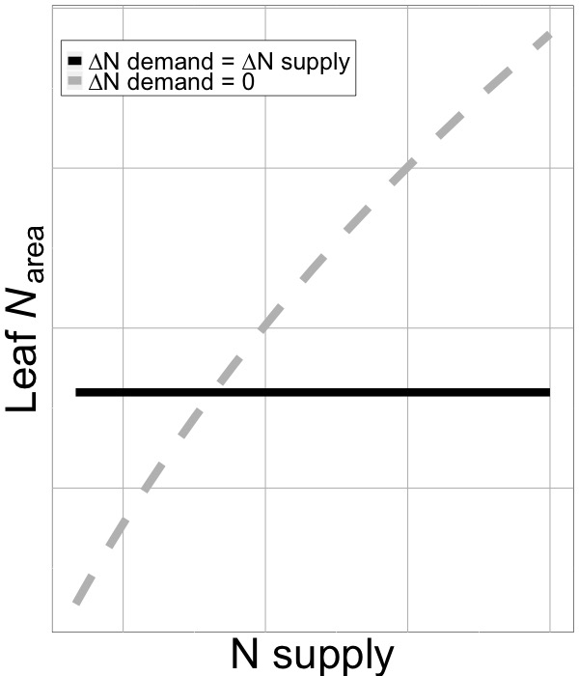

Leaf nitrogen responses to soil nitrogen
Nick Smith, Lizz Waring, et al.
Quantify the impact of soil N on leaf N_{area}
Separate soil N drivers from climate drivers
Separate the impacts of N demand and N availability on leaf N_{area}

