Slide 1
Mechanisms of leaf Narea responses to soil N
Nick Smith

Slide 2
Rationale
Leaf Narea is an important variable for ecosystem carbon and N fluxes
Used to predict photosynthesis in ESMs, including downregulation from N limitation
Not clear how or why leaf Narea responds to soil N availability
Recent analyses suggest strong positive linkages (Firn et al., 2019), while others suggest limited response (Smith et al., 2019)
Other studies indicate that LMA and climate are primary predictors of leaf Narea (Dong et al., 2017)

Slide 3
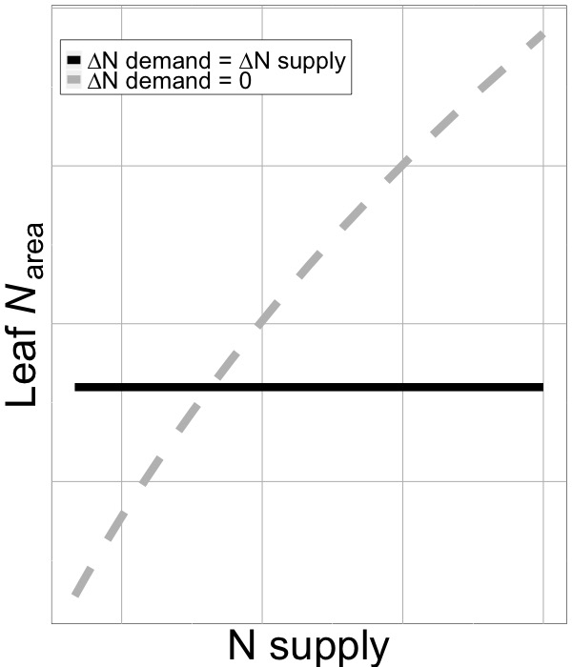
Rationale CTD
Recent analyses suggest that soil N may modify the nutrient economy of leaves following predicts from photosynthetic least cost theory (Paillassa et al., 2020)
This depends on the ratio of soil N demand and soil N availability

Slide 4
Specific aims
Quantify the impact of soil N on leaf Narea
Separate soil N drivers from climate drivers
Separate the impacts of N demand and N availability on leaf Narea

Slide 5
Primary questions
Does soil N impact leaf Narea?
If so, does this coincide with a change in stomatal conductance?
How does the impact of soil N on leaf Narea compare to other drivers, such as climate and LMA?
How does the leaf Narea response to soil N compare to the LAI response to soil N?
Does the impact of soil N on leaf Narea vary with leaf N demand, as indexed through the LAI response?

Slide 6
Nutrient Network (NutNet)
Globally distributed soil nutrient manipulation experiment
Fully factorial soil N x P x K addition experiment (10 g m-2 yr-1)
At least 3 blocks per site

Slide 7
Datasets
NutNet leaf trait data
n = 1946, 191 species, 25 sites
Narea
LMA
d13C (converted to χ)
Growing season climate conditions (CRU)
NutNet plot data
n = 381, 25 sites
LAI

Slide 8
Analyses
**Analyses generally follow Dong et al. (2017)**
Predictors of leaf Narea (mixed model)
Dependent variable: leaf Narea
Fixed effects: soil N * soil P * soil K + χ + temperature + PAR + LMA +Nfixer
Random terms: site + site:block + species
Model predictors of leaf Narea (mixed model)
Dependent variable: leaf Narea
Fixed effects: soil N * soil P * soil K + predicted Nphoto + predicted Nstructure + Nfixer
Random terms: site + site:block + species

Slide 9
Analyses CTD
LAI response to soil N
Dependent variable: plot LAI
Fixed effects: soil N * soil P * soil K + χ + temperature + PAR + LMA +Nfixer
Random terms: site + site:block + species
Supply/demand effects on leaf Narea (linear model)
Dependent variable: change in plot averaged leaf Narea in N addition plots
Fixed effects: change in plot LAI in N addition plots

Slide 10
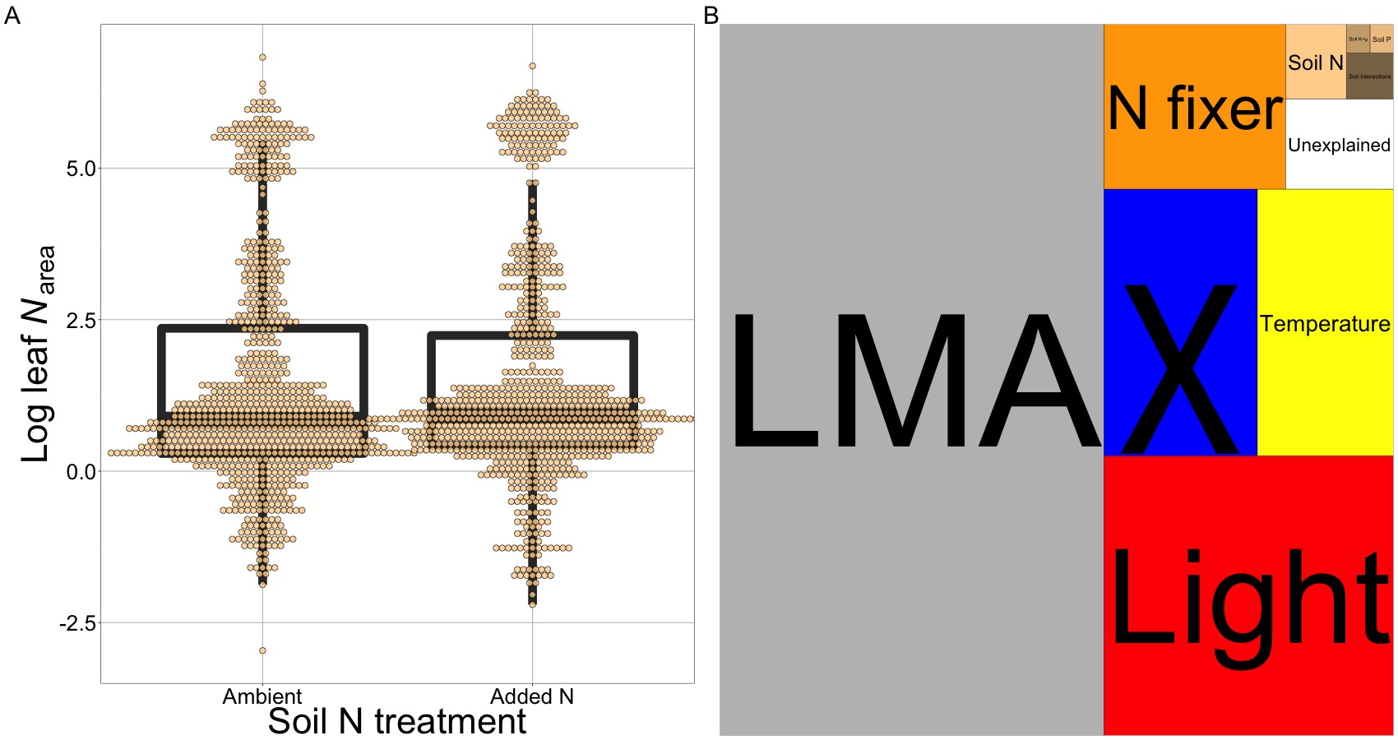
Results: Does soil N impact leaf Narea?
18% increase in leaf Narea with soil N (p < 0.01)

Slide 11
Results: What about other variables?
Soil (brown) is not that important

