Slide 1

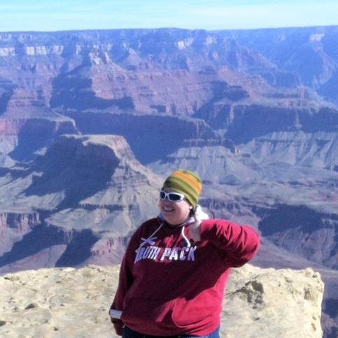
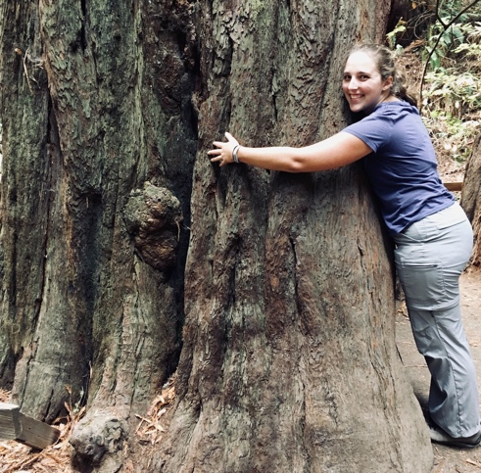
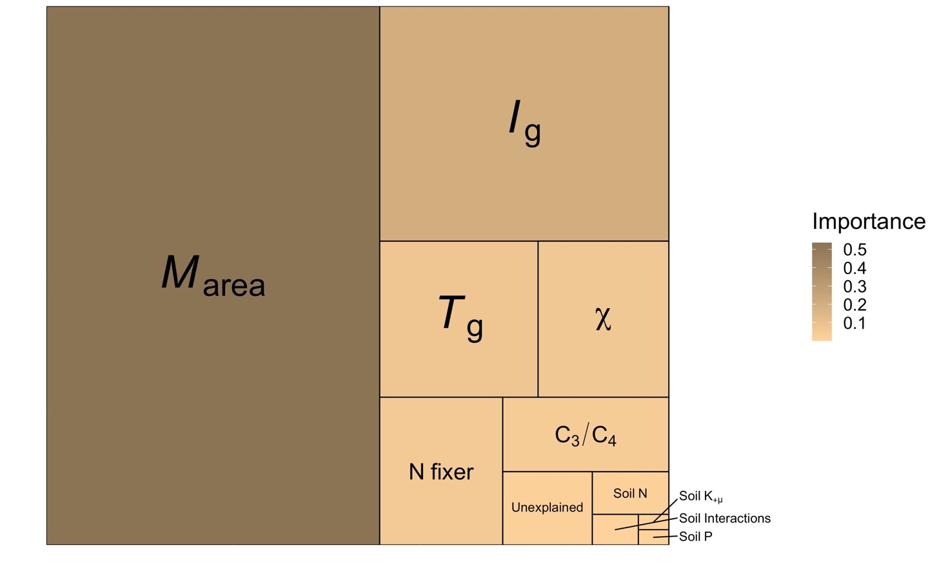
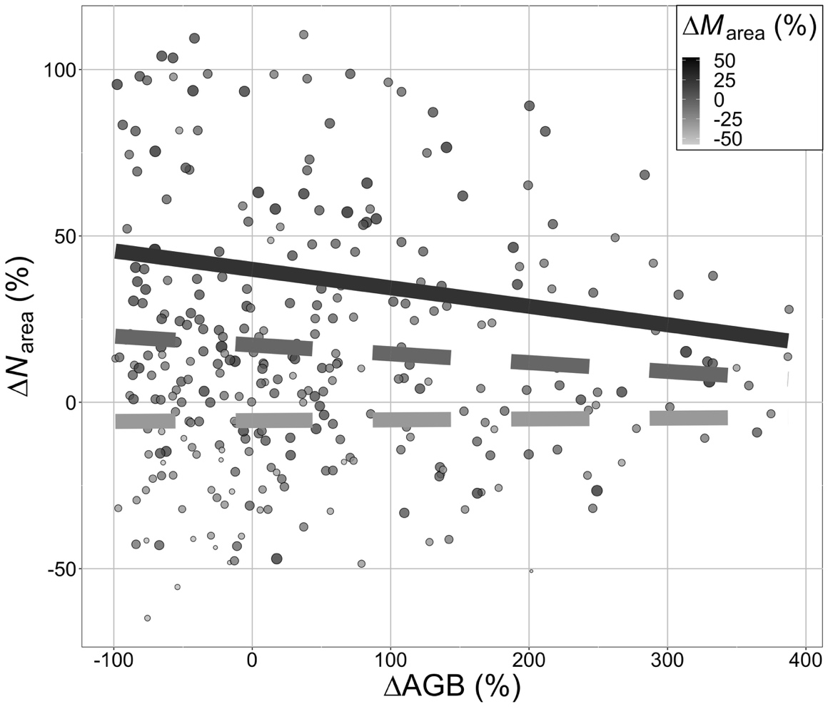

Drivers of leaf nitrogen at NutNet
Leads: Nick Smith, Lizz Waring, Risa McNellis
Texas Tech University
nick.smith@ttu.edu
Project stage
First draft written and circulated to primary co-authors; full NutNet circulation by Fall
Main results
Climate and leaf traits are more important predictors of N_{area} than soil treatments
N_{area} can be well predicted from soil-free ecophysiological theory
There is a tradeoff between allocation to biomass and N_{area}

