Slide 1
The effect of soil fertilization on leaf economics: a least-cost perspective
Nick, Lizz, Risa, Evan, & many others

Slide 2

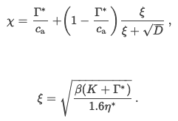
Soil nutrients should modify the costs to obtain nutrients
a = cost to maintain transpiration
b = cost to maintain photosynthetic capacity
β = b/a
ξ = “squiggle”

Slide 3
Soil nutrients should modify the costs to obtain nutrients
a = cost to maintain transpiration
b = cost to maintain photosynthetic capacity
β = b/a
ξ = “squiggle”

Slide 4
Soil nutrients should modify the costs to obtain nutrients
β
Soil nutrients

Slide 5
Soil nutrients
β

Slide 6
Soil nutrients should modify the costs to obtain nutrients
a = cost to maintain transpiration
b = cost to maintain photosynthetic capacity
β = b/a
ξ = “squiggle”

Slide 7
Soil nutrients should modify the costs to obtain nutrients
β
Soil water

Slide 8
Soil nutrients
β
Soil water

Slide 9
Soil nutrients
β
Soil water

Slide 10
Soil nutrients
β
χ
Soil water

Slide 11
Soil nutrients
VPD
T
β
χ
Soil water

Slide 12
Nfix
C4
Soil nutrients
VPD
T
β may differ for different plant types
β
χ
Soil water

Slide 13
Nfix
C4
Soil nutrients
VPD
T
β may differ with different nutrient allocation responses
Biomass
β
χ
Soil water

Slide 14
Nfix
C4
Soil nutrients
VPD
T
Support for some arrows, but not others
Biomass
β
χ
Soil water

Slide 15
Dataset
Nutrient Network (NPK full factorial)
Leaf δ13C
2118 individual leaves
26 sites
167 C4 individuals
227 Nfixers

Slide 16
Nfix
C4
Soil nutrients
Question 1: what drives variation in β?
β
Soil water

Slide 17
Nfix
C4
Soil nutrients
β ~ N*P*K + moisture + Nfix + C4 +
(1|species) + (1|site) + (1|block:site)
β
Soil water

Slide 18
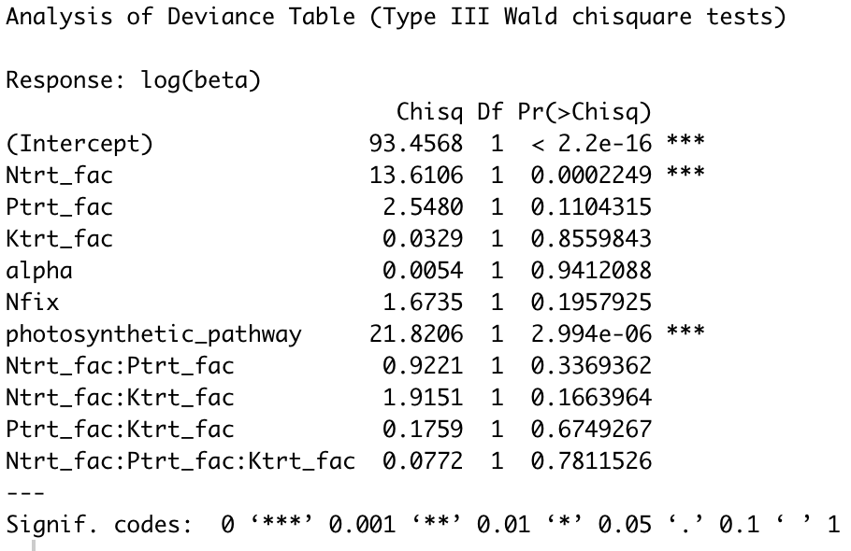
Nfix
C4
Soil nutrients
β ~ N*P*K + Nfix + C4 +
(1|species) + (1|site) + (1|block:site)
β
Soil water
9.7% decrease with added N
78.1% decrease in C4

Slide 19
Nfix
C4
Soil nutrients
Question 2: does biomass influence β response?
Biomass
β
Soil water

Slide 20
Nfix
C4
Soil nutrients
β ~ N*P*K*AGB + moisture*AGB +
Nfix + C4 +
(1|species) + (1|site) + (1|block:site)
Biomass
β
Soil water

Slide 21
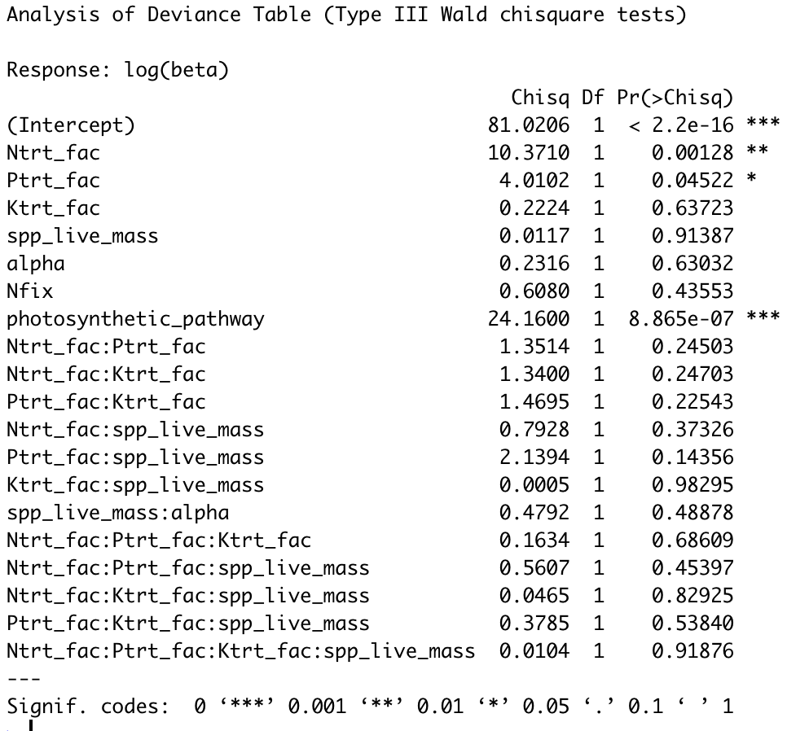
Nfix
C4
Soil nutrients
β ~ N*P*K*AGB + moisture*AGB +
Nfix + C4 +
(1|species) + (1|site) + (1|block:site)
Biomass
β
Soil water
*Nothing really changes*

Slide 22
Nfix
C4
Soil nutrients
VPD
T
Question 3: can we take what we’ve learned to predict χ?
Biomass
β
χ
Soil water

Slide 23
Nfix
C4
Soil nutrients
VPD
T
χ ~ N*P*K + moisture +
Nfix + C4 + VPD + T + (1|species) + (1|site) + (1|block:site)
Biomass
β
χ
Soil water

Slide 24
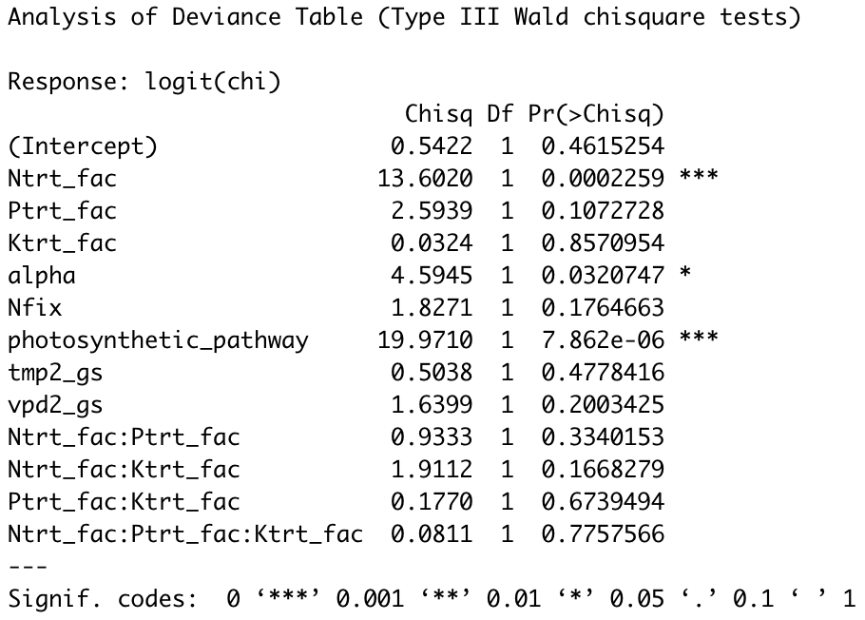
Nfix
C4
Soil nutrients
VPD
T
χ ~ N*P*K + moisture +
Nfix + C4 + VPD + T + (1|species) + (1|site) + (1|block:site)
Biomass
β
χ
Soil water
Soil nut. and C4 as expected (-)
Positive moisture effect, but strong correlation with VPD

Slide 25
Some alternative χ estimation approaches
Least cost model
C3: Prentice et al., 2014
β from low and high N
C4: Scott and Smith, 2022
β from low and high N
Structural equation model (path analysis)

Slide 26
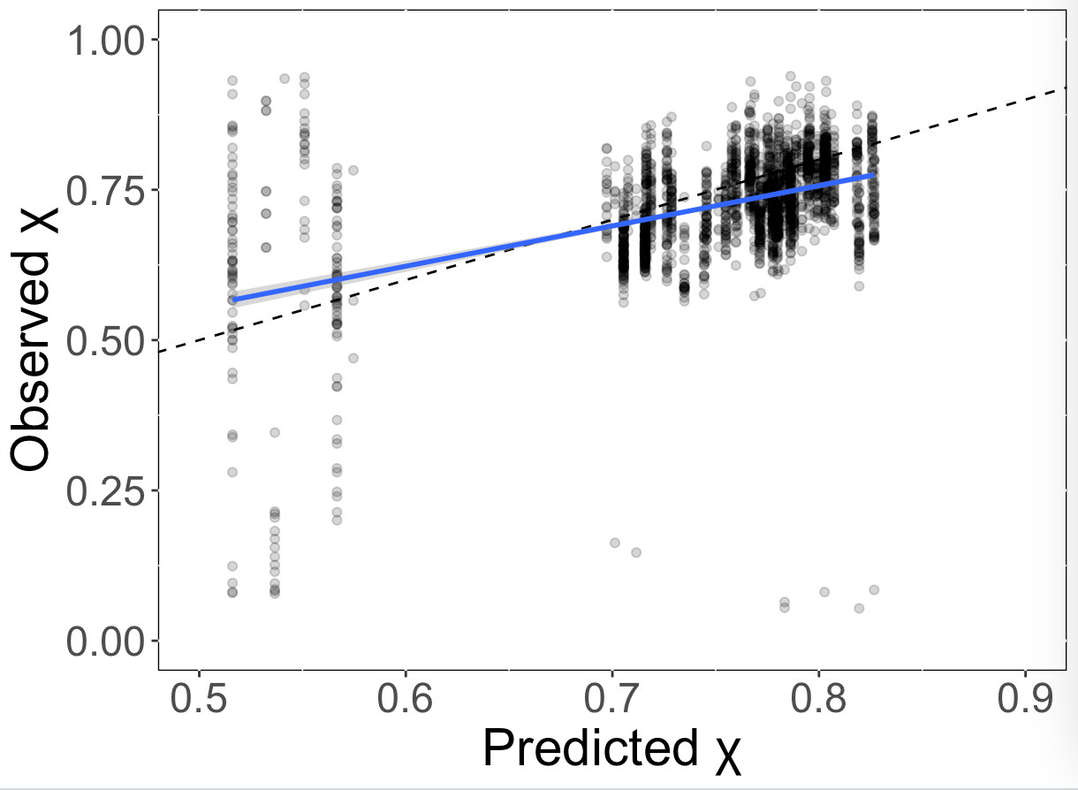
Least cost χ
R2 = 0.2
slope = 0.68 (approach 1 if forced through origin)
Obvious C3/C4 differences

Slide 27
SEM
Nfix
C4
Soil nutrients
VPD
T
β
χ
Soil water

Slide 28
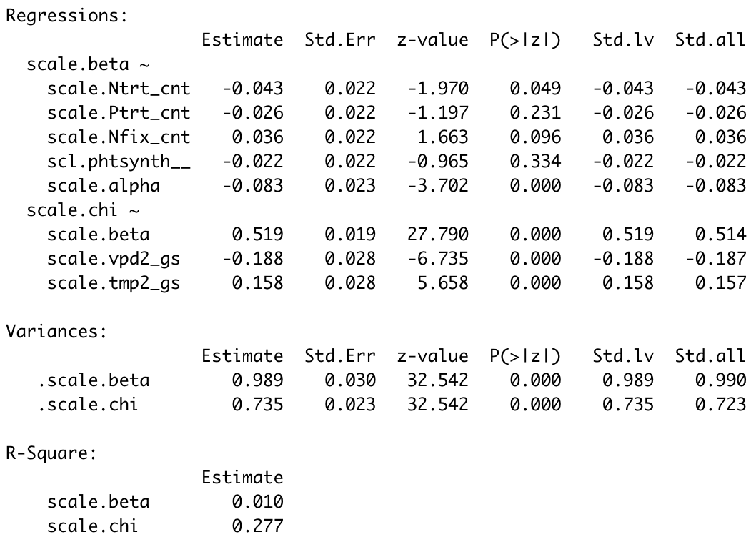
SEM
Nfix
C4
Soil nutrients
VPD
T
β
χ
Soil water

