Slide 1
Pricing Strategy and Tactics

Slide 2
Issues in Pricing
Importance of pricing
Determinants of pricing
Pricing strategies
Pricing tactics

Slide 4
Importance of Pricing

Slide 5
Comparison of Profit Levers
1% improvement in...
…creates operating profit improvement of
Source: McKinsey & Co., based on average economics of 2,463 companies

Slide 6
Price Cut vs. Price Increase
 | –20% | –10% | Current | +10% | +20%
Price | $80 | $90 | $100 | $110 | $120
Cost | $60 | $60 | $60 | $60 | $60
Margin | $20 | $30 | $40 | $50 | $60
BE Volume | 2 | 1.33 | 1 | 0.8 | 0.67

Slide 7
Change in Sales for Same Profits
Increases and decreases in sales to return same profit
Required increase in sales volume (%)
100
A
C
80
60
40
20% price decrease
20
B
10% price decrease
20
40
60
80
Variable unit cost in % of current price
10% price increase
20% price increase
-20
-40
Acceptable decrease in sales volume (%)
To be read as follows: with variable units cost of 60%, a 20% price decrease requires a 100% volume increase (Point A); a 10% price decrease requires only a 33% volume increase (Point B)
Source: Robert Dolan and Hermann Simon, Power Pricing: How Managing Price Transforms the Bottom Line, Free Press, 1997

Slide 8
Price Impact in Practice
Impact of 1% price improvement on net income
Source: Robert Dolan and Hermann Simon, Power Pricing: How Managing Price Transforms the Bottom Line, Free Press, 1997

Slide 9
Pricing in Practice
“…an analysis of our pricing in appliances [revealed] that about $5 billion of it is discretionary. Given all the decisions that sales reps can make on their own, that’s how much is in play. It was the most astounding number I’d have heard—and that’s just in appliances. Extrapolating across our businesses, there may be $50 billion that few people are tracking or accountable for…When it comes to the prices we pay, we study them, we map them, we work them. But with prices we charge, we’re too sloppy.”
—Jeffrey R. Immelt, former CEO of GE
Source: “Growth as a Process: An Interview with Jeffrey R. Immelt,” Harvard Business Review, June 2006, 1-10.

Slide 11
Determinants of Price
Company Factors

Slide 12
Issues in Pricing
Importance of pricing
Determinants of pricing
Pricing strategies
Pricing tactics

Slide 14
Factors That Influence Price
Customer’s Willingness
to Pay (WTP)
Competitors
price
Cost

Slide 15
Company Factors
Company strategy
Low cost player (e.g., Walmart)
High quality player (e.g., Apple)
Consistency with other marketing mix variables
Product quality
Channel selection
Product line issues
Costs

Slide 17
Which Costs to Consider in Pricing
Profit = Q (P – VC) – FC Q = quantity or volume in units P = price per unit VC = variable cost per unit FC = fixed cost (that does not depend on volume)
Profit
Price

Slide 19
Fixed and Variable Costs for Airline
Fixed or variable costs depend on the business decision
Consider three decisions for an airline:
What price should we charge an additional passenger on our scheduled flight from Boston to Chicago?
Should we add another flight from Boston to Chicago?
Should we buy a long-range plane to start international flights?

Slide 21
Determinants of Price
Competitor Factors

Slide 22
Competitor Factors
Competitor strategy and motivation
Competitor financial strength
Cost structure
Historical pricing behavior

Slide 23
Competitive Pricing
United Airlines
Regular
price
Discounted
price
Regular
price
UA = $100M
AA = $100M
UA = $130M
AA = $80M
American Airlines
Discounted
price
UA = $80M
AA = $130M
UA = $90M
AA = $90M

Slide 25
Price Wars
Prisoner’s dilemma: both airlines will charge discounted price and both will be worse off
How do you avoid price wars?
Product differentiation
Clarify your motivation
Signaling
United Airlines
Regular
price
Discounted
price
Regular
price
UA = $100M
AA = $100M
UA = $130M
AA = $80M
AA
Discounted
price
UA = $80M
AA = $130M
UA = $90M
AA = $90M

Slide 27
Determinants of Price
Customer Factors

Slide 28
Customer Factors
Perceived value and willingness to pay (WTP)
Purchase behavior
Psychological aspects

Slide 30
Estimating Demand Curve
Consumer surveys
Conjoint analysis
Experiments
Models using historical data
P
Q

Slide 32
Pricing Strategies

Slide 33
Issues in Pricing
Importance of pricing
Determinants of pricing
Price discrimination
Bundling
Dynamic pricing
Nonlinear pricing
Freemium
Pricing strategies
Pricing tactics

Slide 34
Price Discrimination
Different prices to different customers
Why?
Money left
on the table
P
P*
Uncovered market
Revenue
captured
Q*
Q

Slide 36
Implementing Price Discrimination
Three basic forms of price discrimination
First degree: based on user’s willingness to pay
Second degree: based on observed purchase characteristics (e.g., volume)
Third degree: based on observed user characteristics (e.g., age)
Examples
Product versions
Volume
Timing
Customer segment
Location

Slide 37
Price Discrimination in Practice
Price of a bottle of Coke in the same city at the same time
344
312
243
250
188
141
125
100
108
Large S-market
Grocery Store
Bakery
Vending – Univ.
Gas Station
Vending - Street
Street - Newsstand
Airport - Out
Train - In
Source: Robert Dolan and Hermann Simon, Power Pricing: How Managing Price Transforms the Bottom Line, Free Press, 1997

Slide 38
Bundling
 | Product A | Product B | Bundle price
Customer 1 | $100 | $20 | $120
Customer 2 | $20 | $100 | $120
Individual product price | $100 | $100 | $120
Profit | $100 | $100 | $240

Slide 39
Pricing to Maximize Profit
Segment | Segment size | Product A | Product B
1 | 1,000 | $1,000 | $200
2 | 1,000 | $1,000 | $850
3 | 1,000 | $900 | $950
4 | 1,000 | $500 | $900
Variable cost |  | $800 | $700

Slide 41
Pricing to Maximize Profit
Segment | Segment size | Product A | Product B
1 | 1,000 | $1,000 | $200
2 | 1,000 | $1,000 | $850
3 | 1,000 | $900 | $950
4 | 1,000 | $500 | $900
Variable Cost |  | $800 | $700
Individual product:
A: Price = $1000, Profit (1,2) = $400K
Price = $900, Profit (1,2,3) = $300K
B: Price = $950, Profit (3) = $250K
Price = $900, Profit (3,4) = $400K
Price = $850, Profit (2,3,4) = $450K
Bundle:
A+B: Price = $1850, Profit (2,3) = $700K
Mixed bundle
A+B: Price = $1850, Profit (2,3) = $700K
Price of A = $1000, Profit (1) = $200K
Price of B = $900, Profit (4) = $200K

Slide 42
Dynamic Pricing
Price changes with shifts in supply and demand
Examples
Airline pricing
Hotel pricing
Uber’s surge pricing
Implementing dynamic pricing
Monitoring and/or forecasting competitive prices
Demand forecasting
Capacity/inventory management

Slide 43
Dynamic Pricing at Amazon
Ray-Ban Men’s ORB4165 Justin Polarized Sunglasses, Black Rubber, 55mm
$160
http://camelcamelcamel.com/product/B015EJWFZE
$160.00
$150
$140
$130
$120
$120.00
$110
$100
$90
$80
$70
$60
$50
Dec 9
Feb 13
Apr 19
Jun 16
Aug 9
Oct 5
Nov 24
Jan 9
Mar 10
May 4
2015
2016
2017
Price type | Lowest | Highest
Amazon | $92.47 (Apr 4, 2016) | $160 (Jul 3, 2017)
3rd party new | $55 (Jun 20, 2016) | $160 (Jun 28,2017)
Source: Based on search results at camelcamelcamel.com on July 3, 2017.

Slide 44
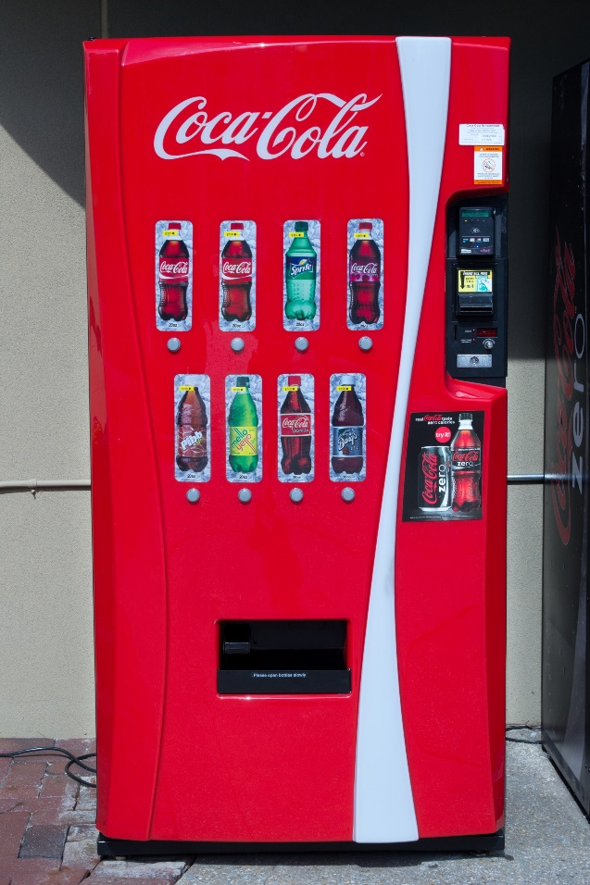
Issue of Fairness in Dynamic Pricing
“Coca-Cola has quietly begun testing vending machines that can automatically raise prices for its drinks in hot weather.”
—The New York Times, Oct 28, 1999

Slide 45
Nonlinear Pricing
Uniform pricing
Two-part tariff: decreasing
Total
cost
Total
cost
Q
Q
Flat fee
Two-part tariff: increasing
Total
cost
Total
cost
Q
Q

Slide 47
Nonlinear Pricing
Reasons for using nonlinear pricing
Encourage or discourage consumption
Price discrimination
Quantity discounts
Cost considerations
Competitive pressures
Examples
Data plans
Water bills
B2B pricing
Source: Raghuram Iyengar and Sunil Gupta, “Nonlinear Pricing,” Handbook of Pricing Research in Marketing, ed. Vithala Rao, 2010.

Slide 48
Freemium Pricing
Basic version of a product is offered free forever and customers pay for a premium version

Slide 50
Freemium Pricing
Reasons for using freemium pricing
Low or no customer acquisition cost
Low or no marginal cost for digital products
Benefit of network effects
Good for experience products
Customer feedback
Creating habit of usage
Determining freemium strategy
Which features to include in the free version
Price for premium version
Potential incentive for referrals
Source: Sunil Gupta, Driving Digital Strategy, HBR Press, 2018

Slide 52
Pricing Tactics

Slide 53
Issues in Pricing
Importance of pricing
Determinants of pricing
Pricing strategies
Pricing tactics

Slide 54
Price Discounting
Discounts or markdowns are used in almost every industry
To increase sales and market share
To get rid of seasonal products
As a response to competition
Key questions
When to offer a discount, if any
To whom
How much
For how long and how often

Slide 55
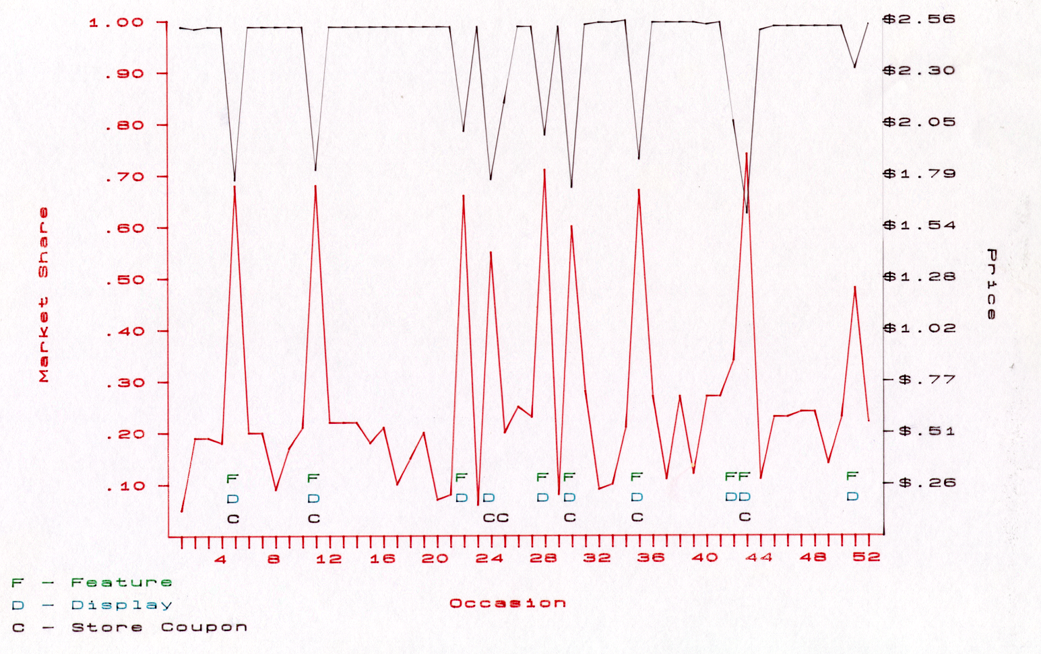
Price Discounting in Grocery Industry

Slide 56
Price Discounting in Grocery Industry
1.00
$2.56
.90
$2.30
.80
$2.05
.70
$1.79
.60
$1.54
.50
$1.28
Market Share
Price
.40
$1.02
.30
$.77
.20
$.51
F
D
C
F
D
C
F
D
F
D
F
D
C
F
D
C
F
D
F
D
$.26
.10
F
D
C
D
C
C
4
8
12
16
20
24
28
32
36
40
44
48
52
F - Feature
D - Display
C - Store Coupon
Occasion

Slide 58
Issues in Price Discounting
Baseline and incremental sales
Stockpiling and borrowed sales
Competitive reactions
Retailer reaction and pass through
Trade-off between advertising and discounting
Long term impact

Slide 59
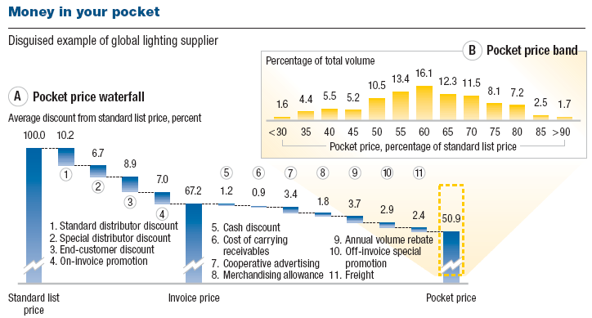
Price Waterfall and Pocket Price
Exhibit from “The power of pricing”, February 2003, McKinsey Quarterly, www.mckinsey.com. Copyright (c) 2019 McKinsey & Company. All rights reserved. Reprinted by permission.

Slide 60
Summary
Importance of pricing
Determinants of pricing
Pricing strategies
Pricing tactics
1% Price
11% Profit
BE price elasticity more than three
Price discount
Bundling
Dynamic
Nonlinear
Freemium
Discounts
Price waterfall and pocket price
WTP
Comp.
Cost

