Slide 1
Digital Marketing

Slide 3
Shift in Media Spend

Slide 4
Media Ad Spending ($ Billions), U.S. 2017
Directories
4.08
Out-of-home
7.67
Newspaper
11.86
Magazines
12.44
Radio
14.36
TV
71.65
Digital
83.00
0
10
20
30
40
50
60
70
80
90
$ Billions
Source: eMarketer, August 2017

Slide 5
Digital Ad Spending, U.S., 2018–2022
180
170.48
100%
160
156.43
90%
142.23
140
80%
125.75
70%
120
107.30
59.6%
62.1%
60%
100
56.8%
$ Billions
53.3%
50%
80
48.6%
40%
60
30%
40
20%
20
10%
0
0%
2018
2019
2020
2021
2022
Digital Ad Spend ($B)
% of Total Media Spend
Source: eMarketer, August 2017

Slide 6
Fundamentals of Advertising
Ad objective
Target audience
Value proposition
Ad creative
Budget
ROI

Slide 7
Digital Marketing Overview
Consumer finds consumer
Social media
Consumer
Consumer
Consumer
Consumer
Consumer
Outbound
marketing
Inbound
marketing
SEM
SEO
Firm finds consumer
Consumer finds firm
Firm
Firm
Firm
Firm
Firm

Slide 9
Search Engine Marketing (SEM)

Slide 10
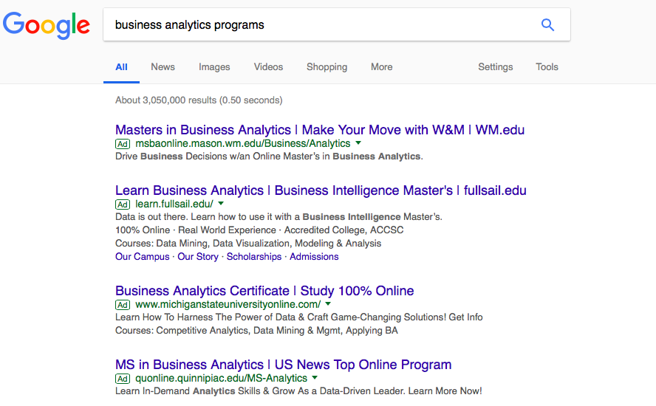
Search Advertising
Headline
URL
Text

Slide 12
Ad Rank = f (Bid, Quality Score)
Rank 1
Rank 2
Rank 3

Slide 15
Google’s Ad Rank
Quality Score

Slide 16
Quality Score
Click through rate (CTR)
Relevance
Landing page quality

Slide 18
Why Use Quality Score?
Consumer
Google
Advertiser

Slide 19
Quality Score and CPC
Firm | Max bid | Price paid | Quality score | Bid* quality | Ad rank | Actual CPC ($)
A | $4.00 | $3.00 | 1 | 4 | 4 | -
B | $3.00 | $2.00 | 3 | 9 | 2 | 8/3 = 2.67
C | $2.00 | $1.00 | 6 | 12 | 1 | 9/6 = 1.5
D | $1.00 |  | 8 | 8 | 3 | 4/8 = 0.5
P₁Q₁ = B₂Q₂ or P₁ = B₂Q₂/Q₁
P₁ = Price paid by firm 1; B₂ = Bid price of firm 2
Q_{1,}Q₂ = Quality score of firm 1 and 2

Slide 21
Quality Score and CPC
Firm | Max bid | Price paid | Quality score | Bid* quality | Ad rank | Actual CPC ($)
A | $4.00 | $3.00 | 1 | 4 | 4 | -
B | $3.00 | $2.00 | 3 | 9 | 2 | 8/3 = 2.67
C | $2.00 | $1.00 | 10 | 20 | 1 | 9/10 = 0.9
D | $1.00 |  | 8 | 8 | 3 | 4/8 = 0.5
P₁Q₁ = B₂Q₂ or P₁ = B₂Q₂/Q₁
P₁ = Price paid by firm 1; B₂ = Bid price of firm 2
Q_{1,}Q₂ = Quality score of firm 1 and 2

Slide 22
Quality Score and CPC
Firm | Max bid | Price paid | Quality score | Bid* quality | Ad rank | Actual CPC ($)
A | $4.00 | $3.00 | 1 | 4 | 4 | -
B | $3.00 | $2.00 | 7 | 21 | 1 | 12/7 = 1.7
C | $2.00 | $1.00 | 6 | 12 | 2 | 8/6 = 1.3
D | $1.00 |  | 8 | 8 | 3 | 4/8 = 0.5
P₁Q₁ = B₂Q₂ or P₁ = B₂Q₂/Q₁
P₁ = Price paid by firm 1; B₂ = Bid price of firm 2
Q_{1,}Q₂ = Quality score of firm 1 and 2

Slide 24
Display Advertising

Slide 25
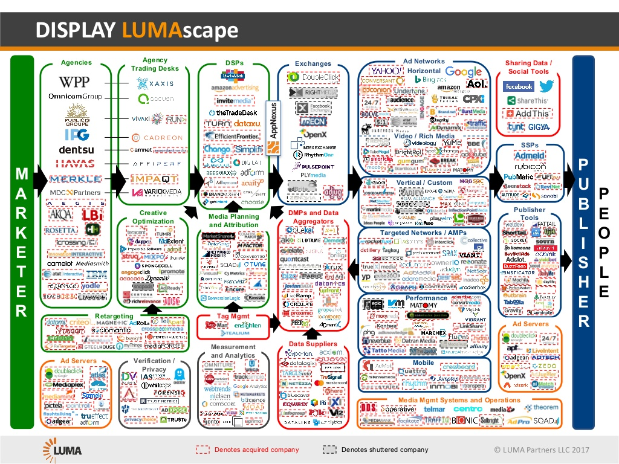
Display Landscape

Slide 26
Real-Time Bidding
On user’s requests, a publisher site starts loading
Ad exchange provides website information and solicits bids
Ad exchange or SSP awards the impression to the highest bidder
User browser adds the winning ad to the webpage it is loading
0.36s
0
Publisher asks ad network if an ad is available, or start ad auction
Using DMP data about users, DSPs offer a bid
Ad exchange sends bid information to publisher’s ad server
Source: John Deighton et al. “DataXu: Assessing Return on Marketing Investment,” HBS Case # 9-517-087.

Slide 28
Mobile Advertising

Slide 29
Daily Hours Spent, USA
6
5.9
5.6
5.4
5.1
5
4.9
4.3
4
2.8
3.1
3.3
3.7
2.3
2.6
3.2
1.6
Hours Spent per Day, USA
3.0
0.8
3
2.7
0.4
0.3
0.3
2
2.3
2.4
2.6
2.5
2.3
2.2
2.2
2.2
2.1
2.2
1
0.2
0.3
0.4
0.3
0.3
0.3
0.3
0.4
0.4
0.6
0
2008
2009
2010
2011
2012
2013
2014
2015
2016
2017
Other Connected Devices
Desktop / Laptop
Mobile
Source: Mary Meeker, “Internet Trends,” May 2018

Slide 30
Mobile Opportunity
% of Time Spent in Media vs. % of Advertising Spending
50%
40%
36%
36%
% of Media Time in Media / Advertising Spending, 2017, USA
30%
~ $7B Opportunity
29%
26%
20%
18%
20%
10%
13%
9%
9%
4%
0%
Print
Radio
TV
Desktop
Mobile
Time Spent
Ad Spend
Source: Mary Meeker, “Internet Trends,” May 2018

Slide 31
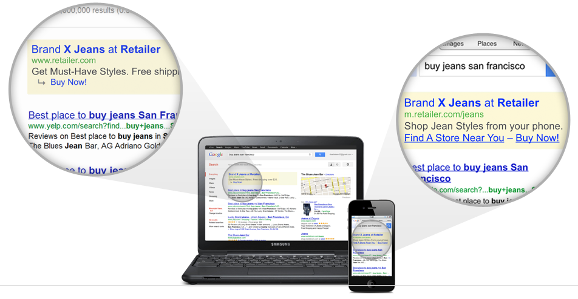
Connecting with Consumers on Mobile
Source: http://www.themobileplaybook.com/en-us/#/cover

Slide 32
Time Spent on Mobile
US Time Spent By App Category
8% BROWSER
Browser 8%
Facebook 19%
92% APP
Other 8%
Sports 2%
News and Weather 3%
Snapchat 2%
Productivity 9%
5 Hours
Messaging/Social 12%
Lifestyle and Shopping 5%
Utilities 9%
YouTube 3%
Gaming 11%
Music. Media and Entertainment 15%
Source: Flurry Analytics, comScore, Facebook, NetMarketShare. Note: US, Dec 2016

Slide 33
Moment-Based Marketing
Want-to-know moments
Want-to-go moments
Want-to-do moments
Want-to-buy moments
Source: https://www.thinkwithgoogle.com/marketing-resources/micro-moments/how-micromoments-are-changing-rules/

Slide 36
Google, Facebook, and Amazon

Slide 38
Google, Facebook, and Amazon
Google: intent-based search
Facebook: target based on interests
Amazon: knowledge of actual purchase

Slide 40
Measuring Ad Effectiveness

Slide 41
Measuring Ad Effectiveness
Objective
Attribution
Dynamics
Online–offline

Slide 42
Advertising Objectives
Brand building
Impressions (CPM)
Brand metrics
Average Brand Impact of Online Display Campaigns Globally After Exposure to 1 Ad of Any Format vs. 2+ Ads of Any Formats
6.0
5.7
5.0
Overall Freq = 1
4.0
Overall Freq = 2+
Percentage Point Delta (Exposed minus Control)
3.0
3.0
3.0
2.4
1.9
2.0
1.1
1.5
1.0
0.9
0.7
0.7
0
Online Ad Awareness
Message Association
Aided Brand Awareness
Brand Favorability
Purchase Intent
Source: Dynamic Logic MarketNorms®, 2008-2010. Campaigns using online display advertising in any format. Frequency level of 1 for campaigns N=1, 496-2,231; frequency level of 2+ for campaigns N=2, 129-2,279.
Direct response or performance advertising
Click-through rate (CTR), cost per click (CPC)
Cost per install (CPI), cost per acquisition (CPA)
Sales and ROI
Customer lifetime value (CLV)

Slide 43
Attribution
Television Ad
Product Reviews
.
. .
Display Ad
Search Ad
Conversion

Slide 45
Attribution
How do you allocate credit for conversion?
Attribution Model |  | Description | Comments
 | Last Interaction | Last ad or click accounts for 100% of the sale | Ignores long-term effects of ads earlier in the tunnel Overweighs ads that appear frequently
 | First Interaction | First ad or click accounts for 100% of sale | Ignores ads later in the funnel that convert customer Overweighs ads that appear frequently
 | Linear | All ads or clicks get a uniform weight | Ad hoc allocation Overweighs ads that appear frequently
 | Time Decay | All ads or clicks get some attribution; more recent ads get higher weight | Ad hoc weights (How much decay?) Overweighs ads that appear frequently Unclear why ads later in the funnel should have higher weight
 | Position-Based | Ads get attribution based on position in the path | Ad hoc weights
 | Regression- or Model-Based | Attributes weight based on regression or other model- based approaches | Scientific way to allocate weights to ads along consumer journey path Ignores that some ads are viewed simply because they are on the relevant site (e.g., contextual ads) even if the ads themselves have no impact
 | Experiment-Based | Attribution based on A/B testing | Most accurate way to determine ad effectiveness but difficult to manage across many different ad networks and consumers Difficult or expensive to conduct
A
B

Slide 46
Online–Offline Interaction
Synergy between online and offline media
Online ads → offline purchase or vice versa
Search Query Volume
TV Gross Spending
Nov
Dec
Jan
Source: HBR…

Slide 48
Search Engine Optimization (SEO)

Slide 49
Digital Marketing Overview
Consumer finds consumer
Social media
Consumer
Consumer
Consumer
Consumer
Consumer
Outbound
marketing
Inbound
marketing
SEM
SEO
Firm finds consumer
Consumer finds firm
Firm
Firm
Firm
Firm
Firm

Slide 50
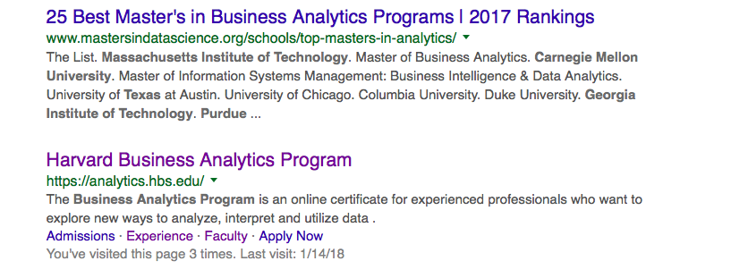
Organic Search Results
Paid links
Organic links

Slide 51
Search Engine Optimization (SEO)
Relevance
Match between search query and a web page
How—create useful content, optimize landing page
Authority (PageRank)
Importance of a web page based on the number and credibility/authority of other web pages that link to it
How—create unique content, encourage inbound links

Slide 54
Social Media

Slide 55
Digital Marketing Overview
Consumer finds consumer
Social media
Consumer
Consumer
Consumer
Consumer
Consumer
Outbound
marketing
Inbound
marketing
SEM
SEO
Firm finds consumer
Consumer finds firm
Firm
Firm
Firm
Firm
Firm

Slide 56
Social Media
Listening
Participating
Leveraging
Measuring
Managing

Slide 57
Source: Adapted from http://www.nielsen.com/content/dam/nielsen/en_us/documents/pdf/Fact%20Sheets/Nielsen%20Brand%20Association%20Map%20-%20US.pdf, accessed Feb 2014

Slide 58
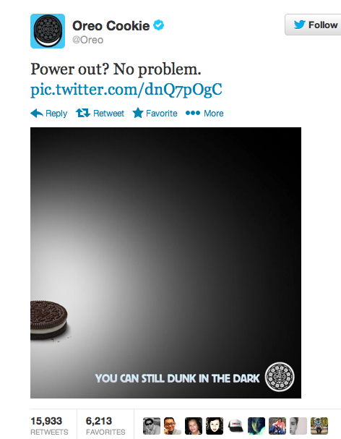
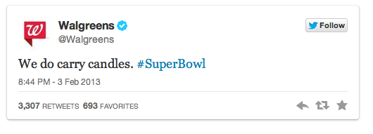
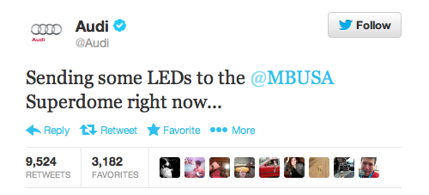
Real-Time Social Media Engagement
Source: Twitter

Slide 59
Leveraging Social Media
Virality
Influencers

Slide 60
Ongoing Debate about Virality
Proponents
“We can engineer virality.” Mekanism, a San Francisco-based social media company
Critics
On average, a YouTube video has <10,000 views
A 2012 study examined the spread of millions of messages on Twitter and Yahoo and found that
more than 90% of the messages did not diffuse at all,
about 4% of the messages were shared only once, and
less than 1% were shared more than seven times

Slide 61
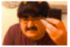

Amplification vs. Virality
The 50 Worst Things On The Internet In 2013
http://www.buzzfeed.com/katienotopoulos/the-50-worst-things-on-the-internet-in-2013. Posted on: December 12. 2013
view post
Traffic History
Launch View
12/12/13 – 01/11/14
1.4X
92K
254K
346K
SOCIAL LIFT
SOCIAL VIEWS
SEED VIEWS
TOTAL VIEWS
?
Social Views
Seed Views
300,000
250,000
200,000
150,000
100,000
50,000
0
12/13
12/15
12/17
12/19
12/21
12/23
12/25
12/27
12/29
12/31 2014
1/3
1/5
1/7
1/9
1/11
Source: Felix Oberholzer-Gee, “BuzzFeed – The Promise of Native Advertising,” HBS Case #9-714-512, August 2014.

Slide 62
Measuring the Impact of Social Media
Metric commonly used
Number of followers, fans, likes, views…
Earned media
Can we measure social influence?

Slide 63
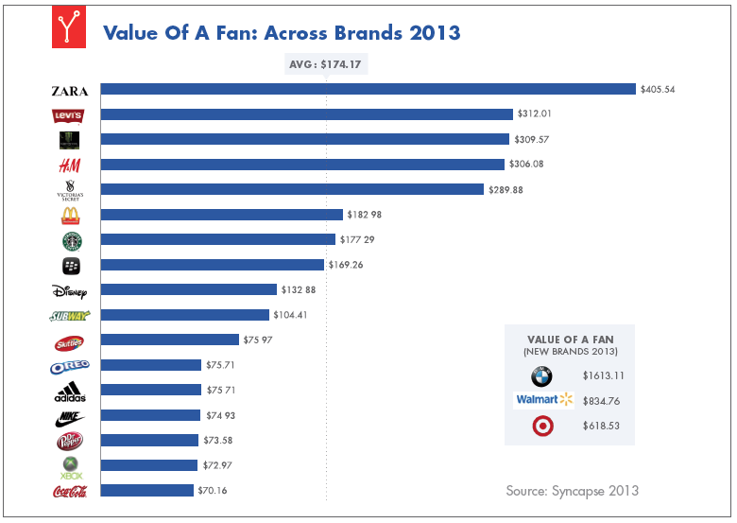
What Is a Facebook Fan Worth?
Value Of A Fan: Across Brands 2013
AVG: $174.17
$405.54
$312.01
$309.57
$306.08
$289.88
$182 98
$ 177 29
$169.26
$132 88
$104.41
$75 97
VALUE OF A FAN [NEW BRANDS 2013]
$75.71
$1613.11
$75.71
$834.76
$74 93
$618.53
$73.58
$72.97
$70.16
Source: Syncapse 2013

Slide 65
What Is a Facebook “Like” Worth?
Potential challenges
Direct effect: selection
Peer effect: homophily
Five experiments (lab and field) and two meta-analysis (n >14,000)
Result: value of a like approximately 0
Source: Leslie John, Oliver Emrich, Sunil Gupta and Michael Norton, “Does ‘Liking’ Lead to Loving? The Impact of Joining a Brand’s Social Network on Marketing Outcomes,” Journal of Marketing Research, February 2017, 144-155

