Slide 1
Gradient Boosting

Slide 2
Data
Recall the original data set of 12 repayers and 12 defaulters. Again, we want to train a decision tree model to make more accurate predictions.
Original Data
y: Repay
; Default
850
800
750
700
X₂ : Credit Score
650
600
550
500
30
40
50
60
70
80
90
100
110
X₁ : Income ($000s)
This time we will use only the 24 observations and will focus the model on the misclassified points.

Slide 3
Gradient Boosting Steps
Make the first cut exactly as we did in the first cut of the Decision Tree in Week 3.
Defaulters are shown in red. Repayers are shown in blue.
800
750
700
Credit
650
600
550
40
50
60
70
80
90
100
110
Income

Slide 4
Gradient Boosting Steps
There are five points misclassified
Misclassified defaulters are labeled 1, 2, 3
Misclassified repayers are labeled a and b
One hyperparameter in gradient boosting is tree depth.
In this example we assume a tree depth of 1, that is only 1 cut is made for each tree.

Slide 5
Stage 1 Tree
800
750
2
1
3
700
Credit
650
b
a
600
550
40
50
60
70
80
90
100
110
Income
Tree weight: 1.3350

Slide 6
Concept of Gradient Boosting
Gradient Boosting focuses on the errors in this tree (that is, misclassification) by increasing the weight given to the observations that are misclassified.
It then fits another tree to these reweighted points, and focuses on its errors
It keeps doing this for many iterations
The final classification is a weighted sum of the classifications from many trees

Slide 7

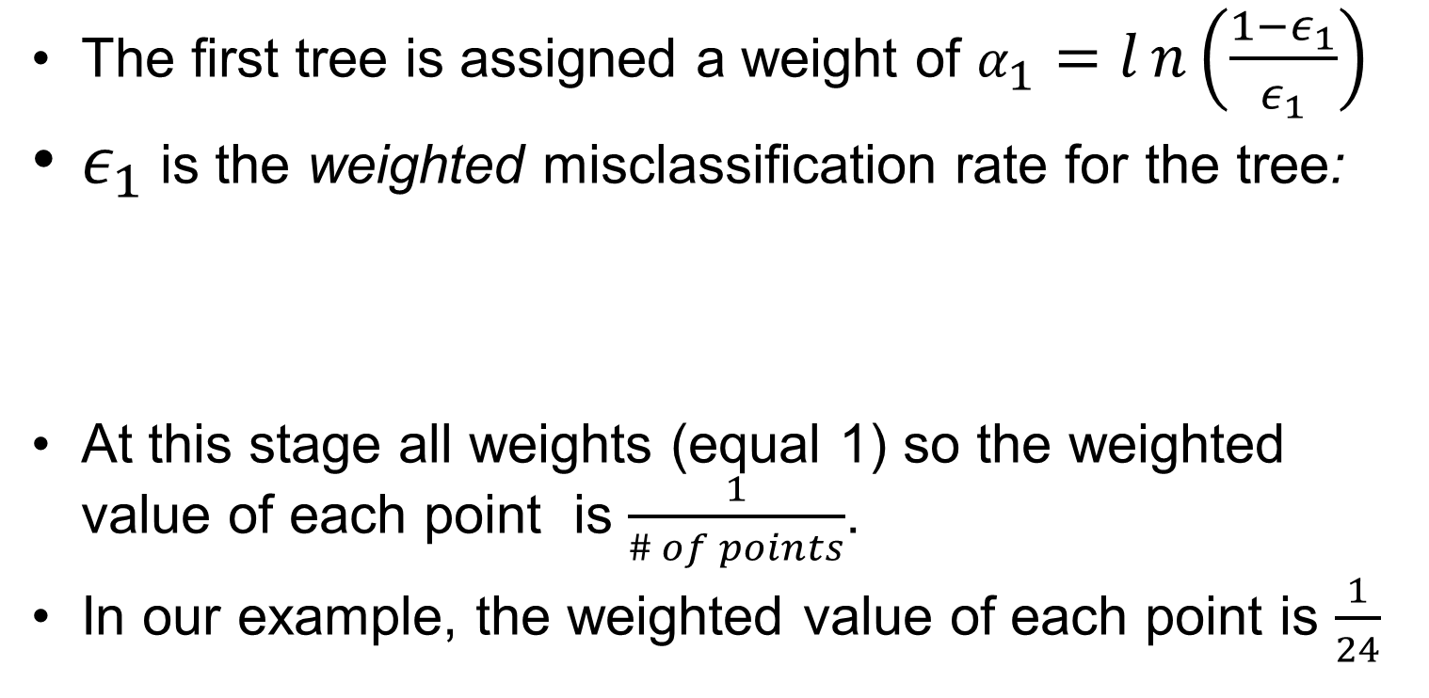
Weighting the first tree
The first tree is assigned a weight of $α_{1}=ln\left(\frac{1−ε_{1}}{ε_{1}}\right)$
$ε_{1}$ is the weighted misclassification rate for the tree:
At this stage all weights (equal 1) so the weighted value of each point is $\frac{1}{\# of points}$.
In our example, the weighted value of each point is $\frac{1}{24}$

Slide 8
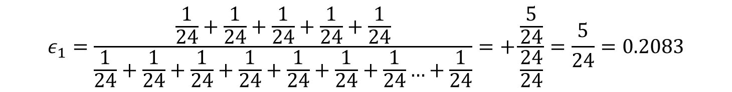
Weighting the first tree (cont'd)
Tree 1: 5 total misclassifications
3 defaulters misclassified: points 1, 2, and 3
2 repayers misclassified: points a and b
$$ε_{1}=\frac{\frac{1}{24}+\frac{1}{24}+\frac{1}{24}+\frac{1}{24}+\frac{1}{24}}{\frac{1}{24}+\frac{1}{24}+\frac{1}{24}+\frac{1}{24}+\frac{1}{24}+\frac{1}{24}+\frac{1}{24}…+\frac{1}{24}}=+\frac{\frac{5}{24}}{\frac{24}{24}}=\frac{5}{24}=0.2083$$
$$α_{1}=ln\left(\frac{1−.2083}{.2083}\right)=\ln\left(\frac{.7917}{.2083}\right)=\ln\left(3.8007\right)=1.335$$

Slide 9
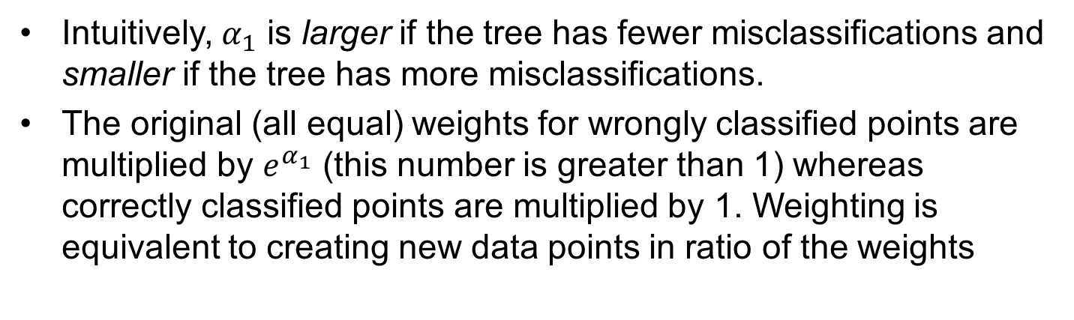

Weighting the first tree (cont'd)
Intuitively, $α_{1}$ is larger if the tree has fewer misclassifications and smaller if the tree has more misclassifications.
The original (all equal) weights for wrongly classified points are multiplied by $e^{α_{1}}$ (this number is greater than 1) whereas correctly classified points are multiplied by 1. Weighting is equivalent to creating new data points in ratio of the weights
$$e^{α_{1}}=3.8007$$

Slide 10
How does Gradient Boosting Achieve This?
Now we fit the data again and this gives us a new decision tree 2
By reweighting, the decision tree algorithm will pay more attention to the misclassified points that now carry more weight and try to correctly classify these points.
Once these weighted data points are introduced into the tree they stay for the rest of the gradient boosting process.
Figure 2 shows this new tree: for these weighted points the cut changes from a credit score of 681 to an income of $78,000, so that points 1, 2, and 3 are now correctly classified as defaulters and points a and b are correctly classified as repayers.
In the process 11 of 12 defaulters are correctly classified, but 5 of the 12 repayers are now classified as defaulters. Notice that each of the defaulters are ones whose values had not been boosted.

Slide 11
Stage 2 Tree
800
c
e
750
2
d
1
f
3
700
g
Credit
650
4
b
a
600
550
40
50
60
70
80
90
100
110
Income
Tree weight: 1.6739

Slide 12

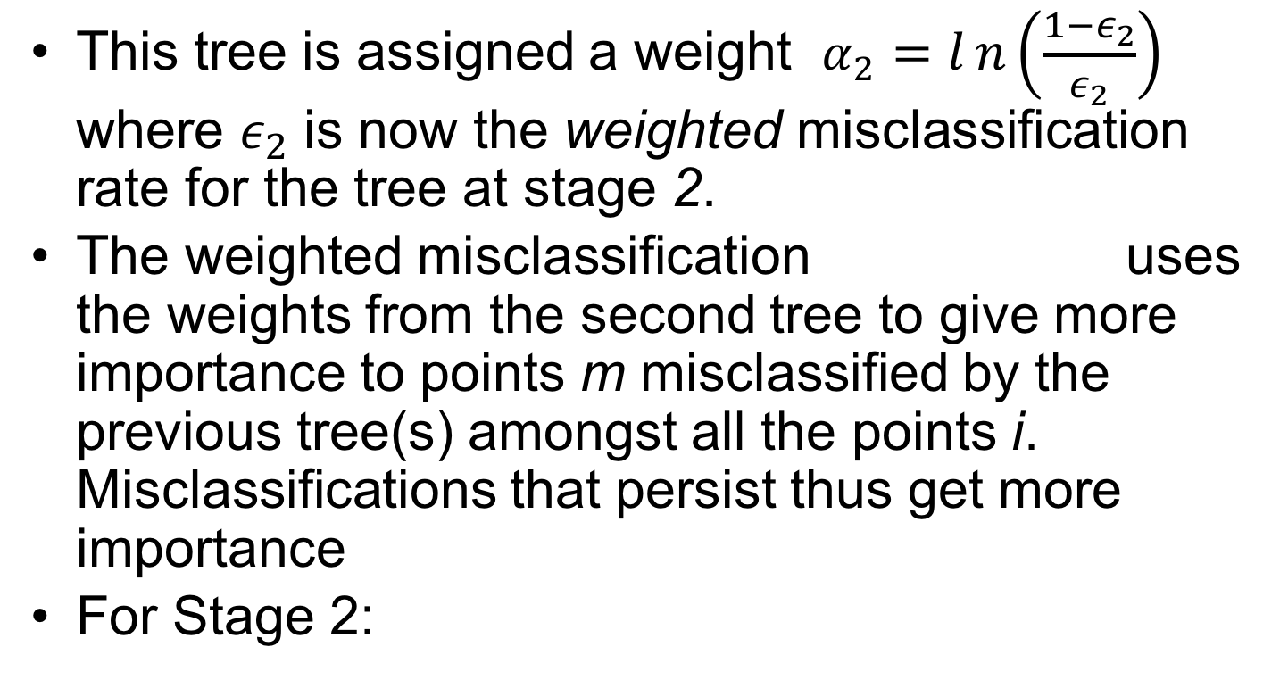
Weighting the Second Tree
This tree is assigned a weight $α_{2}=ln\left(\frac{1−ε_{2}}{ε_{2}}\right)$ where $ε_{2}$ is now the weighted misclassification rate for the tree at stage 2.
The weighted misclassification uses the weights from the second tree to give more importance to points m misclassified by the previous tree(s) amongst all the points i. Misclassifications that persist thus get more importance
For Stage 2:

Slide 13
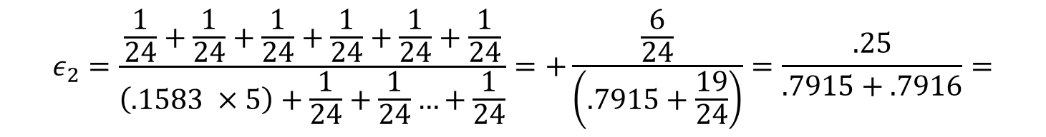
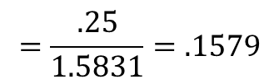
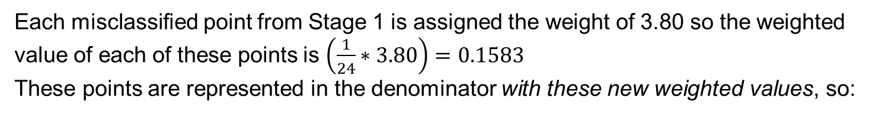
Calculating Weights for Stage 2 Tree
Tree 2: 6 total misclassifications
1 defaulter misclassified: point 4
5 repayers misclassified: points c,d,e,f, and g
All these points carry a weight of 1 from the first tree since they were correctly classified in tree 1.
Each misclassified point from Stage 1 is assigned the weight of 3.80 so the weighted
value of each of these points is $\left(\frac{1}{24}∗3.80\right)=0.1583$
These points are represented in the denominator with these new weighted values, so:
$$ε_{2}=\frac{\frac{1}{24}+\frac{1}{24}+\frac{1}{24}+\frac{1}{24}+\frac{1}{24}+\frac{1}{24}}{\left(.1583 ×5\right)+\frac{1}{24}+\frac{1}{24}…+\frac{1}{24}}=+\frac{\frac{6}{24}}{\left(.7915+\frac{19}{24}\right)}=\frac{.25}{.7915+.7916}=$$
$$=\frac{.25}{1.5831}=.1579$$
$$α_{2}=ln\left(\frac{1−.1579}{.1579}\right)=\ln\left(\frac{.8421}{.1579}\right)=\ln\left(5.333\right)=1.6739$$

Slide 14
From tree 2 to tree 3
The weights for wrongly classified points in tree 2 are multiplied by whereas correctly classified are again multiplied by 1.
Note that misclassifications that persist through the first two trees get even larger weights.
Now we fit the data again and this gives us a new decision tree, tree 3.
We repeat the whole process of fitting a new tree, calculating a weighted error, obtaining a new tree weight, and then using this tree weight to update the weights for individual data points.

Slide 15
Stage 3 Tree
800
c
Point weight:
5.333
e
750
2
d
1
f
3
h
700
i
g
Credit
650
4
b
a
Point weight:
3.880
600
550
40
50
60
70
80
90
100
110
Income
This process is repeated 20 times.
Tree weight: 0.7691

Slide 16

Weighting the t-th Tree
This tree is assigned a weight of
is now the weighted misclassification rate for the tree at stage t.
Finally we update the weights of misclassified points by multiplying them by

Slide 17
Stage 20 Tree
800
c
e
750
2
d
1
f
3
h
700
i
g
Credit
650
4
b
a
600
550
40
50
60
70
80
90
100
110
Income
Tree weight: 0.5820

