Slide 1
Gradient Boosting: Validation Process

Slide 2
Advantages & Disadvantages
Advantages
Train a model to make predictions more accurately because the process focuses sharply on areas of errors. That is, misclassified points.
It is a recursive process that focuses on points different from where the model is performing well.
Disadvantages
Risks overfitting for what might be true errors that are not helpful for future predictions.

Slide 3
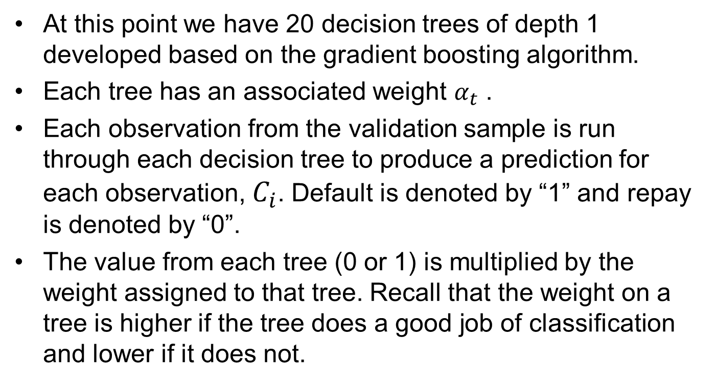
Validation Process 1
At this point we have 20 decision trees of depth 1 developed based on the gradient boosting algorithm.
Each tree has an associated weight $α_{t}$ .
Each observation from the validation sample is run through each decision tree to produce a prediction for each observation, $C_{i}$. Default is denoted by “1” and repay is denoted by “0”.
The value from each tree (0 or 1) is multiplied by the weight assigned to that tree. Recall that the weight on a tree is higher if the tree does a good job of classification and lower if it does not.

Slide 4

After 20 trees:
We create the final classifier by adding the 20 weighted values and dividing by the sum of the weights.
If the resulting answer is less than ½, the observation is classified as repay. If the answer is greater than ½, the observation is classified as default.
Figure 5 shows these calculations.
$$C\left(i\right)=\frac{\sum_{t=1}^{20}{α_{t}C_{t}(i)}}{\sum_{t=1}^{20}{α_{t}}}$$

Slide 5
Validation Process – Weighting Votes
 | Validation Set
 |  |  | Actual
Point # | Income | Credit | Repay = 0, Default = 1
1 | 60 | 680 | 0
2 | 67 | 710 | 0
3 | 55 | 770 | 1
4 | 61 | 702 | 0
5 | 58 | 715 | 0
Gradient Boosted Trees
1 | 2 | 3 | 4 | 5 | 6 | 7 | 8 | 9 | 10 | 11 | 12 | 13 | 14 | 15 | 16 | 17 | 18 | 19 | 20
0 | 0 | 0 | 1 | 0 | 0 | 0 | 1 | 0 | 0 | 1 | 0 | 0 | 1 | 0 | 1 | 0 | 0 | 0 | 0
1 | 0 | 0 | 1 | 0 | 0 | 1 | 1 | 0 | 0 | 1 | 0 | 0 | 1 | 0 | 1 | 0 | 0 | 1 | 0
1 | 1 | 0 | 0 | 1 | 0 | 1 | 1 | 0 | 1 | 1 | 0 | 1 | 1 | 0 | 0 | 1 | 0 | 1 | 0
1 | 0 | 0 | 1 | 0 | 0 | 1 | 1 | 0 | 0 | 1 | 0 | 0 | 1 | 0 | 1 | 0 | 0 | 1 | 0
1 | 0 | 0 | 0 | 0 | 0 | 1 | 1 | 0 | 0 | 1 | 0 | 0 | 1 | 0 | 0 | 0 | 0 | 1 | 0
Tree
Weights
Tree weights
1.335 | 1.674 | 0.769 | 1.427 | 0.852 | 1.115 | 0.768 | 1.069 | 0.776 | 0.771 | 0.584 | 0.466 | 0.754 | 0.853 | 0.788 | 0.348 | 0.579 | 0.752 | 0.542 | 0.582
Observation #
1
2
3
4
5
1 | 2 | 3 | 4 | 5 | 6 | 7 | 8 | 9 | 10 | 11 | 12 | 13 | 14 | 15 | 16 | 17 | 18 | 19 | 20
0.000 | 0.000 | 0.000 | 1.427 | 0.000 | 0.000 | 0.000 | 1.069 | 0.000 | 0.000 | 0.584 | 0.000 | 0.000 | 0.853 | 0.000 | 0.348 | 0.000 | 0.000 | 0.000 | 0.000
1.335 | 0.000 | 0.000 | 1.427 | 0.000 | 0.000 | 0.768 | 1.069 | 0.000 | 0.000 | 0.584 | 0.000 | 0.000 | 0.853 | 0.000 | 0.348 | 0.000 | 0.000 | 0.542 | 0.000
1.335 | 1.674 | 0.000 | 0.000 | 0.852 | 0.000 | 0.768 | 1.069 | 0.000 | 0.771 | 0.584 | 0.000 | 0.754 | 0.853 | 0.000 | 0.000 | 0579 | 0.000 | 0.542 | 0.000
1.335 | 0.000 | 0.000 | 1.427 | 0.000 | 0.000 | 0.768 | 1.069 | 0.000 | 0.000 | 0.584 | 0.000 | 0.000 | 0.853 | 0.000 | 0.348 | 0.000 | 0.000 | 0.542 | 0.000
1.335 | 0.000 | 0.000 | 0.000 | 0.000 | 0.000 | 0.768 | 1.069 | 0.000 | 0.000 | 0.584 | 0.000 | 0.000 | 0.853 | 0.000 | 0.000 | 0.000 | 0.000 | 0.542 | 0.000
Weighted
Votes
This process is repeated to classify each of the five observations in the validation sample.

Slide 6
Validation Process – Assigning Classes
All points are correctly classified for this small validation sample.
18 | 19 | 20
0 | 0 | 0
0 | 1 | 0
0 | 1 | 0
0 | 1 | 0
0 | 1 | 0
Sum
16.803
Tree
Weights
0.752 | 0.542 | 0.582
Actual
18 | 19 | 20
0.000 | 0.000 | 0.000
0.000 | 0.542 | 0.000
0.000 | 0.542 | 0.000
0.000 | 0.542 | 0.000
0.000 | 0.542 | 0.000
Sum | Normalized | Repay <0.5 (0) | Default >0.5 (0) | Correct? | Repay = 0, Default = 1
4.280 | 0.2547 | 0 |  | Yes | 0
6.925 | 0.4121 | 0 |  | Yes | 0
9.780 | 0.5820 |  | 1 | Yes | 1
6.925 | 0.4121 | 0 |  | Yes | 0
5.150 | 0.3065 | 0 |  | Yes | 0
Weighted
Votes
Correct Classification Rate | 5/5

