Slide 1
The Bayesian Approach

Slide 2
Frequentist vs. Bayesian
“A 250-year argument” (Brad Efron)
Frequentist: focus on methods that do well in the long run (under real or hypothetical replications, to obtain many data sets)
Bayesian: focus on quantifying uncertainty about the unknowns of interest, given the data at hand. This requires choosing a prior for the unknown parameters.

Slide 3
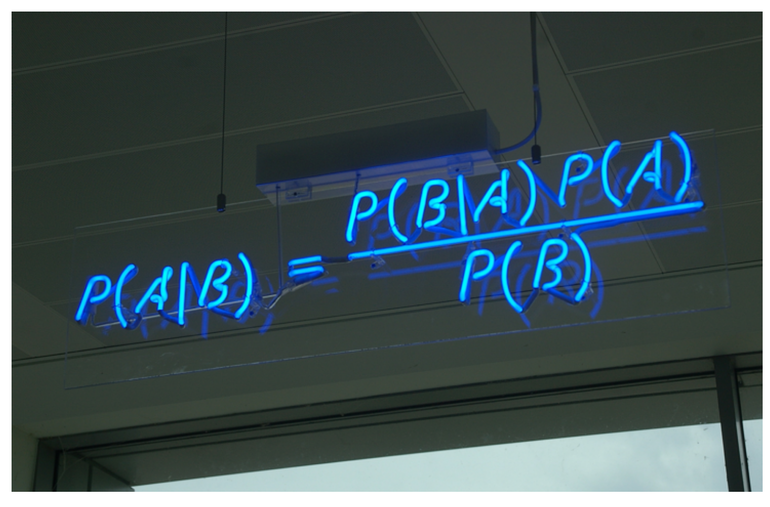
Bayes’ Rule
CC BY-SA 3.0
Own work by mattbuck

Slide 4
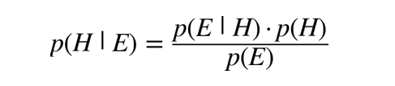
Bayes’ Rule, Events Version
p(H | E): posterior probability that the hypothesis is true given that evidence (E) is true
p(H): prior (predata) probability that the hypothesis is true
p(E | H): probability that evidence (E) is true, given that the hypothesis is true
p(E): probability that the evidence is true

Slide 5
Bayes’ Rule, Likelihood Version
where y is the observed data, θ is the unknown parameter of interest, and L(θ) is the likelihood function

Slide 6
Comparing Proportions
Which proportion is bigger?
A: 1 out of 2
B: 40 out of 100
Which baseball player do you think is a better hitter based on the following data about their performance?
Player A: 1 hit out of 2 at-bats
Player B: 40 hits out of 100 at-bats
Which cab driver would you rather have drive you somewhere based on the following data about their performance?
Driver A: 1 out of 2 times reached desired destination
Driver B: 40 out of 100 times reached desired destination
Prior information often matters! Bayesian statistics requires—and allows—incorporating it.

